Slide 1
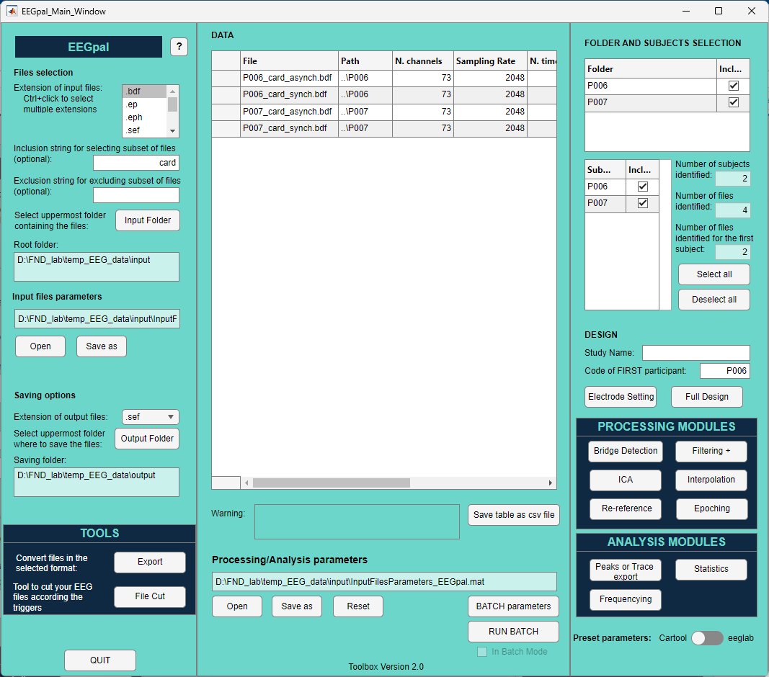
B
C
A
D
E
F
G

Slide 2
4
A
1
2
3
5

Slide 3
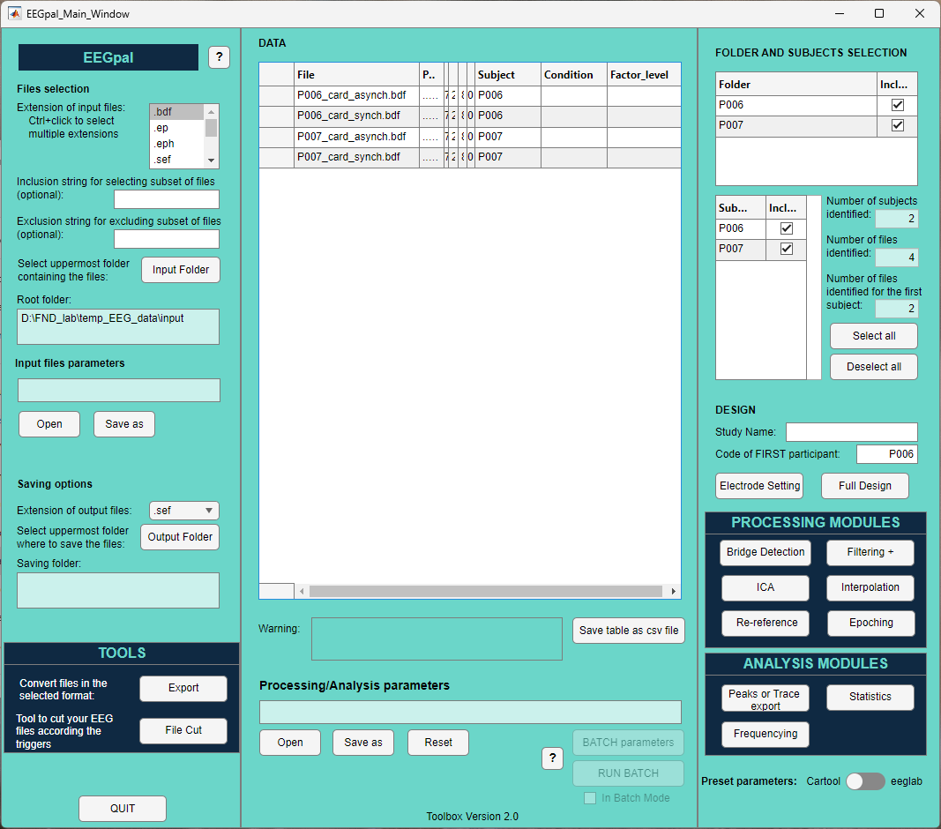
C
3
1
5
4
2

Slide 4
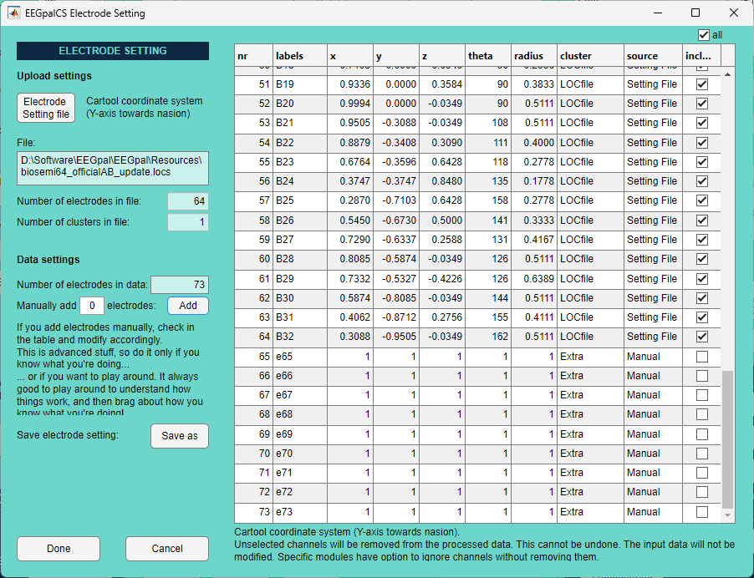
1
2
3
3
4

Slide 5
1
2
3

Slide 6

1
5
3
2
4
6

Slide 8
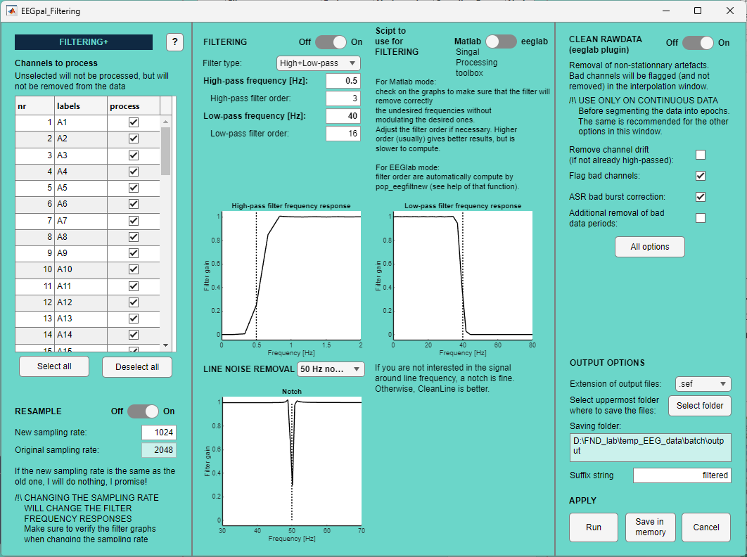
B
C
A
3
4
5
8
1
9
10
11
6
12
13
D
7
2
14
15
16
17

Slide 9
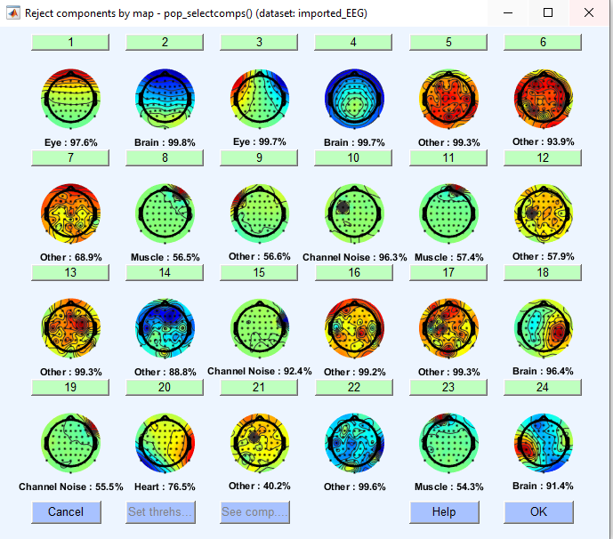
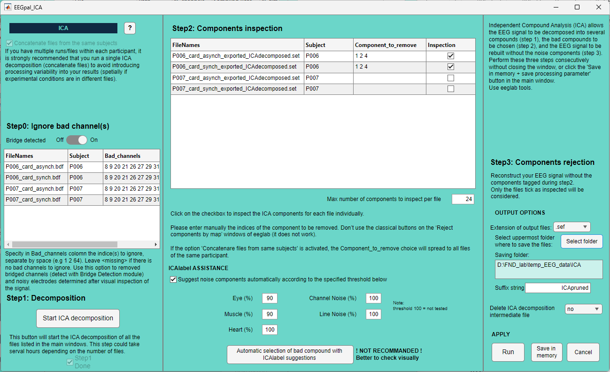
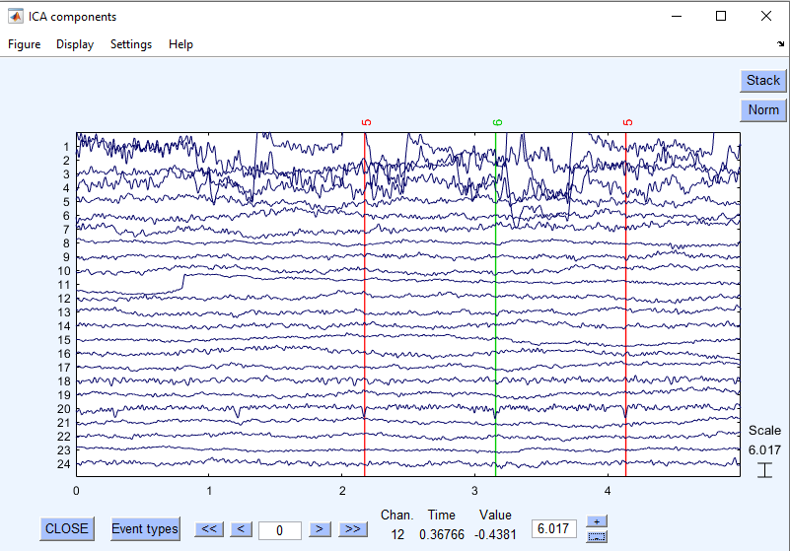
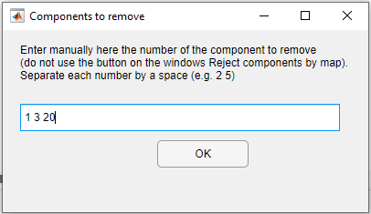
7b
7b
A
B
C
7c
7
1
3
2
5
9
10
6
11
4
12
13
8
7d

Slide 10
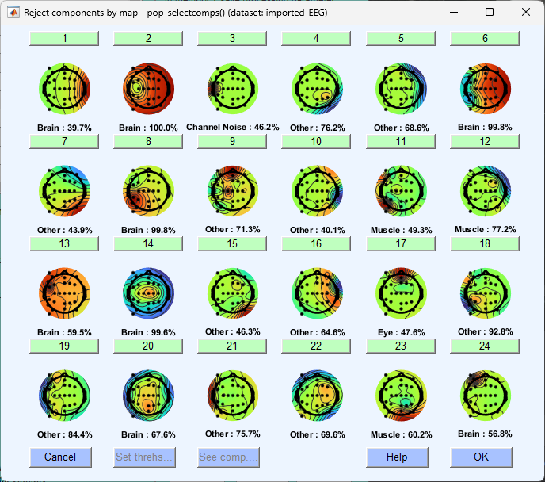
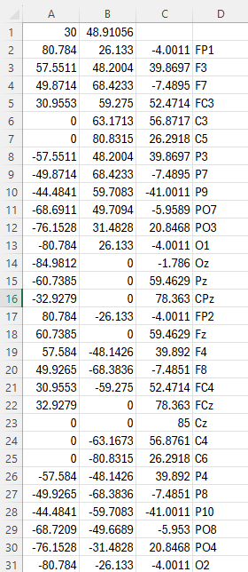
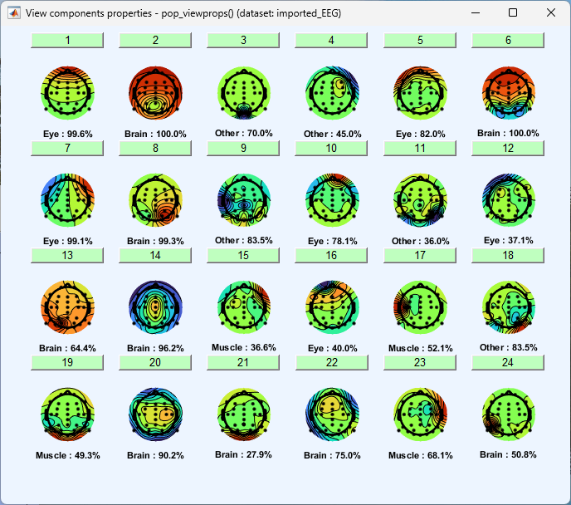
Topographical problem
WRONG
2
1 and 4
2 and 5
3
GOOD
5
x
y

Slide 11
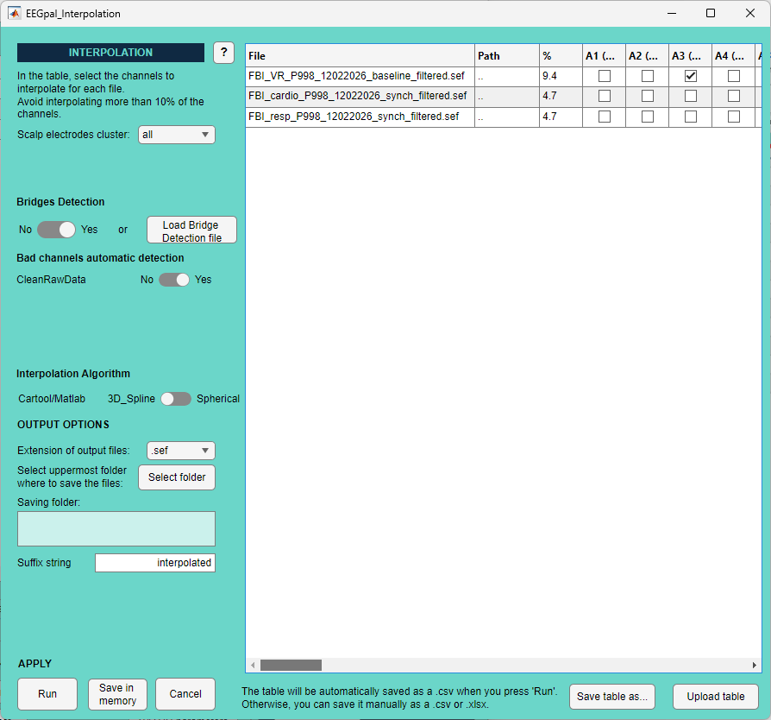
B
A
4
1
5
6
7
C
8
9
10
11
2
3

Slide 12
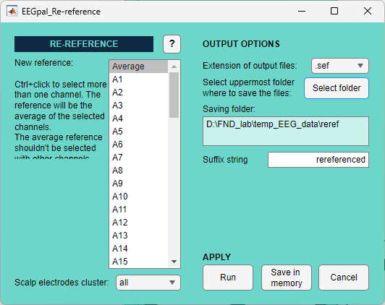
B
A
3
1
4
5
6
2

Slide 13
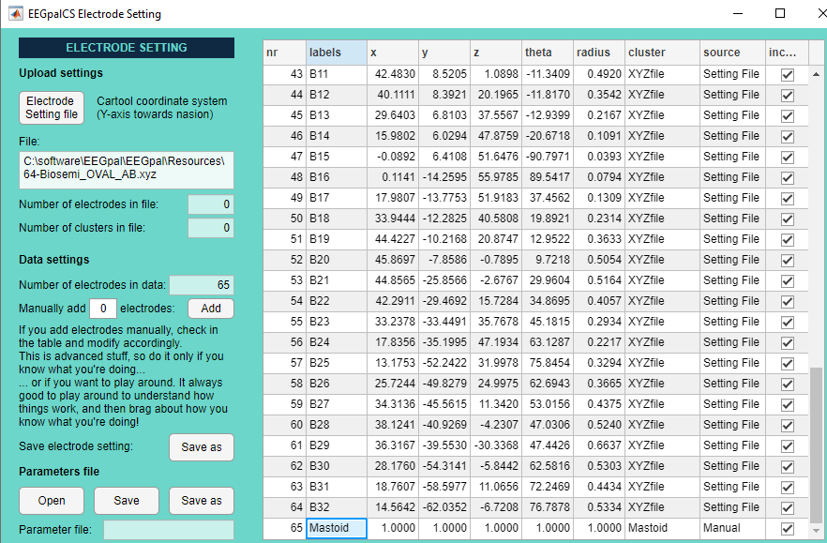

Slide 14
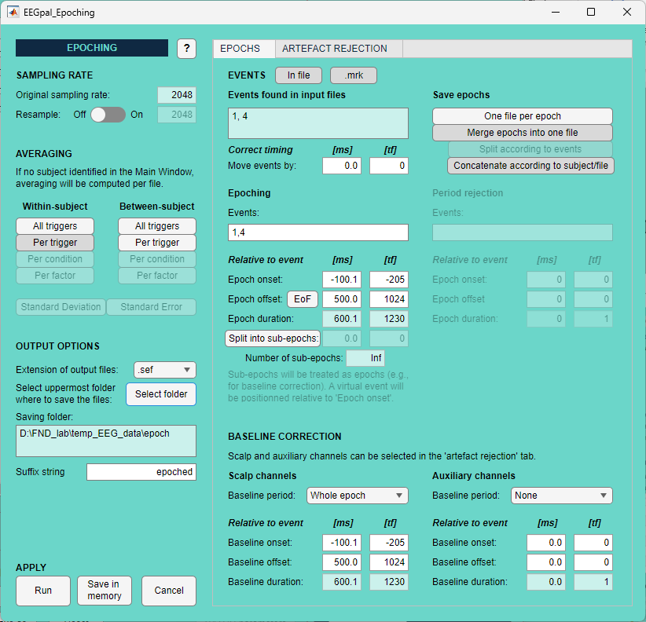
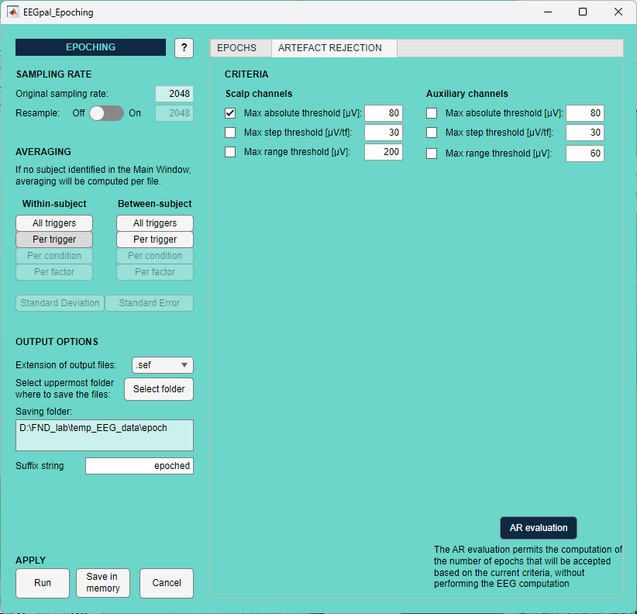

1
A
B
C
1
12
8
9
10
2
3
4
13
5
14
15
16
6
7
17
11
18

Slide 15
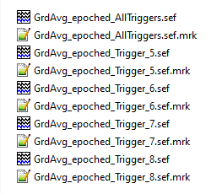
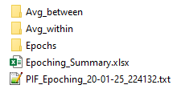

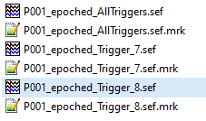
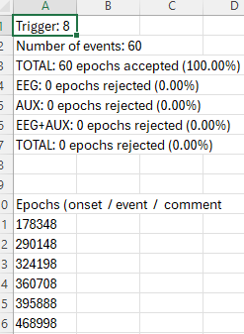

a
b
b
d
c
e
c

Slide 16
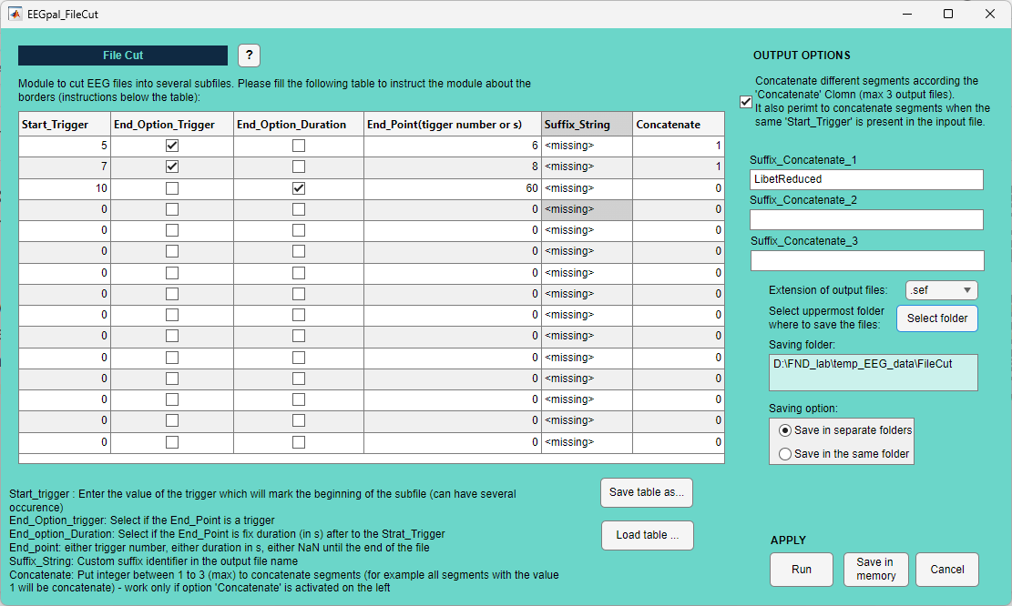
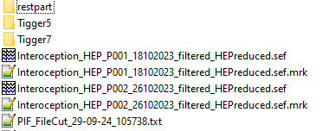
7
2
5
1
3
4
8
9
10
6
11
1
2
3

Slide 17
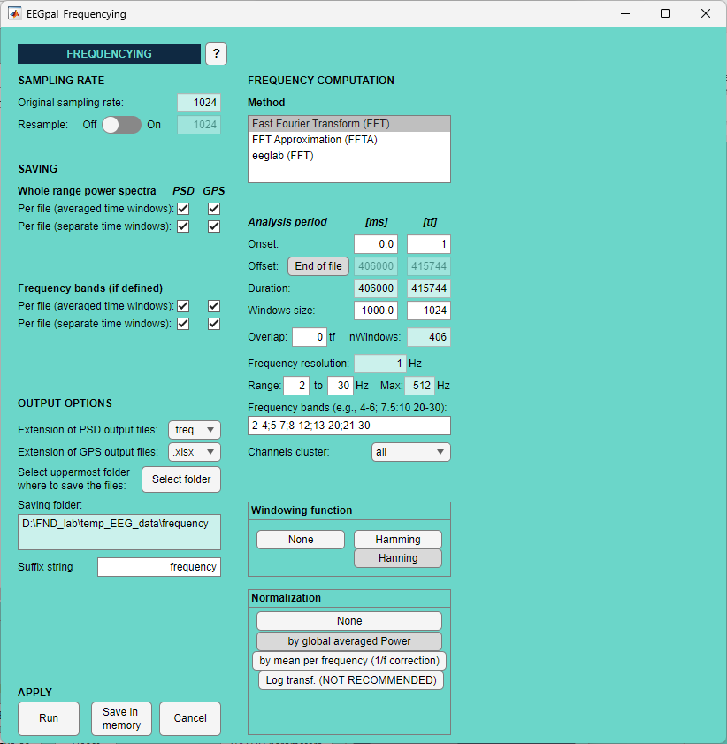
A
D
9
1
10
B
2
11
3
4
5
E
12
6
13
14
C
7
15
8
16

Slide 18
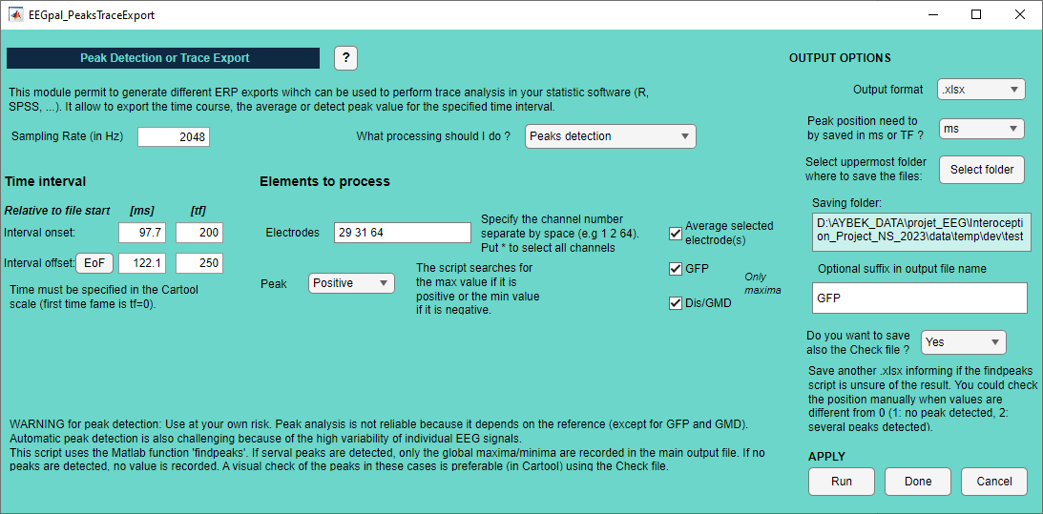

7
1
2
8
4
9
3
6
5
10
11
12

Slide 19
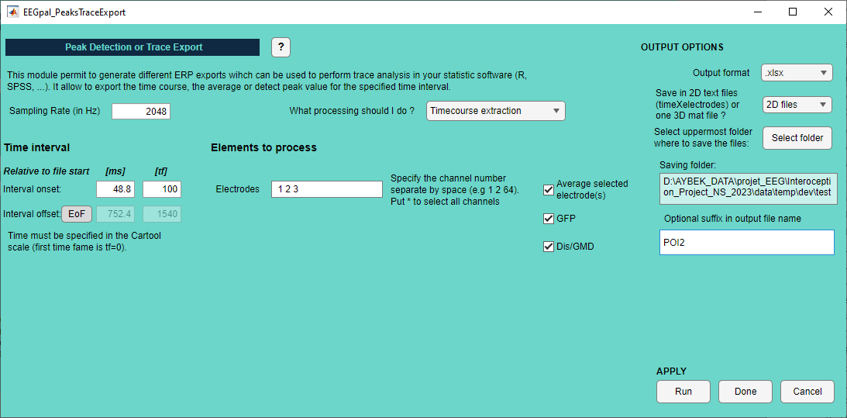
6
1
2
7
4
8
3
9
5
10

Slide 20
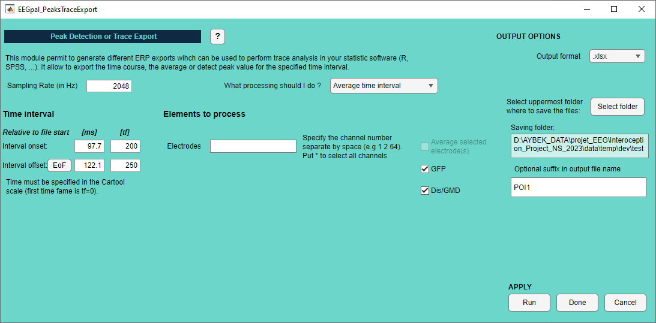
6
1
2
4
7
3
8
5
9

Slide 21
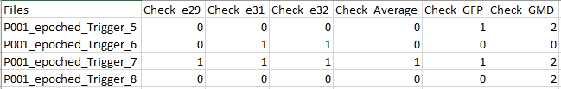
Amplitude
Position

Slide 22
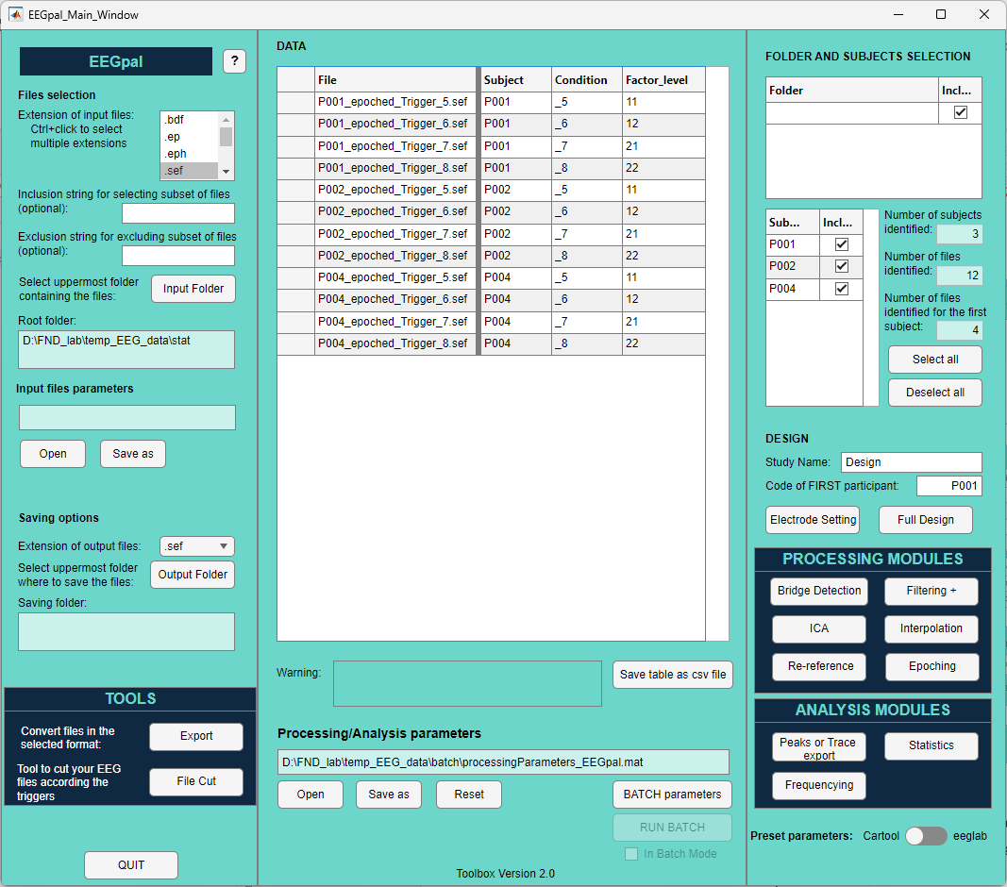
1
2

Slide 23
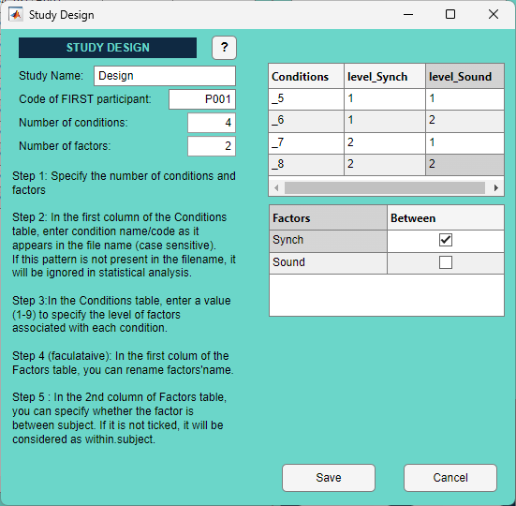
5
6
1
2
3
4
8
7
9

Slide 24
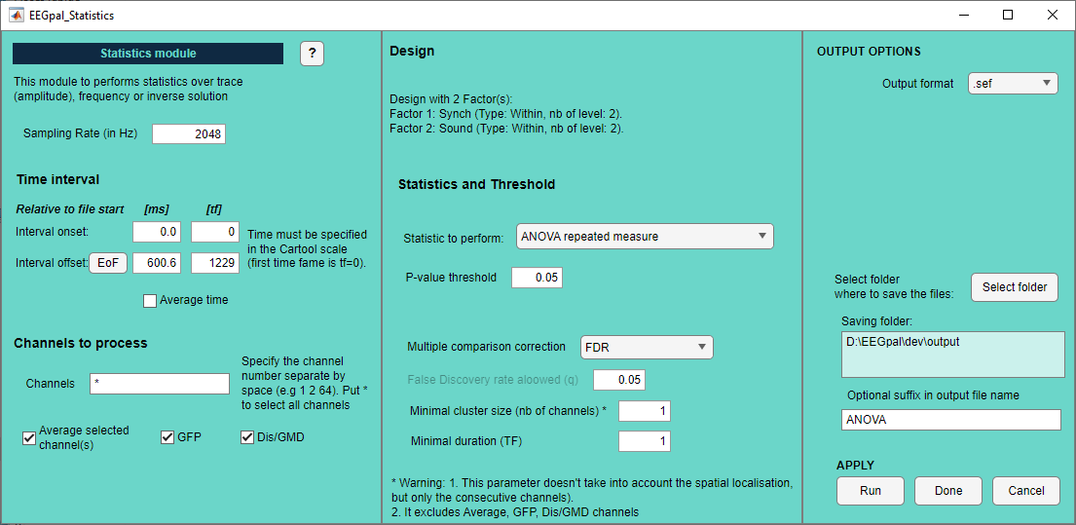
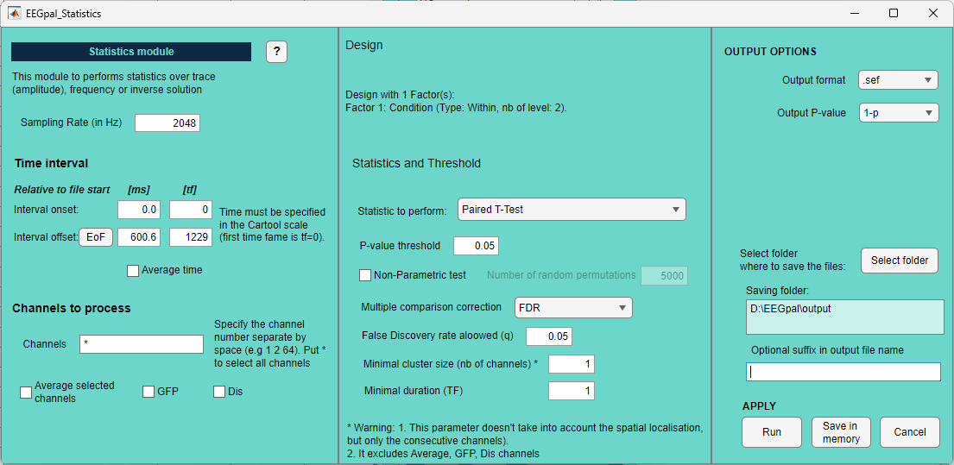

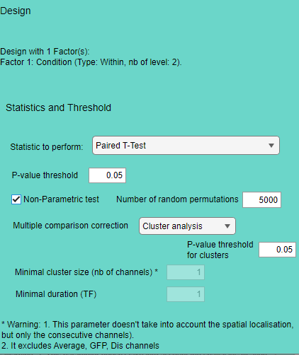
A
B
D
16
1
6
17
2
7
Parametric test
8
3
18
4
9
10
19
5
11
20
C
12
Non-parametric test
12
13
14
15

Slide 25
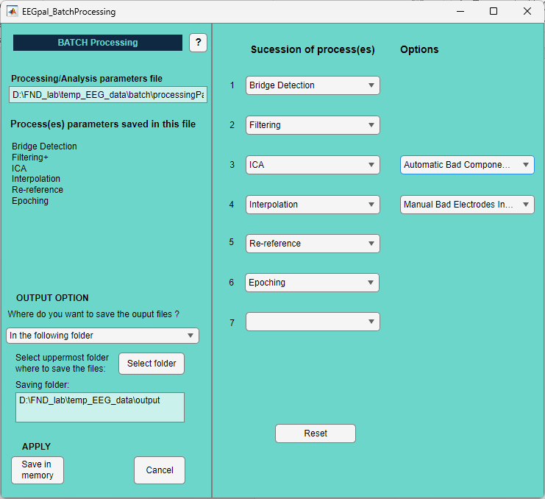

4
3
2
1
5
6

Slide 26
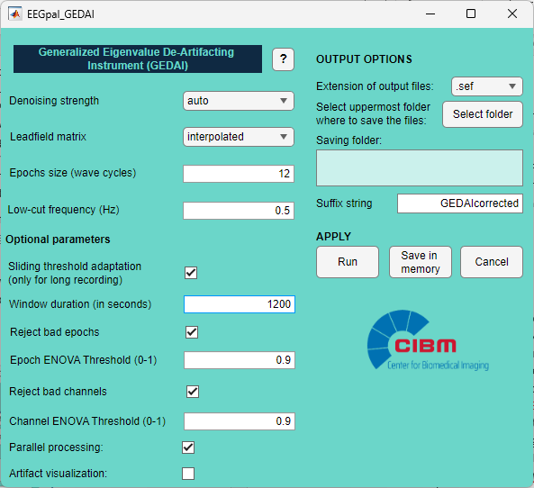
A
1
10
C
2
11
3
4
12
B
13
5
6
7
8
9

