Slide 1
Validation EEGpal v1.1
Michaël Mouthon
15.05.2024

Slide 2
Historic
In May 2024, the EEGpal tool originally developed by Michael DePretto and improved by Michael Mouthon has received it first major update.
The version of Michael DePretto (correction of mineur bugs) and the version of Michael Mouthon (add module of ICA, File Cut, ebridge,….) has been fusion by Michael Mouthon to become the version 1.1
This version is panned to be used in FNDlab interoception project et Franziska Peier exCIPAIN project.
The purpose of this document is to validate the analysis perform by EEGpal in comparaison of three other establish tool : Cartool, EEGlab, BrainVision
EEGpal are not a new methodological software. It is only an graphical interface which called establish Matlab script in the EEG processing : The processing pipeline relies on functions from the EEGLab 2023.1 toolbox (Delorme et al., 2011, available on https://eeglab.org/), official MathWorks function of the signal processing toolbox and on Mike X Cohen scripts (Mike X Cohen, 2014).
To perform this comparison, I will use 6 patients for in the CAS task of FND interoception project (result expected is a Miss Match Negativity ERP). I will use only synch condition. No bridge was detected in these sample (don’t need to include in the test processing).

Slide 3
Steps of the processing
Read bdf and suppress EXG channels
Filter 0.3-40 + 50 Hz Notch (no ASR, no Cleanline)
Interpolate the same channels. Table of interpolation is :
Re-ref on the average channel
ICA decompositions (EEGlab decomposition for Cartool, EEGpal and EEGLAB)
Epoching automatic with 100microV rejection threshold. No Baseline correction
Make grant average for comparision
Participant | Electrodes to interpolate
P012 | A8
P016 | A15, B20
P018 | B28
P034 * | B11
P048 | -
P061 | B20
Decision based on Cartool filtred signal * reference sinal to observe
Interpolation done with the same coordinate file with the official layout (spherical head)

Slide 4
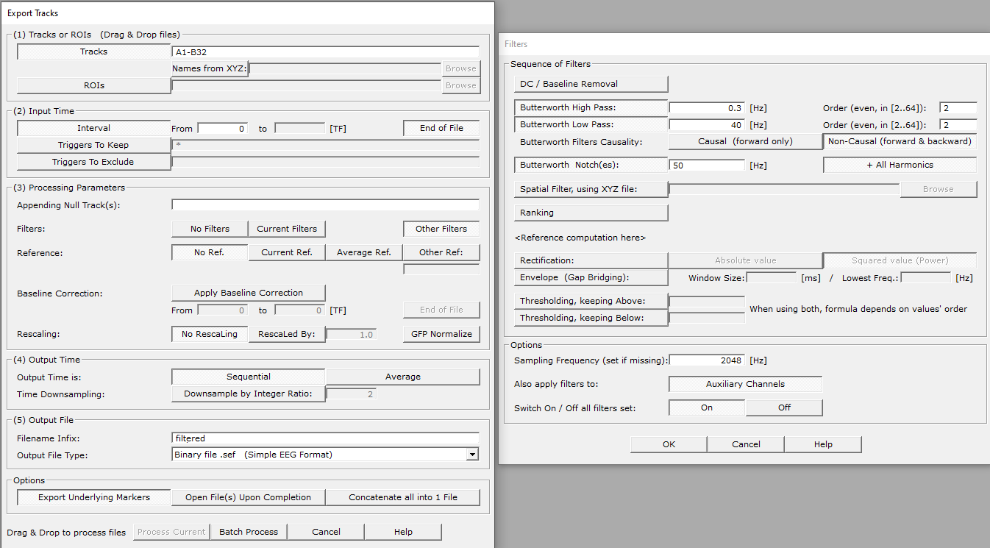
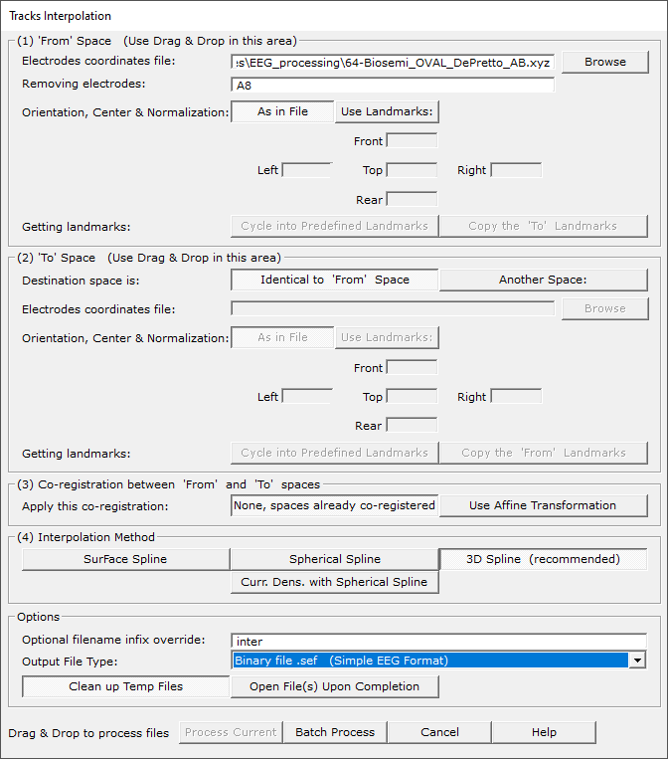
Processing Cartool
Filtering
Interpolation

Slide 5
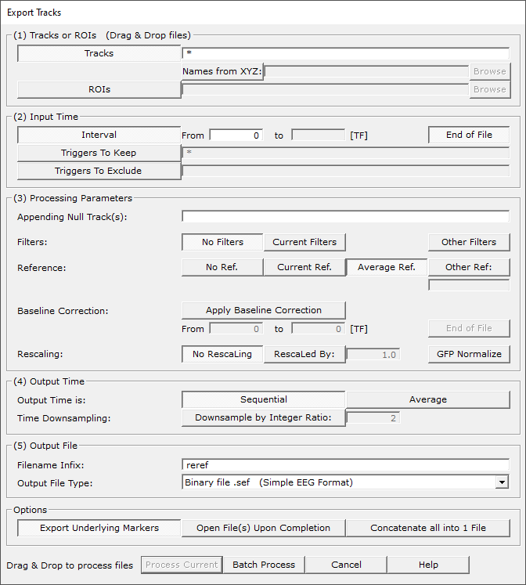
Processing Cartool
Rereferencing to average
Tools-> Export tracks ->
ICA with EEGpal/eeglab

Slide 6
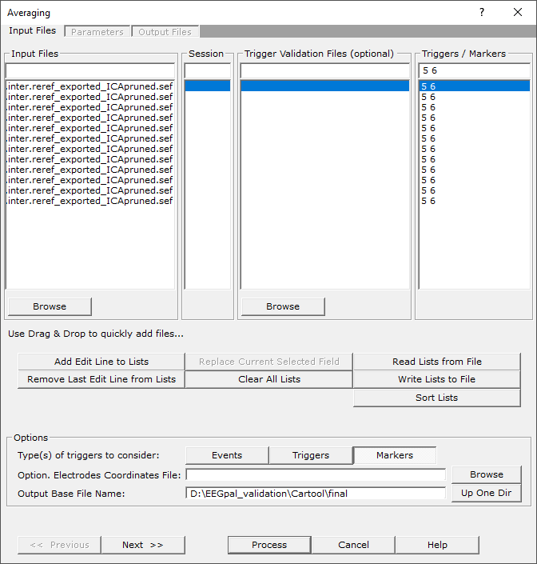
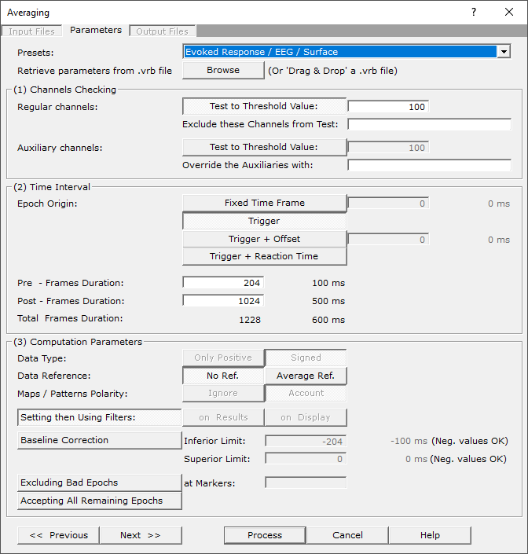
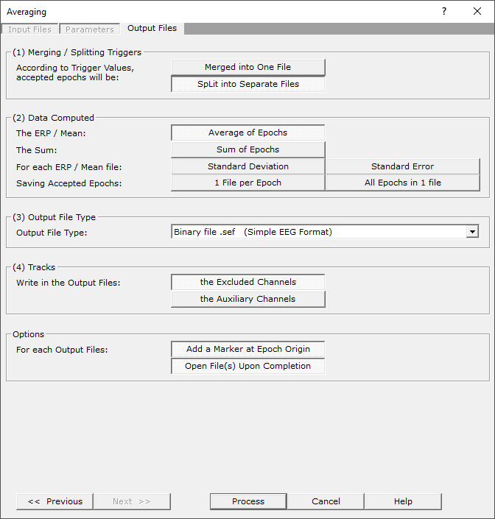
Processing Cartool
Averaging and artefact rejection

Slide 7
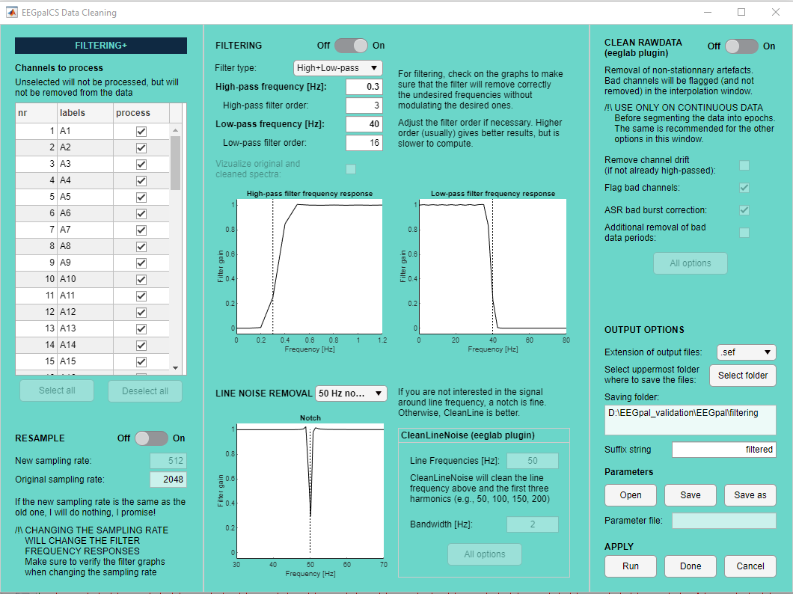
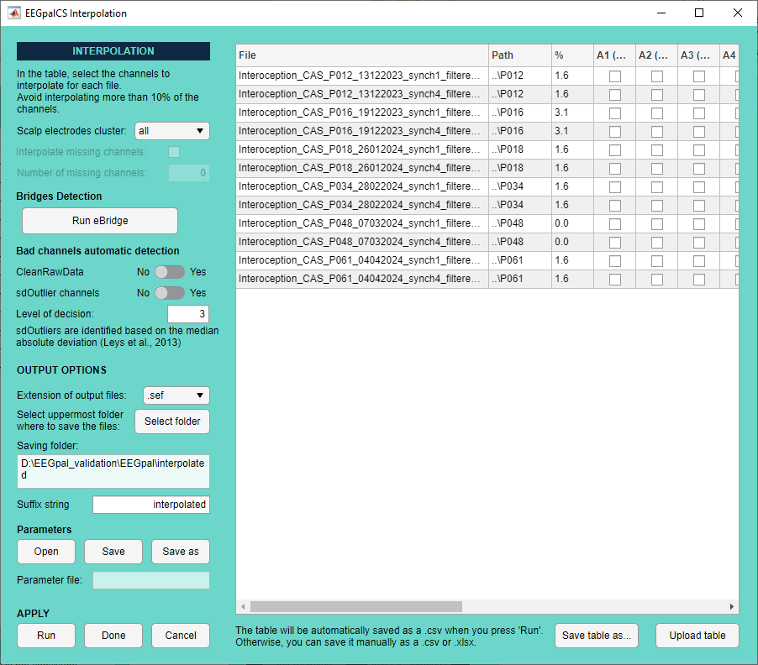
Processing EEGpal
Filtering
Interpolating

Slide 8
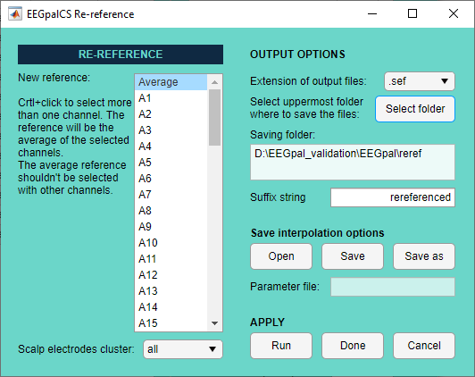
Processing EEGpal
Rereferencing to average
ICA with EEGpal/EEGlab

Slide 9
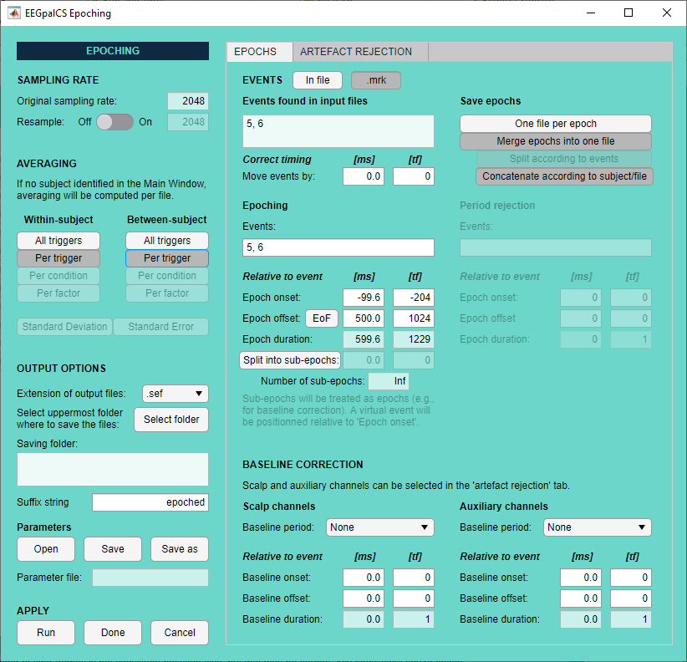
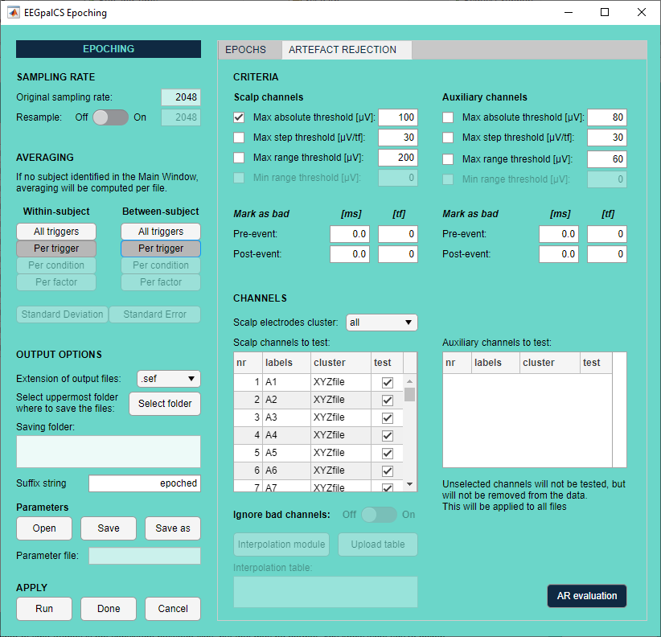
Processing EEGpal
Averaging

Slide 10
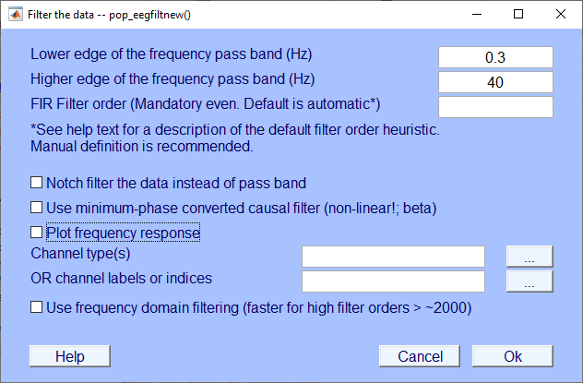
Processing EEGlab
As EEGlab's Biosig import function does bulshit with triggers, I converted them to .set using EEGpal (and took the opportunity to remove the EXG electrodes). Then I worked with eeglab 2023.1
I made the FIR filter 0.3-40Hz with eeglab but I couldn't make the Notch 50Hz. The eeglab interface doesn't handle the selection of several datasets very well in its graphical interface (I had to load and save the 12 files manually). I then converted them to .sef with EEGpal so that I could display them in Cartool.
Filtering

Slide 11
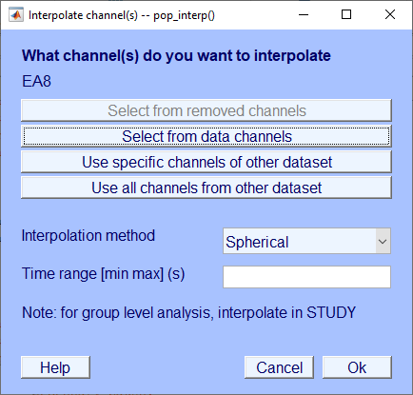
Processing EEGlab
Interpolation
For the coordinate file, I edit the channel location for each file with the classical file biosemi64AB.locs.
The use of interpolation tool of EEGlab is very painful because each file has to be treated separately (no way of multiple set selection)

Slide 12
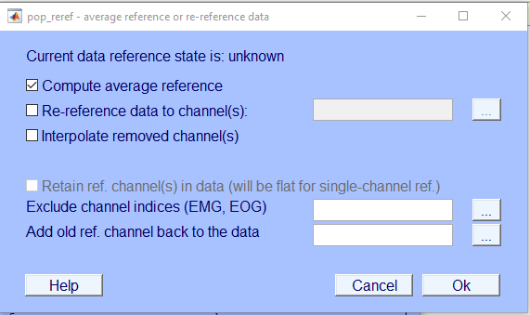
Processing EEGlab
Re-reference to average
Tool -> Reref the data ->
ICA with EEGpal/EEGlab
Averaging artefact rejection : Done with Cartool because otherwise you need to download the package ERPlab in Matlab (which will not do).

Slide 13
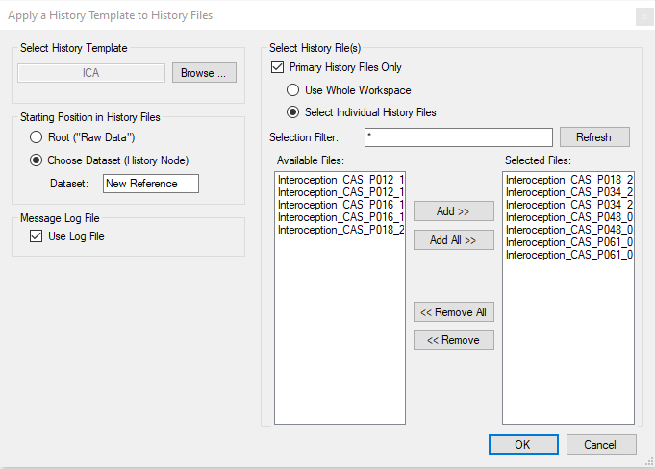
Learning on BrainVision
Est-ce que c’est possible d’importer des fichier .sef, .eph, .set, .ep, .txt?
NON : .sef, .set, .eph, .ep, .txt
So you can go from BrainVision to Cartool, but the reverse is impossible.
Batch system in BrainVision
Important to specify from which point the batch will by applied

Slide 14
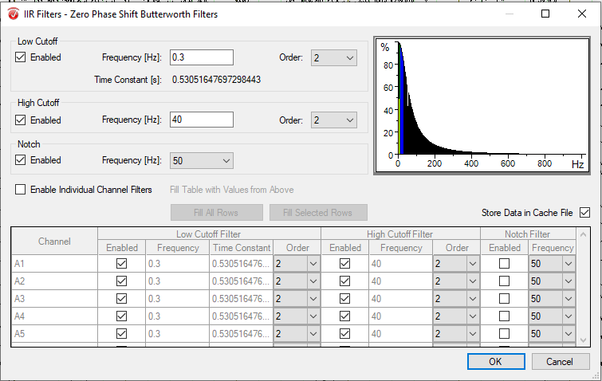
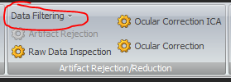
Processing BrainVision
Start by duplicating the marker trigger in Cartool
Filtering
Transformation

Slide 15
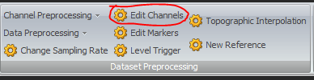
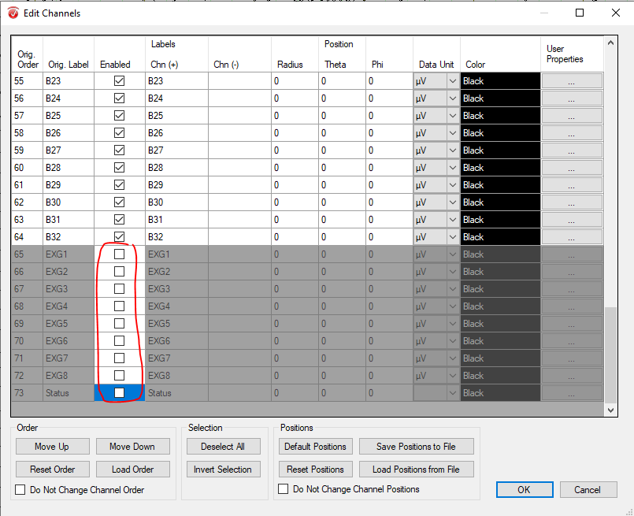
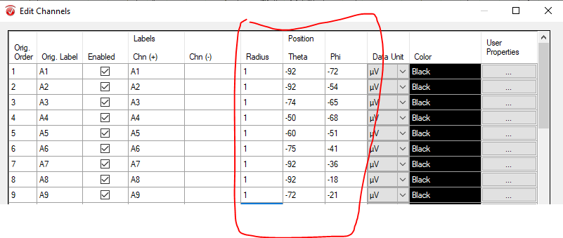
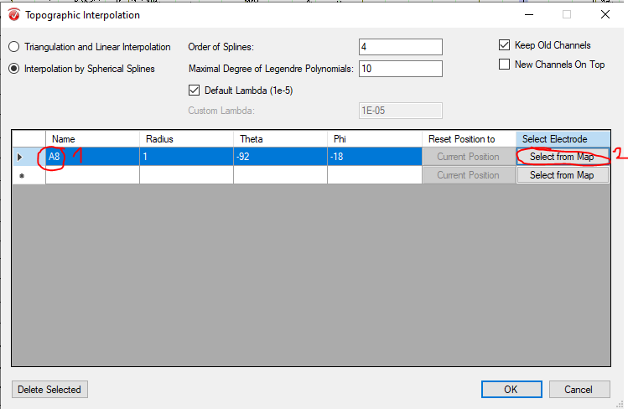

Processing BrainVision
Interpolation
The first thinks to do is define the coordinate of the channel. A. Go to tansformation -> Edit channel; B. untick all the EXG and status channel to remove it; C. Copy the spherical coordinate of channel coming from Cap_coords_all.xls of Biosemi
To apply the interpolation (Tansformation -> Topographic Interpolation), enter the channel name and then press on Select from map to fill the coordinate position.

Slide 16

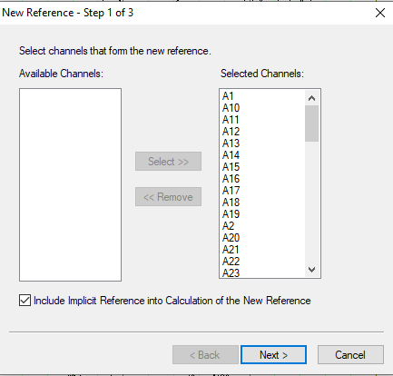
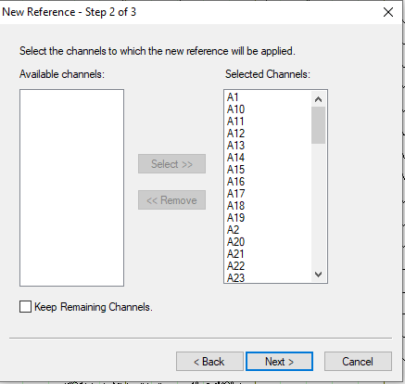
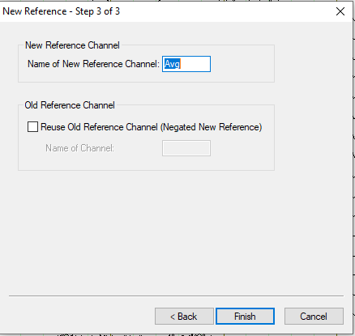
Processing BrainVision
Re-ref to average reference

Slide 17
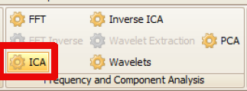
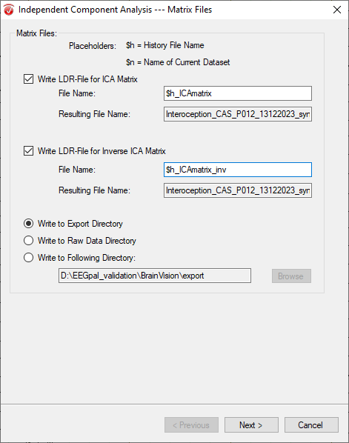
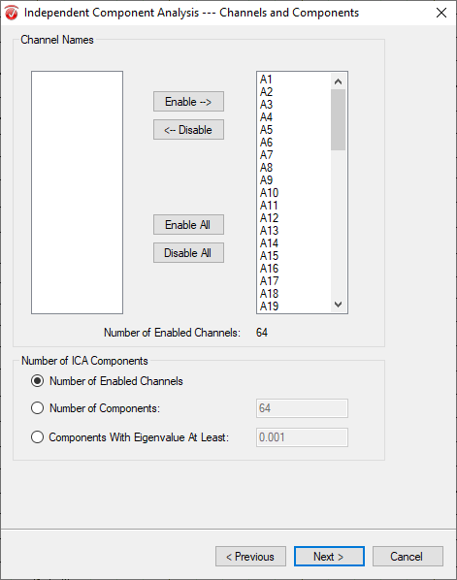
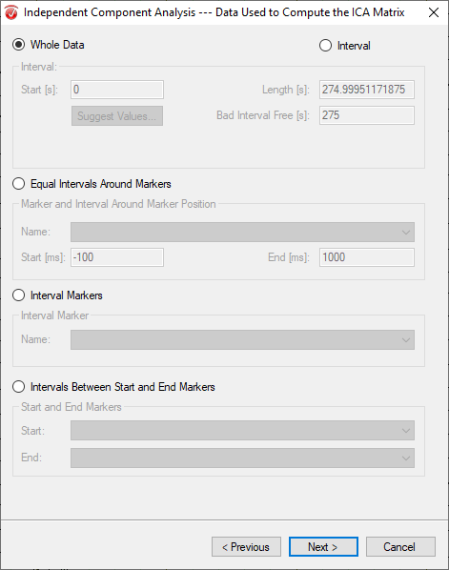
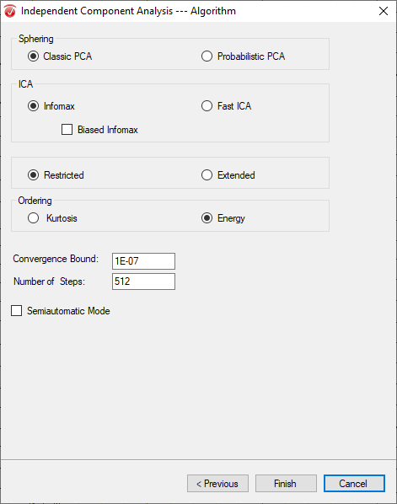
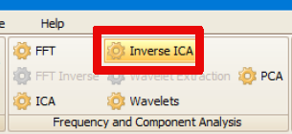
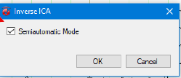
Processing BrainVision
ICA

Slide 18
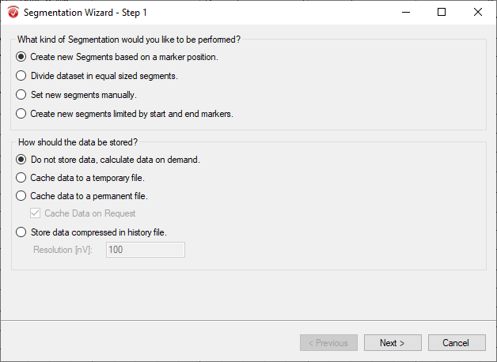
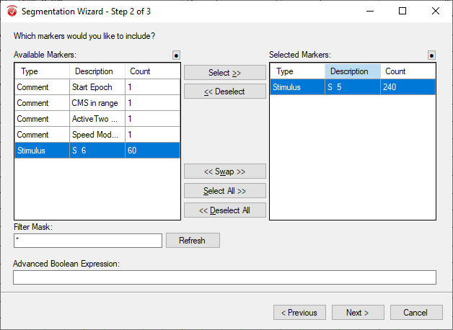
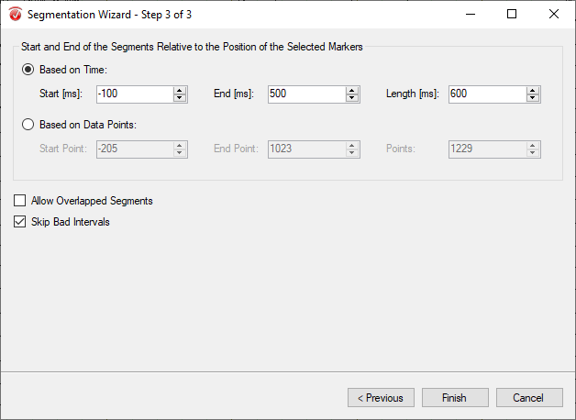

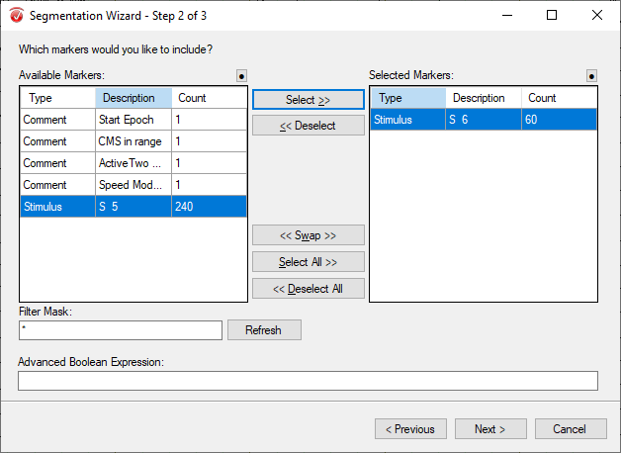


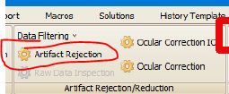
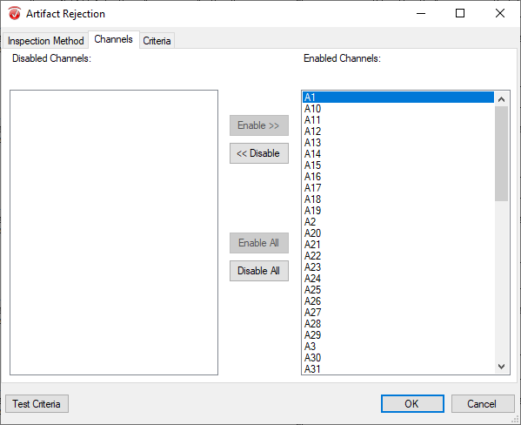
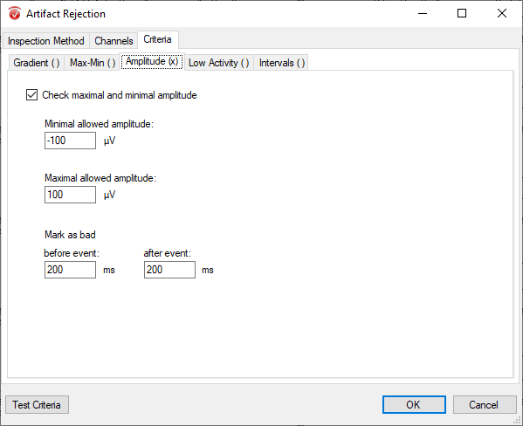
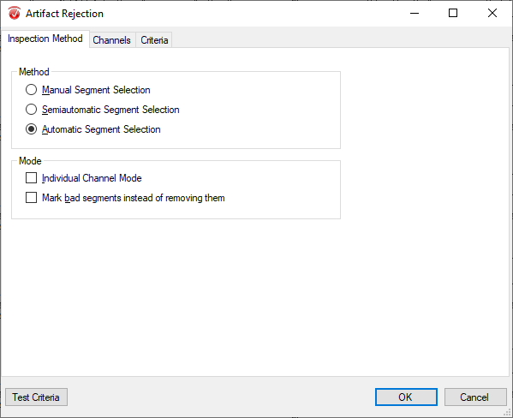
Processing BrainVision
Segmentation
Segmentation must be done twice separately per trigger.
Down bar to change of component
Artefact rejection (to remove segments outside of the amplitude confidence of -100 to 100 microV)
To reject instead of only mark
Allow only the amplitude criteria

Slide 19
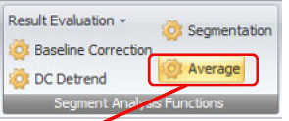
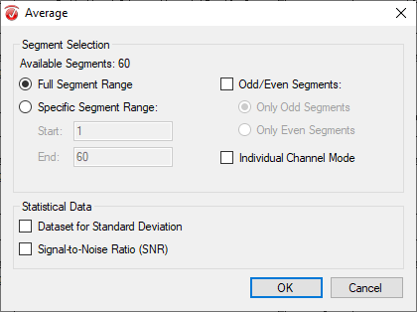
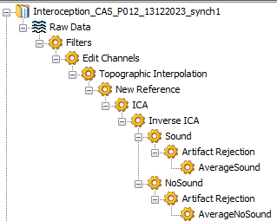
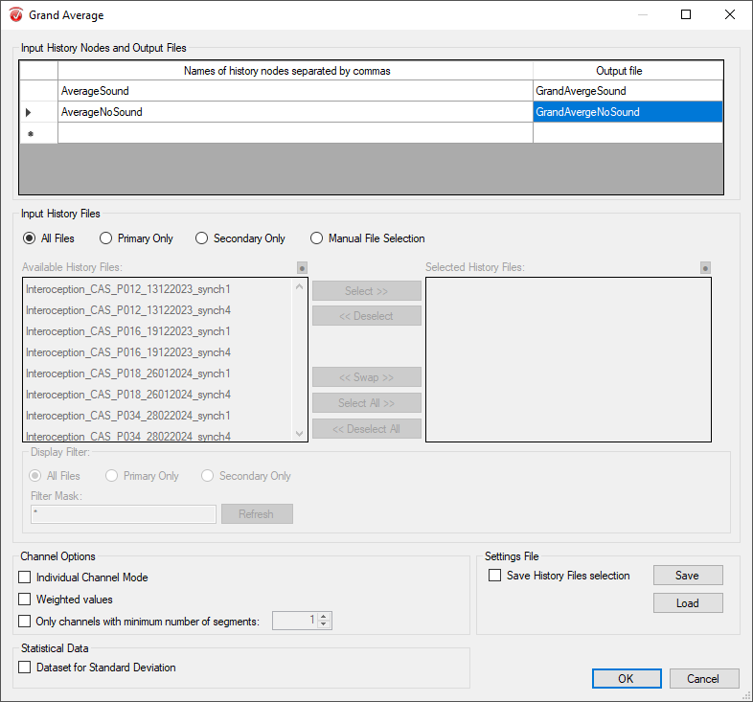
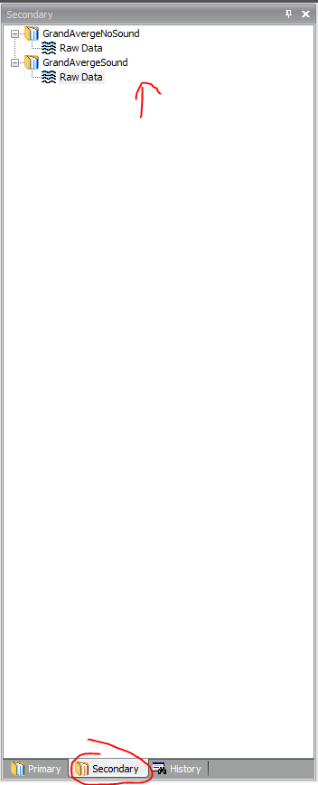
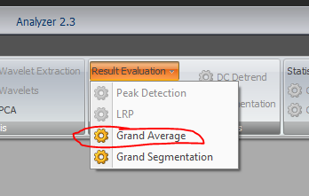
Processing BrainVision
Average
Final tree per participant
Grand Average

Slide 20
Validation of Filtering for a single file
Black = Cartool
Red = EEGpal
Green = eeglab
Blue = BrainVision
Fichier Interoception_CAS_P012_13122023_synch1_filtered.sef
My remarks:
The filter of BrainVision (blue), lets a lot a small oscillations in the data in comparison to the others (these are around 90 Hz)
More oscillations than both Cartool filtering (are around 50-60 Hz)
Filtering result of EEGpal (red) and eeglab (green) have similar trace. Just a difference of amplitude. According MichaelDP, EEGpal sightly better because less variation of amplitude than eeglab (more flat)
Conclusion: The BrainVision is the less efficient because it let pass a lot a high frequency above the cut-off of 40 Hz.

Slide 21
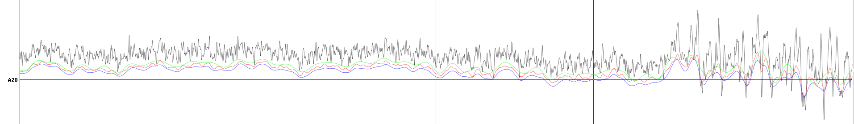
Validation of Filtering for a single file
Black = Raw data
Red = BrainVison
Green = eeglab
Blue = Cartool
Fichier Interoception_CAS_P018_26012024_synch1.bdf
With this example, it confirm that BrainVison has quality inferior to the other filtering methods. There is high frequency in the signal which sould be suppress.

Slide 22
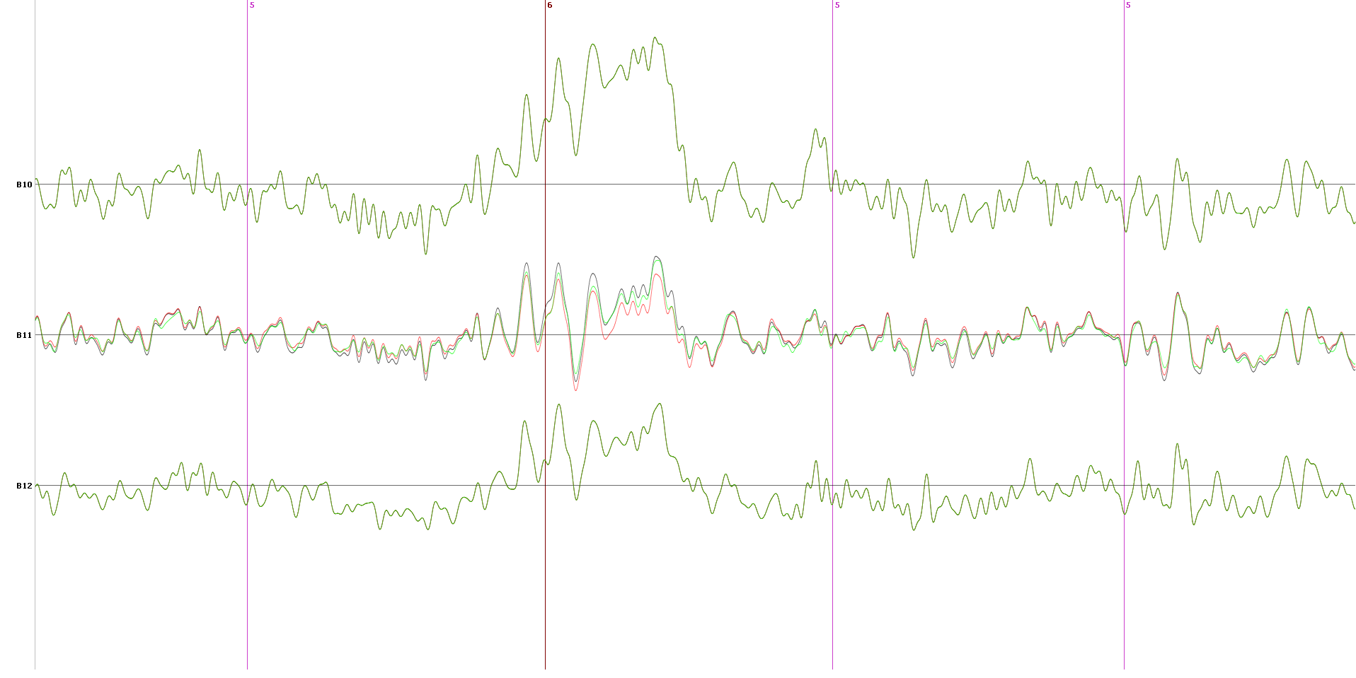
Validation of Interpolation for a single file
To compare the efficiency of the interpolation methods, I interpolate the same electrode B11 with the same cap coordinate on the same original file Interoception_CAS_P034_synch1_filtered.sef (coming from the eeglab filtering).
Black = Cartool
Red = EEGpal
Green = eeglab
Interpolated channel
Remarque: Interpolation trace of Cartool (black) and EEGpal (red) are identical. Interpolated trace of eeglab (green) is similar.
Conclusion: The interpolation algorithm of the three tools provide similar results. The interpolated trace computed by EEGpal is validated (the best according to me)

Slide 23
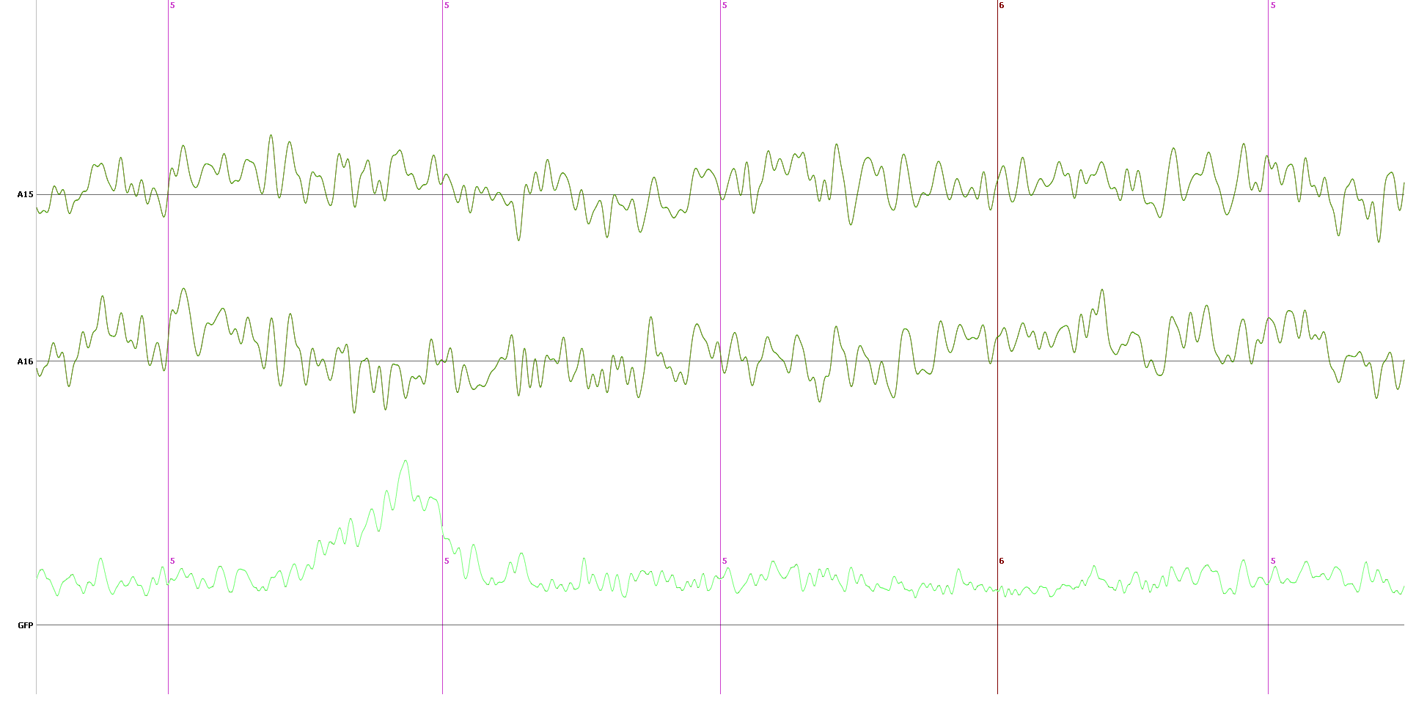
Validation of average Re-ref for a single file
To compare the efficiency of the average re-ref methods. I use the file P012_synch1_filtred_inter.set (coming from the eeglab filtering).
Black = Cartool
Red = EEGpal
Green = eeglab
Remarque: The result is strictely identical between the three methods
Conclusion: The Re-referencing algorithm of EEGpal is totally correct and validated

Slide 24
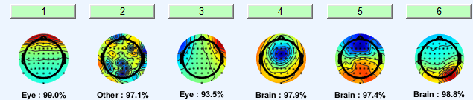
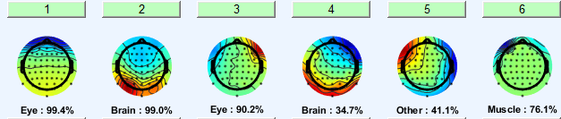




Validation ICA
Based on file Interoception_CAS_P012_13122023_synch1
Cartool
EEGlab
EEGpal
BrainVision

Slide 25




Validation ICA
Based on file Interoception_CAS_P016_19122023_synch1
Cartool
EEGlab
EEGpal
BrainVision

Slide 26
Conclusion about ICA
The compound for the eye are generally consistent between BrainVision and EEGLAB. However, it is much easier to detect eye compound with EEGLAB thanks to IClabel + good default contrast of visualization (which is not the case in BrainVision)
With the ICA module of EEGpal. It is much easier to concatenate participate files which is not the case with BrainVision.

Slide 27

Validation of EEGpal epoching regarding to Cartool Epoching
Test on the same data (D:\EEGpal_validation\EEGpal\ICA\) with Epoching EEGpal and Averaging Cartool (parameters:
Epochs: -100 +500ms (no baseline correction)
Rejection amplitude > 100 microV
Total epochs accepted
- EEGpal= 3504
- Cartool = 3504
Black = EEGpal
Red = Cartool
Values are similar but slightly different

Slide 28

Validation of EEGpal epoching regarding to Cartool Epoching
Test on the same data (D:\EEGpal_validation\EEGpal\ICA\) with Epoching EEGpal and Averaging Cartool (parameters:
Epochs: -100 +500ms (no baseline correction)
Rejection amplitude > 100 microV
First average each participant individually
Second average the previous averages (Grand mean)
Subtraction grand mean trigger 5 - grand mean trigger 6 = MMN
Black = EEGpal 1.2
Red = Cartool
Perfect Match !!
Total epochs accepted
- EEGpal= 3504
- Cartool = 3504
This validate the Epoching module of EEGpal ! The result of grand average over two conditions across 6 participant give exactly the same results between Cartool and EEGpal. It means that the individual means will also fit.
We can trust the Epoching module of EEGpal
Notes:
Parameters: rejection Epochs >100 microV.
Previous result was not exactly the same because I directly averages all the participants. Here, I make individuals means and then the mean of these means (the means of means give never exactly the same results as the direct mean across participant).

Slide 29

Comparison of the Grant Mean for Missmach Negativity (MMN)
Substraction : Sound-noSound (MMN for cardio synch condition over 6 patients)
Black = Cartool
Red = EEGpal
Green = eeglab
Blue = BrainVision
Remarks:
Quality of the Dis very bad for BrainVision (blue).
The quality of Cartool is less good as the two Matlab methods (mainly due to filtering)
The signal of EEGpal is the best in term of topographie

Slide 30

Comparison of the Grant Mean for Missmach Negativity (MMN)
TF: 481 = 135 ms post stim (MMN peak position)
Cartool
EEGpal
EEGlab
BrainVision
Topo of EEGpal closer to Cartool

Slide 31
General Conclusion
The MMN results are quite similar between the different analysis methods (the final result will not depend on the toolbox choice)
The worst performance is provided by BrainVision (I don’t recommend the use of this software)
The two matlab softwares (eeglab and EEGpal) give the cleanest results (better than a pure Cartool pipeline)
The EEGpal version 1.1 is totally correct and validated for ERPs study. Each processing steps give a correct result in comparison of other EEG processing software.

