Slide 1
WELCOME

Slide 2

Online Jewelry Store

Slide 3
Submitted by
Akshay Jadhav 1030
Devidas Pandhare 1059

Slide 4
Contents
—Introduction
—Motivation
—Objectives
—Description of system
—Advantages and Disadvantages
—Future Scope
— Conclusions
—References
— Diagrams
—Screenshots

Slide 5
Introduction
Online shopping definitely is the thing in this digital age. You have full control of your shopping experience, from the selection to check out. You can also purchase a product in peace without anyone judging your choices or salespersons talking you into buying the more expensive piece.
An online Jewelry Store that allows users to check for various Jewelry available at the online store and purchase online.

Slide 6
Motivation
Traditional shopping can be very time consuming going and visiting different shops if you haven’t made the decision of what to buy.
It is very physically tiring to visit different shops specially if there is wedding or some kind of function also it is not safe to visit shops in covid-19 situation.
Physically less options to select so we need keep on visiting new shops for our requirements.

Slide 7
Objectives
To produce a web-based system that allow the store owner/shopper to add/update/delete products.
To ease customers physical efforts of going to different shops and do lot of formalities
Providing customers access to wide variety of designs and models of the products.

Slide 8
Description of System
Admin:
Admin can login to the system.
View the list products.
Add new products.
Delete added products.
Update existing products.
View customers.
Customer can logout from system

Slide 9
Description of System
Customer:
Admin can login to the system.
View the list products.
Add new products.
Delete added products.
Update existing products.
View customers.
Customer can logout from system

Slide 10
Advantages / Disadvantages
Advantage :
The system allows the customer to browse through wide verity .
Shop owner can add new products, update existing products, and delete the products.
You will save valuable time .
And be able to choose from a wide variety of jewelry designs.
Disadvantage :
We need assure customer about the authenticity of products.

Slide 11
Future Scope
The Message and Email alerts for various happenings can be added to the system so that users do not miss the updates and happenings of the system. New Shipment department can be added for product delivery purpose.
GUI modification

Slide 12
Conclusion
Online jewelry Store that allows customers to check for various jewelry available at the online store and purchase online. The project consists of list of jewelry products displayed in various model and designs.
The application provides facility to add/remove/update products facilities to shop owner.
Also allows customer to facility of placing order, adding product to cart etc.

Slide 13
References
1]. Java and advance java lectures of Madhura Anturkar.
ONLINE REFERENCES:
https://www.ejohri.com/
www.tanishq.co.in
https://docs.oracle.com/javase/tutorial/

Slide 14
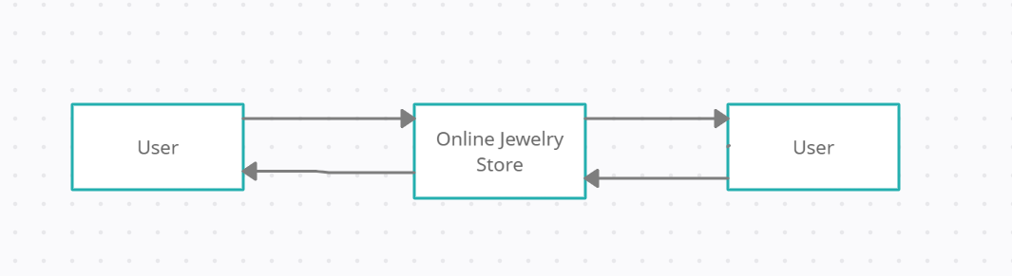
Figure : Level 0 Data Flow Diagram

Slide 15
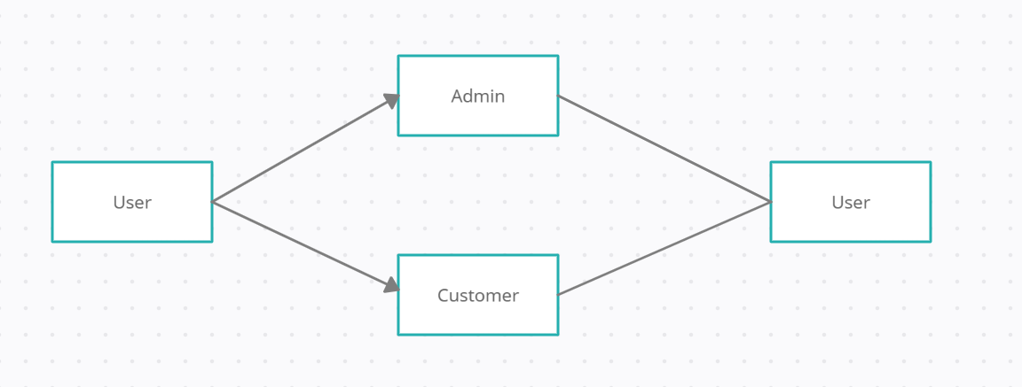
Figure 4: Level 1 Data Flow Diagram

Slide 16
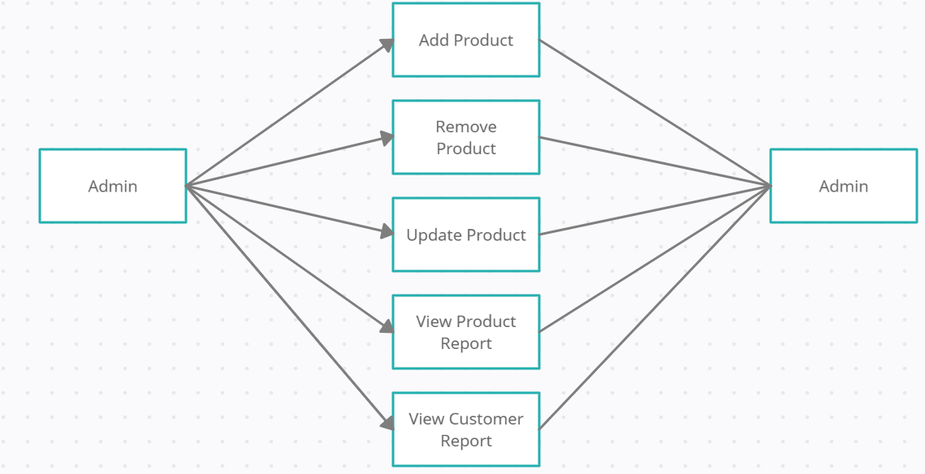
Figure 4: Level 2 Data Flow Diagram For Admin

Slide 17
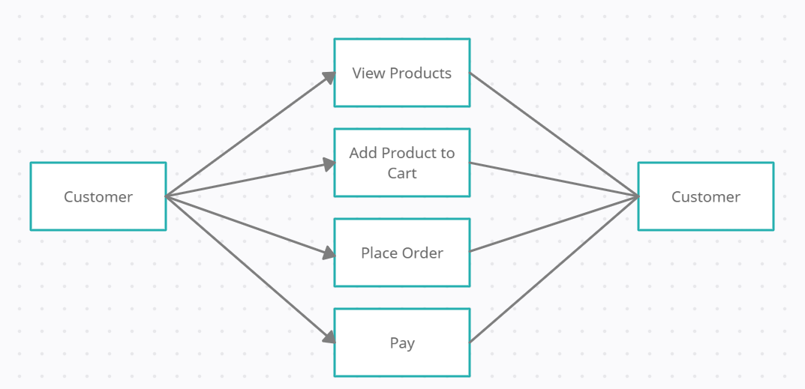
Figure 4: Level 2 Data Flow Diagram For Customers

Slide 18
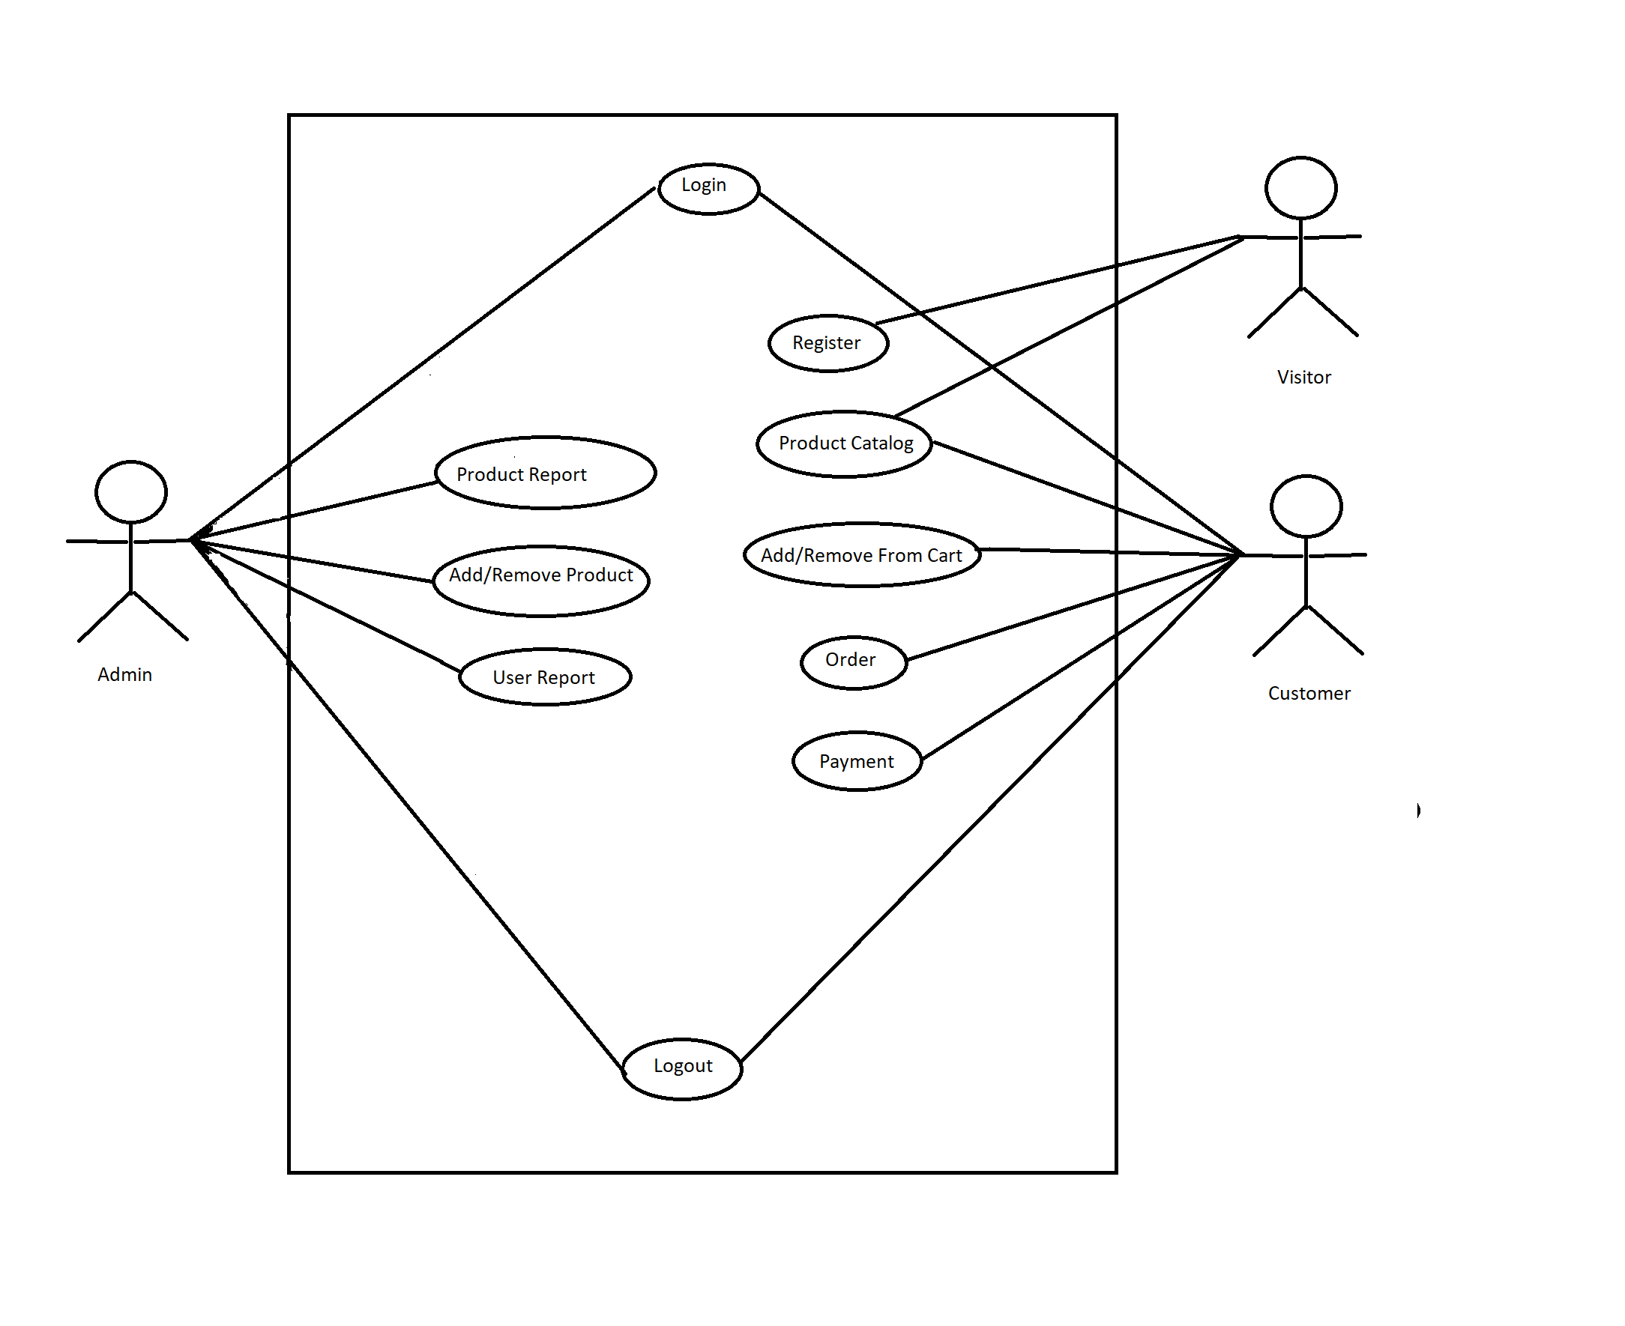
Figure 4: Level 2 Data Flow Diagram For Customers
Figure : Use Case Diagram

Slide 19
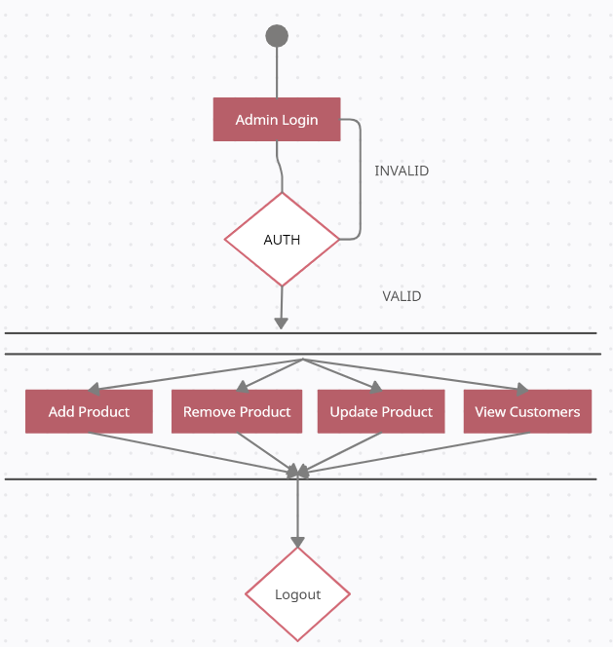
Figure : Admin Activity Diagram

Slide 20
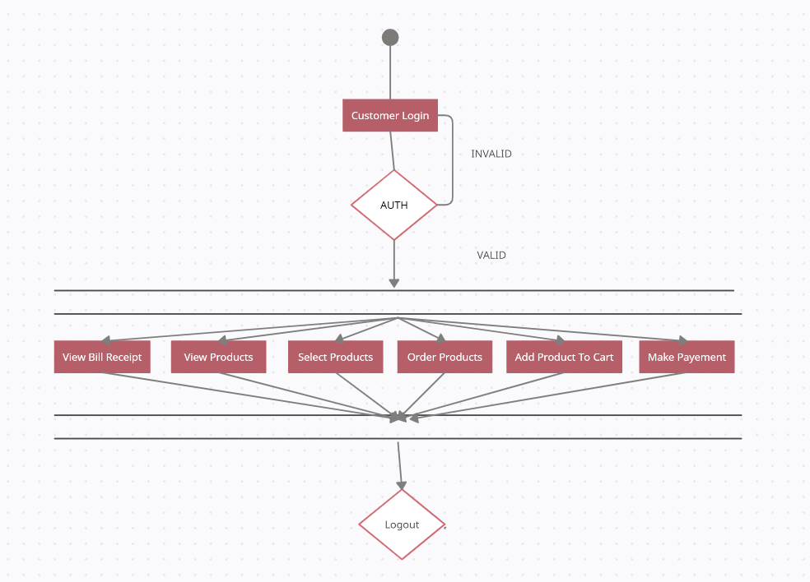
Figure : Customer Activity Diagram

Slide 21
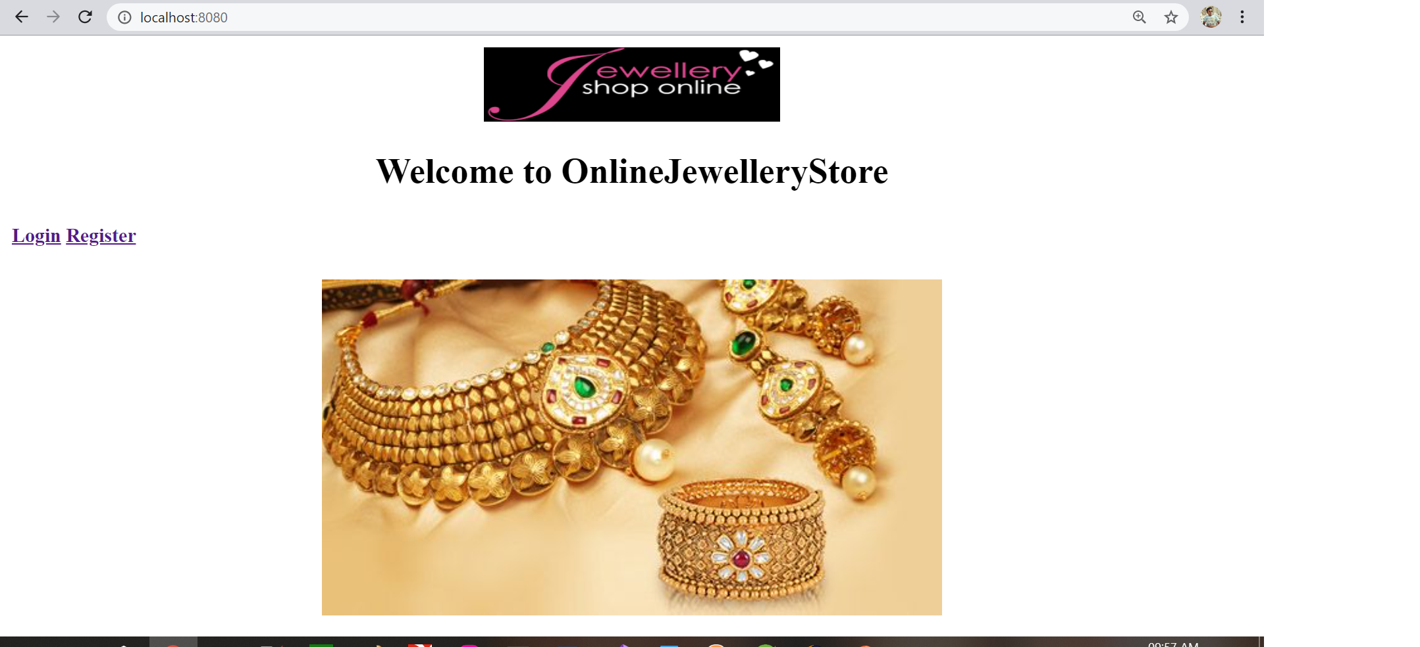

Slide 22
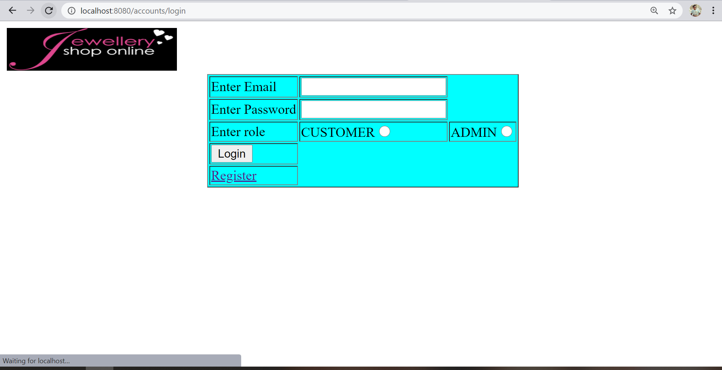

Slide 23
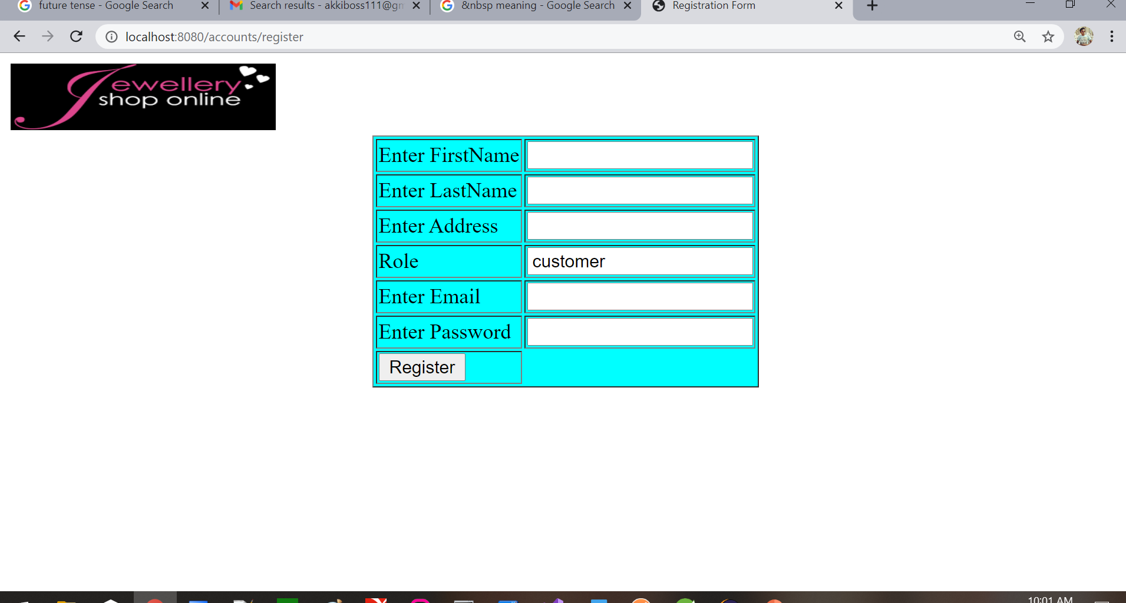

Slide 24
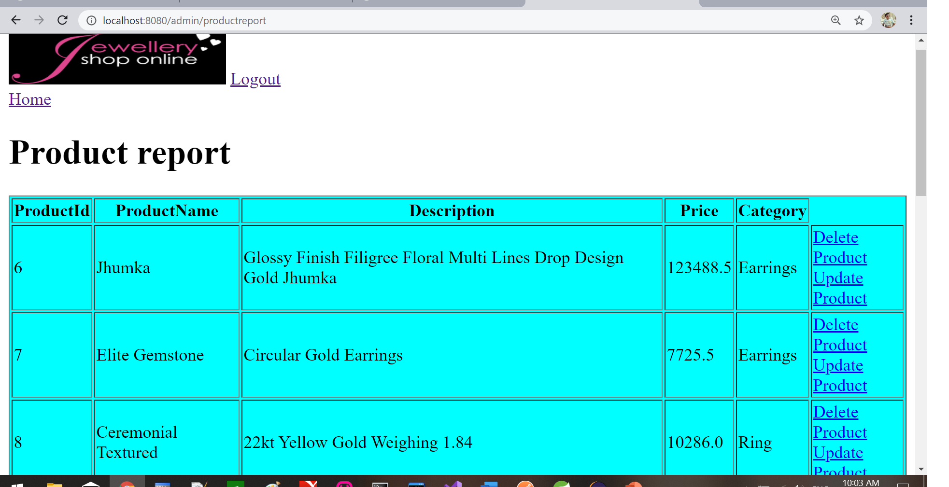

Slide 25
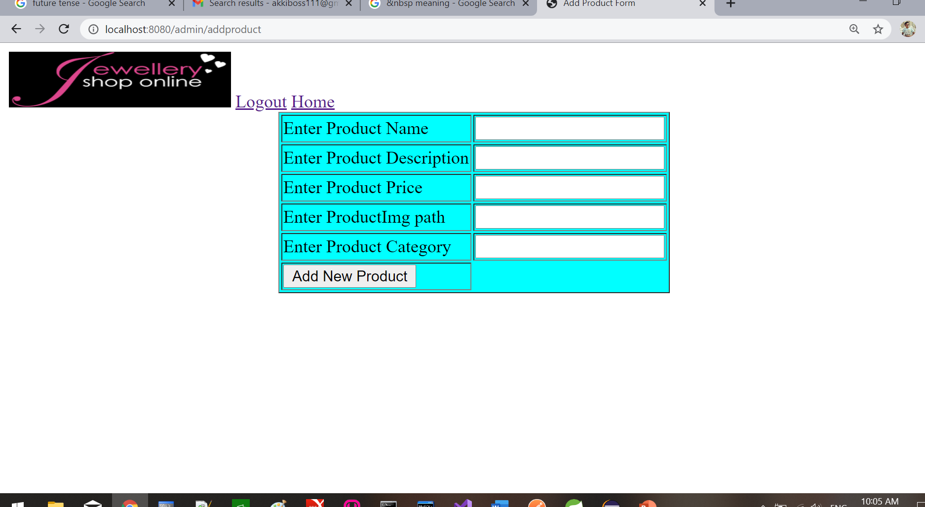

Slide 26
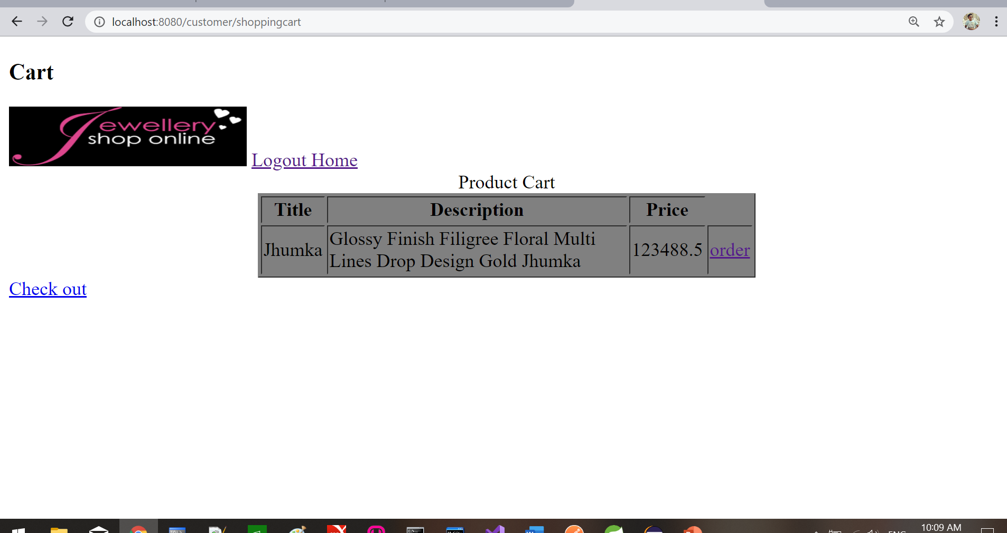

Slide 28
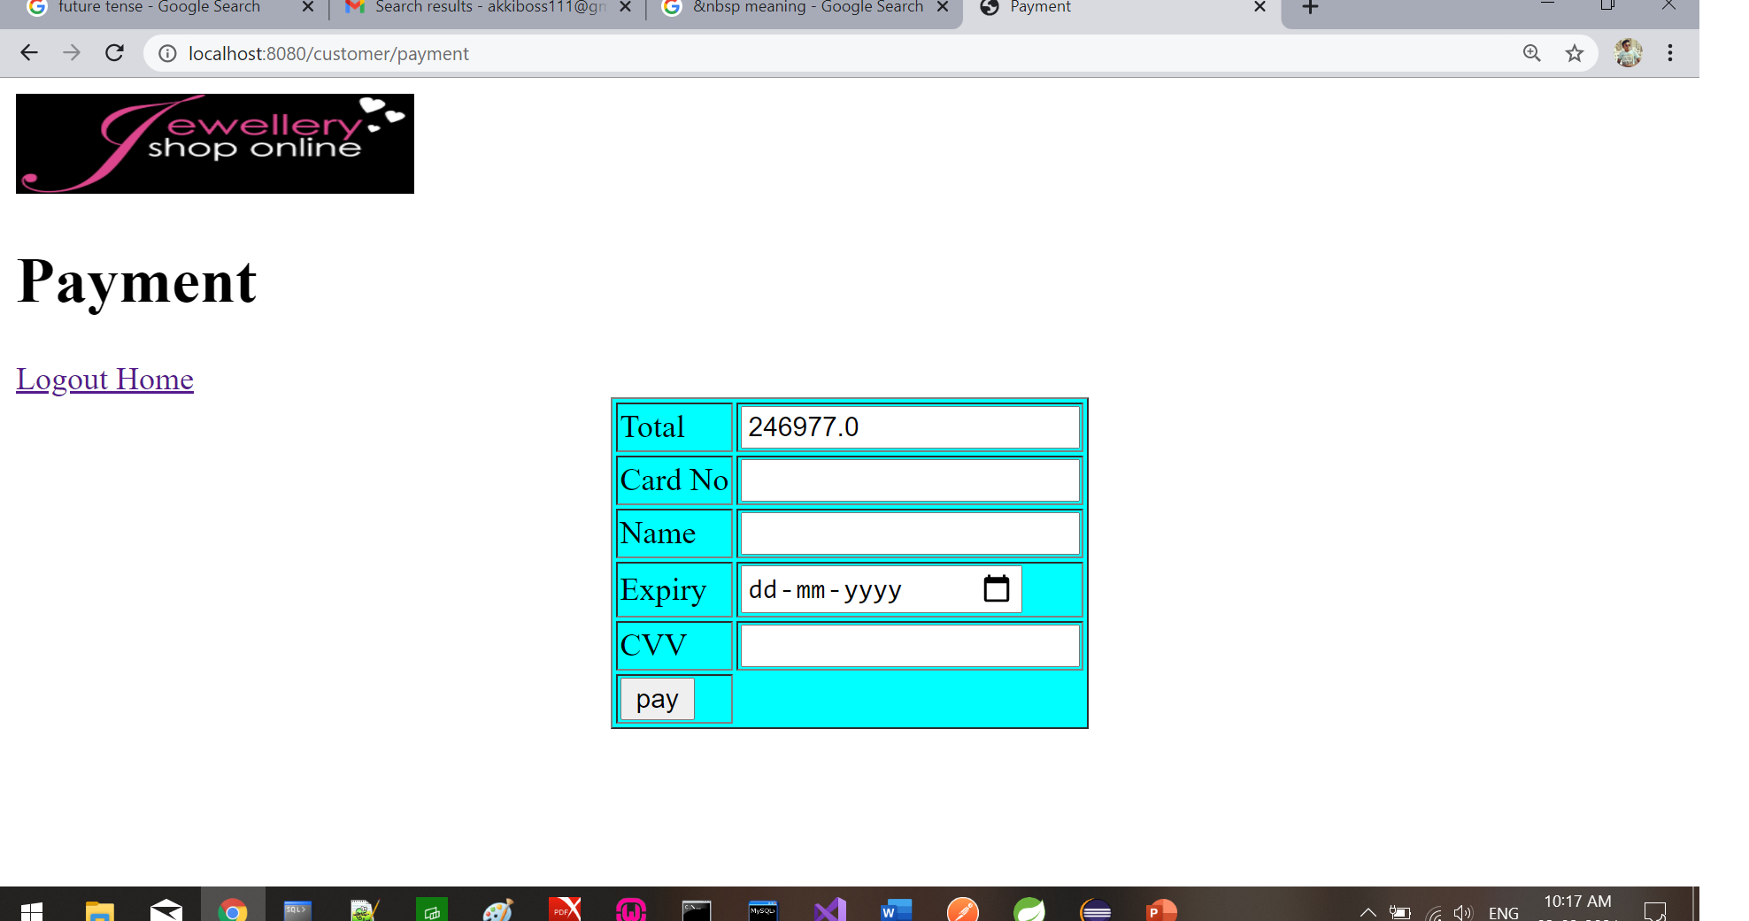

Slide 29
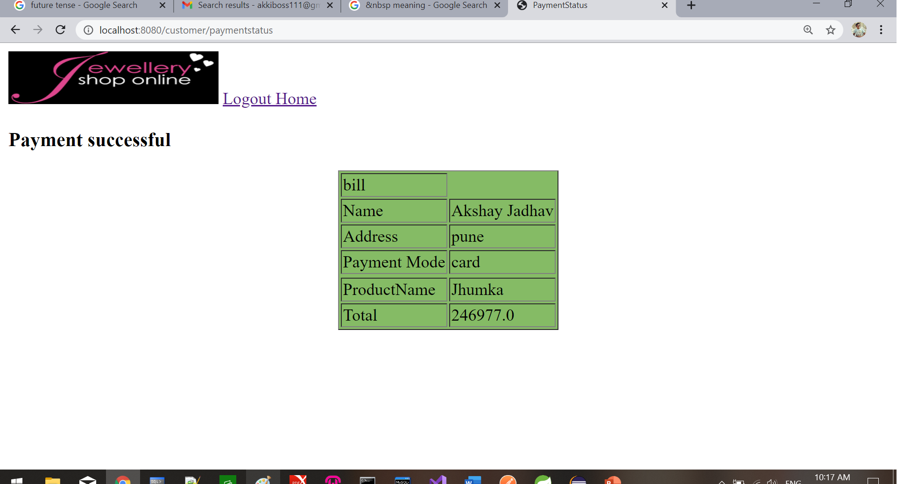

Slide 30
Thank You!!!

