Slide 1

Images & Description
02|
EXEMPLES
Brice
Prince of Darkness
Waiting for his moment
Circa 2018

Slide 2
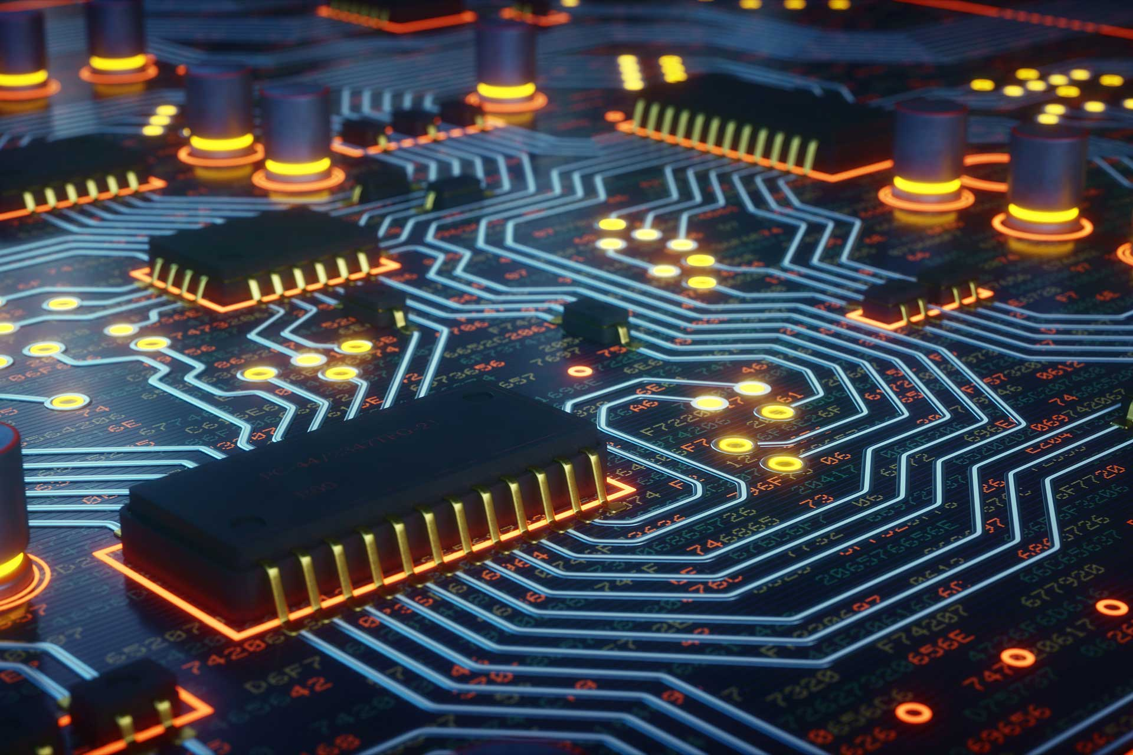
Electronic & Embedded Systems
Lecture 02
- Semi-conductors
Brice PARILUSYAN
PhD Student
brice.parilusyan@gmail.com

Slide 3
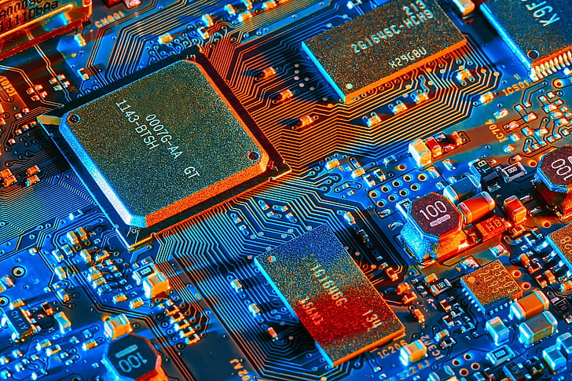
Course overview
01|
NP connection
02|
Diodes
03|
Transistors

Slide 4
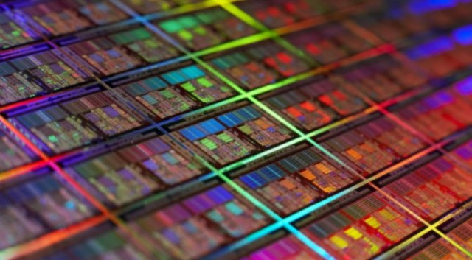
NP connections
Physic Principles

Slide 5
1|
NP connections
Physic principles
Silicon structure
N-type silicon
P-type silicon

Slide 6
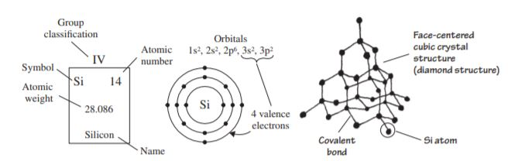
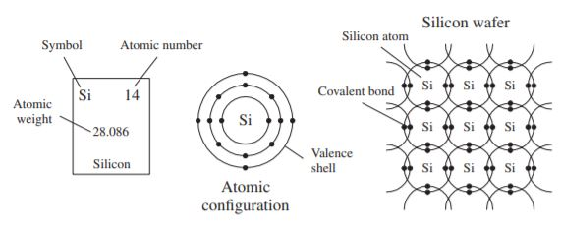
Silicon structure
1|
NP connections
Definition :
Silicon is ranked second in the order of elements appearing in the earth’s crust, an average of 27 percent occurring in igneous rocks. Silicon is the most important semi-conductor used in building electrical devices.
Semi-conductors are atoms molecules with a specific range conductivity. They are naturally insulating but can be conductor with specific conditions.

Slide 7
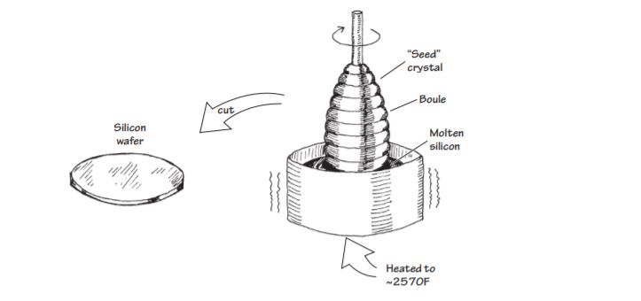
Silicon structure
1|
NP connections
Properties :
It is extremely rare to find silicon in its pure crystalline form in nature, and before it can be used in making electronic devices, it must be separated from its binding elements. After individuals (chemists, material scientists, etc.) perform the purification process, the silicon is melted and spun into a large “seed” crystal. This long crystal can then be cut up into slices or wafers that semiconductor- device designers use in making electrical contraptions.

Slide 8
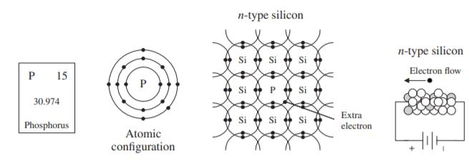
N-type silicon
1|
NP connections
Definition :
N-type silicon is created when we add a phosphorus (P) atom to the net. P has 5 electrons on his valence layer. 4 of them are stuck in covalent bond, but the fifth is free.
The fifth electron will be able to move from the phosphorus atom and create current.

Slide 9
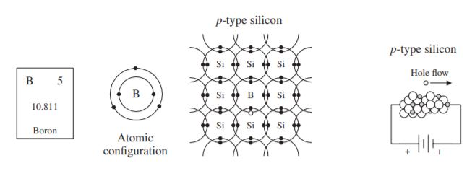
1|
NP connections
N-type silicon
Definition :
P-type silicon is created when we add a boron (B) atom to the net. P has 3 electrons on his valence layer. All of them will be stuck in a covalence bond. However, there will be a vacant spot, called a hole.
This hole can “move” between the silicon atom and create current.

Slide 10
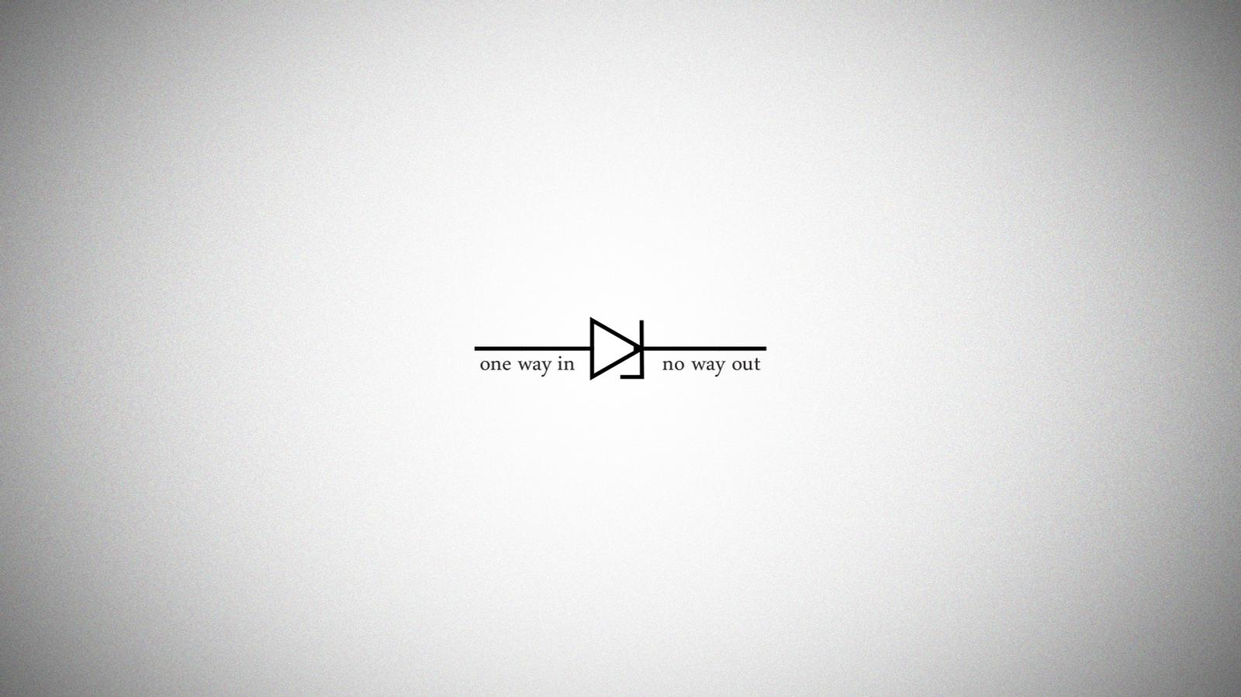
Diodes
Working principle
Practical use

Slide 11
2|
Diodes
Working principle
Physical structure
P-N junction
Schottky diodes
Zener diodes

Slide 12
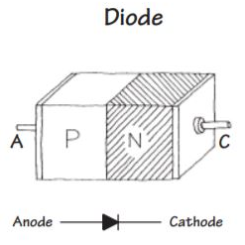
2|
Diodes
Physical structure
Definition :
A diode is a component who is composed of a P-type junction against an N-type junction.
Properties :
A diode allow the current to flow in only one direction
The silicon diodes create a voltage drop of 0.6 volts, it’s the necessary tension to initiate the conductivity.

Slide 13
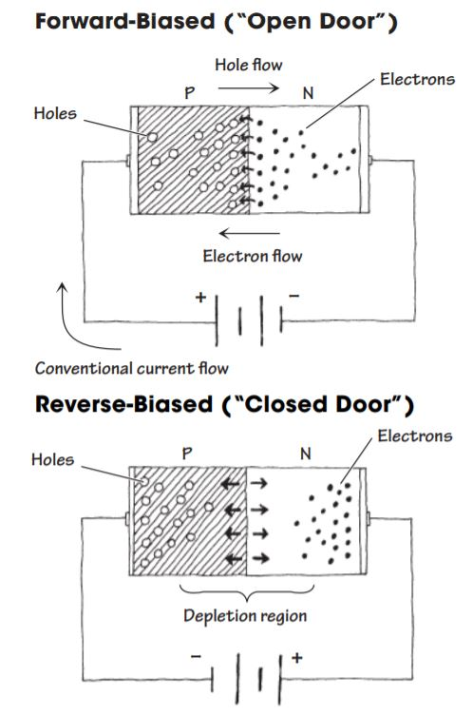
2|
Diodes
P-N junction
Definition :
Forward-biased position is activated when the current flow from P to N connection. At this moment, the free electrons of N try to pass through the P, and the holes of the P go against N and let electron flow through them.
Reverse-Biased position is when the current flow from N to P. In this case, the electrons of N will be forced to the left and holes of P will be forced to the right. This result in an empty zone around p-n junction who is free of charges. We called it depletion region and it is insulant.

Slide 14
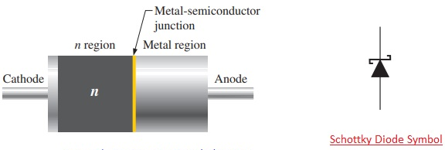
2|
Diodes
Schottky diodes
Definition :
Schottky diodes have a particularly low junction capacitance and faster switching (∼10 ns) when compared to silicon p-n junction diodes due to their special metal semiconductor junction interface. They also have a lower junction threshold voltage, around 0.3V. these characteristics enable them to detect low-voltage, high-frequency signals that ordinary p-n junction diodes would not see.

Slide 15
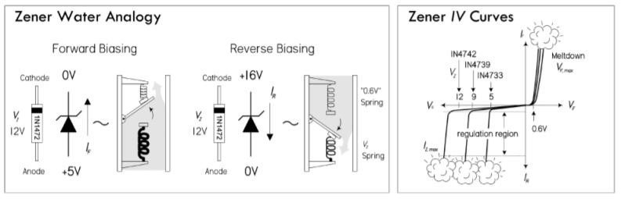
2|
Diodes
Zener diodes
Definition :
A zener diode acts like a two- way gate to current flow. In the forward direction, it’s easy to push open; only about 0.6 V, just like a standard diode. In the reverse direction, it’s harder to push open; it requires a voltage equal to the zener’s breakdown voltage VZ. This breakdown voltage can be anywhere between 1.8 and 200 V, depending on the model

Slide 16
2|
Diodes
Practical use
Rectifier application
Circuit protection
Voltage management
Digital electronic
AM detector

Slide 17
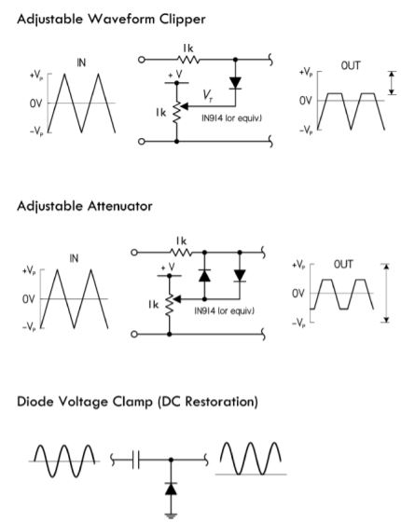
2|
Diodes
Rectifier application
Definition :
A rectifier circuit is designed to modify a signal. With the right set of component, it is possible to change the shape of a signal in order to match with your expectation.

Slide 18
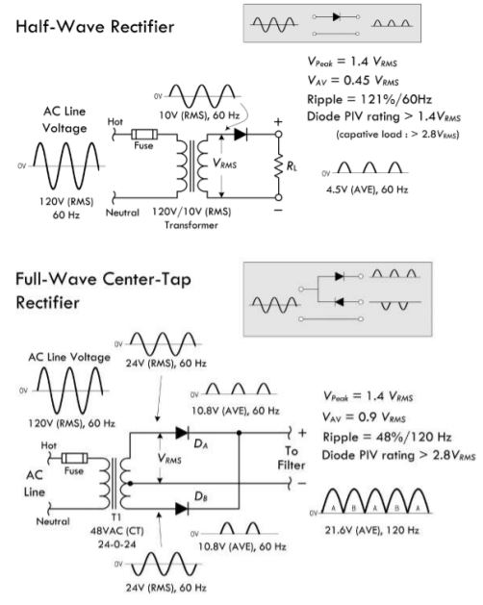
2|
Diodes
Rectifier application
Definition :
The wave rectifier are used to transform an AC signal in a full positive or full negative signal. It is used to create a DC from an AC signal.

Slide 19
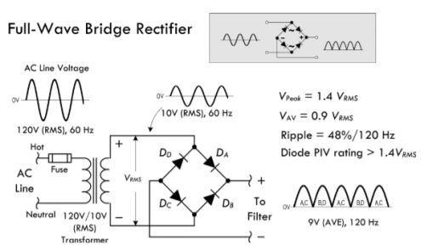
2|
Diodes
Rectifier application
Definition :
The full bridge rectifier is a specific bridge rectifier designed to create the more powerful DC signal from an AC signal. It can reverse the negative parts of the signal in positive part. With a diode and capacitor after, you can recreate a DC signal.
This circuit is used in all electric alimentations.

Slide 20
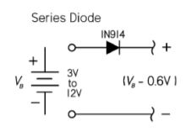
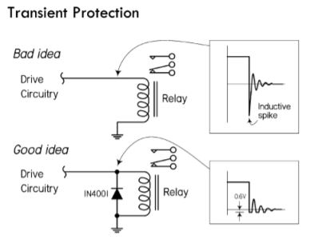
2|
Diodes
Circuit protection
Properties :
As diodes allow current to flow in one direction, it help to protect circuit against reverse current.
Used in parallel of a component who can generate voltage, it avoid this component to burn the circuit with a reverse voltage.

Slide 21
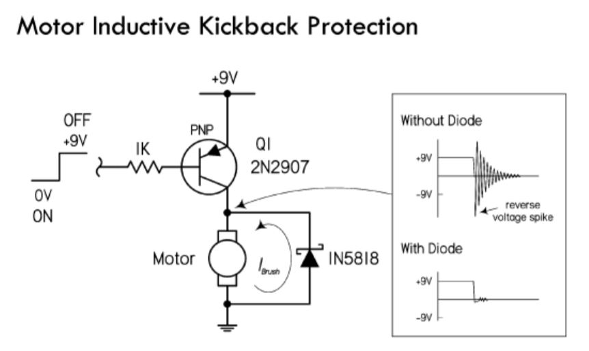
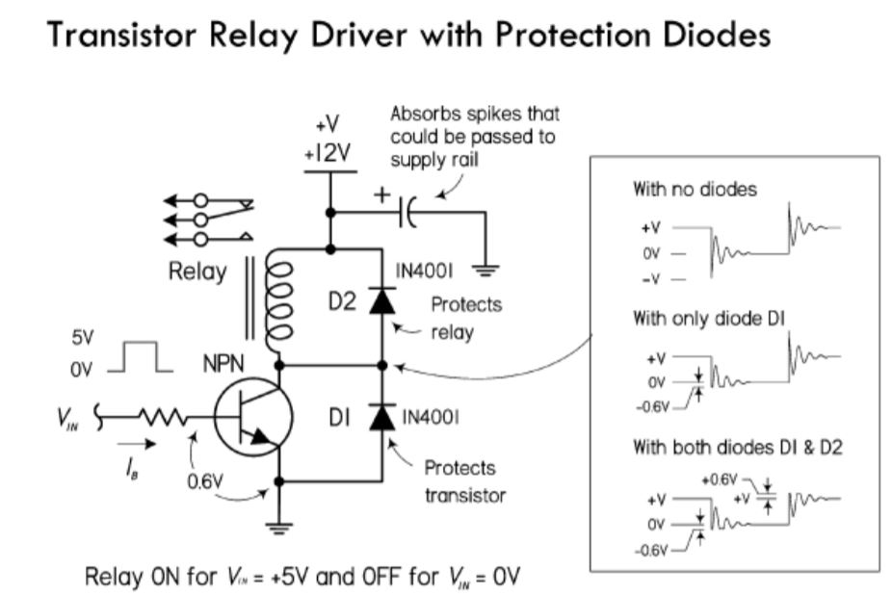
2|
Diodes
Circuit protection
Example :
When a working continue motor is deprived of its power source, the remaining rotational movement create a generate current and the motor become a generator. Parallel diode avoid this current to burn the circuit.
The activation / deactivation of a relay generate spike in the circuit. Diode can avoid this spike and protect the circuit.

Slide 22
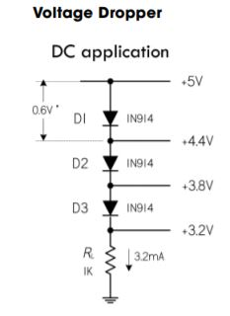
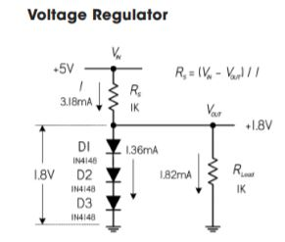
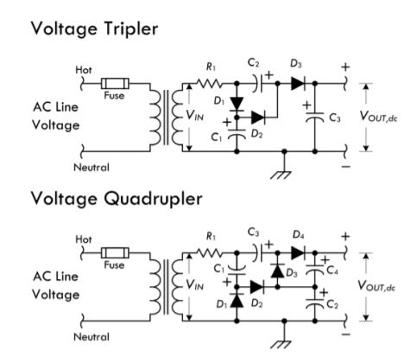
2|
Diodes
Voltage management
Definition :
The voltage regulator use the threshold voltage effect of the diode to reduce voltage.
RS = (Vin – Vout) / I
Voltage multiplier are circuits who can obtain a DC voltage with a value superior of the maximum peak of the AC voltage it is created from.

Slide 23
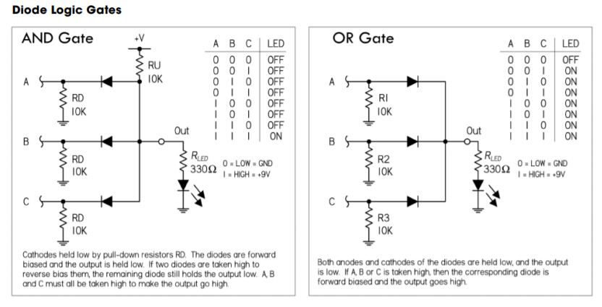
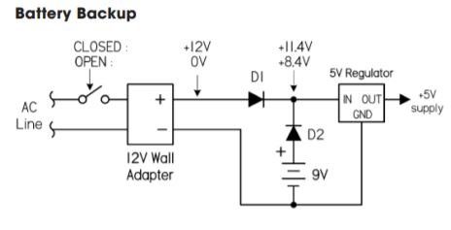
2|
Diodes
Digital electronic
Properties :
Logic gates can be created from diodes. The and gate use the reverse bias property. This kind of logic gates are less performant than with transistors but can be used for non-logic-level electronic (ex: battery backup with or gate)

Slide 24
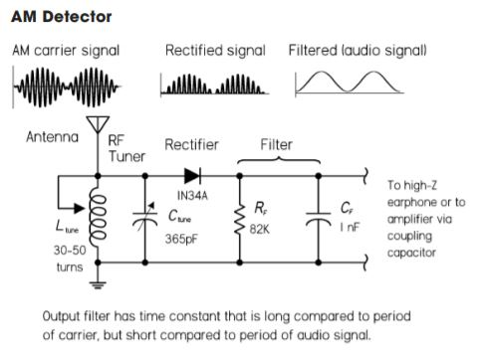
2|
Diodes
AM detector
Properties :
Diodes are often used in the detection of amplitude modulated (AM) signals. Here, a signal diode is then used to rectify out the negative portion of the incoming signal so it can be manipulated by the next dc stages. The rectified signal is then stripped of its high- frequency carrier by passing through a low- pass filter. The output signal is the audio signal.

Slide 25
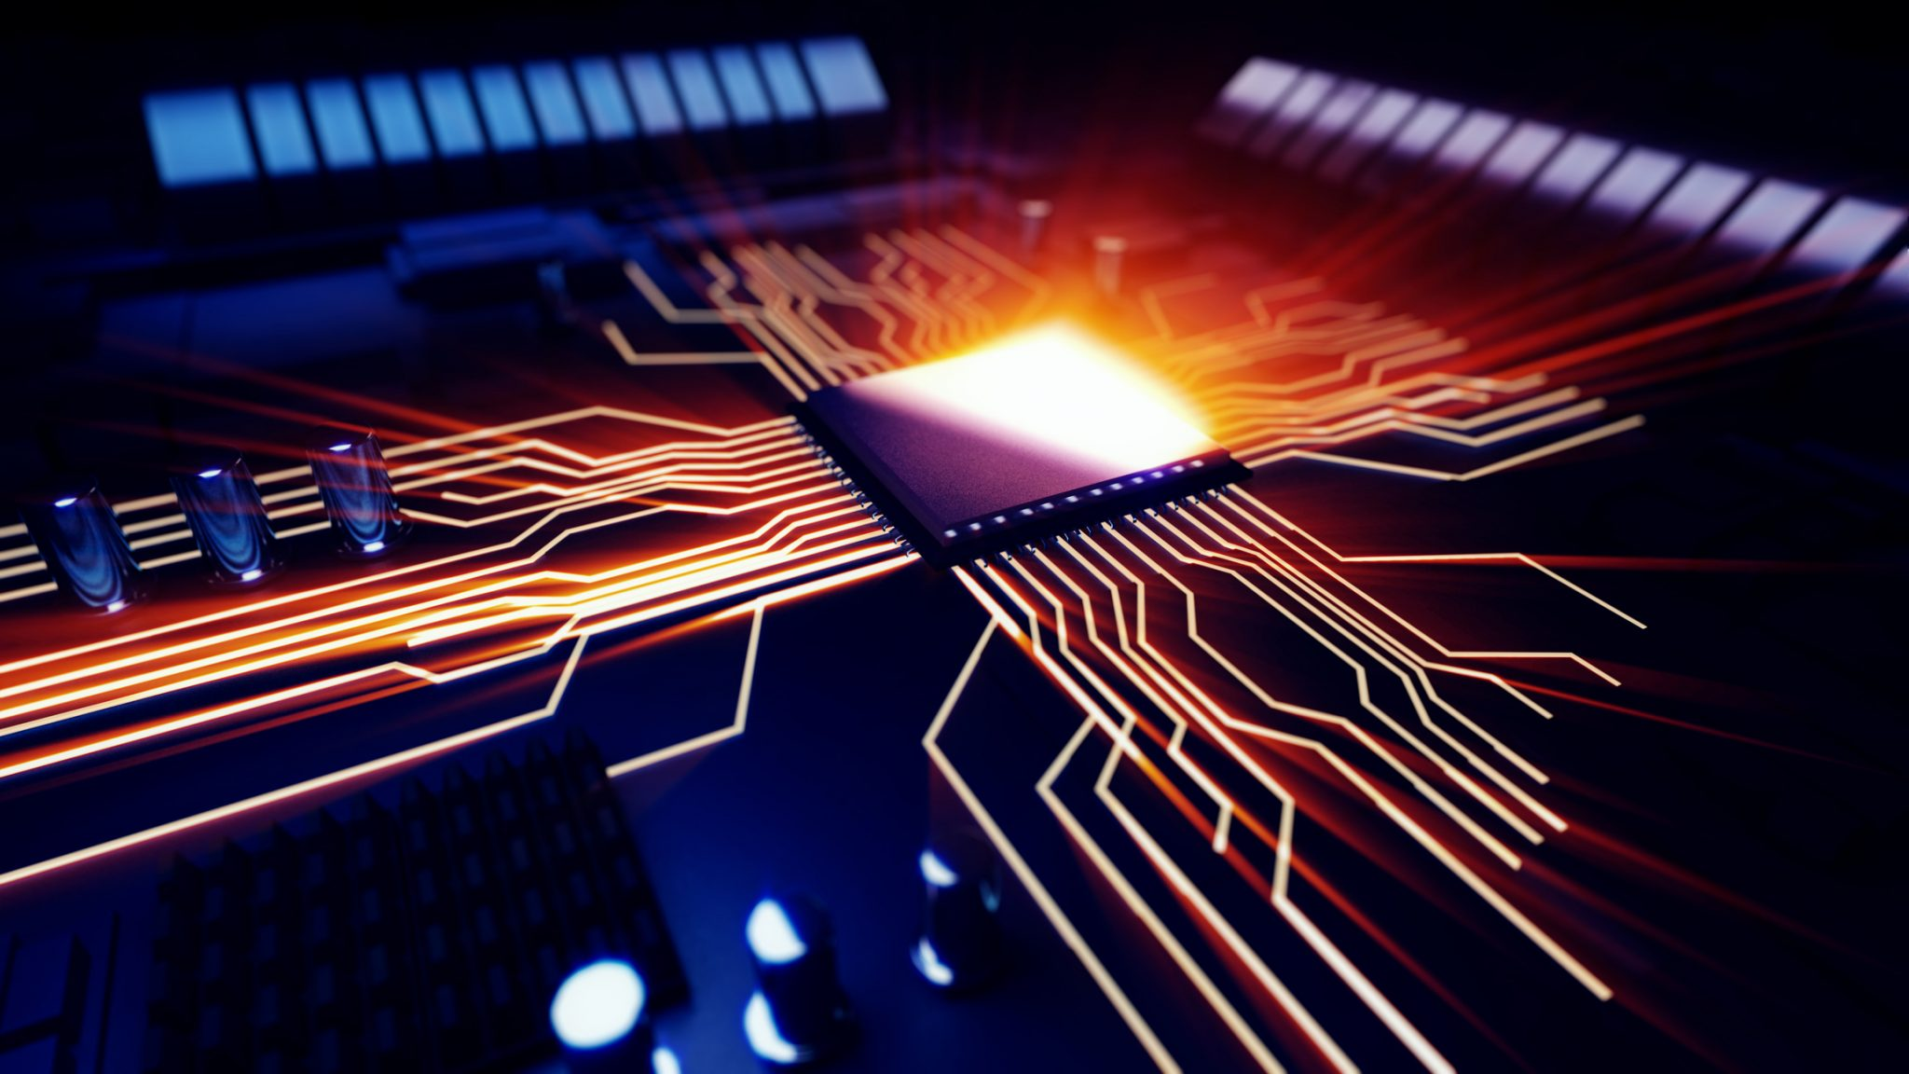
Transistors
Bipolar/FET transistors
Application

Slide 26
3|
Transistors
Bipolar/FET transistors
Transistors
BJTs
JFETs
MOSFETs
IGBTs
Thyristors

Slide 27
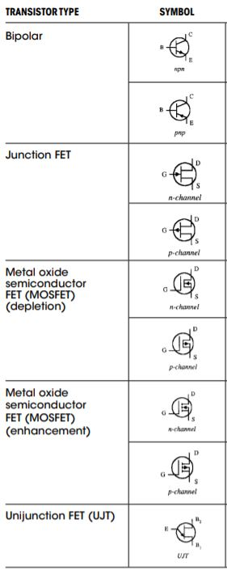
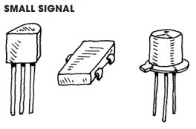
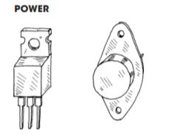
3|
Transistors
Transistors
Definition :
Transistors are components made from 3 semi-conductive links. (NPN or PNP). They act as electronic switch and can be activate by current, voltage or both depending of the transistor.
The 2 main types are bipolar junction transistor (BJT) and field-effect transistors (FET). 2 differences : First, BJT need current to be activate when FET need only voltage.
Secondly, BJT draw some current from the circuit, which mean it alter it. In contrary, FET draw nothing from the circuit, it doesn’t influence it.

Slide 28
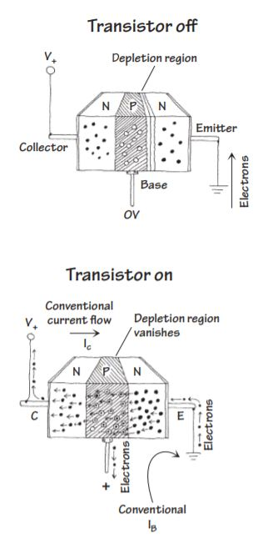
3|
Transistors
BJT
Definition :
Bipolar junction transistors (BJT) are three terminal devices that act as electrically controlled switches or as amplifier controls. These devices come in either npn or pnp configurations. A npn bipolar transistor uses a small input current and positive voltage at its base (relative to its emitter) to control a much larger collector to emitter current. Conversely, a pnp transistor uses a small output base current and negative base voltage (relative its emitter) to control a larger emitter to collector current

Slide 29
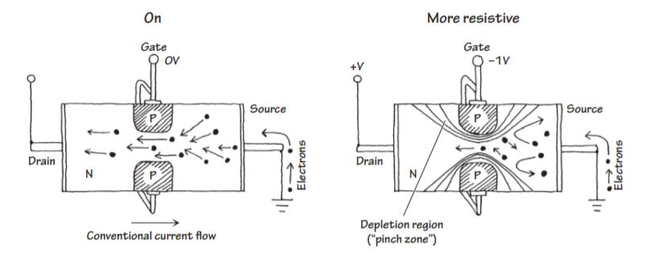
3|
Transistors
JFET
Definition :
Junction field-effect transistors (JFETs) are three-lead semiconductive devices. Unlike bipolar transistors, JFETs are exclusively voltage-controlled, they do not require a biasing current. Another unique trait of a JFET is that it is normally on when there is no voltage difference between its gate and source leads. However, if a voltage difference forms between these leads, the JFET becomes more resistive to current flow. For this reason, JFETs are referred to as depletion devices, unlike bipolar transistors, which are enhancement devices (bipolar transistors become less resistive when a current/voltage is applied to their base leads).

Slide 30
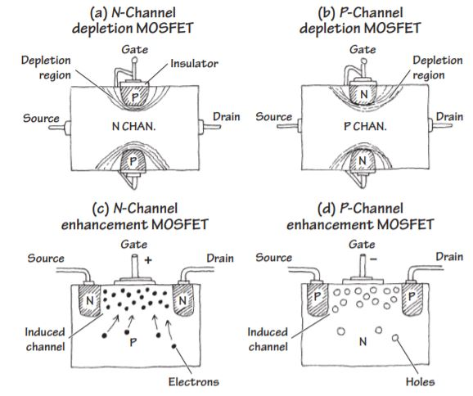
3|
Transistors
MOSFET
Definition :
Metal oxide semiconductor field-effect transistors (MOSFETs) are incredibly popular transistors. They work in a similar way than JFET. Like them they do not draw ant current from the circuit and are voltage driven. The two major kinds of MOSFETs are enhancement-type MOSFETs and depletion-type MOSFETs
Depletion-type MOSFETs work in a similar way than JFET, they are naturally conductive and became more resistive in function of the voltage applied to the gate.
Enhancement-type MOSFETs is normally off. However, if a voltage is applied to its gate lead, the drain-source channel becomes less resistive.

Slide 31
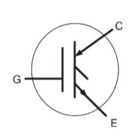
3|
Transistors
IGBT
Definition :
IGBTs are a hybrid of a MOSFET and a bipolar transistor. This has the Gate terminal of a MOSFET and the Collector and Emitter terminals of a bipolar transistor. The transistor is commonly used as a switch often at very high currents and voltages. The switch is voltage controlled like a MOSFET but has high current capabilities of a bipolar transistor.
IGBTs have found a niche in very high-power applications such as electric vehicles. The very forgiving pulse capabilities have found application amongst hobbyists in solid-state Tesla coils.

Slide 32
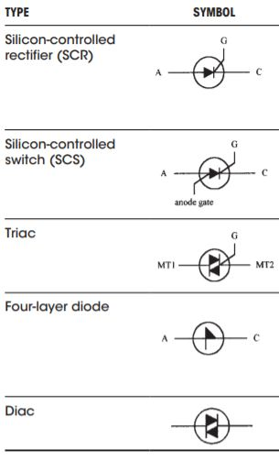
3|
Transistors
Thyristors
Definition :
Thyristors are two to four-lead semiconductors devices who acts as switch. Their specialty is that some of them are designed to switch on when the voltage across its leads reaches a specific level, known as the breakdown voltage. Thyristors are less tricky to use than other transistors concerning their switching states. They can be only on or off, when transistors had a resistance variation.

Slide 33
3|
Transistors
Application
Switch
Amplifier
Vibrator
Drivers

Slide 34
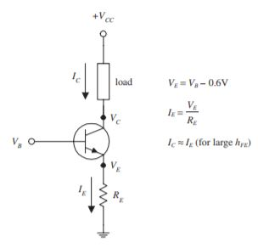
3|
Transistors
Switch
Definition :
The switch use of a transistor is one of the most common use of this component. Even if the transistors doesn’t act as a binary switch (not 2 states but a resistance variation), the transistor switch is the base of logic gates.

Slide 35
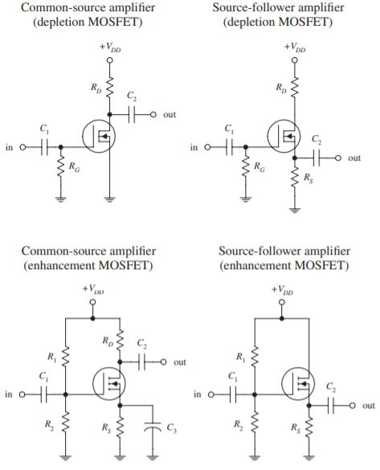
3|
Transistors
Amplifier
Definition :
An amplifier circuit is used to create a significant electric flow from a little one. Amplification is used to increase the power of a signal.

Slide 36
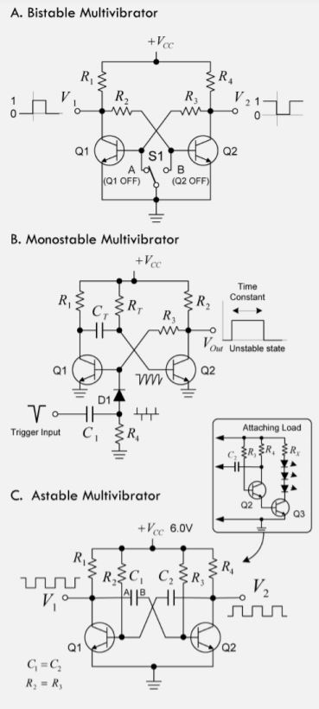
3|
Transistors
Vibrator
Definition :
A vibrator circuit is able to create periodical and stable signal. It is often used to rhythm the operations in a circuit.

Slide 37
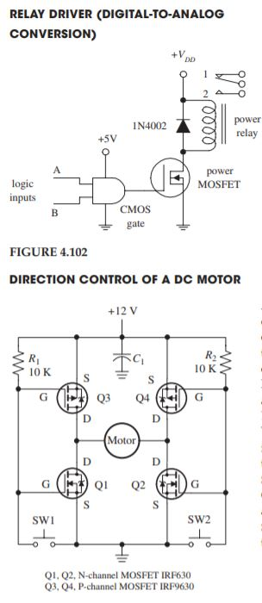
3|
Transistors
Driver
Definition :
A driver is a circuit who can perform signal modification to activate/disactivate/drive an electronic element (motor, inductances). The most common driver is the H-bridge. It is used to invert the rotation of a continuous motor by inverting his voltage.

