Slide 1

AVL Trees
Michael Hahsler
With figures from Weiss: Data Structures and Algorithms

Slide 2
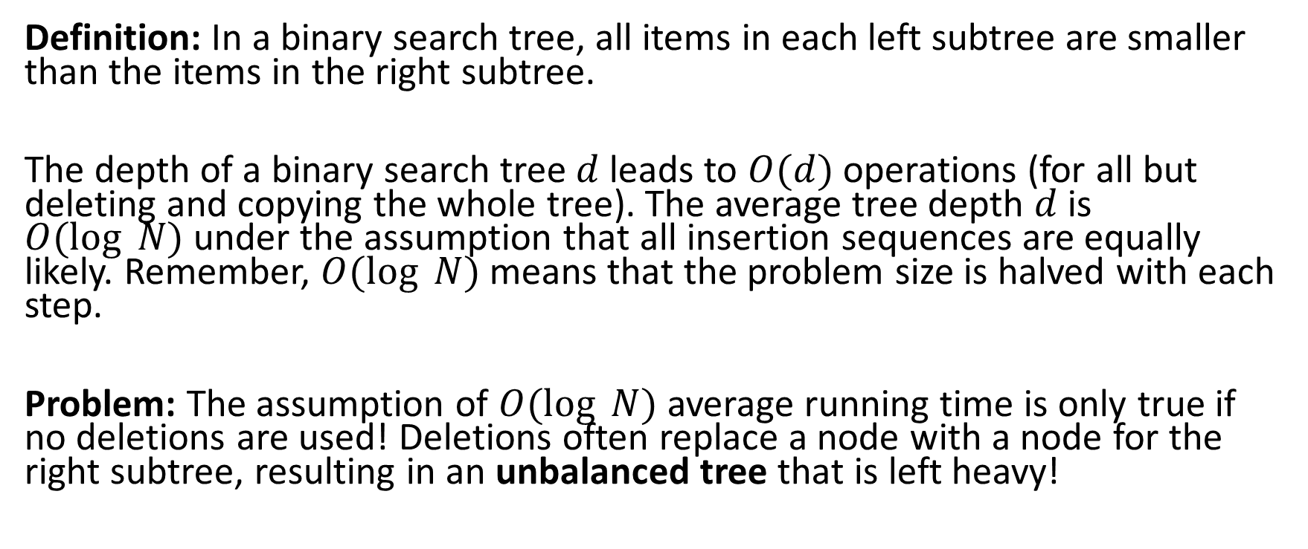
Binary Search Trees
Definition: In a binary search tree, all items in each left subtree are smaller than the items in the right subtree.
The depth of a binary search tree $d$ leads to $O(d)$ operations (for all but deleting and copying the whole tree). The average tree depth $d$ is $O(log⁡ N)$under the assumption that all insertion sequences are equally likely. Remember, $O(log⁡ N)$means that the problem size is halved with each step.
Problem: The assumption of $O(log⁡ N)$average running time is only true if no deletions are used! Deletions often replace a node with a node for the right subtree, resulting in an unbalanced tree that is left heavy!

Slide 3
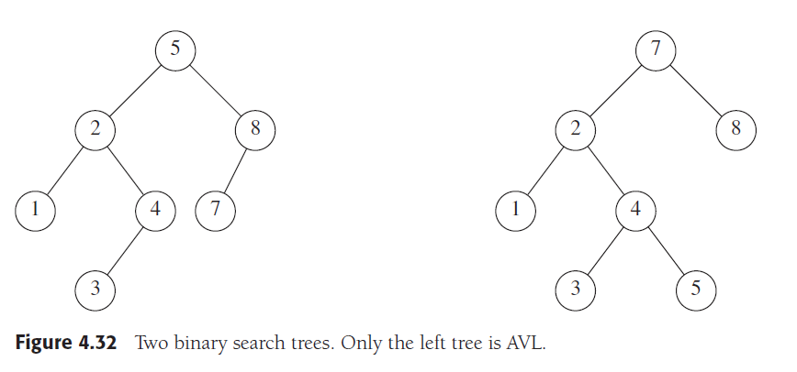
AVL Trees
An AVL AVL (Adelson-Velskii and Landis) tree is a binary search tree with the following balance condition:
For every node in the tree, the height of the left and the right subtree can differ by at most 1.
Balance condition is violated!
height = 2
height = 0

Slide 4
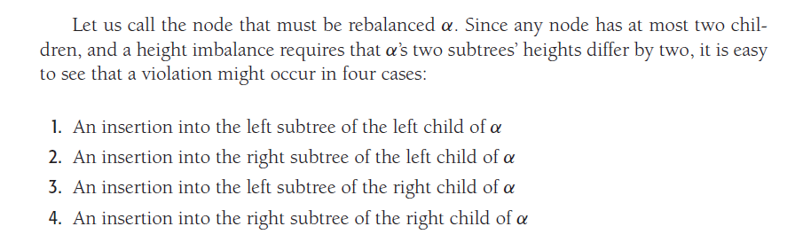

Rebalancing
Only necessary locally where the tree gets changed by an insertion (or deletion). If we store and update height information in the nodes, then detection is easy!
Cases:
$$α$$
Child
L
R
L
R
L
R
Subtree
Case
1
2
3
4
Inside insertion
Outside insertion

Slide 5
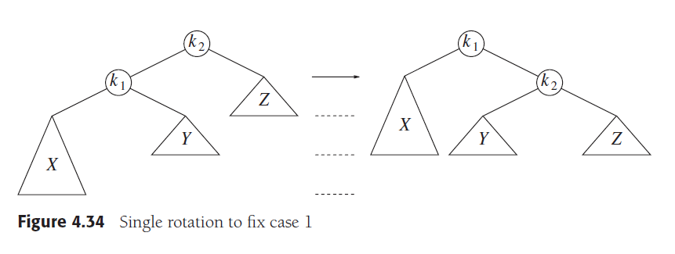
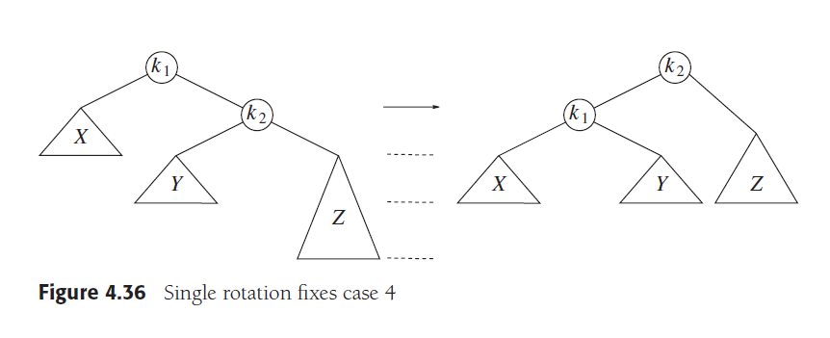

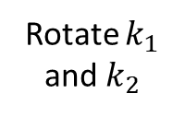
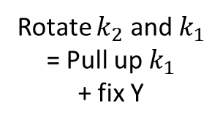
Single Rotation
Balance condition is violated!
Rotate $k_{2}$ and $k_{1}$
= Pull up $k_{1}$ + fix Y
height = 3
height = 1
height = 2
height = 2
Insertion in X
Note: Y is smaller than $k_{2}$
: lifts up X by one level.
Balance condition is violated!
These cases a perfectly symmetric!
Rotate $k_{1}$ and $k_{2}$
Insertion in Z
: lifts up Z by one level.

Slide 6
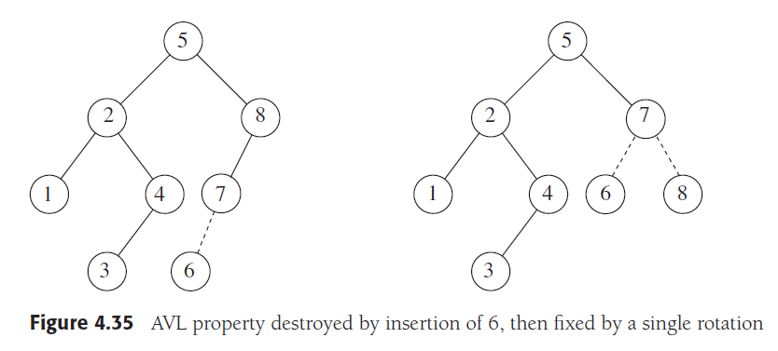
Example:
Balance condition is violated!
Rotate 8 and 7
Note: There is no Y to fix since 7 has only a single child.

Slide 7
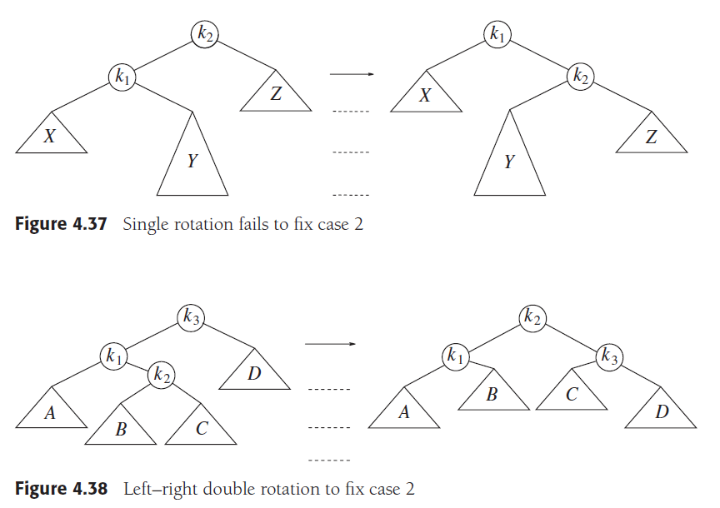

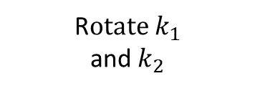

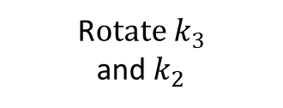




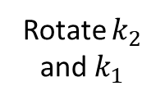

Single RotationFails
Balance condition is violated!
Balance condition is still violated!
Rotate $k_{2}$ and $k_{1}$
height = 1
height = 1
height = 3
height = 3
Insertion in Y makes it too deep
: does not lift up Y!
Balance condition is violated!
R$otate k_{1}$ and $k_{2}$
R$otate k_{3}$ and $k_{2}$
$${ k}_{3}$$
$${ k}_{2}$$
$$D$$
$${ k}_{1}$$
$$C$$
$$A$$
$$B$$
Left-right double rotation: lifts up B by one level.

Slide 8
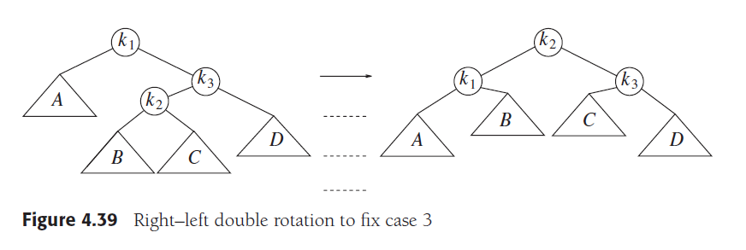
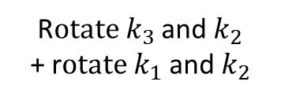
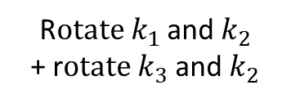
Double Rotation
R$otate k_{1}$ and $k_{2}$ + r$otate k_{3}$ and $k_{2}$
R$otate k_{3}$ and $k_{2}$ + r$otate k_{1}$ and $k_{2}$

Slide 9
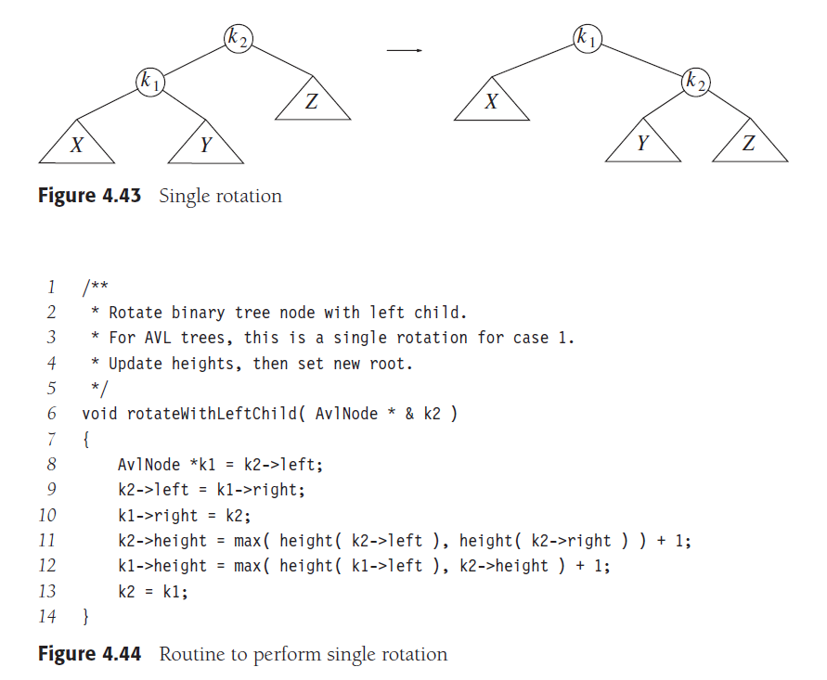
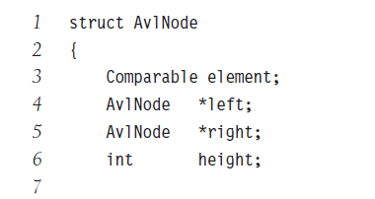
}
rotateWithRightChild() is similar with right and left switched.

Slide 10
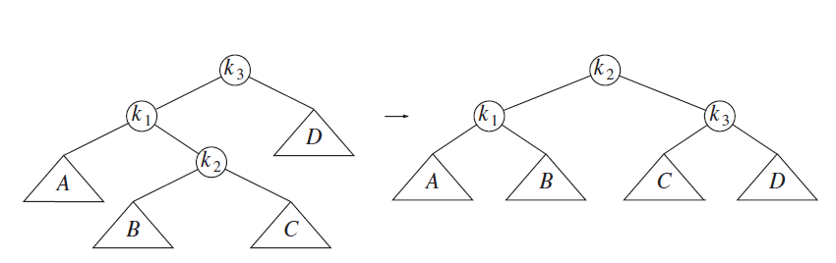
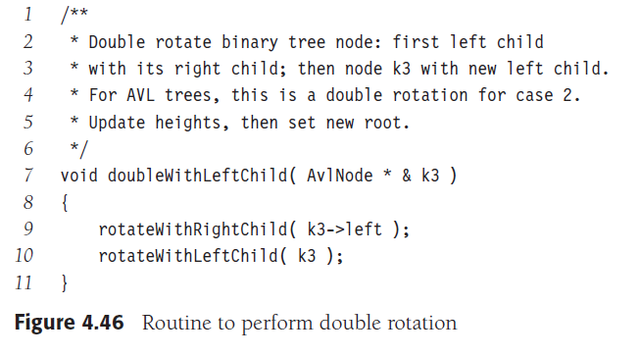
doubleWithRightChild() is similar with right and left switched.

