Slide 1
Generating thermal states on NISQ devices: a scoping study
Intern:
Carlo Zollo
Tutor:
Prof. Angelo Bassi

Slide 2
Agenda
Motivations
NISQ devices: state of art
Gibbs states generation algorithms
VarQITE algorithm
LMG Model
Results
Documentation

Slide 3
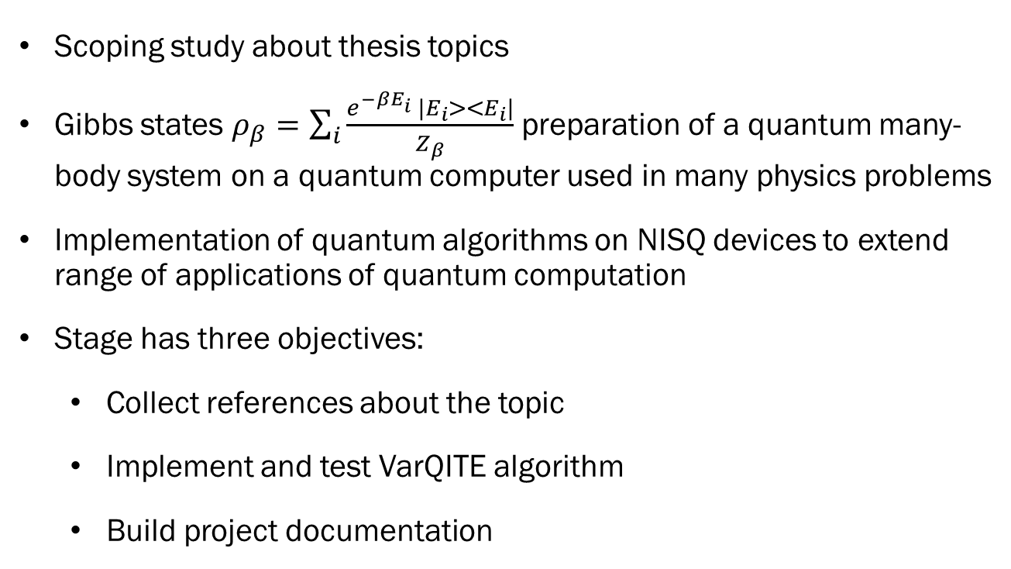
Motivations
Scoping study about thesis topics
Gibbs states $ρ_{β}=\sum_{i}{\frac{e^{−βE_{i}} |E_{i}><E_{i}|}{Z_{β}}}$ preparation of a quantum many-body system on a quantum computer used in many physics problems
Implementation of quantum algorithms on NISQ devices to extend range of applications of quantum computation
Stage has three objectives:
Collect references about the topic
Implement and test VarQITE algorithm
Build project documentation

Slide 4
NISQ: state of art
Current state of quantum computation: Noisy Intermediate-Scale Quantum era
Quantum processors containing up to 1000 qubits
Sensitive to their environment
Not capable of continous quantum error correction
Quantum State Preparation can be QMA-hard problem
Hybrid quantum-classical algorithms are preferred

Slide 5
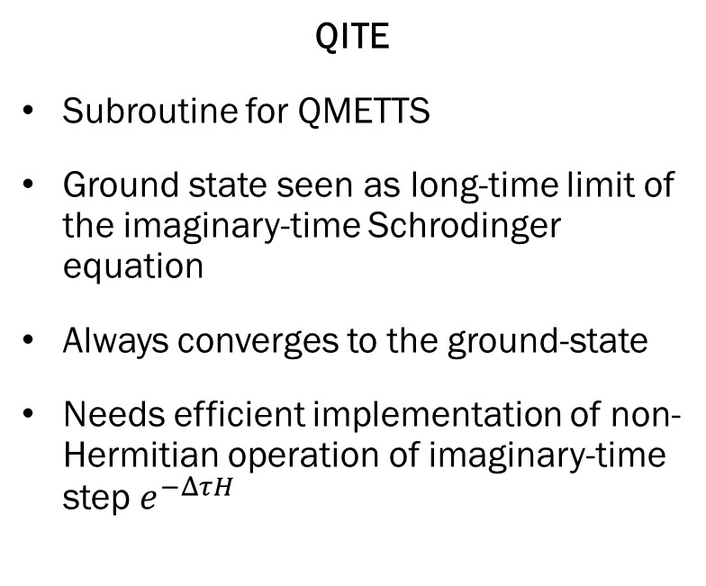
Gibbs states generation algorithms
QITE
Subroutine for QMETTS
Ground state seen as long-time limit of the imaginary-time Schrodinger equation
Always converges to the ground-state
Needs efficient implementation of non-Hermitian operation of imaginary-time step $e^{−ΔτH}$
VQAs
Preparation and measure of a parameteric state
Parameters classically optimized by minimizing a cost function
Robust to coherent errors
Limited in accuracy by a fixed Ansatz (circuit object that addresses parametrization)
Involve high dimensional noisy classical optimizations

Slide 6
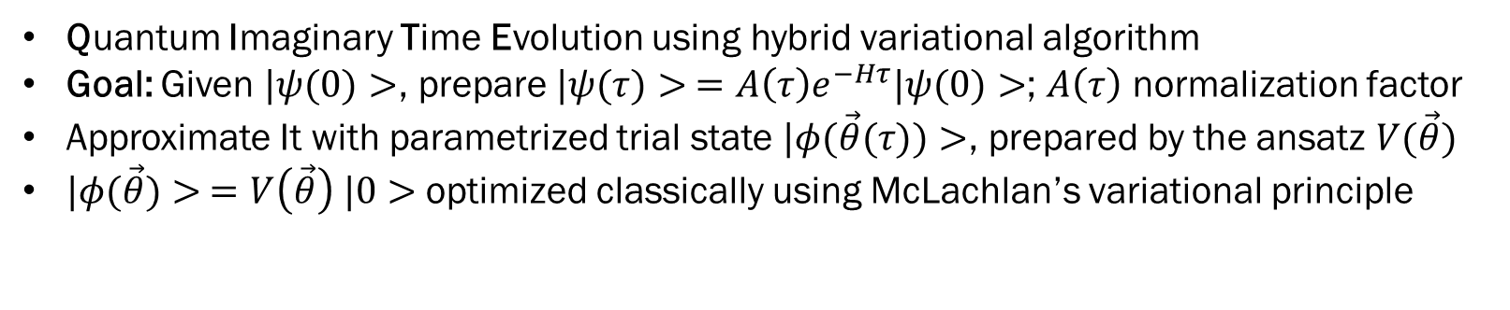
VarQITE
Quantum Imaginary Time Evolution using hybrid variational algorithm
Goal: Given $|ψ(0)>$, prepare $|ψ(τ)> =A\left(τ\right)e^{−Hτ}|ψ(0)>$; $A\left(τ\right)$ normalization factor
Approximate It with parametrized trial state $|φ(\vec{θ}(τ))>$, prepared by the ansatz $V(\vec{θ})$
$|φ(\vec{θ})> =V\left(\vec{θ}\right) |0>$ optimized classically using McLachlan’s variational principle
PROS
Shallow depth of quantum circuit
Robust to noise
CONS
Trial state space limited by ansatz
Simulation can be trapped in local minima

Slide 7
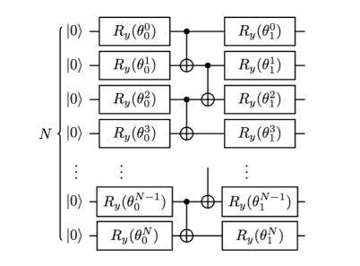
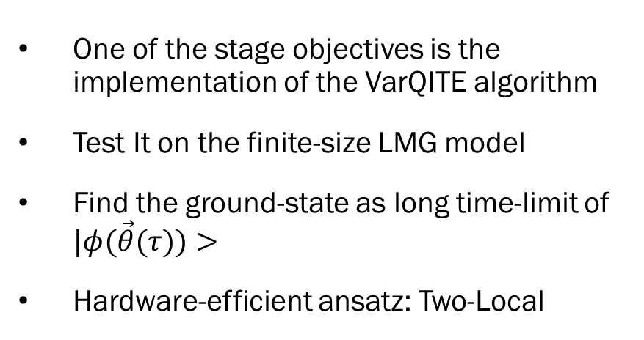
VarQITE Implementation
One of the stage objectives is the implementation of the VarQITE algorithm
Test It on the finite-size LMG model
Find the ground-state as long time-limit of $|φ(\vec{θ}(τ))>$
Hardware-efficient ansatz: Two-Local

Slide 8
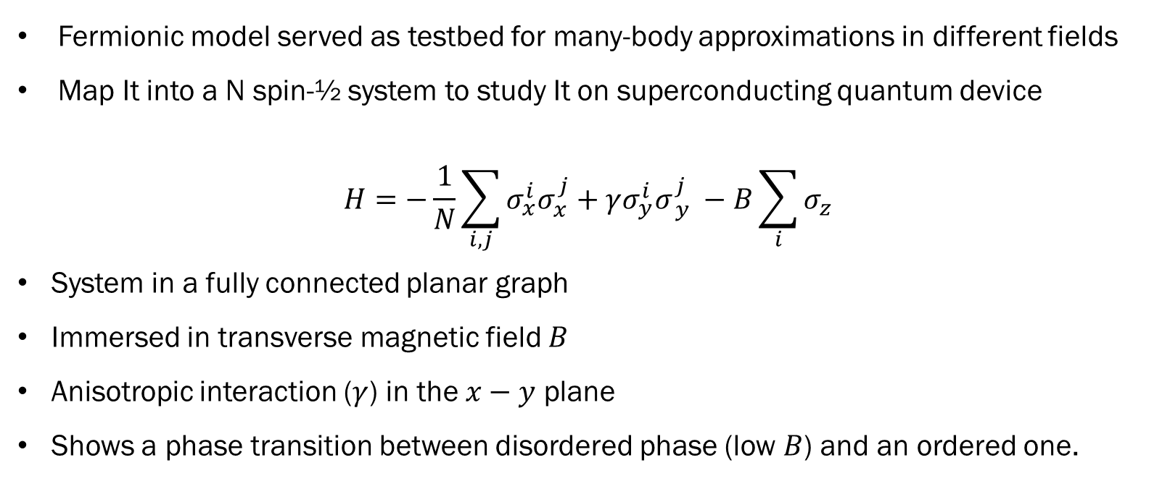
Lipkin-Meshkov-Glick Model
Fermionic model served as testbed for many-body approximations in different fields
Map It into a N spin-½ system to study It on superconducting quantum device
$$H=−\frac{1}{N}\sum_{i,j}{σ_{x}^{i}σ_{x}^{j}}+γσ_{y}^{i}σ_{ y}^{j} −B\sum_{i}{σ_{z}}$$
System in a fully connected planar graph
Immersed in transverse magnetic field $B$
Anisotropic interaction ($γ$) in the $x−y$ plane
Shows a phase transition between disordered phase (low $B$) and an ordered one.

Slide 9
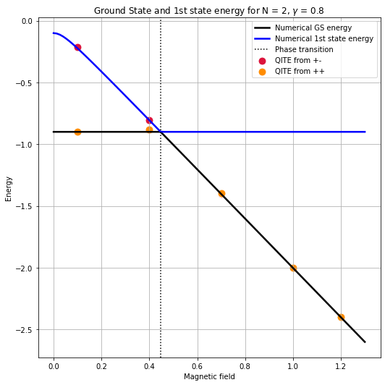
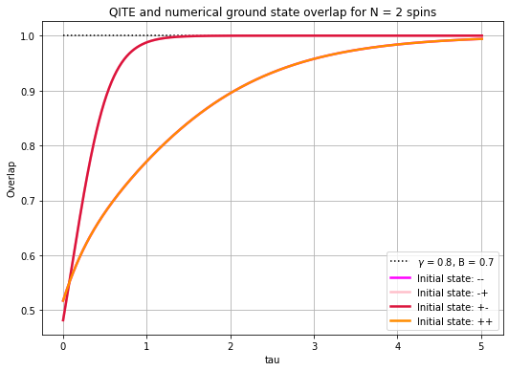
Results
Ground state can be found only after evolution of an initial state with non-zero overlap
In fact, at low $B$ the $|+−>$ initial state doesn’t converge to the ground state
Next step is to implement the algorithm to sample thermal averages, which is based on QITE

Slide 10
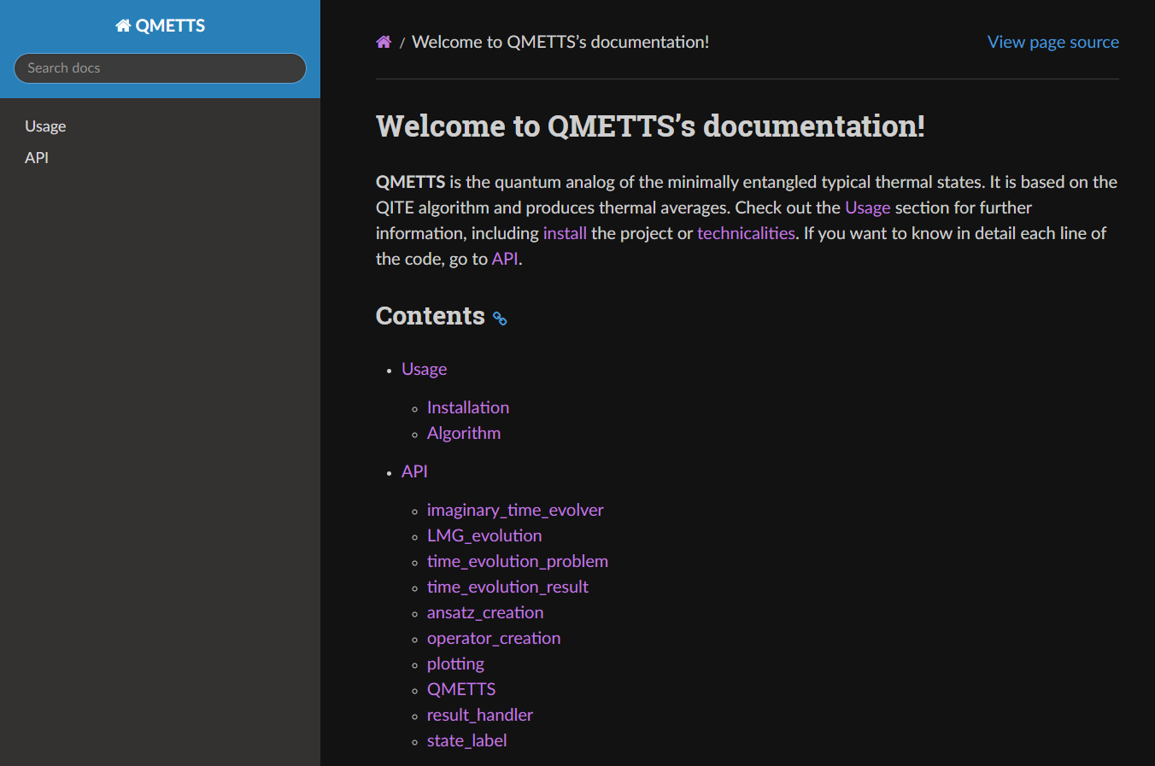
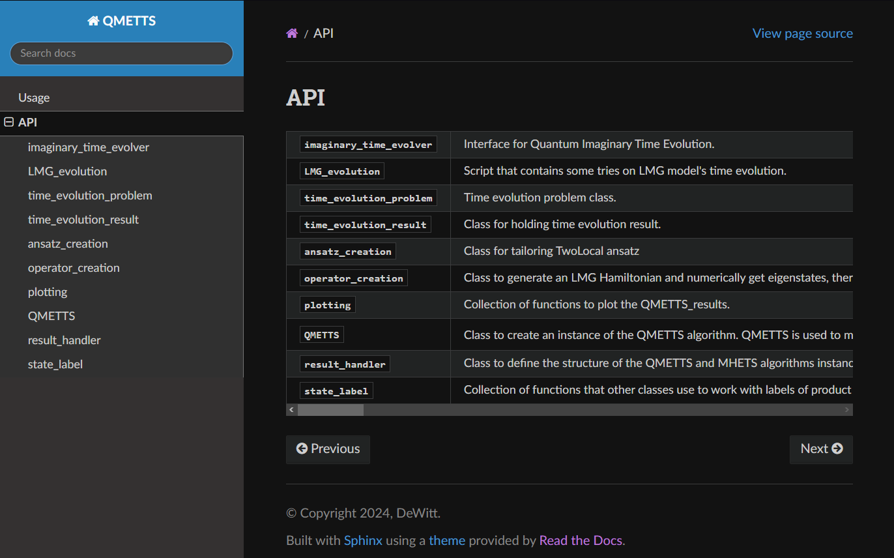
Documentation
Project under active development
Documentation is easily built and managed using the software Sphinx
Documentation and code available at my GitHub

Slide 11
Thank you for your attention
Carlo Zollo
CARLO.ZOLLO@studenti.units.it
https://github.com/DeWitt46

