Slide 1
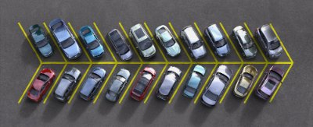
Introducing Park Me !
TEAM ROCKETS
-jessie- -kenneth- -chelle- -michaelangelo-
Rethinking ways for the digital age
Notes:
This presentation demonstrates the new capabilities of PowerPoint and it is best viewed in Slide Show. These slides are designed to give you great ideas for the presentations you’ll create in PowerPoint 2011!
For more sample templates, click the File menu, and then click New From Template. Under Templates, click Presentations.

Slide 2
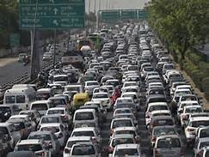


How we come up with this idea?
1
2
3
Traffic Jam Reduction
Maximize returns from your assets
Productivity for everyone
Rethinking ways for the digital age

Slide 3

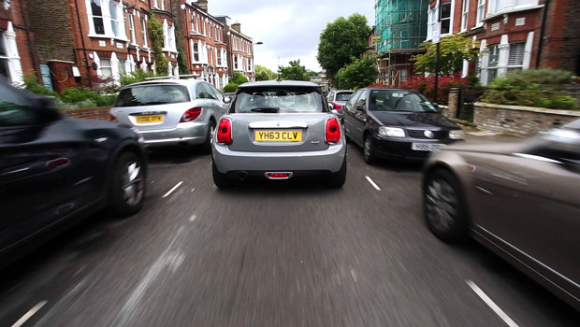
About Us
WE are rethinking parking for the future. By unlocking over thousands of underused spaces, we provide cheaper, more convenient parking to over 1 million drivers in the Philippines.
Our apps allows driver to find, reserve and pay for parking seamlessly whenever and wherever they need…

Slide 4



How this app works?
Rethinking ways for the digital age

