Slide 1

License plates detection
introduction
Deac Melinda-Anca

Slide 2
MEANING OF THE LICENSE PLATES
License plates are the unique identifiers of cars. In Romania, they have the form: CO 00 SMT. CO comes from county, 00 is the number of the license plate which has the code SMT in CO.
For example, if I go to the license plate registration unit and say that I am from county HD and that I want to register my car with the code EMA, and if there are no other cars with the code EMA in the HD county, I will receive the following license plate: HD 01 EMA. But, if one of my friends comes right after me and says that they want the same code, they will receive HD 02 EMA. Now, there are two cars with the code EMA, but they are still uniquely identifiable on the roads.

Slide 3
The need for such a system
The need for license plate detection stands to support the need of license plate recognition. It is well known that with the increase of availability of cars, the number of legislation violations on the streets increased as well.
It is our job, as engineers, to design a solution to restrict and reduce the number of injured people or even deaths caused by legislation violations.
In this matter, detecting and recognizing the license plate of a vehicle is mandatory as the base pillar for any other further implementation.

Slide 4
Problem description
Color images of vehicles (at different distances) with visible license plates are given (the license plates can be a little bit rotated to the horizontal direction).
The problem covered in this introductory presentation refers to the implementation of an algorithm which identifies and marks the areas where the license plates are found.

Slide 5
Difficulties in license plate detection
The main issues which come with detection of license plates are:
The number plate generally occupies a small portion of the whole image
The images could be blurred, uneven, low illuminated
The vehicle could be in motion, the characters could be distorted, the plate could be dirty
These issues will be handled in the next slides and in the upcoming presentations
For the sake of the laboratory, images will be chosen in such a way that, hopefully, the only distortion will be an uneven placement to the camera.

Slide 6

General steps in plate detection algorithms
Processing of the input image
License plate detection
License plate marking

Slide 7
Algorithms for license plate detection
Texture based Candidate Extraction (97.5% accuracy)
Uses binarization, a reference line
Edge Detection based Plate Extraction (99.45% accuracy)
Line grouping (extracts the line segments and groups them based on a set of geometrical conditions) and Edge Density () are used
Rank filter and Robert’s operator
Autocorrelation and a projection algorithm used to detect fake candidates
LG detects a rectangle at the plate boundary accurately (no rectangle => image is rejected)
ED finds plate regions at which the vertical edges appear the densest
This method is called the double chance method

Slide 8
Algorithms for license plate detection
Feature extraction based on L0-norm smoothing
Is performed in a number of steps:
L0 smoothing
Binarization
Edge detection
Feature filtering
Projection location

Slide 9
Possible steps to follow
Load the image
Convert to grayscale (most image processing algorithms work on grayscale images)
Apply image preprocessing (for example, image thresholding, morphological operations and edge detection)
Detect potential license plate regions (HOG – Histogram of Gradients / Cascade Classifier / Scale-Invariant Transform / Template Matching)
Refine license plate regions
Extract license plate characters (OCR – optical character recognition)
Mark the license plate

Slide 10
IMPLEMENTATION
For implementation, I kept the following steps:
Reading the color image
Transforming it from RGB to Grayscale
Resizing the image, so the algorithm will work on any input
Applying Canny Edge Detection Algorithm:
Applying Gaussian Filtering to remove noise
Gradient magnitude and orientation computation using Sobel kernels
Non-maxima suppression to get thinner edges
Adaptive thresholding and edge linking to remove fake edges and unify the strong ones with the corresponding weak ones

Slide 11
IMPLEMENTATION – CNT.
After applying Canny edge detection:
I make sure to ignore the margins which are otherwise, biasing the result
I find the contours using findContours function from opencv, which then are sorted by their area
Then, I pick the top 5 largest contours

Slide 12
Implementation – cnt.
After all of these, it’s time to draw the rectangle around the supposed license plate:
This procedure must be done on the original source image.
I obtain a bounding rectangle for each contour candidate and if the difference between them is too high, it means that the candidate is much likely not a rectangle, so we can cut it off
Then, I filter out only those candidates that have the shape of a square, or at most, a 1:6 ratio rectangle
Afterwards, I draw the remaining rectangles:
I fit the coordinates by multiplying the values from the resized image with the ratio between the original and the resized image
I generate a random color

Slide 13
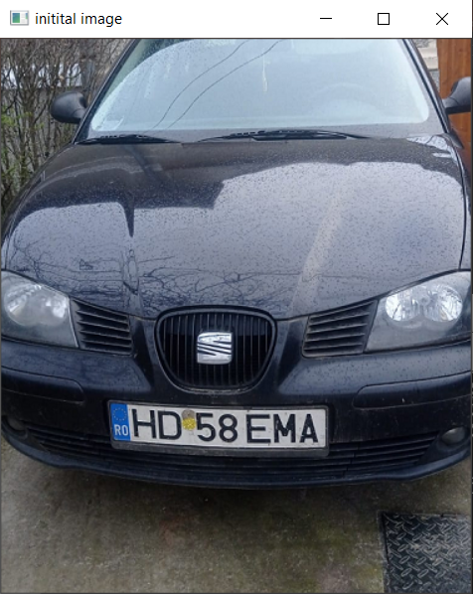
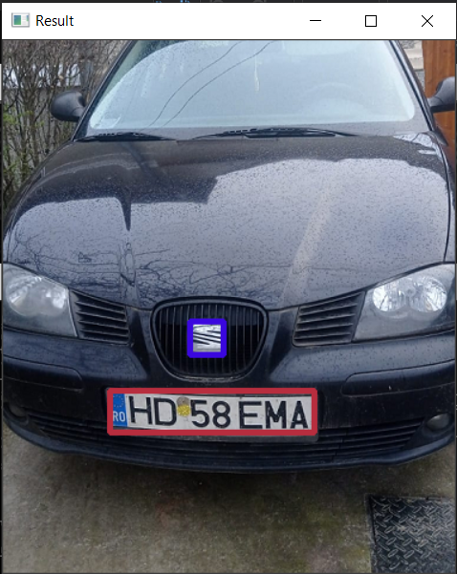
Results

Slide 14
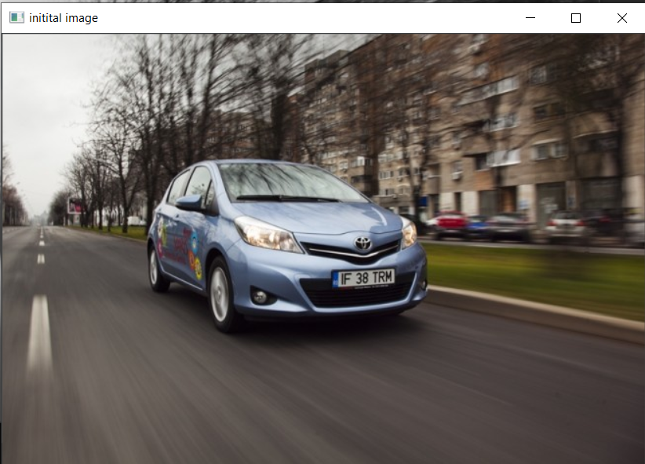

Results

Slide 15
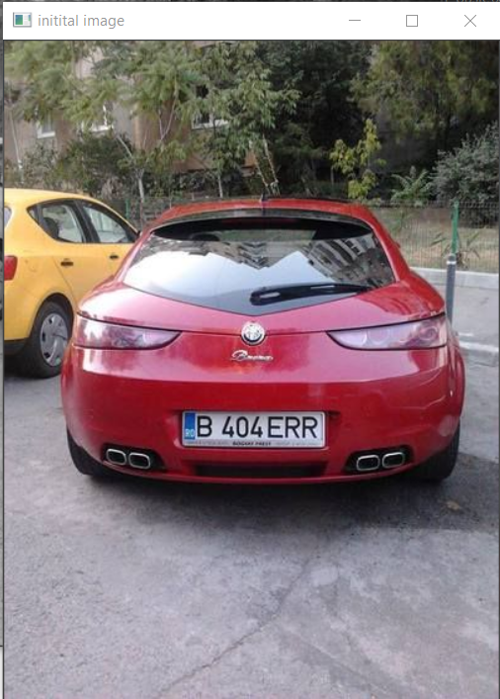
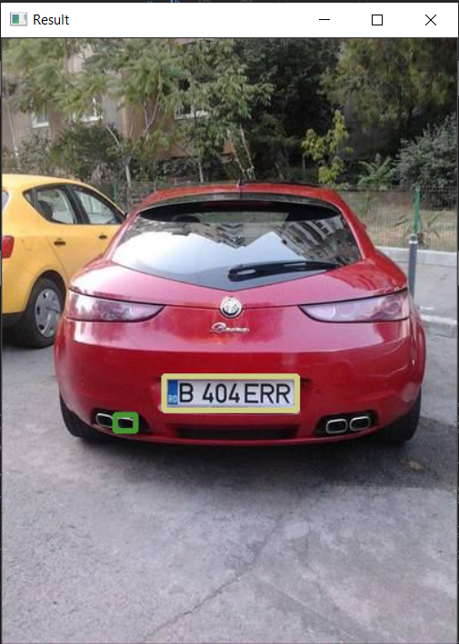
results

Slide 16
Bibliography
License Plate Recognition System‐Survey (scitation.org)
Feature extraction for license plate location based on L0-norm smoothing (degruyter.com)

Slide 17

Thank you!
MELINDADEAC000@GMAIL.COM

