Slide 1
ELearning
Team Members
Hasnaine Ahmed Dihan, 180042109
MD. Munimul Islam, 180042136
MD. Reyanus Salehin, 180042148

Slide 2
Problem Statement
We uttered that we’ll build a platform where an instructor can upload educational contents and a student can access these contents.

Slide 3
Proposed Features
Authorization and authentication for users (Instructor and Student)
Profile info for users
Course upload for Instructor
Upload option for course-contents in text, pdf, image, audio or video format
Monetize option of courses for an Instructor
Search option for courses with course names
Online payment

Slide 4
Implemented features
Implemented Authorization and authentication for both types of user
Both types of user can see their profile info
Instructor can upload course
Instructor can upload course-contents in text, image, audio and video format
Instructor can monetize his/her courses
Users can search courses with course names
Users can access in contents of paid courses only

Slide 5
Features to be implemented in future
Rating and review system for individual course
Online payment gateway for payment system

Slide 6
Technology
Platform : Web Application
Languages :
Front end : React JS
Back end : Node JS
Database : MongoDB
Framework: Express
IDE: Visual Studio, Sublime Text
Source Control : Github

Slide 7
Data Flow Diagram
External Entities:
Visitor
Student
Instructor
Data Store:
Users
Courses
Categories
Uploads

Slide 8
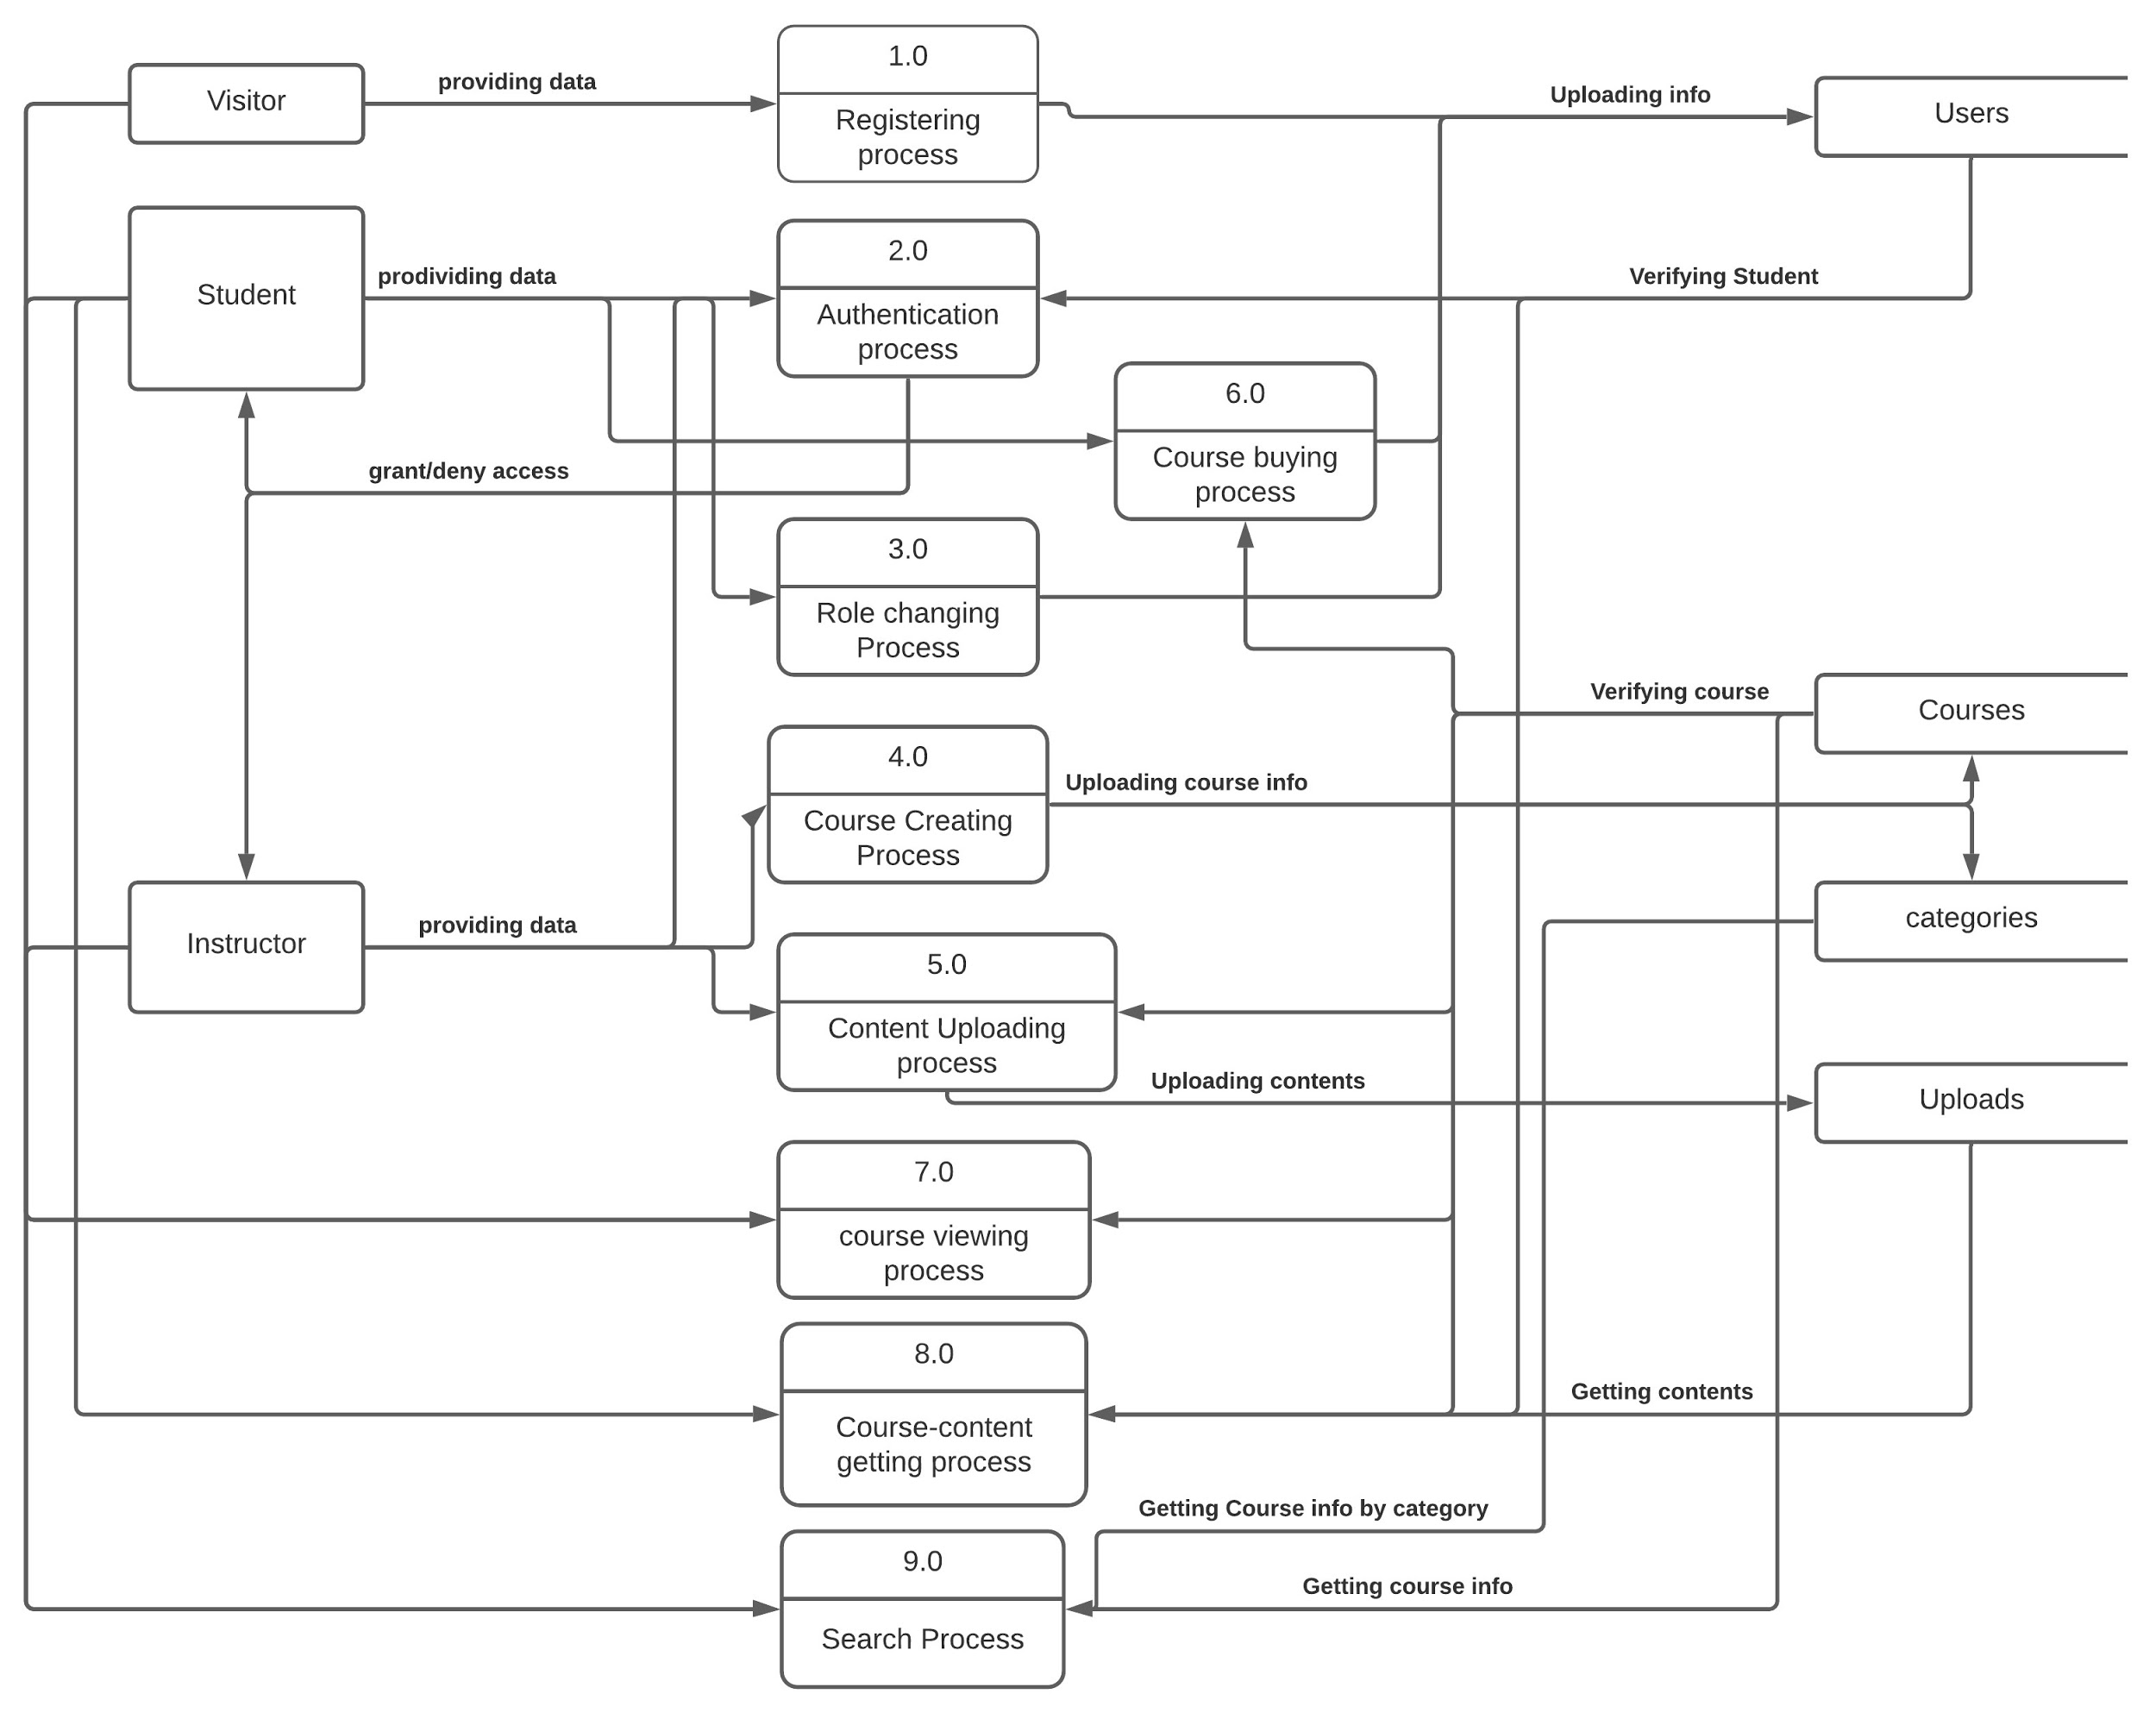

Slide 9
Timeline
Login & registration system
Homepage
& course page
design
Implement Search Option
5/11/2020
14/11/2020
25/11/2020
Payment System
Course access
system
Course upload
system
15/1/2020
30/12/2020
15/12/2020

Slide 10
Demo

