Slide 1

Android
First Meeting: Setup

Slide 2
ADT Bundle
Android Development Tools
http://developer.android.com/sdk/index.html
Download and Extract

Slide 3
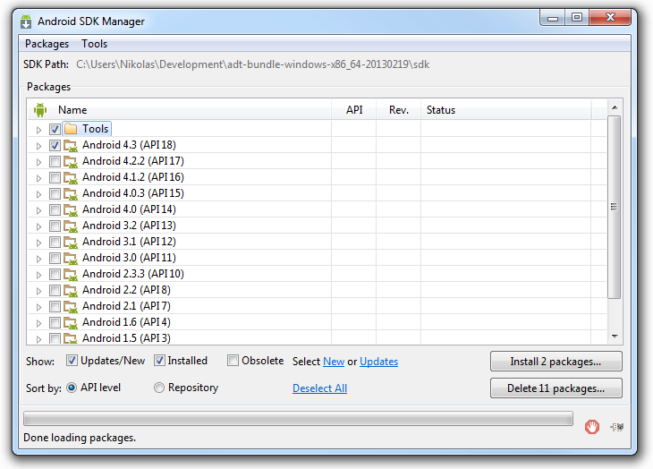
Configure SDK Manager
Window -> Android SDK Manager
Choose Platform (Android 4.3 and API 18)
Select Tools folder
Click Install and if necessary hit Restart once that is done

Slide 4
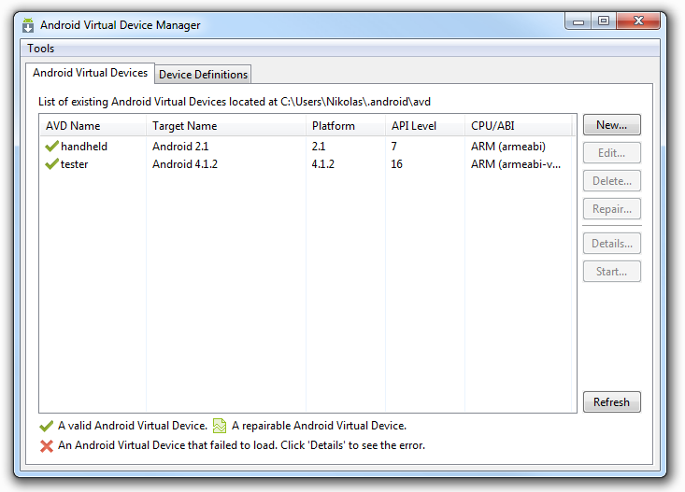
Setup an AVD
Open up the Android Virtual Device Manager (AVD)
Click New
Give it a Name, Device (Nexus 4), Target Android 4.3
Change RAM to 512
Click Ok

Slide 5
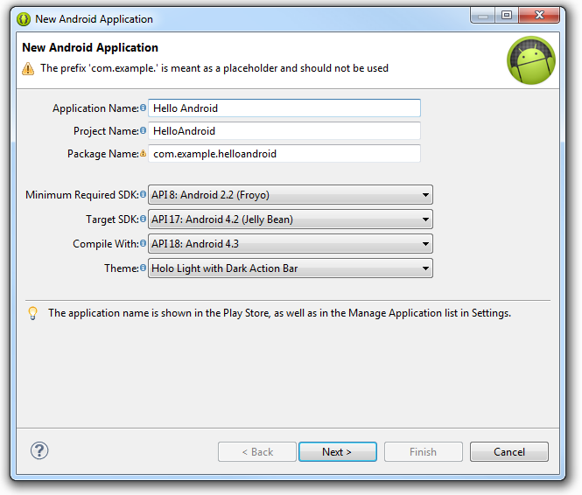
Create New Android Project
New -> Android Application Project
Application Name: Hello Android
Project Name: HelloAndroid
Package Name: com.example.helloandroid

Slide 6
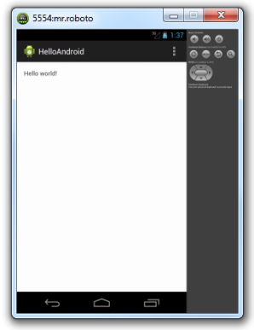
Running The Application
Run your Blank app
Choose AVD or choose your phone
Simple as that!

