Slide 1
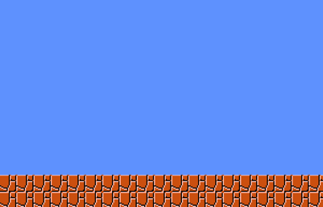
Evolving Intelligence Via Mario Arena Combat aka Mario: Beyond Thunderdome
Nicholas Barrett, Abraham Dominguez, Pepper Marts

Slide 2
Artificial Neural Network
ANN is a hand-coded implementation built in Python
We did not use NEAT
We did not use back-propagation
Each ANN has 14 inputs
Wall locations, Nearest Marios, Absolute Positions
Each ANN has 6 outputs
Right, Left, Jump, Don’t Jump, Move Down, Stand Still

Slide 3
Genetic Algorithm
Generations have 150 Marios each
Gen. 1 has randomly assigned node weights
Point mutations and crossover between generations
Tournament selection with 8 Marios
Each tournament has three arena runs

Slide 4
Experimental Design
What is the marginal rate of improvement?
i.e. is the improvement from gen. 1 to gen. 2 bigger than from gen. 15 to gen. 16?
Run simulation for 100 generations
Combat the top eight from each generation against top eight from last and first generations
Generate a comparative fitness

Slide 5
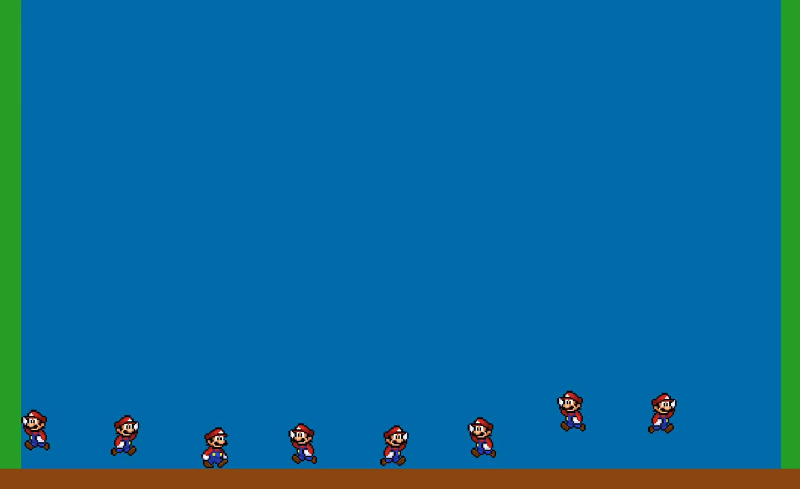

Slide 6
