Slide 1
Verizon’s DataLog App
Daniel A. Santiago Rivera – Computer Engineering Student
IAP – 18/04/2012

Slide 2
Introduction
Verizon Wireless is both large and complex with over 108.7M of subscribers.
Verizon Wireless Network requires great technological and man power.
Network diagnosis is possible from the end-users handheld devices.

Slide 3
Objectives
Find end-user data that can improve network diagnosis.
Learn and familiarize with Google’s Android Mobile OS in order to retrieve such data.
Provide and implement method to retrieve, store and organize such data.
Interpret data and reach conclusive points for network diagnosis.

Slide 4
Implementation
Data collected:
IMEI
Phone Number
Localization
Signal Strength
Signal Type
Phone Model
Android Version
Kernel Version
Available Memory
Available SD Storage
Amount of Drop Calls
Optional E-mail and Message

Slide 5
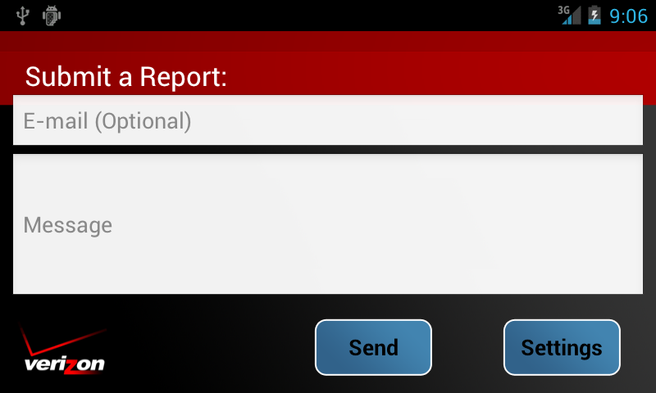
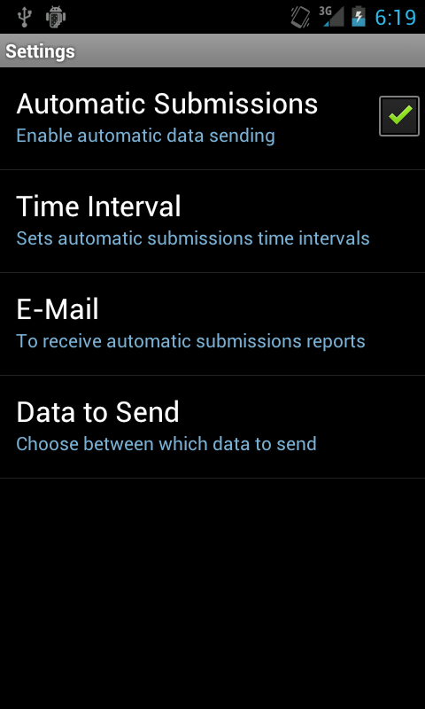
Implementation
Simple User Interface
Options Menu
Automatic Submissions
Time Intervals
Data to Send
Preferred E-mail

Slide 6
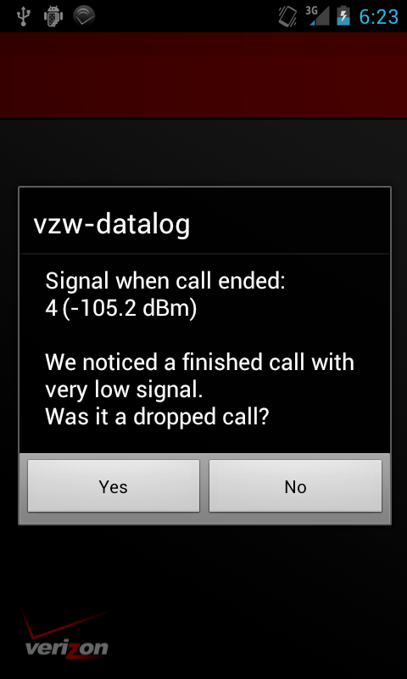
Implementation
Android Service
Automatic Submission
Signal Strength and Type Monitor
Drop Call Event Monitor

Slide 7
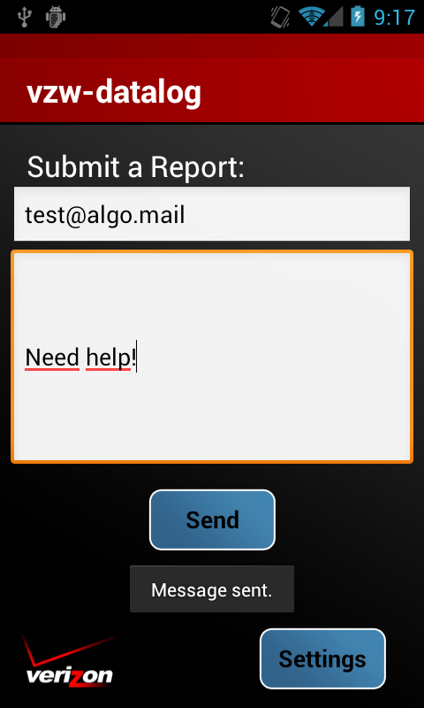
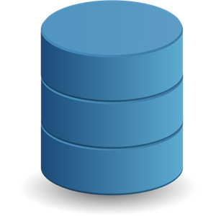
Implementation
Android ASyncTask
Data recollection.
Data sending.
HTTP Protocols and JSON strings.

Slide 8
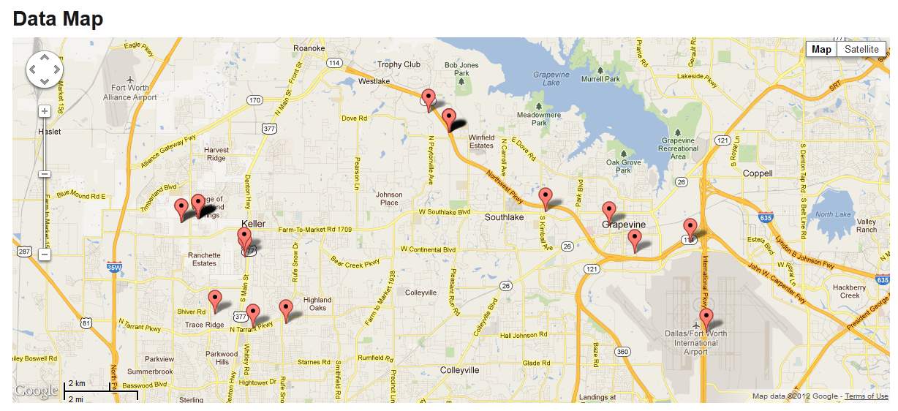
Implementation
Dedicated Server
LAMP (Linux Apache MySQL PHP)
SQL Database
PHP Geo-Decoder
App Update Service
PHP E-Mail Response
Downloadable Database in Excel Spreadsheet format.
Google’s Map API with data pins.

Slide 9
Results
Android is unaware of what a ‘Drop Call’ is. Android only knows that the Phone is either Ringing, Off-Hook or Idle.
Android’s signal measurement is based on signal type.
(i.e. LTE, 3G, Edge)
With the data retrieved not only network diagnosis is possible but also general network statistics.

Slide 10
Future Goals
Successful localized data can be used to pinpoint areas where the users report low signal or high amount of dropped calls.
Statistical analysis of the data can help the company the types of phones being used, their software and their operating points in terms of memory and SD storage available.
Smart implementation app enables data retrieval even in a non-service environment.

Slide 11
Future Goals
Data filters and search queries can be implemented for specific data history; this can help in the diagnosis of special cases.
Data submissions with user message can be analyzed with text pattern recognition algorithms that can help determine the high needs or problems of the users.

Slide 12
Questions?
?

