Slide 1
Hotel Database

Slide 2
Team members
Akhmetov Abylay
id (210103019)
Amir Mamytbekov
id (210103034)

Slide 3
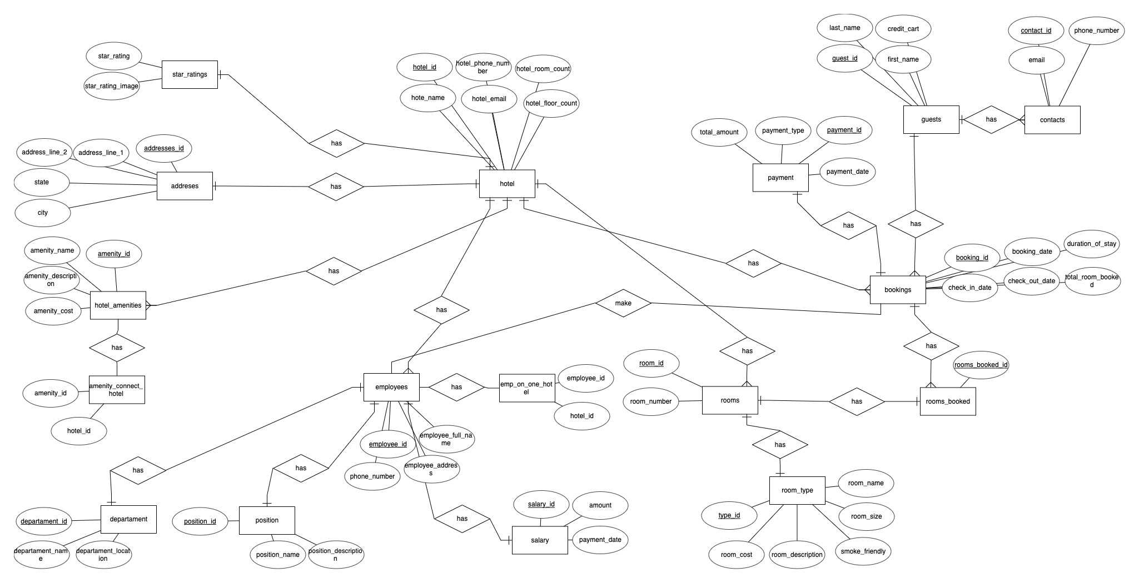
ER Diagram

Slide 4
Functional Dependencies
addresses_id -> addresses_line1 , addresses_line2 , state , zipcode , city
amenity_id -> amenity_name , amenity_description , amenity_cost
department_id -> department_name , department_location
position_id -> position_name , position_description
employee_id -> phone_number , employee_address_id , employee_full_name
salary_id -> amount , payment_date
room_id -> room_number
type_id -> room_cost , room_description , smoke_friendly , room_size , room_name
booking_id -> check_in_date , booking_date , duration_of_stay , check_out_date , total_room_booked , payment_id
payment_id -> payment_date , payment_type , total_amount
guest_id -> last_name , first_name , credit_cart
contact_id -> email , phone_number
hotel_id -> hotel_phone_number , hotel_room_count , hotel_name , hotel_email , hotel_floor_count

Slide 5
Normalization
Bring tables into the correct form
Conditions to avoid or minimize redundancy, update anomalies, insert and deletion anomalies

Slide 6
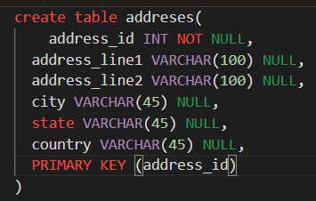
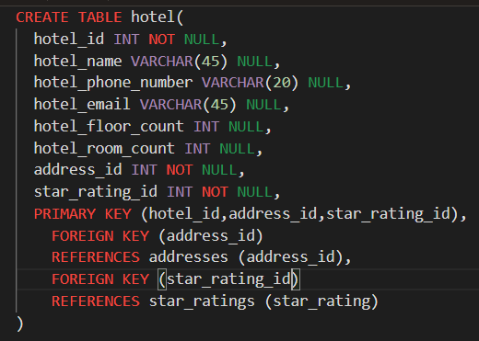
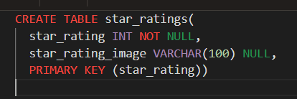
Creating Tables

Slide 7
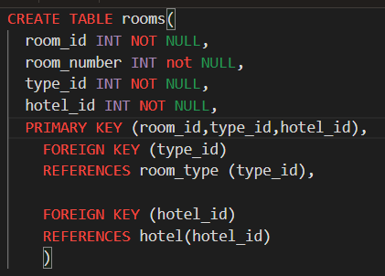
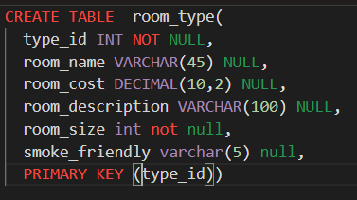
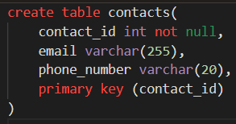
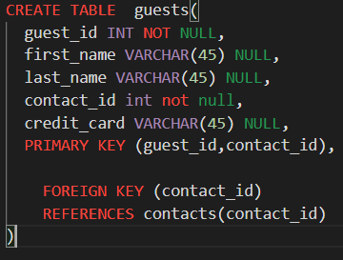
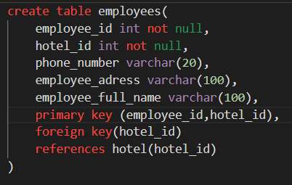
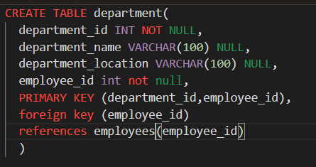

Slide 8
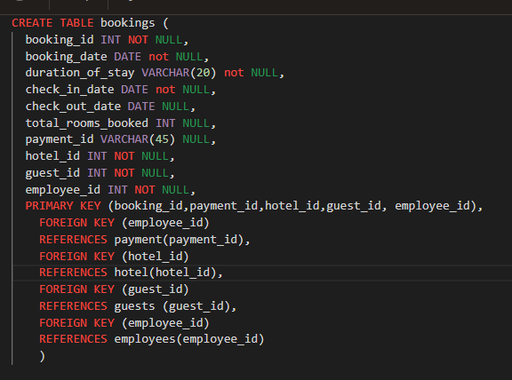
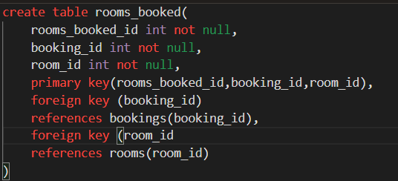
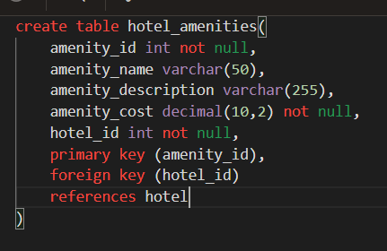
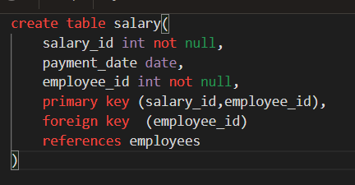
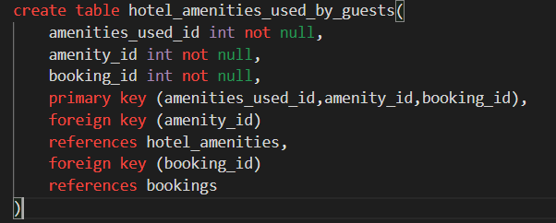

Slide 9
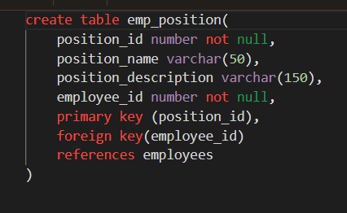
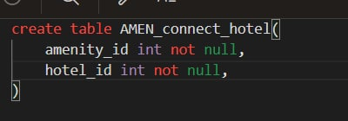

Slide 10
Queries
Сколько номеров забронировано в конкретном отеле на определенную дату
SELECT count(booking_id) AS "Total Rooms Booked"
FROM bookings
WHERE booking_date LIKE :booking_date;
π "Total Rooms Booked" (count(booking_id))
(σ booking_date LIKE :booking_date (bookings))
Выводить имена , номера телефонов , день въезда и день выселения гостей на определенную дату
SELECT last_name, first_name, phone_number, booking_date, check_out_date
FROM guests
JOIN contacts ON guests.contact_id = contacts.contact_id
JOIN bookings ON guests.guest_id = bookings.guest_id and bookings.booking_date = :booking_date
Test dates (12/28/2021 , 03/12/2022)
π last_name, first_name, phone_number, booking_date, check_out_date(guests ⨝ contacts[guests.contact_id = contacts.contact_id] ⨝ bookings[guests.guest_id = bookings.guest_id and bookings.booking_date = :booking_date])

Slide 11
Выводит имя отеля, контактный номер отеля , его рейтинг, в каком штате находится, количество комнат
SELECT hotel.hotel_name, hotel.hotel_phone_number, addresses.state, star_ratings.star_rating_image, hotel.hotel_room_count
FROM hotel
JOIN addresses ON hotel.address_id = addresses.address_id
JOIN star_ratings ON hotel.star_rating_id = star_ratings.star_rating;
π hotel_name, hotel_phone_number, state, star_rating_image, hotel_room_count(hotel ⨝ addresses[hotel.address_id = addresses.address_id] ⨝ star_ratings[hotel.star_rating_id = star_ratings.star_rating])
Выводит имя отеля, имя его комнат, его КВ м, описание комнаты и его стоимость
select hotel_name,room_name,room_size,room_description,room_cost
from hotel,rooms,room_type
where room_type.type_id = rooms.type_id
and hotel.hotel_id = rooms.hotel_id
π hotel_name, room_name, room_size, room_description, room_cost(hotel ⨝ rooms ⨝ room_type[room_type.type_id = rooms.type_id and hotel.hotel_id = rooms.hotel_id])

Slide 12
Сколько сколько раз в год клиент сделал резервирование номера
SELECT count(*)
FROM bookings
WHERE booking_date LIKE '%2022' AND guest_id = 501;
π count(*)(σ booking_date LIKE '%2022' AND guest_id = 501 (bookings))
Сколько номеров забронировано в конкретном отеле на определенную дату
SELECT count(booking_id) AS "Total Rooms Booked"
FROM bookings
WHERE booking_date LIKE :booking_date;
π "Total Rooms Booked" (count(booking_id))(σ booking_date LIKE :booking_date (bookings))

Slide 13
Сколько номеров доступно в данном отеле на конкретную дату
SELECT h.hotel_id, h.hotel_room_count - SUM(b.total_rooms_booked)
FROM bookings b JOIN hotel h ON b.hotel_id = h.hotel_id
WHERE b.booking_date LIKE '12/28/2021' AND h.hotel_id = 1
GROUP BY h.hotel_id, h.hotel_room_count
π h.hotel_id, h.hotel_room_count - SUM(b.total_rooms_booked)(bookings ⨝ hotel[bookings.hotel_id = hotel.hotel_id]WHERE booking_date LIKE '12/28/2021' AND h.hotel_id = 1 GROUP BY h.hotel_id, h.hotel_room_count)
Выводить сотрудника , отель в котором он работает , номер телефона и название должности
select hotel_name,employee_full_name,phone_number,position_name
from employees,hotel, emp_on_one_hotel,emp_position
where hotel.hotel_id = emp_on_one_hotel.hotel_id
and employees.employee_id = emp_on_one_hotel.employee_id
and employees.employee_id = emp_position.employee_id
π hotel_name, employee_full_name, phone_number, position_name
(hotel ⨝ emp_on_one_hotel[hotel.hotel_id = emp_on_one_hotel.hotel_id] ⨝ employees[emp_on_one_hotel.employee_id = employees.employee_id] ⨝ emp_position[employees.employee_id = emp_position.employee_id])

Slide 14
Вывести список комнат в которые заселяются гости на конкретную дату
SELECT room_number
FROM rooms
WHERE room_number IN (
SELECT room_number
FROM bookings
WHERE check_in_date = '04/28/2022'
);
π room_number (rooms ⨝ (σ check_in_date ='04/28/2022' (bookings[room_number])

Slide 15
Triggers
Trigger который запрещает тип оплаты ‘cash’
CREATE OR REPLACE TRIGGER prevent_cash_payments
BEFORE INSERT ON payments
FOR EACH ROW
BEGIN
IF :new.payment_type = 'cash' THEN
RAISE_APPLICATION_ERROR(-20001, 'Cash payments are not allowed');
END IF;
END;
Trigger который удаляет строку когда проходит ‘check_out_date’
CREATE OR REPLACE TRIGGER delete_expired_bookings
AFTER INSERT OR UPDATE ON bookings
FOR EACH ROW
BEGIN
IF :new.check_out_date < SYSDATE THEN
DELETE FROM bookings WHERE booking_id = :new.booking_id;
END IF;
END;

Slide 16
Если длина вводимого номера карточки не равна 16 ти то выводит ошибку
CREATE OR REPLACE TRIGGER credit_card_length_trg
BEFORE INSERT OR UPDATE ON guests
FOR EACH ROW
BEGIN
IF LENGTH(:NEW.CREDIT_CARD) != 16 THEN
RAISE_APPLICATION_ERROR(-20002, 'The credit card number must be exactly 16 characters long');
END IF;
END;

Slide 17
VIEWS
View который объединяет employees и emp_position tables
CREATE OR REPLACE VIEW employee_position AS
SELECT e.employee_id, e.EMPLOYEE_FULL_NAME, e.EMPLOYEE_ADRESS, e.PHONE_NUMBER , p.position_name , p.POSITION_DESCRIPTION
FROM employees e
JOIN emp_position p ON e.employee_id = p.employee_id;
π(employee_id, employee_full_name, employee_adress, phone_number, position_name, position_description)(employees ⨝ emp_position)
View который объединяет guests и contacts tables
CREATE VIEW combined_view AS
SELECT g.GUEST_ID AS GUEST_ID, g.FIRST_NAME AS guest_name, c.CONTACT_ID AS contact_id, c.PHONE_NUMBER AS contact_phone
FROM guests g
JOIN contacts c ON g.contact_id = c.CONTACT_ID;
π(guest_id, guest_name, contact_id, contact_phone) (guests ⨝ contacts)

Slide 18
View в который объединяет rooms и room_type tables
CREATE VIEW room_roomtype_view AS
SELECT r.ROOM_ID AS room_id, r.ROOM_NUMBER AS room_number, rt.TYPE_ID AS type_id, rt.ROOM_NAME AS type_name
FROM rooms r
JOIN room_type rt ON r.TYPE_ID = rt.TYPE_ID;
π(room_id, room_number, type_id, type_name)(rooms ⨝ room_type)

Slide 19
Transactions
Обновление информации о комнате
BEGIN
UPDATE rooms
SET room_type = :new_room_type,
rate = :new_rate
WHERE room_number = :room_number;
COMMIT;
EXCEPTION
WHEN OTHERS THEN
ROLLBACK;
RAISE;
END;
Проверка на существующий guest_id
BEGIN
INSERT INTO guests (guest_id, first_name, last_name,contact_id,credit_card)
VALUES (:guest_id, :first_name, :last_name, :contact_id,:credit_card);
EXCEPTION
WHEN dup_val_on_index THEN
raise_application_error (-20001, 'Error: product already exists');
END;

Slide 20
Indexes
Индекс на имя и фамилию постояльцев
CREATE INDEX guest_room_index ON guests (guest_id, first_name);
Индекс для поля check_in_date таблицы booking :
CREATE INDEX check_in_date_index ON booking (check_in_date);
Индекс для поля room_number таблицы rooms:
CREATE INDEX room_number_index ON rooms (room_number);
Индекс для поля email таблицы guests, с проверкой уникальности
CREATE UNIQUE INDEX email_index ON guests (email);

Slide 21
Thank you for attention!

