Slide 1
working of Cooling Fan with temperature control
By Proteus Simulation

Slide 2
Introduction :-
The aim of the project is to control the speed of a Fan (DC Motor) according to the temperature of the environment. The more the temperature the more will be the speed of the fan and maintains the coolness of the surroundings instead of manual control. The fan doesn't go on for temperature below 0°C and slowly varies its speed from minimum to maximum over 0 to 150°C. The circuit is simulated in Proteus Simulation Software.

Slide 3
Project Principles :-
ADC [analog to digital convertor]
DAC [digital to analog convertor]
PWM [pulse width modulation]

Slide 4
Components of the circuit :-
ADC0804 [conversion module]
LM35 [temperature sensor]
L293D [motor driver]
8051 [micro-processor]

Slide 5
Virtualization of the circuit
Converts the temperature into voltage signal which is proportional to temperature outside
The output analog voltage signal is converted into digital signal
Temp
Sensor
ADC
Powers the DC motor according to PWM signal
The digital signal is used to create a PWM signal for controlling the speed of DC fan using a motor driver
Motor Driver
MC 8051
Fan

Slide 6
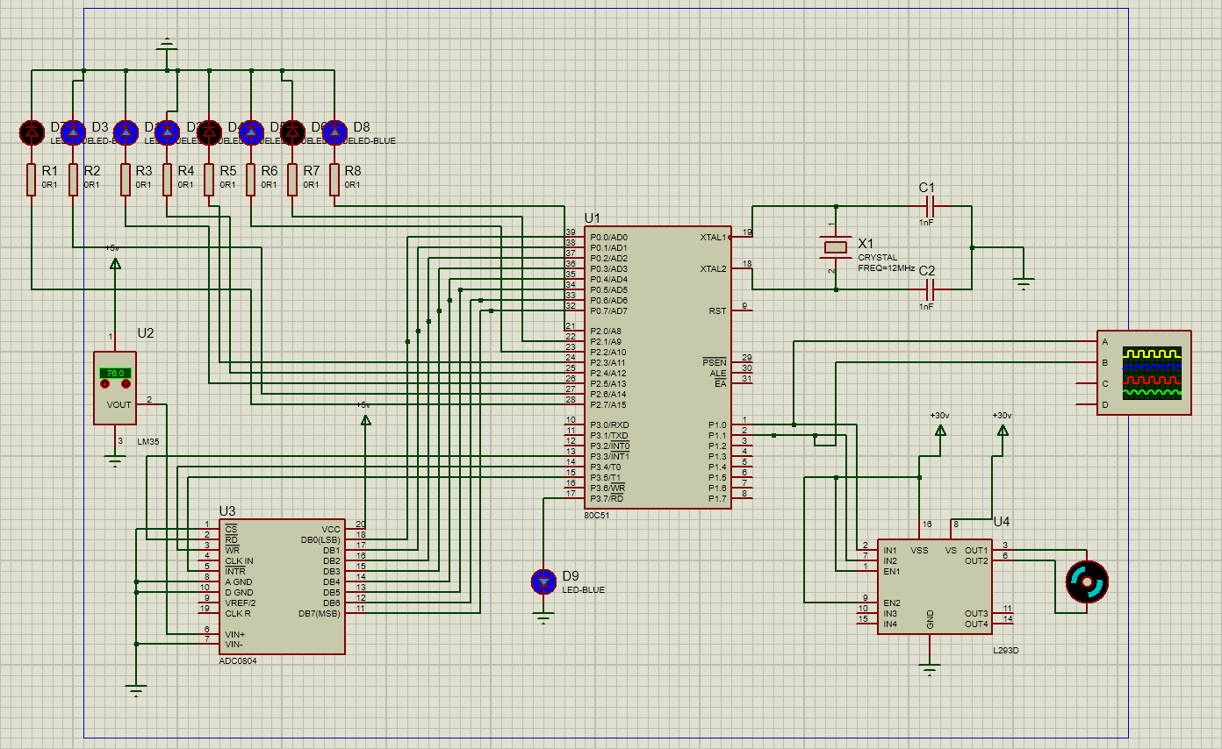
Circuit design

Slide 7
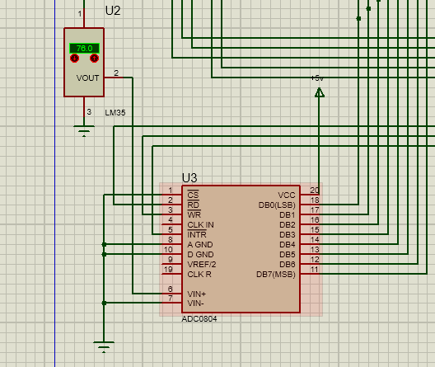
Temperature Detection & ADC Conversion
The sensor detects the temperature of the environment and sends the analog value of that to the ADC Converter. The converter converts that analog value into digital value and sends it to the 8051 MC.

Slide 8
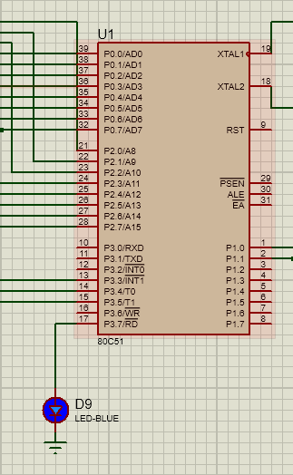
8051 MC and Digital Value Indicator
The picture in the left indicates the 8051 MC which is the heart and brain of the whole project. It receives the digital output of the ADC through the P0 port. We then used the logic to scale the temperature value to 255, which should be the input for the PWM pulse.

Slide 9
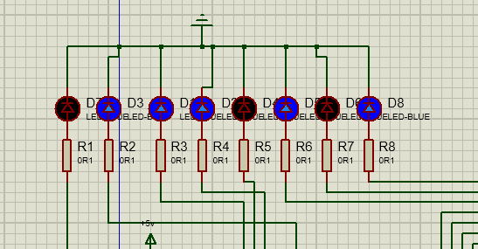
LED BULBS
The picture shows the digital value of temperature scaled to 255 in the form of an 8-bit binary number, which is connected to Port 2.

Slide 10
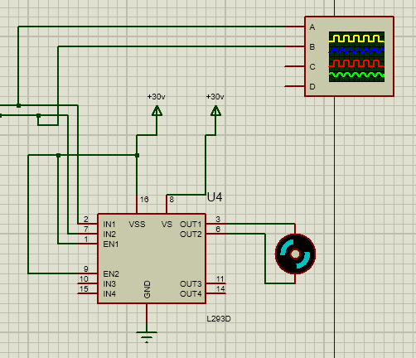
Motor and Motor Driver
DC Motor which is connected to the 8051MC via L293D Motor Driver to provide the DC Motor with sufficient current.
The wave box kind of thing in the top right corner is the Digital Oscilloscope, which is used here to capture the PWM Pulse, which essentially is the output of the circuit.

Slide 11
LOGICS
THIS ANALOGUE VOLTAGE SIGNAL IS GIVEN AS INPUT TO ADC0804 (ANALOGUE TO DIGITAL CONVERTOR) WHICH WILL CONVERT SIGNAL TO DIGITAL SIGNAL BASED ON THE SIGNALS FROM 8051 MICROCONTROLLER.
A LED IS CONNECTED TO P3.7 OF 8051 MICROCONTROLLER WHICH IS USED TO CHECK WHETHER THE CIRCUIT IS FUNCTIONING OR NOT, IF IT GLOWS IT DENOTES THAT MICROCONTROLLER IS FUNCTIONING CORRECTLY OTHERWISE IT DENOTES THAT IT HAS A FAULT.
THIS DIGITAL SIGNAL VALUE IS OUTPUTTED TO PORT 0 WHICH IS CONNECTED TO LEDS.
THIS PWM SIGNAL IS FED TO LM293D MOTOR DRIVER.

Slide 12
Conclusion
The basic idea of this project is to automate the fan speed according to the temperature without any need for us to change the speed of the fan changes every time the temperature changes, we used 8051 microcontroller to control the fan speed, a temperature sensor named LM35 gives analog voltage directly proportional to the temperature, and this analog voltage signal is then converted into a digital signal using ADC0804 and this digital signal is used to make a PWM signal which is fed to the DC motor, The duty cycle is directly proportional to the temperature, hence the Dc motor speed will be proportional to the temperature, and the environment of the system will remain cooled. In this way, our main objective of the project is achieved.

Slide 13
That’s all for today
Thank You

