Slide 1
Lecture 4
Topics:
Universal and Existential Quantification
De Morgan’s Law
Nested Quantifiers
Applying De Morgan’s Law in Nested Quantifier

Slide 2


Slide 3


Slide 4


Slide 5

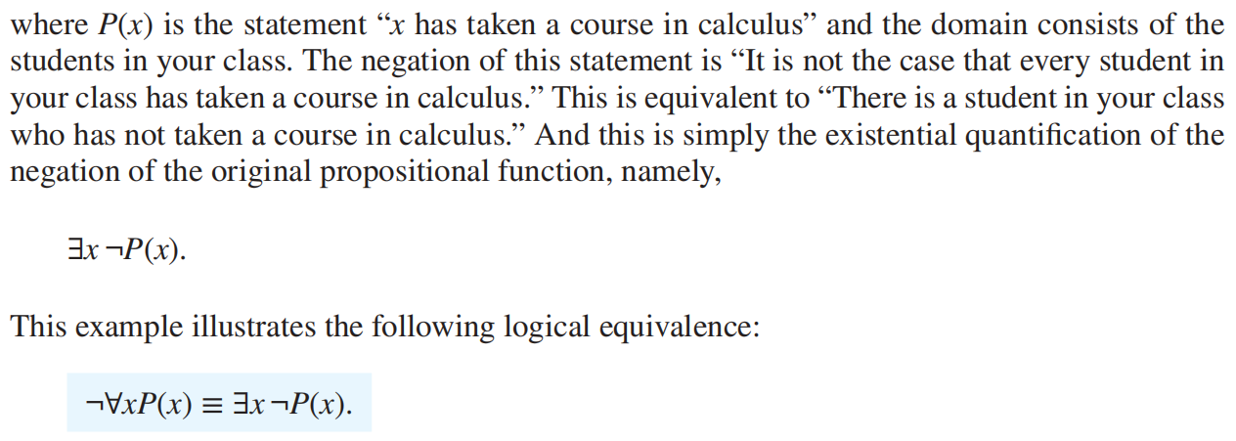

Slide 6
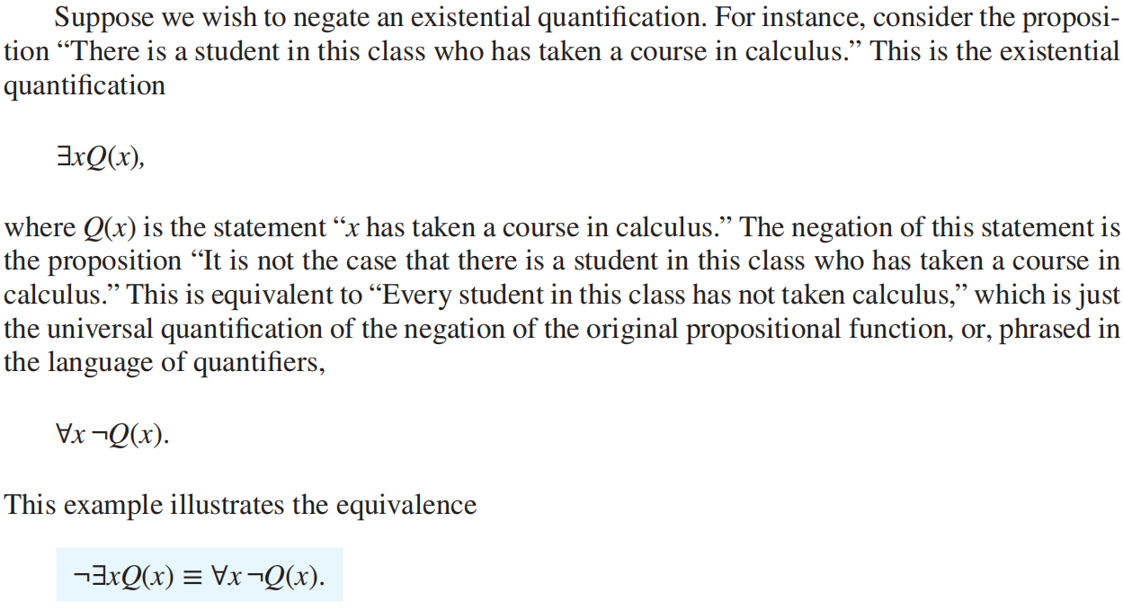

Slide 7


Slide 8


Slide 9


Slide 10
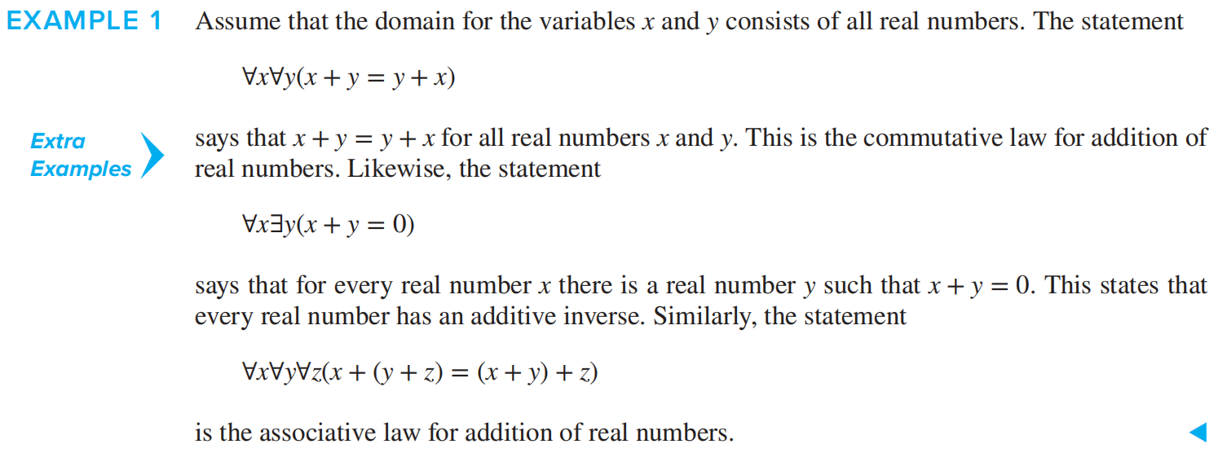

Slide 11


Slide 12



Slide 13


Slide 14
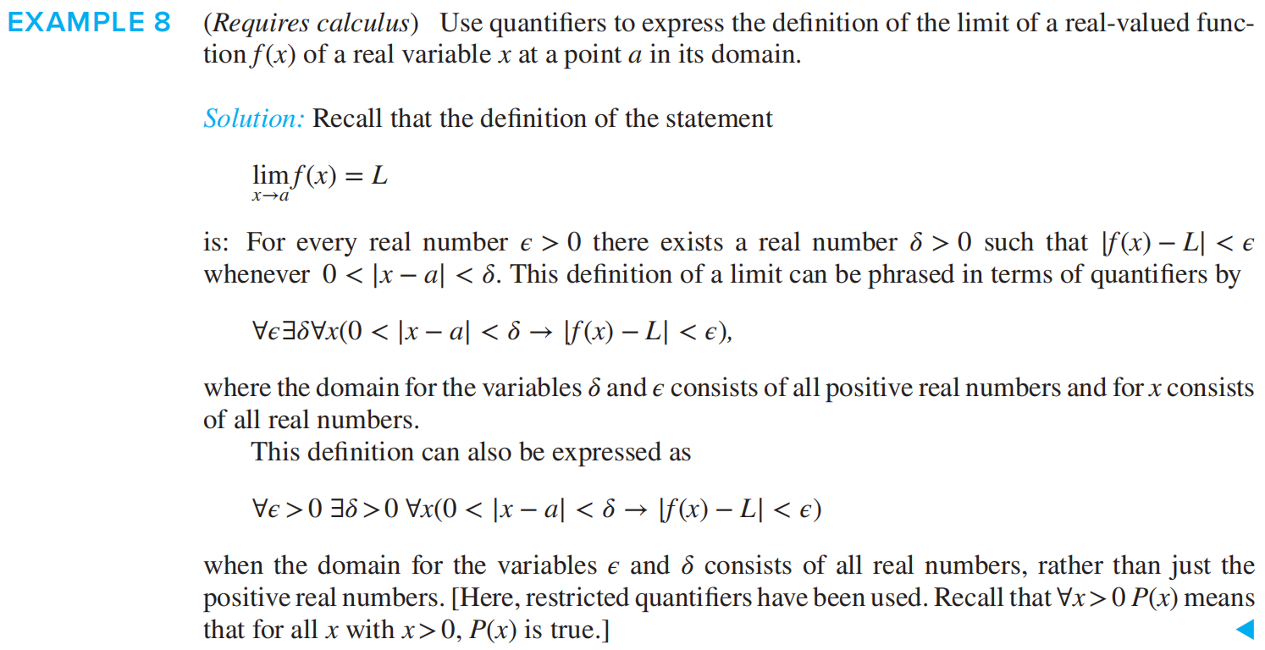

Slide 15


Slide 16


Slide 17


Slide 18



Slide 19


Slide 20
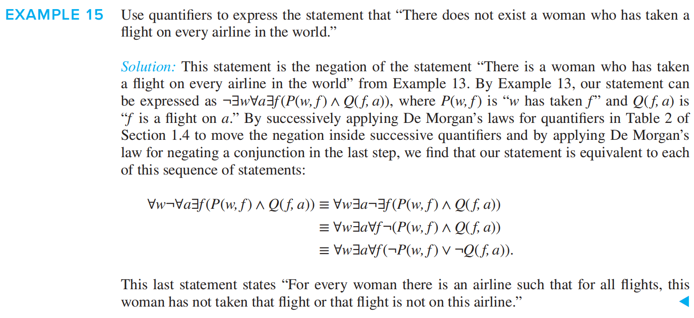

Slide 21


Slide 22
