Slide 1
Lecture 9

Slide 2
Topics
Function Definition
Domain and Range
One-to-one and Onto Functions
One-to-one Correspondence
Cardinality of Sets
Countable and Uncountable Sets

Slide 3
Function Definition
Let A and B be nonempty sets. A function f from A to B is an assignment of exactly one element of B to each element of A. We write f(a) = b if b is the unique element of B assigned by the function f to the element a of A. If f is a function from A to B, we write f : A → B.
Abir A
Chanda B
Gopal C
Rihan D
Shyamoli F
Fig : Assignment of grades in a discrete mathematics class

Slide 4
Domain and Range
If f is a function from A to B, we say that A is the domain of f and B is the codomain of f. If f(a) = b, we say that b is the image of a and a is a preimage of b. The range, or image, of f is the set of all images of elements of A. Also, if f is a function from A to B, we say that f maps A to B.
f
a
b=f(a)
A
B
f
Fig : The function f maps A to B

Slide 5
Examples
EXAMPLE: Let R be the relation with ordered pairs (Abdul, 22), (Bidyut, 24), (Chanda, 21), (Dayem, 22), (Emon, 24), and (Fahim, 22). Here each pair consists of a graduate student and this student’s age. Specify a function determined by this relation.
SOLUTION: If f is a function specified by R, then f(Abdul) = 22, f(Bidyut) = 24 and so on. For domain we take the set {Abdul, Bidyut, Chanda, Dayem, Emon, Fahim}. We also need to specify the codomain, which needs to contain all possible ages of the students. Because it is highly likely that all students are less than 100 years old, we can take the set of positive integers less than 100 as the codomain.

Slide 6
Definition
Let f₁ and f₂ be functions from A to R. Then f₁+f₂ and f₁f₂ are also functions from A to R defined for all x ∈ A by
(f₁+f₂)(x) = f₁(x) + f₂(x)
(f₁f₂)(x) = f₁(x)f₂(x)
EXAMPLE: Let f₁ and f₂ be functions from R to R such that f₁(x) = x² and f₂(x) = x − x². What are the functions f₁ + f₂ and f₁ f₂?
SOLUTION: From the definition of the sum and product of functions, it follows that
(f₁+ f₂)(x) = f₁(x) + f₂(x) = x² + (x − x² ) = x
( f₁f₂)(x) = x² (x − x²) = x³ − x⁴ .

Slide 7
Definition
Let f be a function from A to B and let S be a subset of A. The image of S under the function f is the subset of B that consists of the images of the elements of S. We denote the image of S by f(S), so
f(S) = {t ∣ ∃s∈S (t = f(s))}.
We also use the shorthand {f(s) ∣ s ∈ S} to denote this set.
EXAMPLE: Let A = {a, b, c, d, e} and B = {1, 2, 3, 4} with f(a) = 2, f(b) = 1, f(c) = 4, f(d) = 1, and f(e) = 1. The image of the subset S = {b, c, d} is the set f(S) = {1, 4}.

Slide 8
One-to-one Functions
A function f is said to be one-to-one, or an injection, if and only if f(a) = f(b) implies that a = b for all a and b in the domain of f.
A function is said to be injective if it is one-to-one.
Contrapositive of the previous implication: A function f is one-to-one if and only if f(a) ≠ f(b) whenever a ≠ b.
Expressing the previous implication using quantifiers: ∀a∀b( f(a) = f(b) → a = b) or equivalently ∀a∀b(a ≠ b → f(a) ≠ f(b)), where the universe of discourse is the domain of the function.

Slide 9
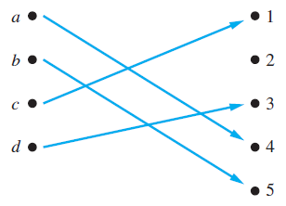
Examples
EXAMPLE: Determine whether the function f from {a, b, c, d} to {1, 2, 3, 4, 5} with f(a) = 4, f(b) = 5, f(c) = 1, and f(d) = 3 is one-to-one.
SOLUTION: The function f is one-to-one because f takes on different values at the four elements of its domain.

Slide 10
Examples
EXAMPLE: Determine whether the function f(x) = x² from the set of integers to the set of integers is one-to-one.
SOLUTION: The function f(x) = x² is not one-to-one because, for instance, f(1) = f(−1) = 1, but 1 ≠ −1.
EXAMPLE: Determine whether the function f(x) = x + 1 from the set of real numbers to itself is one-to-one.
SOLUTION: Suppose that x and y are real numbers with f(x) = f(y), so,
f(x) = f(y)
→ x + 1 = y + 1
→ x = y.
Hence, f(x) = x + 1 is a one-to-one function from R to R.

Slide 11
Definition
A function f whose domain and codomain are subsets of the set of real numbers is called increasing if f(x) ≤ f(y), and strictly increasing if f(x) < f(y), whenever x < y and x and y are in the domain of f. Similarly, f is called decreasing if f(x) ≥ f(y), and strictly decreasing if f(x) > f(y), whenever x < y and x and y are in the domain of f. (The word strictly in this definition indicates a strict inequality.)

Slide 12
Examples
EXAMPLE: The function f(x) = x² from R⁺ to R⁺ is strictly increasing. To see this, suppose that x and y are positive real numbers with x < y. Multiplying both sides of this inequality by x gives x² < xy. Similarly, multiplying both sides by y gives xy < y². Hence, f(x) = x² < xy < y² = f(y). However, the function f(x) = x² from R to the set of nonnegative real numbers is not strictly increasing because −1 < 0, but f(−1) = (−1)² = 1 is not less than f(0) = 0² = 0.

Slide 13
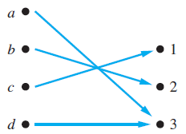
Onto Functions
A function f from A to B is called onto, or a surjection, if and only if for every element b ∈ B there is an element a ∈ A with f(a) = b. A function f is called surjective if it is onto.
Fig: An onto Function

Slide 14
Examples
EXAMPLE: Is the function f(x) = x+1 from the set of integers to the set of integers onto?
SOLUTION: This function is onto, because for every integer y there is an integer x such that f(x) = y. To see this, note that f(x) = y if and only if x+1 = y, which holds if and only if x = y−1. (Note that y−1 is also an integer, and so, is in the domain of f )
EXAMPLE: Is the function f(x) = x² from the set of integers to the set of integers onto?
SOLUTION: The function f is not onto because there is no integer x with x² = −1, for instance.

Slide 15
One-to-one Correspondence
The function f is a one-to-one correspondence, or a bijection, if it is both one-to-one and onto. We also say that such a function is bijective.
EXAMPLE: Let f be the function from {a, b, c, d} to {1, 2, 3, 4} with f(a) = 4, f(b) = 2, f(c) = 1, and f(d) = 3. Is f a bijection?
SOLUTION: The function f is one-to-one and onto. It is one-to-one because no two values in the domain are assigned the same function value. It is onto because all four elements of the codomain are images of elements in the domain. Hence, f is a bijection.

Slide 16
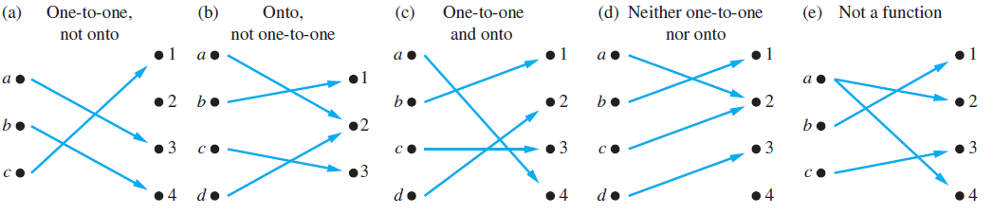
Examples
Fig: Examples of different types of correspondences.

Slide 17
Techniques
Suppose that f : A → B.
To show that f is injective: Show that if f(x) = f(y) for arbitrary x, y ∈ A, then x = y.
To show that f is not injective: Find particular elements x, y ∈ A such that x ≠ y and f(x) = f(y).
To show that f is surjective: Consider an arbitrary element y ∈ B and find an element x ∈ A such that f(x) = y.
To show that f is not surjective: Find a particular y ∈ B such that f(x) ≠ y for all x ∈ A.

Slide 18
Cardinality of Sets
The sets A and B have the same cardinality if and only if there is a one-to-one correspondence from A to B. When A and B have the same cardinality, we write |A| = |B|.
In another words, if there is a one-to-one function from A to B, the cardinality of A is less than or the same as the cardinality of B and we write |A| ≤ |B|. Moreover, when |A| ≤ |B| and A and B have different cardinality, we say that the cardinality of A is less than the cardinality of B and we write |A| < |B|.

Slide 19
Countable and Uncountable Sets
A set that is either finite or has the same cardinality as the set of positive integers is called countable. A set that is not countable is called uncountable.
When an infinite set S is countable, we denote the cardinality of S by ℵ₀ (where ℵ is aleph, the first letter of the Hebrew alphabet). We write |S| = ℵ₀ and say that S has cardinality “aleph null.”

Slide 20
Examples
EXAMPLE: Show that the set of odd positive integers is a countable set.
SOLUTION: To show that the set of odd positive integers is countable, we will exhibit a one-to-one correspondence between this set and the set of positive integers. Consider the function f(n) = 2n−1 , from Z⁺ to the set of odd positive integers.
We show that f is a one-to-one correspondence by showing that it is both one-to-one and onto. To see that it is one-to-one, suppose that f(n) = f(m). Then 2n−1 = 2m−1, so n = m. To see that it is onto, suppose that t is an odd positive integer. Then t is 1 less than an even integer 2k, where k is a natural number. Hence t = 2k−1 = f(k).

Slide 21
Examples
Please try to understand the examples 4 and 5 from book.

Slide 22
Thank You

