Slide 1
Lecture 11
Sequences and Summations
Topics:
Sequences and their Summation
Recurrence Relations

Slide 2
Sequences
Definition: A sequence is a function from a subset of the set of integers (usually either the set {0, 1, 2, …} or the set {1, 2, 3, …}) to a set S. We use the notation an to denote the image of the integer n. We call a_{n} a term of the sequence.
Example: Consider the sequence {a_{n}}, where
a_{n} = 1 /n .
The list of the terms of this sequence, beginning with a₁, namely,
a₁, a₂, a₃, a₄, … ,
starts with 1, 1/ 2 , 1 /3 , 1 /4 , . …

Slide 3
Sequences: Geometric Progression
Definition: A geometric progression is a sequence of the form
a, ar, ar² , … , ar^{n} , …
where the initial term a and the common ratio r are real numbers.
Remark: A geometric progression is a discrete analogue of the exponential function f(x) = ar^{x}.

Slide 4
Sequences: Geometric Progression
Example: The sequences{b_{n}} with b_{n} = (-1)^{n}, {c_{n}} with c_{n} = 2·5^{n}, and {d_{n}} with d_{n} = 6 · (1/3)^{n} are geometric progressions with initial term and common ratio equal to 1 and −1; 2 and 5; and 6 and 1/3, respectively, if we start at n = 0. The list of terms b₀,b₁,b₂,b₃,b₄,...begins with
1, −1, 1, −1, 1,...;
the list of terms c₀,c₁,c₂,c₃,c₄,...begins with
2, 10, 50, 250, 1250,...;
and the list of terms d₀,d₁,d₂,d₃,d₄,...begins with
6, 2, 2/3, 2/9, 2/27 ,....

Slide 5
Sequences: Arithmetic Progression
Definition: An Arithmetic Progression is a sequence of the form
a,a +d,a+2d,...,a+nd,...
where the initial term a and the common difference d are real numbers.

Slide 6
Sequences: Arithmetic Progression
Example: The sequences {s_{n}} with s_{n} = −1 + 4n and {t_{n}} with t_{n} = 7 − 3n are both arithmetic progressions with initial terms and common differences equal to −1 and 4, and 7 and −3, respectively, if we start at n = 0. The list of terms s₀, s₁, s₂, s₃, … begins with
−1, 3, 7, 11, … ,
and the list of terms t₀, t₁, t₂, t₃,, … begins with
7, 4, 1,−2, … .
Sequences of the form a₁, a₂, … , a_{n} are often used in computer science. These finite sequences are also called strings. This string is also denoted by a₁ a₂ … a_{n} . The length of a string is the number of terms in this string. The empty string, denoted by 𝜆, is the string that has no terms. The empty string has length zero. For example, The string abcd is a string of length four.

Slide 7
Recurrence Relations
Definition: A recurrence relation for the sequence {a_{n}} is an equation that expresses an in terms of one or more of the previous terms of the sequence, namely, a₀, a₁, … , a_{n−1}, for all integers n with n ≥ n₀, where n₀ is a nonnegative integer. A sequence is called a solution of a recurrence relation if its terms satisfy the recurrence relation. (A recurrence relation is said to recursively define a sequence.)

Slide 8
Recurrence Relations
Example: Let {a_{n}} be a sequence that satisfies the recurrence relation a_{n} = a_{n−1} + 3 for n = 1, 2, 3, … , and suppose that a₀ = 2. What are a₁, a₂, and a₃?
Solution: We see from the recurrence relation that a₁ = a₀ + 3 = 2 + 3 = 5.
It then follows that a₂ = 5 + 3 = 8
and a₃ = 8 + 3 = 11.

Slide 9
Recurrence Relations: Fibonacci sequence
Definition: The Fibonacci sequence, f₀, f₁, f₂, … , is defined by the initial conditions f₀ = 0, f₁ = 1, and the recurrence relation
f_{n} = f_{n−1} + f_{n−2}
for n = 2, 3, 4, … .

Slide 10
Recurrence Relations: Fibonacci sequence
Example: Find the Fibonacci numbers f₂, f₃, f₄, f₅, and f₆.
Solution: The recurrence relation for the Fibonacci sequence tells us that we find successive terms by adding the previous two terms. Because the initial conditions tell us that f₀ = 0 and f₁ = 1, using the recurrence relation in the definition we find that,
f₂ = f₁ + f₀ = 1 + 0 = 1 f₅ = f₄ + f₃ = 3 + 2 = 5
f₃ = f₂ + f₁ = 1 + 1 = 2 f₆ = f₅+ f₄= 5 + 3 = 8
f₄ = f₃ + f₂ = 2 + 1 = 3

Slide 11
Recurrence Relations: Compound Interest
Example: Suppose that a person deposits $10,000 in a savings account at a bank yielding 11% per year with interest compounded annually. How much will be in the account after 30 years?
Solution: To solve this problem, let P_{n} denote the amount in the account after n years. Because the amount in the account after n years equals the amount in the account after n−1 years plus interest for the nth year, we see that the sequence { P_{n}} satisfies the recurrence relation
P_{n} = P_{n−1} + 0.11P_{n−1} = (1.11)P_{n−1}.
The initial condition is P₀ = 10,000. We can use an iterative approach to find a formula for P_{n} . Note that
P₁ = (1.11)P₀
P₂ = (1.11)P₁ = (1.11)²P₀
P₃ = (1.11)P₂ = (1.11)³P₀
⋮
P_{n} = (1.11)P_{n−1} = (1.11)^{n}P₀.

Slide 12
Recurrence Relations: Compound Interest
When we insert the initial condition P₀ = 10,000, the formula P_{n} = (1.11)^{n}10,000 is obtained.
Inserting n = 30 into the formula P_{n} = (1.11)^{n}10,000 shows that after 30 years the account contains
P₃₀ = (1.11)³⁰10,000 = $228,922.97.

Slide 13
Special Integer Sequences
Example 1: Find formulae for the sequences with the following first five terms: (a) 1, 1/2, 1/4, 1/8, 1/16 (b) 1, 3, 5, 7, 9 (c) 1, −1, 1, −1, 1.
Solution: (a) We recognize that the denominators are powers of 2. The sequence with a_{n} = 1/2^{n}, n = 0, 1, 2, … is a possible match. This proposed sequence is a geometric progression with a = 1 and r = 1/2.
(b) We note that each term is obtained by adding 2 to the previous term. The sequence with a_{n} = 2n + 1, n = 0, 1, 2, … is a possible match. This proposed sequence is an arithmetic progression with a = 1 and d = 2.
(c) The terms alternate between 1 and −1. The sequence with a_{n} = (−1)^{n}, n = 0, 1, 2… is a possible match. This proposed sequence is a geometric progression with a = 1 and r = −1.

Slide 14
Special Integer Sequences
Example 2: How can we produce the terms of a sequence if the first 10 terms are 1, 2, 2, 3, 3, 3, 4, 4, 4, 4?
Solution: In this sequence, the integer 1 appears once, the integer 2 appears twice, the integer 3 appears three times, and the integer 4 appears four times. A reasonable rule for generating this sequence is that the integer n appears exactly n times, so the next five terms of the sequence would all be 5, the following six terms would all be 6, and so on. The sequence generated this way is a possible match.

Slide 15

Summations
Next, we consider the addition of the terms of a sequence. For this we introduce summation notation. We begin by describing the notation used to express the sum of the terms
a_{m}, a_{m+1}, … , a_{n}
from the sequence {a_{n}}. We use the notation
(read as the sum from j = m to j = n of a_{j}) to represent
a_{m} + a_{m+1} + … + a_{n}

Slide 16

Summations
Here, the variable j is called the index of summation, and the choice of the letter j as the variable is arbitrary; that is, we could have used any other letter, such as i or k. Or, in notation,

Slide 17
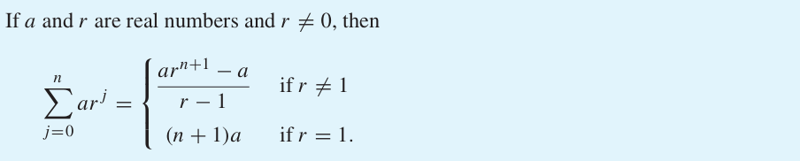
Sum of terms of a geometric progression
Theorem:

Slide 18

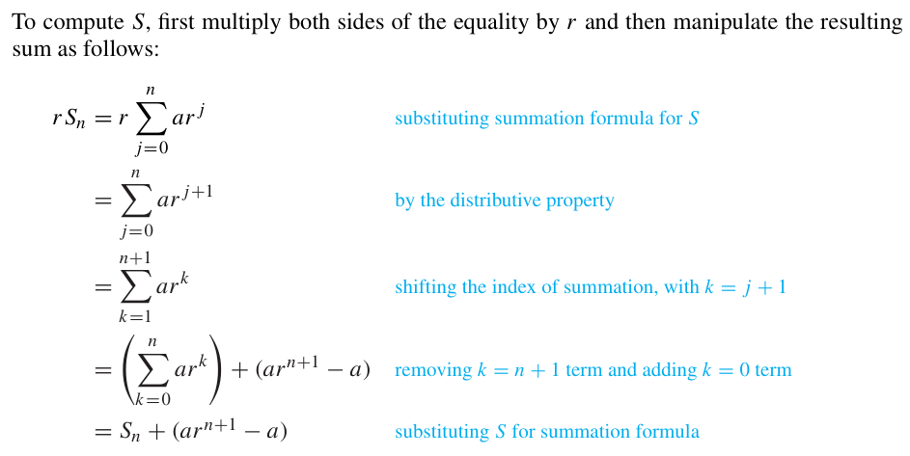
Sum of terms of a geometric progression
Proof: Let

Slide 19
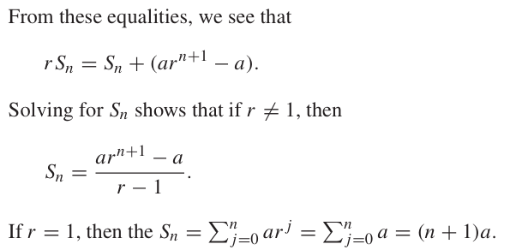
Sum of terms of a geometric progression

