Slide 1
Lecture 17
Topics:
Mathematical Induction

Slide 2
5.1 Mathematical Induction
5.1.1 Introduction
Suppose that we have an infinite ladder, as shown in Figure 1, and we want to know whether we can reach every step on this ladder. We know two things:
1. We can reach the first rung of the ladder.
2. If we can reach a particular rung of the ladder, then we can reach the next rung.

Slide 3
5.1 Mathematical Induction (Continued)
For example, after 100 uses of (2), we know that we can reach the 101st rung. But can we conclude that we are able to reach every rung of this infinite ladder? The answer is yes, something we can verify using an important proof technique called mathematical induction. That is, we can show that the statement that we can each the nth rung of the ladder is true for all positive integers n.
Mathematical induction is an extremely important proof technique that can be used to prove assertions of this type.

Slide 4
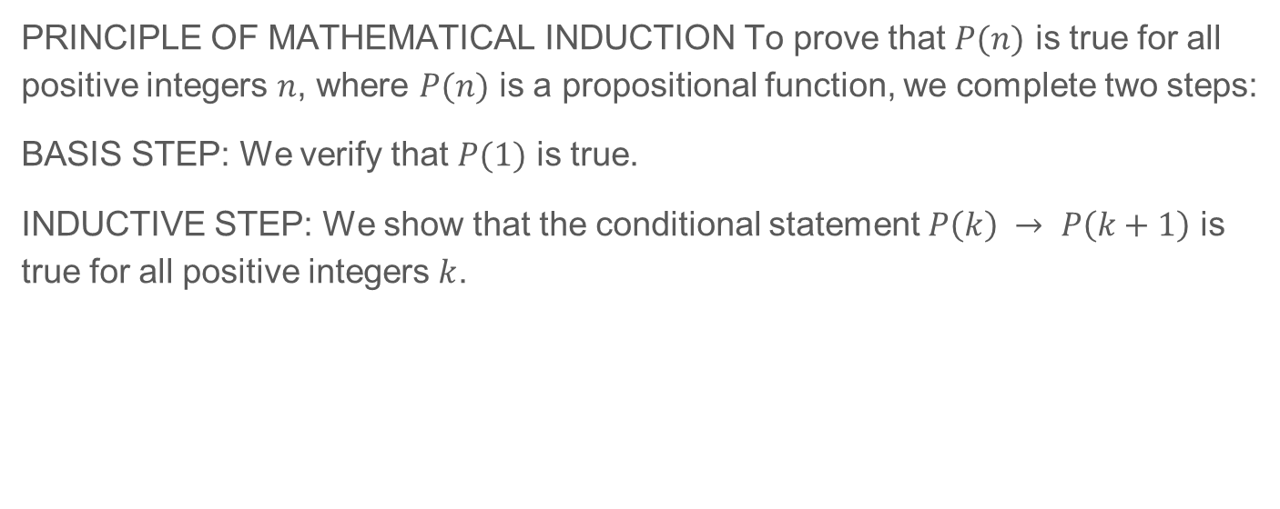
5.1 Mathematical Induction (Continued)
PRINCIPLE OF MATHEMATICAL INDUCTION To prove that $P(n)$ is true for all positive integers $n$, where $P(n)$ is a propositional function, we complete two steps:
BASIS STEP: We verify that $P(1)$ is true.
INDUCTIVE STEP: We show that the conditional statement $P\left(k\right) → P\left(k+1\right)$ is true for all positive integers $k$.

Slide 5
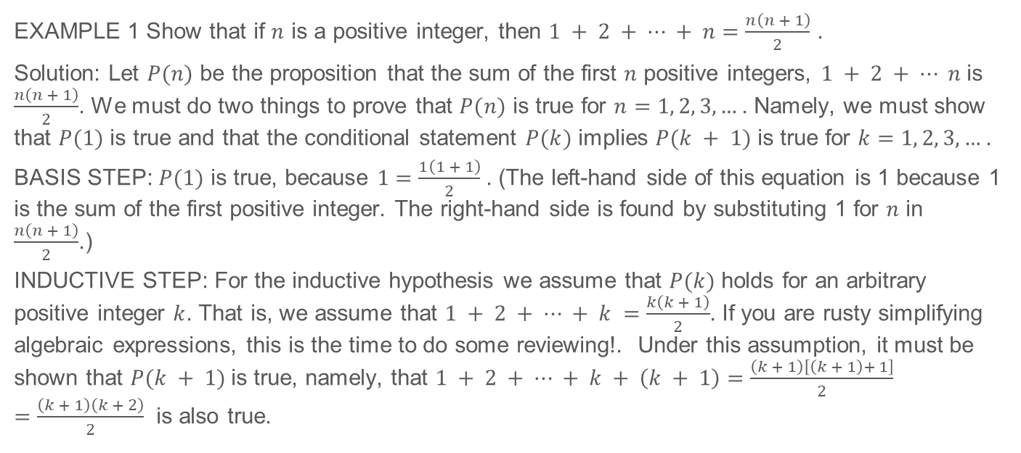
5.1 Mathematical Induction (Continued)
EXAMPLE 1 Show that if $n$ is a positive integer, then $1 + 2 + ⋯ + n=\frac{n\left(n + 1\right)}{2}$ .
Solution: Let $P(n)$ be the proposition that the sum of the first $n$ positive integers, $1 + 2 + ⋯ n$ is $\frac{n\left(n + 1\right)}{2}$. We must do two things to prove that $P(n)$ is true for $n=1, 2, 3, …$. Namely, we must show that $P(1)$ is true and that the conditional statement $P(k)$ implies $P(k + 1)$ is true for $k=1, 2, 3, …$.
BASIS STEP: $P(1)$ is true, because $1=\frac{1\left(1 + 1\right)}{2}$. (The left-hand side of this equation is 1 because 1 is the sum of the first positive integer. The right-hand side is found by substituting 1 for $n$ in $\frac{n\left(n + 1\right)}{2}$.)
INDUCTIVE STEP: For the inductive hypothesis we assume that $P(k)$ holds for an arbitrary positive integer $k$. That is, we assume that $1 + 2 + ⋯ + k =\frac{k\left(k + 1\right)}{2}$. If you are rusty simplifying algebraic expressions, this is the time to do some reviewing!. Under this assumption, it must be shown that $P(k + 1)$is true, namely, that $1 + 2 + ⋯ + k + \left(k + 1\right)=\frac{\left(k + 1\right)\left[\left(k + 1\right)+ 1\right]}{2} =\frac{\left(k + 1\right)\left(k + 2\right)}{2}$ is also true.

Slide 6
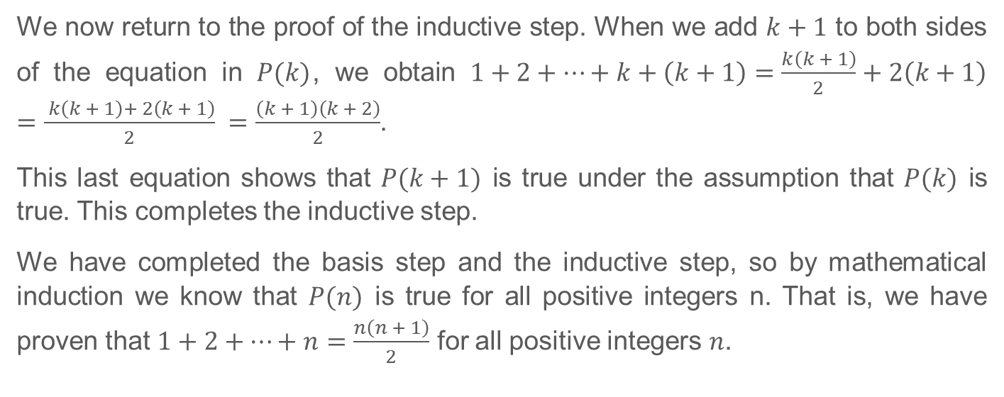
5.1 Mathematical Induction (Continued)
We now return to the proof of the inductive step. When we add $k+1$ to both sides of the equation in $P(k)$, we obtain $1+2+⋯+k+\left(k+1\right)=\frac{k\left(k + 1\right)}{2}+2\left(k+1\right)=\frac{ k\left(k + 1\right)+ 2\left(k + 1\right)}{2} =\frac{\left(k + 1\right)\left(k + 2\right)}{2}$.
This last equation shows that $P(k+1)$ is true under the assumption that $P(k)$ is true. This completes the inductive step.
We have completed the basis step and the inductive step, so by mathematical induction we know that $P(n)$ is true for all positive integers n. That is, we have proven that $1+2+⋯+n=\frac{n\left(n + 1\right)}{2}$ for all positive integers $n$.

Slide 7
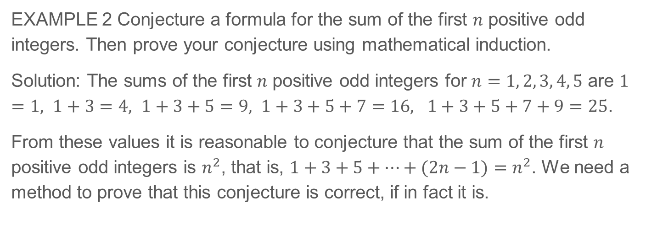
5.1 Mathematical Induction (Continued)
EXAMPLE 2 Conjecture a formula for the sum of the first $n$ positive odd integers. Then prove your conjecture using mathematical induction.
Solution: The sums of the first $n$ positive odd integers for $n=1, 2, 3, 4, 5$ are $1=1, 1+3=4, 1+3+5=9, 1+3+5+7=16, 1+3+5+7+9=25$.
From these values it is reasonable to conjecture that the sum of the first $n$ positive odd integers is $n^{2}$, that is, $1+3+5+⋯+(2n−1)=n^{2}$. We need a method to prove that this conjecture is correct, if in fact it is.

Slide 8
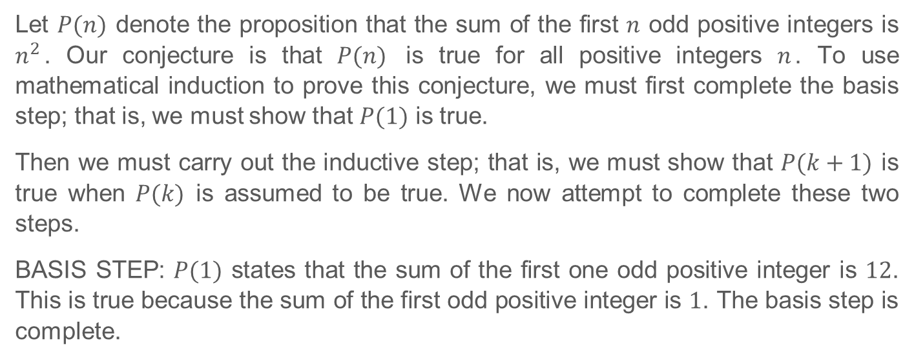
5.1 Mathematical Induction (Continued)
Let $P(n)$ denote the proposition that the sum of the first $n$ odd positive integers is $n^{2}$. Our conjecture is that $P(n)$ is true for all positive integers $n$. To use mathematical induction to prove this conjecture, we must first complete the basis step; that is, we must show that $P(1)$ is true.
Then we must carry out the inductive step; that is, we must show that $P(k+1)$ is true when $P(k)$ is assumed to be true. We now attempt to complete these two steps.
BASIS STEP: $P(1)$ states that the sum of the first one odd positive integer is $12$. This is true because the sum of the first odd positive integer is $1$. The basis step is complete.

Slide 9
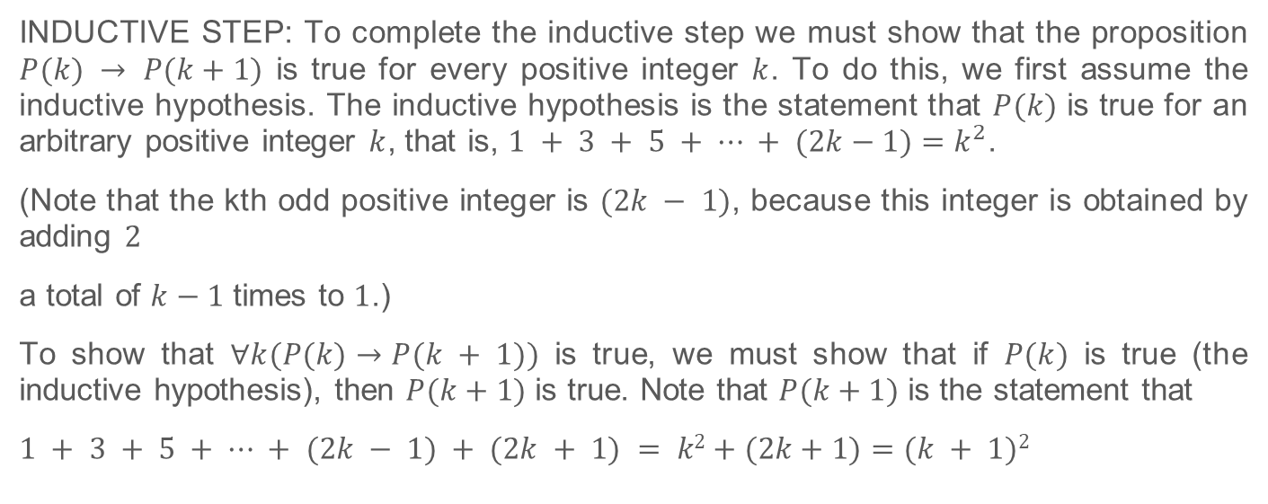
5.1 Mathematical Induction (Continued)
INDUCTIVE STEP: To complete the inductive step we must show that the proposition $P(k) → P(k+1)$ is true for every positive integer $k$. To do this, we first assume the inductive hypothesis. The inductive hypothesis is the statement that $P(k)$ is true for an arbitrary positive integer $k$, that is, $1 + 3 + 5 + ⋯ + (2k−1)=k^{2}$.
(Note that the kth odd positive integer is $(2k − 1)$, because this integer is obtained by adding $2$
a total of $k−1$ times to $1$.)
To show that $∀k(P(k)→P(k + 1))$ is true, we must show that if $P(k)$ is true (the inductive hypothesis), then $P(k+1)$ is true. Note that $P(k+1)$ is the statement that
$1 + 3 + 5 + ⋯ + (2k − 1) + (2k + 1) = k2+(2k+1)=(k + 1)2$

Slide 10
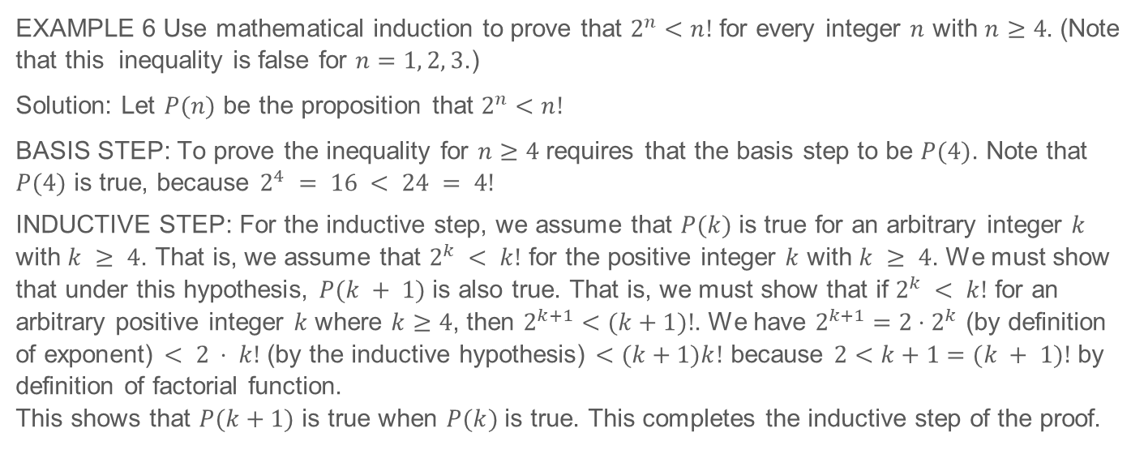
5.1 Mathematical Induction (Continued)
EXAMPLE 6 Use mathematical induction to prove that $2^{n}<n!$ for every integer $n$ with $n≥4$. (Note that this inequality is false for $n=1, 2, 3$.)
Solution: Let $P(n)$ be the proposition that $2^{n}<n!$
BASIS STEP: To prove the inequality for $n≥4$ requires that the basis step to be $P(4)$. Note that $P(4)$ is true, because $2^{4} = 16 < 24 = 4!$
INDUCTIVE STEP: For the inductive step, we assume that $P(k)$ is true for an arbitrary integer $k$ with $k ≥ 4$. That is, we assume that $2^{k} < k!$ for the positive integer $k$ with $k ≥ 4$. We must show that under this hypothesis, $P(k + 1)$ is also true. That is, we must show that if $2^{k} < k!$ for an arbitrary positive integer $k$ where $k≥4$, then $2^{k+1}<(k+1)!$. We have $2^{k+1}=2⋅2^{k}$ (by definition of exponent) $< 2 ⋅ k!$ (by the inductive hypothesis) $<(k+1)k!$ because $2<k+1=(k + 1)!$ by definition of factorial function.
This shows that $P(k+1)$ is true when $P(k)$ is true. This completes the inductive step of the proof.

Slide 11
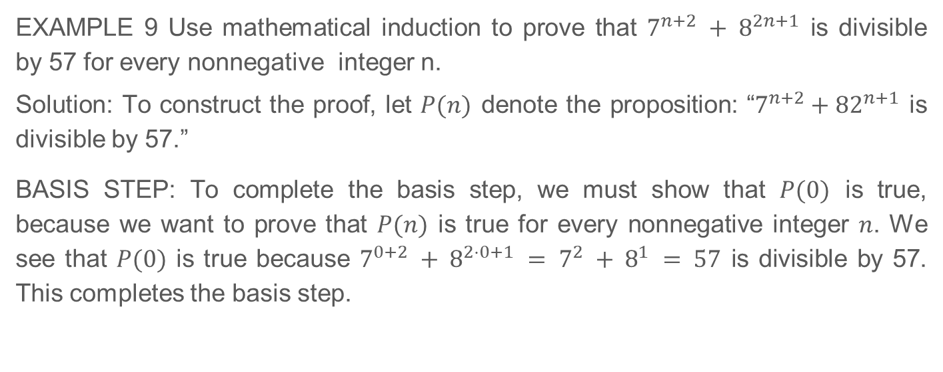
5.1 Mathematical Induction (Continued)
EXAMPLE 9 Use mathematical induction to prove that $7^{n+2} + 8^{2n+1}$ is divisible by 57 for every nonnegative integer n.
Solution: To construct the proof, let $P(n)$ denote the proposition: “$7^{n+2}+{82}^{n+1}$ is divisible by 57.”
BASIS STEP: To complete the basis step, we must show that $P(0)$ is true, because we want to prove that $P(n)$ is true for every nonnegative integer $n$. We see that $P(0)$ is true because $7^{0+2} + 8^{2⋅0+1} = 7^{2} + 8^{1} = 57$ is divisible by 57. This completes the basis step.

Slide 12
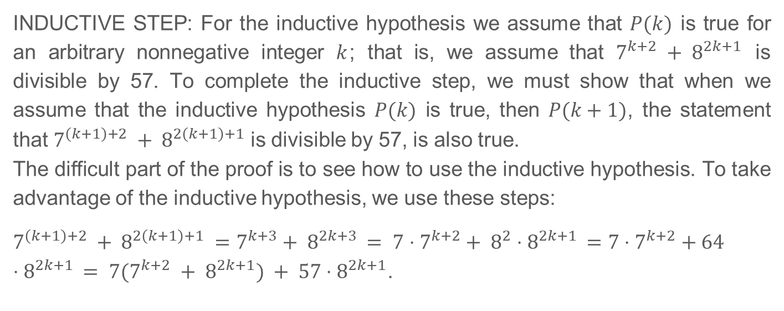
5.1 Mathematical Induction (Continued)
INDUCTIVE STEP: For the inductive hypothesis we assume that $P(k)$ is true for an arbitrary nonnegative integer $k$; that is, we assume that $7^{k+2} + 8^{2k+1}$ is divisible by 57. To complete the inductive step, we must show that when we assume that the inductive hypothesis $P(k)$ is true, then $P(k+1)$, the statement that $7^{\left(k+1\right)+2} + 8^{2\left(k+1\right)+1}$ is divisible by 57, is also true.
The difficult part of the proof is to see how to use the inductive hypothesis. To take advantage of the inductive hypothesis, we use these steps:
$7^{\left(k+1\right)+2} + 8^{2\left(k+1\right)+1} =7^{k+3}+ 8^{2k+3} = 7⋅7^{k+2}+ 8^{2}⋅8^{2k+1} =7⋅7^{k+2}+64⋅8^{2k+1} = 7(7^{k+2} + 8^{2k+1}) + 57⋅8^{2k+1}$.

Slide 13
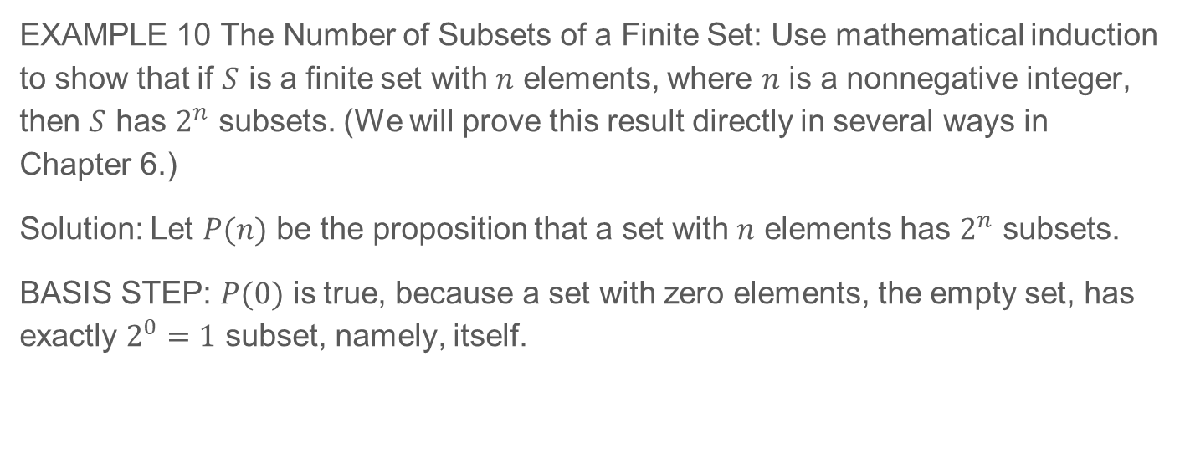
5.1 Mathematical Induction (Continued)
EXAMPLE 10 The Number of Subsets of a Finite Set: Use mathematical induction to show that if $S$ is a finite set with $n$ elements, where $n$ is a nonnegative integer, then $S$ has $2^{n}$ subsets. (We will prove this result directly in several ways in Chapter 6.)
Solution: Let $P(n)$ be the proposition that a set with $n$ elements has $2^{n}$ subsets.
BASIS STEP: $P(0)$ is true, because a set with zero elements, the empty set, has exactly $2^{0}=1$ subset, namely, itself.

Slide 14
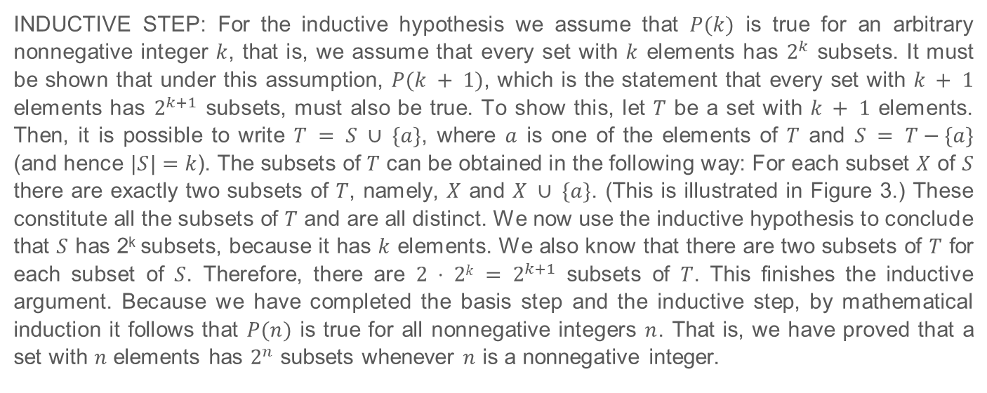
5.1 Mathematical Induction (Continued)
INDUCTIVE STEP: For the inductive hypothesis we assume that $P(k)$ is true for an arbitrary nonnegative integer $k$, that is, we assume that every set with $k$ elements has $2^{k}$ subsets. It must be shown that under this assumption, $P(k + 1)$, which is the statement that every set with $k + 1$ elements has $2^{k+1}$ subsets, must also be true. To show this, let $T$ be a set with $k + 1$ elements. Then, it is possible to write $T = S ∪ \{a\}$, where $a$ is one of the elements of $T$ and $S = T−\{a\}$ (and hence $|S|=k$). The subsets of $T$ can be obtained in the following way: For each subset $X$ of $S$ there are exactly two subsets of $T$, namely, $X$ and $X ∪ \{a\}$. (This is illustrated in Figure 3.) These constitute all the subsets of $T$ and are all distinct. We now use the inductive hypothesis to conclude that $S$ has 2^{k} subsets, because it has $k$ elements. We also know that there are two subsets of $T$ for each subset of $S$. Therefore, there are $2 ⋅ 2k = 2^{k+1}$ subsets of $T$. This finishes the inductive argument. Because we have completed the basis step and the inductive step, by mathematical induction it follows that $P(n)$ is true for all nonnegative integers $n$. That is, we have proved that a set with $n$ elements has $2^{n}$ subsets whenever $n$ is a nonnegative integer.

Slide 15
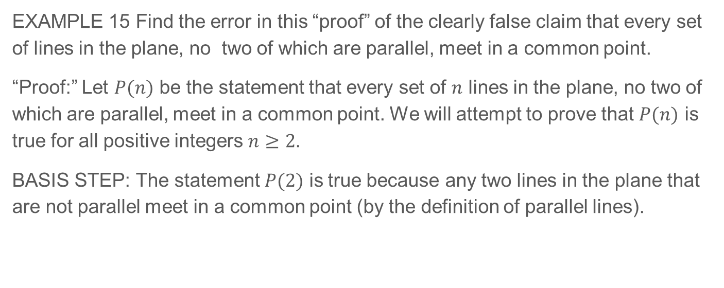
5.1.8 Mistaken Proofs By Mathematical Induction
EXAMPLE 15 Find the error in this “proof” of the clearly false claim that every set of lines in the plane, no two of which are parallel, meet in a common point.
“Proof:” Let $P(n)$ be the statement that every set of $n$ lines in the plane, no two of which are parallel, meet in a common point. We will attempt to prove that $P(n)$ is true for all positive integers $n≥2$.
BASIS STEP: The statement $P(2)$ is true because any two lines in the plane that are not parallel meet in a common point (by the definition of parallel lines).

Slide 16
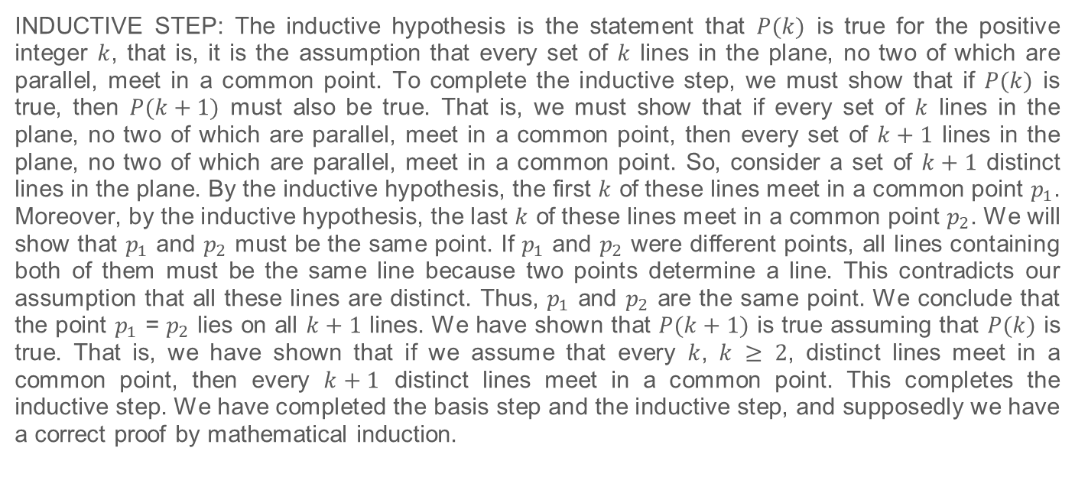
5.1.8 Mistaken Proofs By Mathematical Induction (Continued)
INDUCTIVE STEP: The inductive hypothesis is the statement that $P(k)$ is true for the positive integer $k$, that is, it is the assumption that every set of $k$ lines in the plane, no two of which are parallel, meet in a common point. To complete the inductive step, we must show that if $P(k)$ is true, then $P(k+1)$ must also be true. That is, we must show that if every set of $k$ lines in the plane, no two of which are parallel, meet in a common point, then every set of $k+1$ lines in the plane, no two of which are parallel, meet in a common point. So, consider a set of $k+1$ distinct lines in the plane. By the inductive hypothesis, the first $k$ of these lines meet in a common point $p_{1}$. Moreover, by the inductive hypothesis, the last $k$ of these lines meet in a common point $p_{2}$. We will show that $p_{1}$ and $p_{2}$ must be the same point. If $p_{1}$ and $p_{2}$ were different points, all lines containing both of them must be the same line because two points determine a line. This contradicts our assumption that all these lines are distinct. Thus, $p_{1}$ and $p_{2}$ are the same point. We conclude that the point $p_{1}$ = $p_{2}$ lies on all $k+1$ lines. We have shown that $P(k+1)$ is true assuming that $P(k)$ is true. That is, we have shown that if we assume that every $k$, $k ≥ 2$, distinct lines meet in a common point, then every $k+1$ distinct lines meet in a common point. This completes the inductive step. We have completed the basis step and the inductive step, and supposedly we have a correct proof by mathematical induction.

