Slide 1
DTA-Driver aims to drive away data gaps related to data-driven applications.
Team 10:Deadline-Driven

Slide 2

Motiviation
Photo by Joshua Sortino on Unsplash

Slide 3


Why Edge Compute is important?
In the following scenarios the traditional approach will be inefficient
The amount of collected data overwhelms the computing power of the central device;
Certain data preprocessing is needed on edge devices. For example, data compression may be required if transmission bandwidth or memory capacity is limited
Photo by Mouh2DZ and OpenClipart-Vectors on pixabay

Slide 4
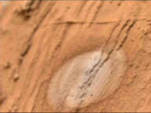

Method-Vision Data
Super Resolution
Downsample

Slide 5
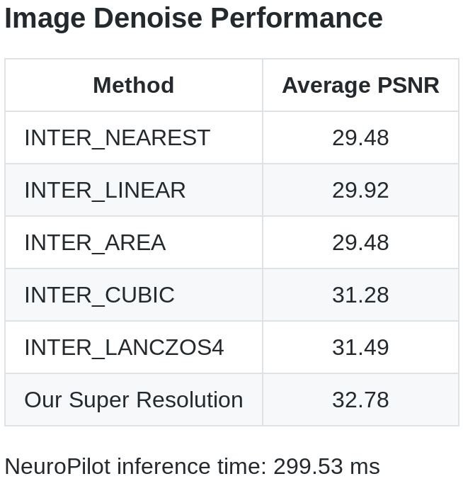
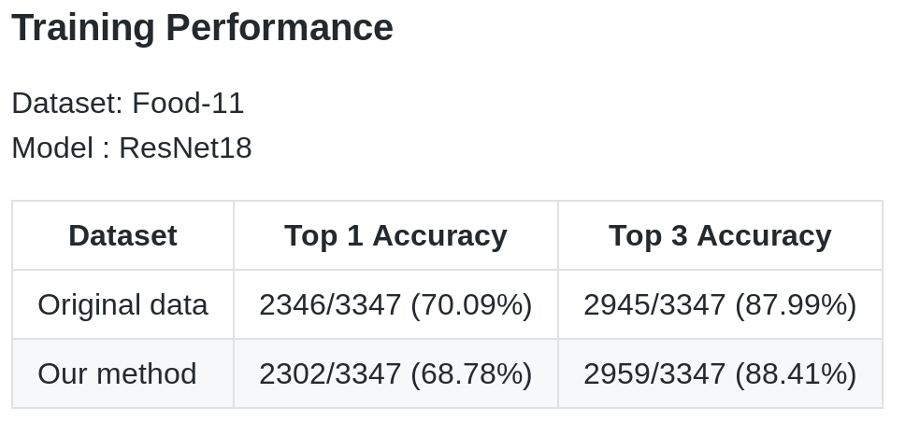
Performance

Slide 6
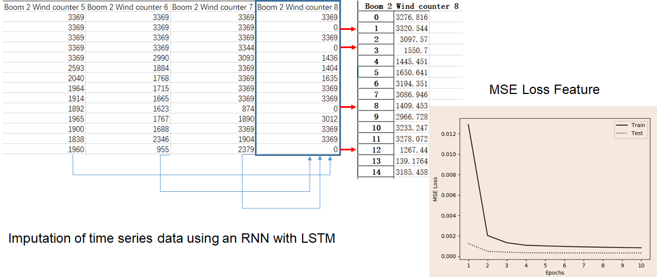
Method-Time-Series Data

Slide 7
Future Improvement
Using quantization techniques to make model size smaller and more efficient
Most deep learning acceleration solution focus on accelerating quantized model
On-device learning is the key component for edge AI
Model will keep improve itself after deploy
Using Network Architecture Search to find the better fit model before deploy to edge device
The diverse data type and device type need dedicated model

Slide 8
Reference
Real-Time Single Image and Video Super-Resolution Using an Efficient Sub-Pixel Convolutional Neural Network
MediaTek NeuroPilot
OpenCV
Atmosphere data on Mars collected by Curiosity

Slide 9

Backup

