Slide 1
Intelligent video surveillance using deep learning
By
1) R.J.Prahadeesh (822720104705)
2) K.Arunachalam (822720104704)
3) S.Ashok kumar (822720104007)
4) M.chidhambararaj (822720104703)
Under the Guidance of
Dr. K. SANTHOSH KUMAR

Slide 2
CONTENTS
OVERVIEW OF DOMAIN
ABSTRACT
OBJECTIVES
EXISTING WORK
PROPOSED WORK
ADVANTAGES OF PROPOSED WORK
DETAILS OF THE TOOLS FOR IMPLEMENTATION

Slide 3
OVERVIEW OF DOMAIN
Intelligent video surveillance refers to the use of advanced technologies such as machine learning, computer vision, and artificial intelligence to enhance traditional video surveillance systems. It enables the detection of specific objects, behaviors, and events in real-time and can automatically alert authorities to potential threats or suspicious activities.
Intelligent video surveillance systems use cameras and sensors to collect visual data, which is then analyzed using algorithms to identify patterns, anomalies, and other relevant information. This information can be used to improve security and safety in a variety of settings, including public spaces, commercial buildings, and private residences.
Some of the key features of intelligent video surveillance systems include facial recognition, object tracking, license plate recognition, and motion detection. These features can help identify individuals and track their movements, as well as recognize and track vehicles and other objects.
Overall, intelligent video surveillance has the potential to greatly enhance security and safety in a variety of settings, while also reducing the need for human intervention and improving the efficiency of security operations.

Slide 4
DOMAIN: deep learning
Intelligent video surveillance refers to the use of advanced technologies, such as artificial intelligence (AI), computer vision, and machine learning, to analyze video footage captured by surveillance cameras in order to detect, track, and respond to potential security threats or suspicious activities.
In the intelligent video surveillance domain, algorithms are trained to recognize and classify specific objects or events, such as people, vehicles, or suspicious behaviors, and to generate alerts or notifications in real-time when certain criteria are met. These alerts can be sent to security personnel or integrated with other security systems, such as access control or alarm systems.
Intelligent video surveillance can be used in a variety of settings, such as public spaces, airports, banks, retail stores, and transportation hubs. The technology can help enhance public safety, improve situational awareness, and provide valuable insights for security and business operations. However, it also raises concerns about privacy and the potential misuse of surveillance data. Therefore, it is important to implement proper safeguards and ethical guidelines when using intelligent video surveillance systems

Slide 5
ABSTRACT:
An intelligent video surveillance system is a project that involves developing a system capable of detecting and tracking objects in real-time using video footage. The system uses various techniques such as computer vision, machine learning, and deep learning to analyze video data and identify potential threats or suspicious behavior. The project aims to enhance the security of public areas by providing a reliable and efficient surveillance system that can alert security personnel in real-time. The system can also be used in traffic management, crowd control, and other applications that require real-time analysis of video data. The project requires a team of experts in computer vision, machine learning, and software development to design and implement the system

Slide 6
objectives
Enhancing security
Crime prevention
Crowd control
Traffic monitoring
Emergency response
Behavioral analysis

Slide 7
Existing work

Slide 8
existing work
Object detection and tracking: Object detection is the process of detecting specific objects in an image or video frame. Tracking is the process of following the detected object as it moves through the scene. There are many algorithms available for object detection and tracking, including YOLO, Faster R-CNN, and OpenCV.
Activity recognition: Activity recognition involves identifying and classifying human activities in a video stream. This can include actions like walking, running, and sitting, as well as more complex activities like fighting, stealing, and loitering. Many different machine learning algorithms can be used for activity recognition, including deep neural networks, support vector machines, and decision trees.
Facial recognition: Facial recognition is the process of identifying individuals in a video stream based on their facial features. This can be used to track individuals as they move through a space, to identify known criminals or persons of interest, or to match faces against a watchlist. Facial recognition algorithms often use deep learning techniques to analyze and interpret facial features.

Slide 9
Disadvantages with the existing work

Slide 10
Disadvantages :
Privacy concerns: One of the biggest concerns with intelligent video surveillance is privacy. People may feel uncomfortable with the idea of being constantly monitored, and there is a risk that the data collected could be misused or stolen.
Cost: Intelligent video surveillance systems can be expensive to install and maintain, especially in large or complex environments. This can make it difficult for smaller businesses or organizations to adopt this technology.
False positives: Intelligent video surveillance systems are not perfect and can sometimes generate false alarms or alerts. This can lead to wasted time and resources as security personnel investigate these false positives.
Bias: There is a risk that intelligent video surveillance systems could be biased against certain groups of people, such as those from specific racial or ethnic backgrounds. This could result in unfair treatment or even harm to innocent individuals.
Technical limitations: Intelligent video surveillance systems rely on advanced technology such as machine learning algorithms, and these algorithms may not always be accurate or effective. Additionally, the quality of video feeds can vary depending on factors such as lighting and weather, which can impact the accuracy of these systems.

Slide 11
Proposed work

Slide 12
Proposed work :
Object Detection and Tracking: One of the most important tasks in intelligent video surveillance is detecting and tracking objects in the video stream. Many algorithms have been proposed for this task, including traditional methods like background subtraction, and more recent deep learning-based methods like YOLO (You Only Look Once) and Mask R-CNN.
Activity Recognition: Another important task in intelligent video surveillance is recognizing human activities in the video stream. This can include actions like walking, running, and even more complex activities like fighting or stealing. Researchers have proposed a variety of approaches for activity recognition, including rule-based methods, feature-based methods, and deep learning-based methods.
Anomaly Detection: One of the main goals of intelligent video surveillance is to detect unusual or suspicious behavior. Anomaly detection algorithms are designed to identify events that deviate from normal patterns of behavior, such as people entering restricted areas or objects being left unattended.
Video Analytics: In addition to detecting and tracking objects and activities, intelligent video surveillance systems can also perform a variety of other tasks, such as counting the number of people in a particular area, measuring the speed and direction of moving objects, and detecting changes in lighting conditions

Slide 13
Proposed work in the field of intelligent video surveillance includes:
Multi-Camera Systems: One area of research that is currently gaining attention is the development of intelligent video surveillance systems that use multiple cameras to capture a wider field of view. These systems can be used to track objects or activities across multiple cameras, or to provide a more complete picture of a particular area.
Deep Learning: Another area of active research is the use of deep learning techniques to improve the accuracy and efficiency of intelligent video surveillance algorithms. Researchers are exploring the use of convolutional neural networks (CNNs), recurrent neural networks (RNNs), and other deep learning architectures to solve a variety of problems in this field.
Privacy-Preserving Techniques: With the increasing use of intelligent video surveillance in public spaces, privacy concerns have become an important issue. Researchers are exploring a variety of techniques for preserving privacy while still allowing intelligent video surveillance systems to function effectively. These techniques may include blurring or obscuring faces or other identifying features, or using encryption to protect sensitive data.
Real-Time Processing: As the volume of video data generated by intelligent video surveillance systems continues to grow, real-time processing has become a critical challenge. Researchers are exploring ways to improve the speed and efficiency of video processing algorithms, such as by using distributed computing or specialized hardware like GPUs

Slide 14

ENHANCING SECURITY
One of the primary objectives of intelligent video surveillance is to enhance security by detecting and alerting security personnel to potential security threats. This can include the detection of suspicious individuals, vehicles, or objects that could pose a security risk.

Slide 15
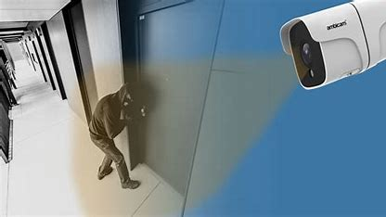
Crime prevention
Intelligent video surveillance can also be used to prevent crimes before they occur. By detecting suspicious activity and alerting security personnel, potential criminals can be deterred from committing crimes.

Slide 16
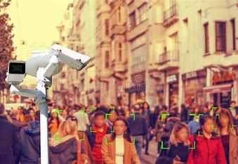
Crowd control
Intelligent video surveillance can be used to monitor crowds and detect potentially dangerous situations, such as overcrowding or disturbances. This can help prevent accidents and ensure the safety of the public.

Slide 17
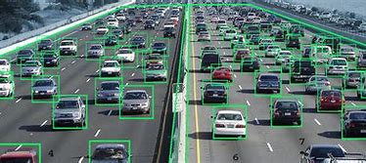
Traffic monitoring
Intelligent video surveillance can be used to monitor traffic and detect potential traffic violations, such as running red lights or speeding. This can help improve traffic flow and reduce accidents.

Slide 18
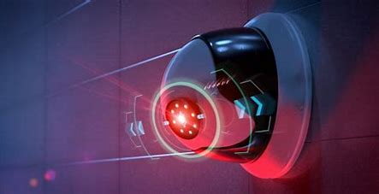
Emergency response
Intelligent video surveillance can be used to detect and respond to emergency situations, such as fires or natural disasters. By detecting these situations early, emergency responders can be alerted and respond more quickly.

Slide 19
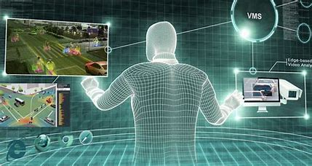
Behavioral analysis
Intelligent video surveillance can be used to analyze the behavior of individuals and detect anomalies that may indicate criminal activity. This can help security personnel detect and prevent crimes.

Slide 20
Advantages of Proposed work

Slide 21
Advantages :
INCREASED ACCURACY: Intelligent video surveillance systems can analyze video footage in real-time, which allows for more accurate and timely detection of suspicious activity.
IMPROVED EFFICIENCY: By automating the surveillance process, intelligent video surveillance systems can reduce the need for human operators and improve overall efficiency.
ENHANCED SECURITY: Intelligent video surveillance systems can be used to monitor and detect potential security threats in public areas

Slide 22
modules

Slide 23
intelligent video surveillance moduleS
VIDEO INPUT MODULE: This module is responsible for capturing video data from various sources, such as cameras, and converting it into a digital format for processing.
PRE-PROCESSING MODULE: This module performs basic image processing tasks such as filtering, noise reduction, and image enhancement to improve the quality of the video data.
OBJECT DETECTION MODULE: This module uses computer vision and machine learning algorithms to detect and recognize objects in the video data.
OBJECT TRACKING MODULE: This module tracks the movement of the detected objects over time and predicts their future positions.
EVENT DETECTION MODULE: This module analyzes the object tracking data to detect events or behaviors that may indicate potential threats or suspicious activity.
ALERT MODULE: This module generates alerts to security personnel or other authorized individuals when potential threats or suspicious activity is detected.

Slide 24
Some of the features of an intelligent video surveillance module include:
Object detection and tracking.
Vehicle Crash Detection.
Motion detection.
Fall detection.
Social Distancing Detection.
Overall, an intelligent video surveillance module provides advanced security features that can help organizations to improve their security and safety.

Slide 25
SOFTWARE AND HARDWARE Requirements:
SOFTWARE REQUIREMENTS:
Python
VS Code
Pycharm
HARDWARE REQUIREMENTS:
Windows 7 os
Ram: 8 GB (Required)

Slide 26
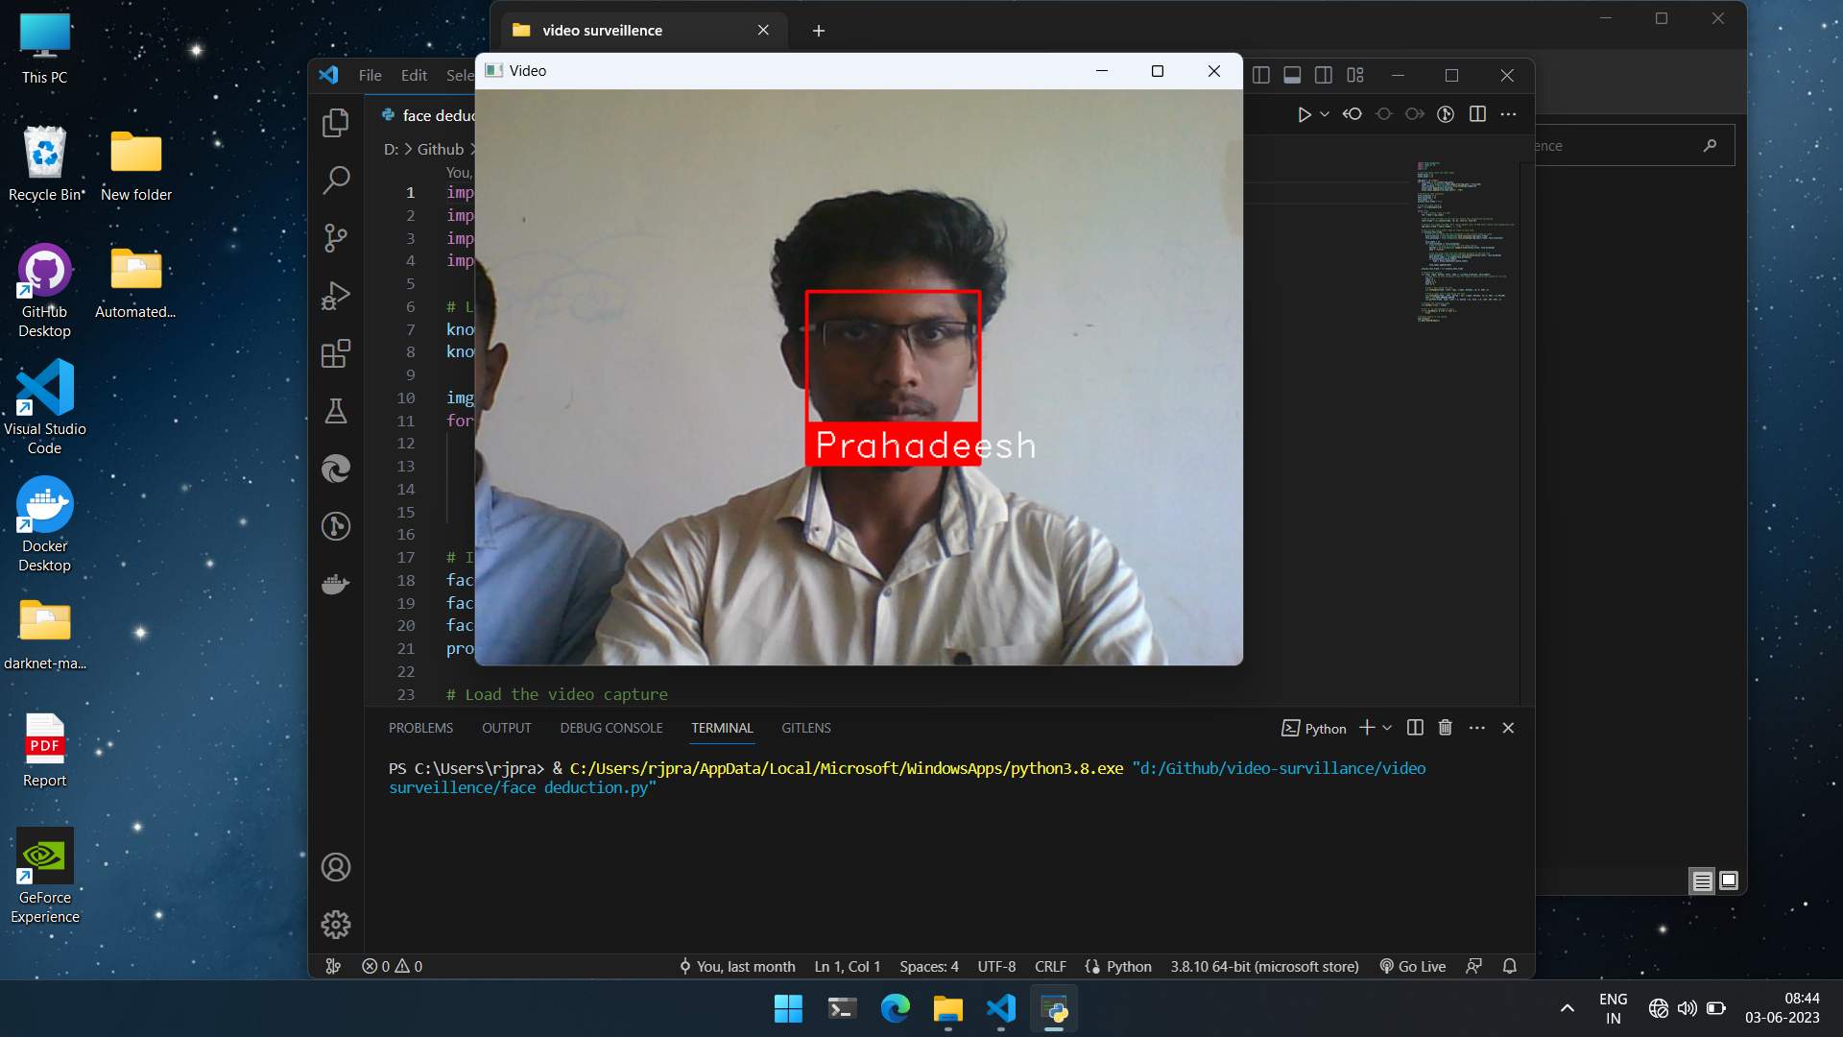

RESULT & Output:

Slide 27
References:
“Advance Intelligent Video Surveillance System (AIVSS): A Review” - IntechOpen
“Design of an intelligent video surveillance system for crime prevention and detection” - SpringerLink
“What is an Intelligent Video Surveillance System?” - EPIC iO
“Intelligent Video Surveillance Systems” - IEEE Conference Publication
“A Systematic Review of Intelligence Video Surveillance: Trends, Challenges, and Opportunities” - IEEE Xplore
“Intelligent video surveillance: a review through deep learning techniques” - Journal of Big Data

Slide 28
Thank you

