Slide 1

Car Dealership Management System (CDMS)
Made by: Tristan Beason, Prohor Muchev, Jovan Tone & Erol Balkan
Mentors: Goce Gavrilov & Viktor Denkovski

Slide 2
Introduction:
CDMS is a software solution designed to streamline vehicle inventory management, sales processes, and service operations in car dealerships. This system aims to enhance dealership efficiency, improve customer satisfaction, and optimize business performance. In this presentation, we will talk about the key features, functionalities, and benefits of CDMS, emphasizing its role in modernizing dealership operations.

Slide 3
Goals:
1. Objective:
Revolutionizing dealership management by providing a centralized platform with robust features and intuitive interfaces.
2. Focus Areas:
Inventory Management: Streamline inventory management
Customer Interaction: Enhance customer interaction
Sales Performance Tracking: Track and analyze sales performance
Service Operations Maintenance: Optimize service operations

Slide 4
User Personas:
Sales Managers:
Service Technicians:
Responsible for overseeing sales operations, tracking performance metrics, and analyzing sales trends to improve sales strategies and outcomes.
Tasked with performing vehicle maintenance, inspections, and repairs to ensure optimal vehicle performance and high customer satisfaction.
Finance Managers:
Customers:
Involved in managing financial transactions, processing sales contracts, and facilitating financing options for customers, ensuring smooth financial operations.
Individuals interested in purchasing or leasing vehicles from the dealership. They seek information, schedule test drives, and make inquiries about available inventory and pricing.

Slide 5
Functional Requirements
Inventory Management:
User Access Control:
The system provides real-time visibility into the dealership's vehicle inventory, allowing users to view, update, and track vehicle details such as model, brand, price, and specifications like license plate numbers. Key functionalities include adding, updating, and deleting vehicle listings, categorizing vehicles based on attributes and facilitating search and retrieval.
Role-based access control ensures that users only have access to the information and functionalities relevant to their roles within the dealership, ensuring security and efficiency.

Slide 6
Functional Requirements
Sales Tracking:
Customer Interaction:
Maintenance Management:
Sales managers can monitor sales performance, track vehicle sales, and generate sales reports to analyze trends and identify opportunities for improvement.
Customers can browse the dealership's inventory online, view detailed vehicle information, schedule test drives, and make online inquiries about vehicle availability and pricing, enhancing communication with dealership staff.
Service technicians can access vehicle service history and create maintenance schedules to efficiently perform vehicle inspections, maintenance, and repairs.

Slide 7
Quality Requirements:
1
Reliability:
2
Usability:
3
Performance:
Consistent and accurate operations
Intuitive interfaces and navigation
High-volume support and real-time updates
4
Security:
5
Scalability:
Robust data protection and cybersecurity
Accommodating growth and expansion
Ensuring consistent and accurate CDMS operation, intuitive interfaces for efficient user tasks, optimized performance for high volumes, robust security measures, and scalable design.

Slide 8


The Code - Java Spring Boot Application Overview:
The Vehicle Application was developed using Java Spring Boot, a framework for building Java applications and it was coded in IntelliJ IDEA.
Key Java Components:
Controllers: Defines RESTful endpoints for handling HTTP requests.
Services: Contains business logic for vehicle operations.
Repositories: Interface for querying and manipulating vehicle data.
Configuration Classes: Defines bean configurations and initialization logic.
Application Properties: Contains configuration properties for the Spring Boot application.
Commands HTTP File: Contains sample HTTP requests for interacting with the application's RESTful endpoints.

Slide 9
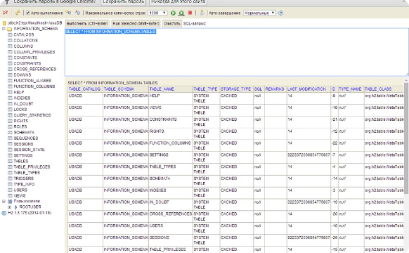
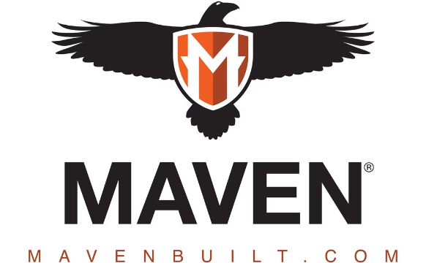
Database and Dependency Management:
H2 In-Memory Database:
Apache Maven:
The app uses an H2 in-memory database, configured via Spring Boot's default database properties in the 'application.properties' file. It provides a lightweight, embedded solution for development and testing without requiring an external database setup. The schema is automatically created based on the entity mappings in the Vehicle class.
The project uses Apache Maven as a build automation tool and dependency management system. The 'pom.xml' file defines the project metadata, dependencies, plugins, and build configurations, ensuring all necessary components are included and correctly configured for the app to run smoothly.

Slide 10
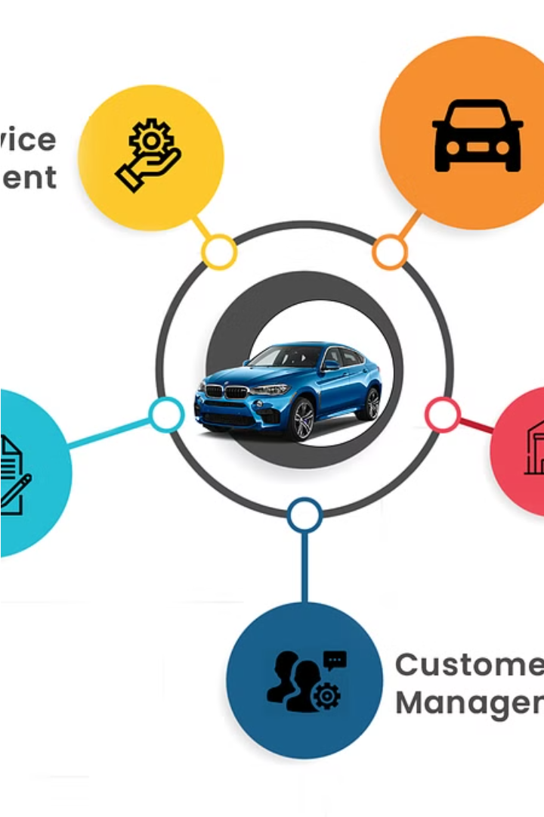
Conclusion:
In summary, the development of our Car Dealership Management System using Java Spring Boot has been a meticulous process aimed at delivering a comprehensive solution for modern car dealerships. By leveraging the robustness of Spring Boot and the efficiency of Spring Data JPA, we have crafted a scalable and efficient application architecture.

