Slide 1
Heuristic Evaluation
Manuel Sammer, Lukas Kloiber, Marius Laffer, Manuel Moser

Slide 2
Graztourismus
Official tourist website of Graz
Reference website
Tries to provide everything tourists might need when they visit or plan to visit

Slide 3
Our Team And planned devices settings – Mobile devices
Evaluator | Manuel Sammer (MS) | Lukas Kloiber (LK) | Manuel Moser (MM) | Marius Laffer (ML)
Age | 23 | 21 | 22 | 24
Gender | male | male | male | male
Device | Huawei P30 | OnePlus 7Pro | Motorola Moto g8 power | iPad 8th Generation
OS and Version | Android 10 | Oxygen OS 10.0.11 (based on Android 10) | Android 10 | iPadOS 14.4.1
Screen Size | 6.1″ | 6.67″ | 6.4″ | 10.2″
Screen Resolution | 1080x2349 | 1440x3120 | 1080x2300 | 1620x2160
Web Browser | Chrome 89.0.4389.90 m (64-Bit) | Firefox 86.1.1 | Brave 1.21.77 | Safari 605.1.15
Ad Blocker | none | none | none | none
Internet Connection | WiFi | WiFi | WiFi | WiFi
Download Speed | 45 mbps | 50 mbps | 25 mbps | 60 mbps
Browser Resolution | 1080x2349 | 1440x3120 | 1080x2300 | 1620x2160
Screen Recording Software | AZ Screen recorder | AZ Screen recorder | AZ Screen Recorder | iOS Screen Recording
Planned Date of Evaluation | 2021-04-14 | 2021-04-12 | 2021-04-12 | 2021-04-16

Slide 4
Evaluator | Manuel Sammer (MS) | Lukas Kloiber (LK) | Manuel Moser (MM) | Marius Laffer (ML)
Age | 23 | 21 | 22 | 24
Gender | male | male | male | male
Device | PC | PC | PC | PC
OS and Version | Windows 10 Education EN Build 19041 | Windwos 10 Education 20H2 19042.867 | Debian 5.10.0-4-amd64 | Windows 10 Pro DE v 2004 Build 19041.876
Screen Size | 27" | 24″ | 27″ | 24″
Screen Resolution | 1920x1080 | 1920x1080 | 2560x1440 | 1920×1080
Web Browser | Chrome 89.0.4389.90 (64-bit) | Firefox 84.0.1 | Brave 1.22.66 | Edge 89.0.774.57 (64-bit)
Ad Blocker | AdblockPlus | AdblockPlus | Brave Shield | AdBlock
Internet Connection | Magenta, xdsl | Magenta | Magenta | A1, LTE
Download Speed | 45 mbps | 50 mbps | 250 mbps | 60 mbps
Browser Resolution | 1920x1080 | 1920x1080 | 1920x1080 | 1920x1080
Screen Recording Software | OBS Studio 26.1.1 | Obs Studio 18.0.1 | OBS Studio - 26.1.2+dfsg1-1+b2 (linux) | OBS Studio 25.0.8
Planned Date of Evaluation | 021-04-15 | 2021-04-12 | 2021-04-12 | 2021-04-15
Our Team And planned devices settings - Personal Computer

Slide 5
Findings
Please ask questions!
This is not an attack on your website but helpful critique
Questions and remarks please AFTER each remark or at the end
Personal opinion! Your design might be better than our understanding of it.

Slide 6
General „Vibe“ of your Website
A lot of information provided
Bloated
Can‘t find things
Well meant but poorly done
Would prefer simpler design
“Higher” functions idea good, but often riddled with bugs
In depth information on some content

Slide 7
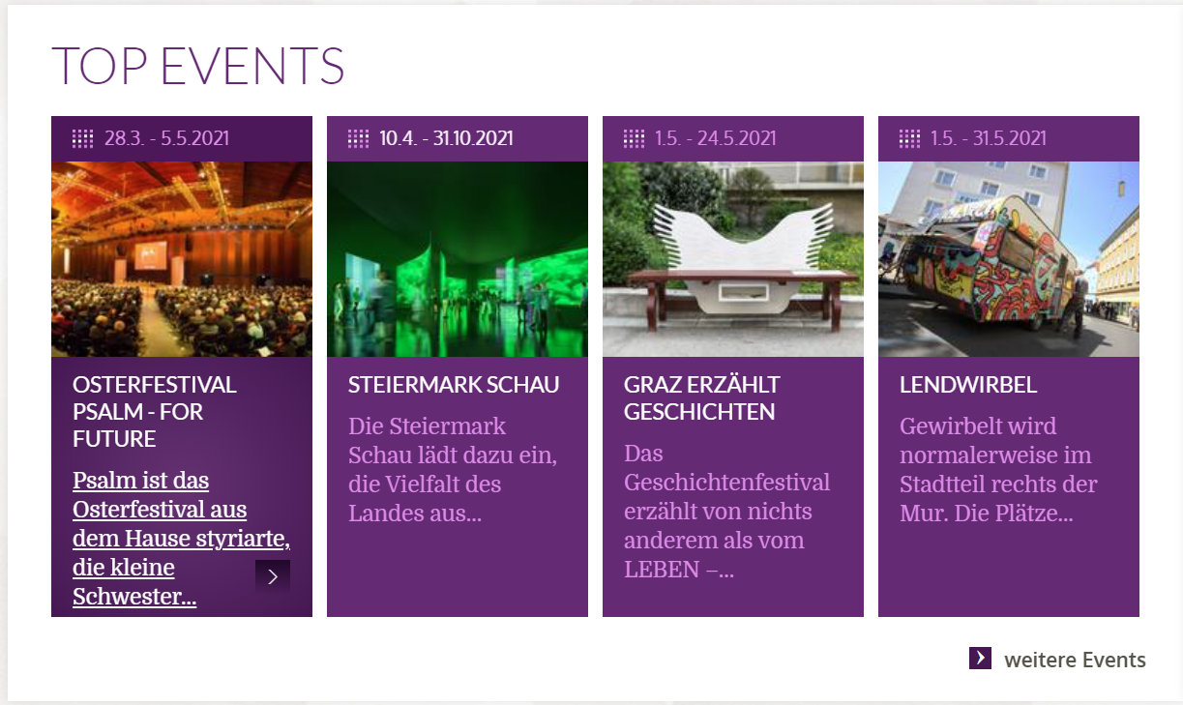
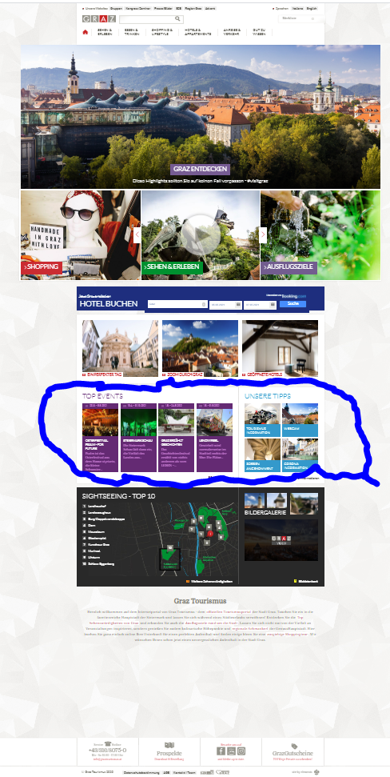
Best POsitive
Top Event Slide
Useful for all usergroups
Should be moved up maybe
Instant way to know what festivities the are in Graz

Slide 8
Negative #1
Cookie Preference´s
No way to change them
Maybe even illegal
Highly recommend to change that

Slide 9
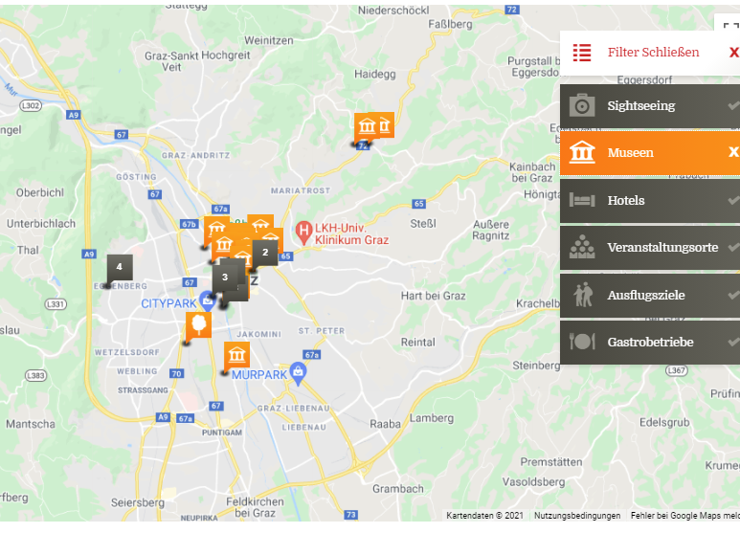
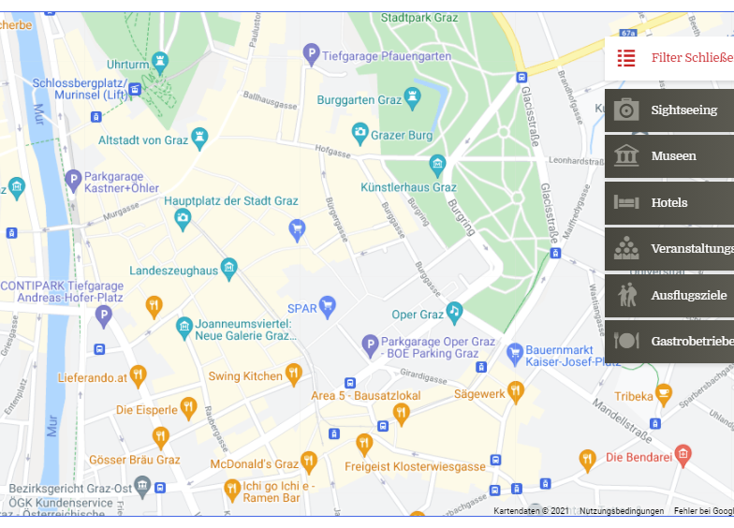
Negative #2
Interactive Map Autozoom
Autozooms the Map
Makes it very hard to use
Specific Area

Slide 10
Negative #3
Missing COVID information
No mention of „Lieferservice“ etc
Only one warning on main page
No warning on restaurant page
Notes:
The website offers several pages for different kinds of restaurant options (breakfast, dinner, etc). They inform the user on the main gastronomy guide page that restaurants are currently closed due to COVID restrictions. They do not inform the user on each option page ("Frühstücken & Branchen", "Buschenschank", etc). Also there is no information of the covid restrictions on the pages for each restaurant.

Slide 11
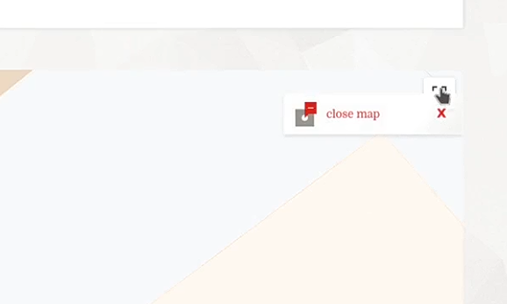
Negative #4
Overlapping buttons
Full Screen and Closing overlap
Hard to press

Slide 12
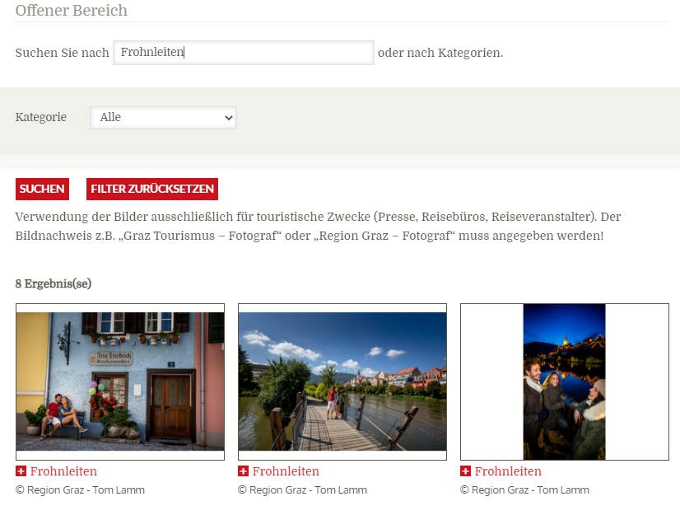
Negative #5
Picture Search not working
Wrong results shown
Example:
Search for „Frohnleiten“
Graz pictures are shown

Slide 13
Negative #6
Interactive Map Leisure Destinations
Wrong Data in Map
Zooms out to Europe
Shows destinations nearch Czech Republic

Slide 14
Negative #7
Bookmark can‘t be deleted
There is simple no way to remove a bookmark

Slide 15
Positive #2
Interactive City Plan
Has some bugs, but all in alll very good.

Slide 16
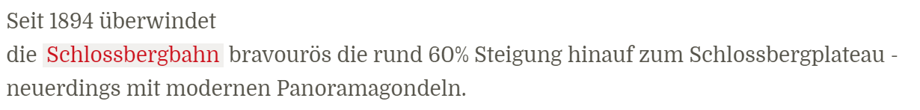
Positive #3
Keyword = Links
Most important information or Destination are links

Slide 17
Positive #4
Group activities
The site provides special suggestion for group activities

Slide 18
Positive #5
Top Sightseeing attractions
Visit the website and scroll down to the top attractions in Graz

Slide 19
Individual Remarks Lukas Kloiber, Manuel Sammer, Marius Laffer, Manuel Moser

Slide 20
Thank you for your attention

