Slide 1
SMARTROAD
Traffic Accident Risk, Severity & Hotspot Analytics Computational Analytics - Assignment 2 BCA Semester 7 | Academic Year 2026-2027 Group members: ______________________________

Slide 2
1. Problem, Goal & Data
Problem: recorded traffic collisions contain temporal, road, environmental and geographic signals that are difficult to summarize manually. Goal: build an end-to-end analytics solution that explores collision patterns, identifies geographic hotspots, and classifies whether a reported collision is high severity. Dataset: official UK Department for Transport STATS19 collision CSV for 2025. Records processed: 101,525.

Slide 3
2. Analytics Pipeline
Acquire -> Clean -> EDA -> Feature Engineering -> Train/Test -> 5-Fold Cross-Validation -> Evaluation -> Hotspot Clustering -> Dashboard Python stack: Pandas, NumPy, Matplotlib, Seaborn, Scikit-learn, Streamlit, Plotly.

Slide 4
3. Preprocessing & Feature Engineering
Cleaning: duplicate removal, date/time parsing, numeric validation, median/mode imputation and one-hot encoding. Engineered features: hour, month, weekend, night, rush_hour, multi_vehicle and modeled road/environment indicators. Target: high_severity = Fatal or Serious; 0 = Slight. Target prevalence in the 2025 data: 26.24%.

Slide 5
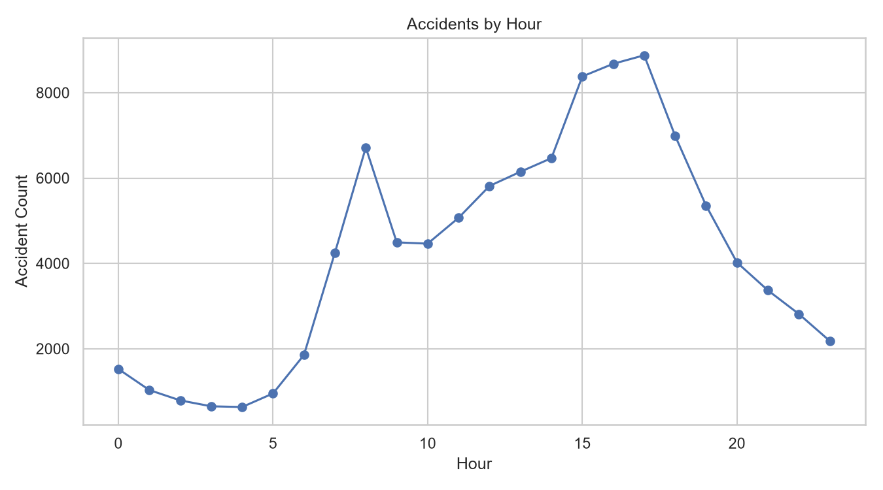
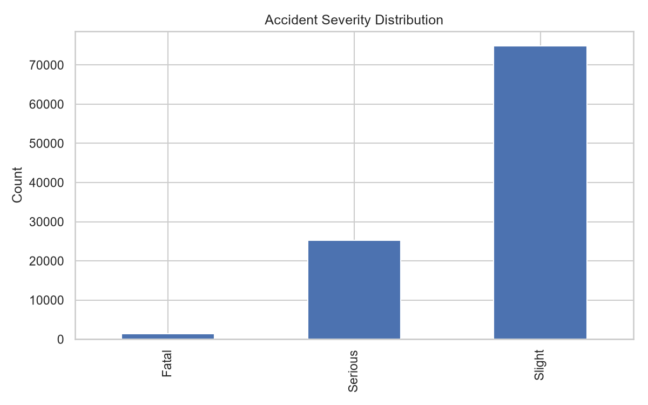
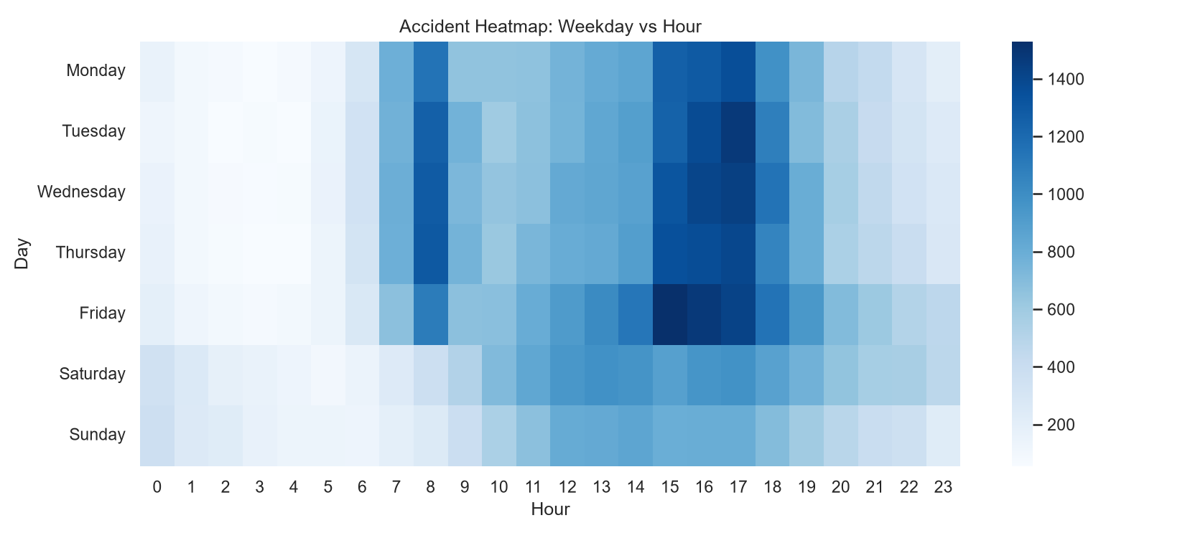
4. Visual Analytics
Real 2025 visual analytics
• Accident counts by hour reveal strong concentration during daytime and evening periods.
• Severity distribution shows Slight collisions as the largest class, followed by Serious and Fatal.
• The weekday-hour heatmap highlights recurring temporal concentration, especially during weekday peak periods.
Eight real 2025 PNG outputs were generated: six EDA charts plus the confusion matrix and model-comparison chart.
Representative real 2025 EDA outputs

Slide 6
5. Machine Learning Model Comparison
Model Accuracy Precision Recall F1 CV F1 Random Forest 65.01% 33.85% 34.92% 34.38% 34.59% Logistic Regression 57.33% 32.60% 58.66% 41.91% 41.85% Gradient Boosting 60.58% 34.12% 53.95% 41.80% 42.09% Selected model: Gradient Boosting, based on the highest mean 5-fold cross-validated F1.

Slide 7
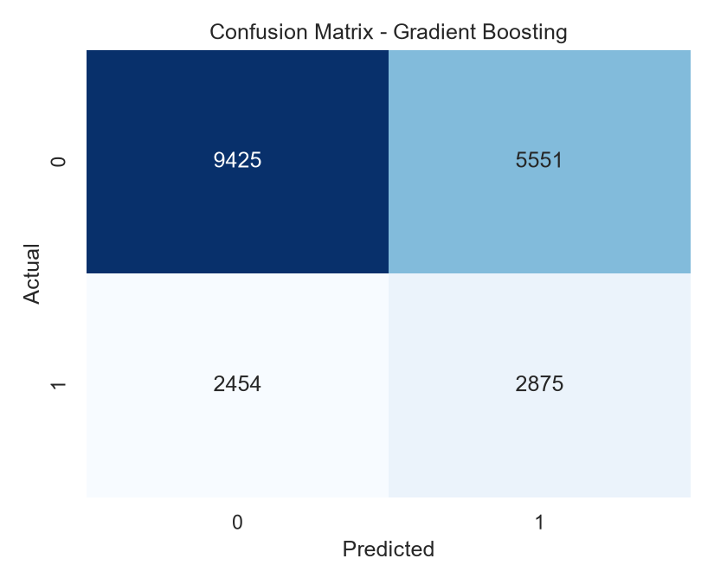
6. Final Evaluation
Selected model: Gradient Boosting
Accuracy: 60.58%
Precision: 34.12%
Recall: 53.95%
F1-score: 41.80%
5-fold CV F1: 42.09% ± 0.24%
The confusion matrix is included to show true/false classifications for the high-severity class. F1 is emphasized because the positive class represents 26.24% of the 2025 records.
Figure: Gradient Boosting confusion matrix - official 2025 run

Slide 8
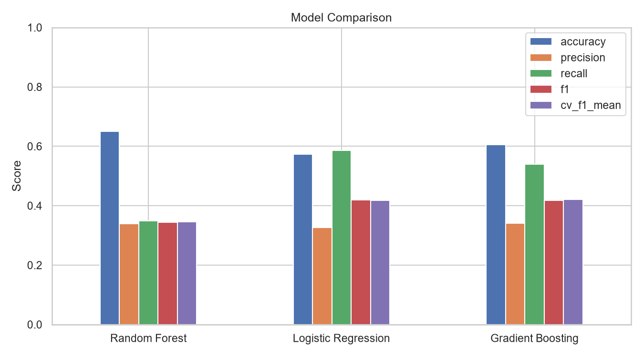
7. Feature Importance & Hotspots
Top features in the final 2025 run
1. number_of_vehicles - 0.04165
2. urban_or_rural_area - 0.01993
3. speed_limit - 0.01917
4. road_type - 0.01271
5. hour - 0.00727
K-Means groups valid latitude/longitude records into exploratory geographic clusters and ranks them using collision volume and high-severity rate.
Figure: Three-model comparison - official 2025 run

Slide 9
8. Interactive Dashboard
Streamlit dashboard functions: - KPI cards for collision count, high-severity count/rate and average vehicles - Severity and hourly interactive charts - Geographic visualization - Adjustable K-Means hotspot clustering - Model comparison and confusion matrix - High-severity prediction form - Data-quality summary The dashboard uses data/road_collisions_2025.csv when present and otherwise falls back to the demo dataset for local software testing.

Slide 10
9. Conclusion, Deliverables & Future Scope
Conclusion: SmartRoad implements the requested analytics lifecycle from acquisition through predictive modeling, evaluation, clustering and dashboard delivery. Deliverables: source code, dataset, charts, report, presentation and requirements file. Future scope: live traffic/weather APIs, exposure-adjusted risk, explainable AI, probability calibration and cloud deployment. Presentation length: designed for the professor requirement of 8-10 slides and a maximum 10 minutes.

