Slide 1
T
BLK
T
BLK
T
BLK
T
BLK
T
BLK
T
BLK
T
BLK
T
BLK
data

Slide 2
A1
A2
A3
A4
A5
A6
A7
A8
A9
A10
A11
A12
A13
A14
NB
High
NB
Low

Slide 3
Record 1
45
1328
49
1526
59
1702
43
1899
44
1615
45
1203
34
1525
2
…

Slide 4
23
DBLK
1
35
DBLK
10
50
DBLK
19
-
-
-
-
-
-
-
-
-
-

Slide 5
Record S
78
59
49
45
44
44
34
2
…
75
69
59
48
44
34
34
10
…
34
33
…
…
9
…
20
19
…
…
8
…
A
Record S
78
59
49
45
44
44
34
2
…
75
69
59
48
44
34
34
10
…
34
33
…
…
9
…
20
19
…
…
8
…
B

Slide 6
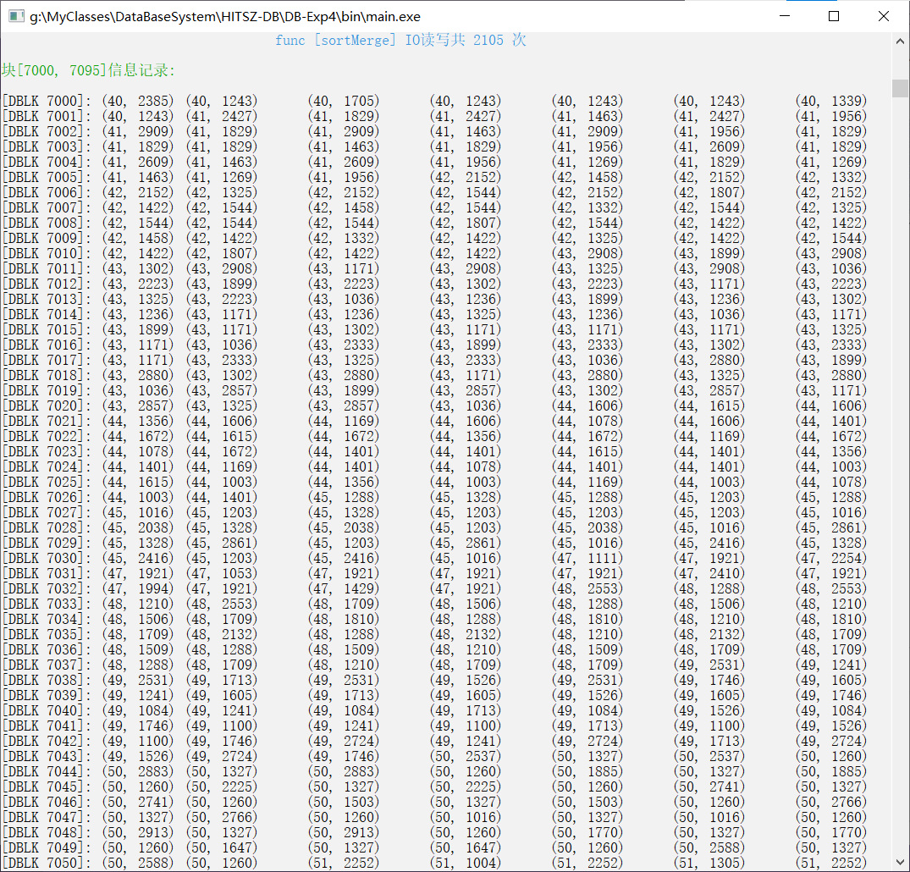
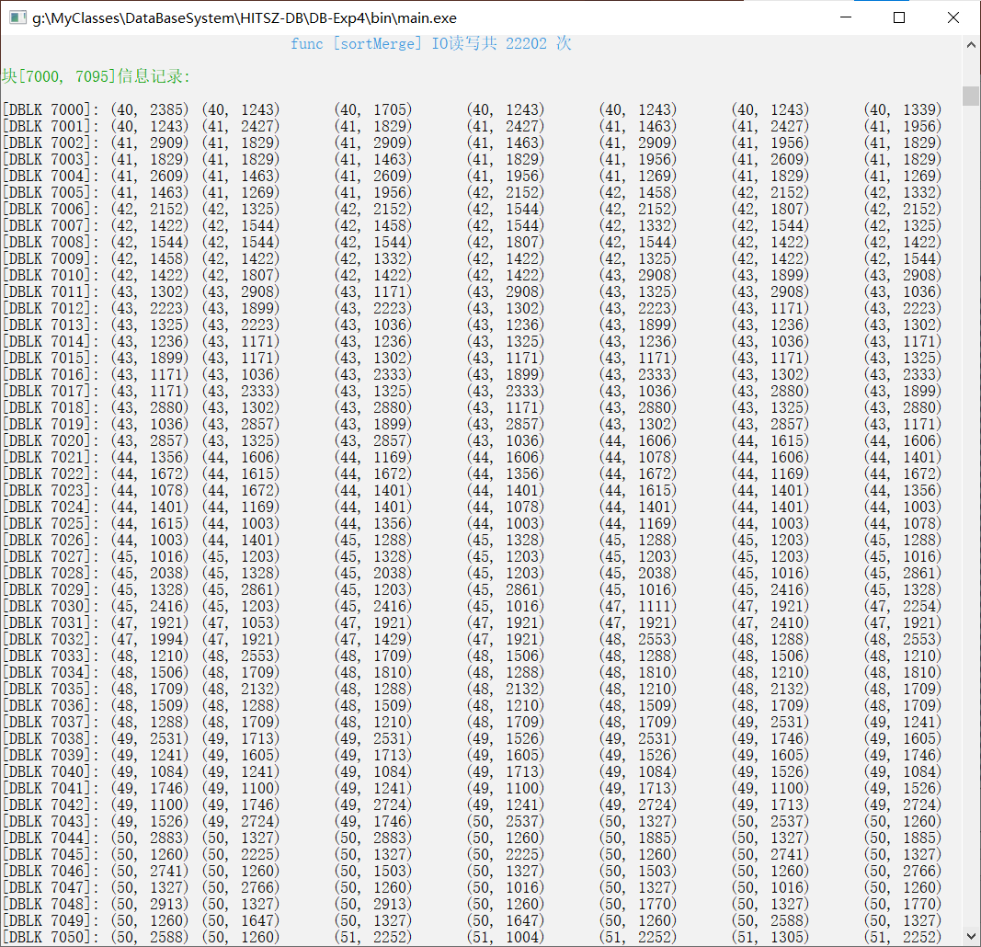
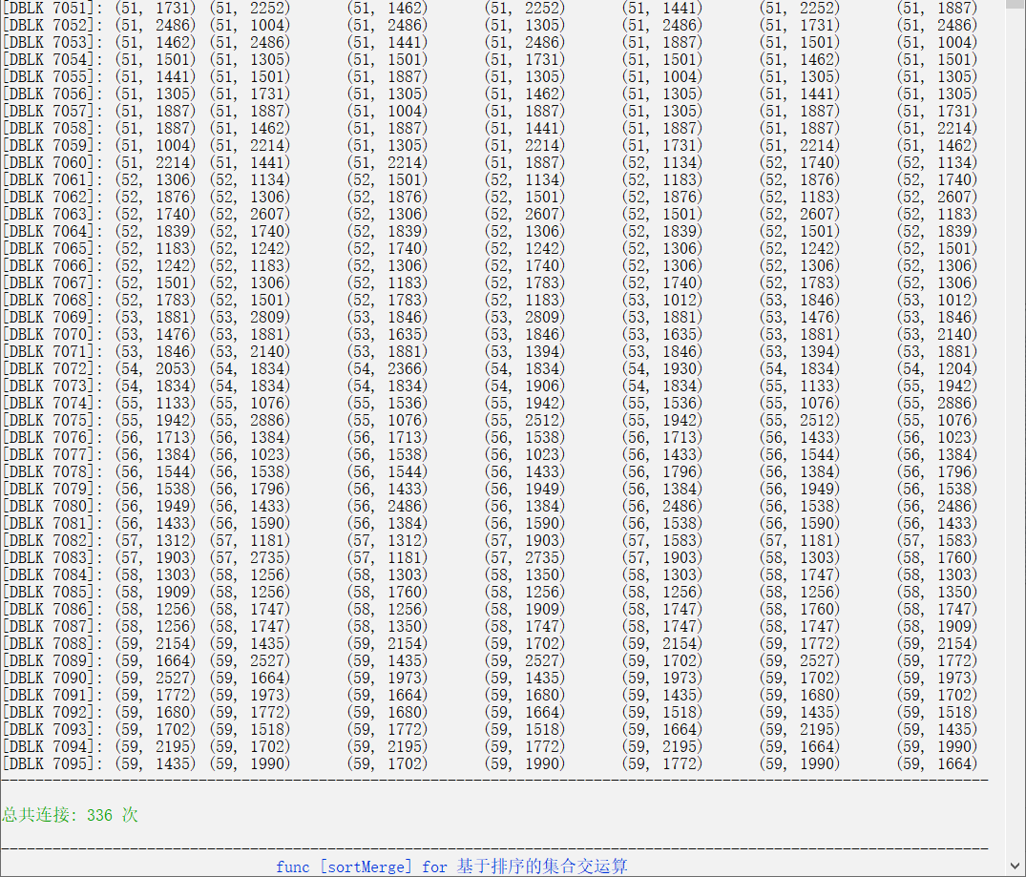
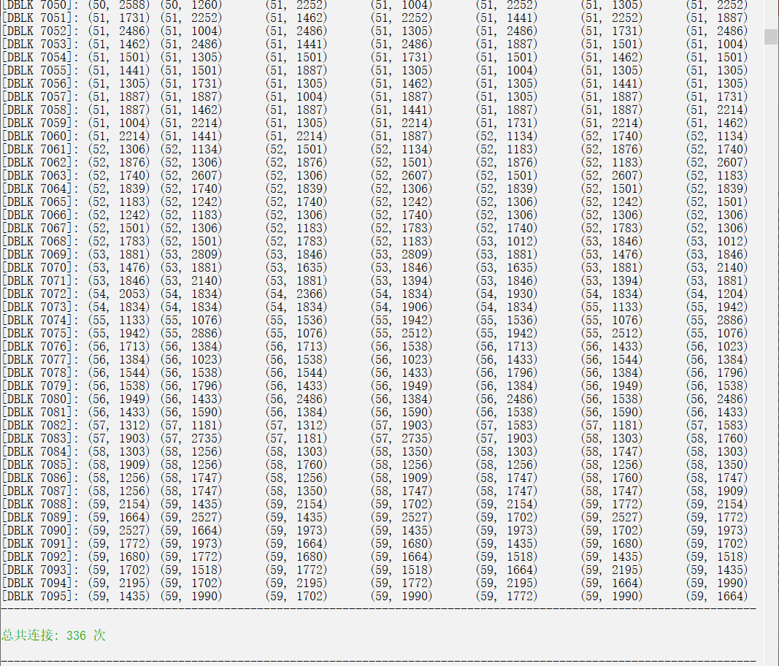
……
……

Slide 7
Disk BLK
Buffer BLK
Compare BLK
11
10
9
8
8
8
8
8
8
8
8
8
8
8
8
8
11
10
9
8
8
8
8
8
8
8
8
8
8
8
8
11
10
9
8
8
8
8
8
8
8
8
8
8
8
8
8
11
10
9
8
8
8
8
8
8
8
8
8
8
8
8
8
8
8
8
8
8
8
8
8
8
8
8
8
8
11
10
9
8
8
8
8
8
8
8
8
8
8
8
①
8
8
8
8
8
8
8
NB
Write BLK

Slide 9
Buffer *initBuffer(size_t bufSize, size_t blkSize, Buffer *buf void freeBuffer(Buffer *buf)
unsigned char *getNewBlockInBuffer(Buffer *buf);
/* Set a block in a buffer to be available. */
void freeBlockInBuffer(unsigned char *blk, Buffer *buf);
/* Drop a block on the disk */
int dropBlockOnDisk(unsigned int addr);
/* Read a block from the hard disk to the buffer by the address of the block. */
unsigned char *readBlockFromDisk(unsigned int addr, Buffer *buf);
/* Read a block in the buffer to the hard disk by the address of the block. */
int writeBlockToDisk(unsigned char *blkPtr, unsigned int addr, Buffer *buf);
select S.C, S.D from S where S.C = 50
select S.C, S.D, R.A, R.B from S inner
join R on S.C = R.A
getNewBlockInBuffer
bGetBLKRecord

Slide 10
