Slide 1

STUDENT MANAGEMENT SYSTEM
(SMS)

Slide 2

TEAM MEMBERS
ADITYA BARNWAL 21BCS2730
ADITYA RUHELA 21BCS1945
MANAS TIWARI 21BCS1965
ROHAN JAISWAL 21BCS2856

Slide 3
CREDITS
Main idea of project → Aditya Barnwal.
Presentation → Aditya Ruhela, Manas Tiwari and Rohan Jaiswal
Report(synopsis) → Manas Tiwari and Rohan Jaiswal
Coding → All of us

Slide 4
INTRODUCTION
A database is an organised collection of data stored and accessed electronically from a computer system.
By this we can analyse any individual student or group of students information.
The Student Management System is an automated version of manual student management system.

Slide 5
OBJECTIVES
Student Management system is a management information system for education establishment to manage student data.
It provide capabilities for registering students in courses, Admitting students, Tracking student details.
Ensure data integrity, Privacy and security in an open access environment.

Slide 6
TOOLS AND PLATFORM
We have used Python, Pandas, Matplotlib and csv module to make this.
We have saved students data in csv format.

Slide 7
FLOW OF THE PROJECT
STEP 1 - Collecting data in CSV format.
STEP 2 - Coding and developments
1. Making function for interacting with user.
2. Making function for searching student information.
3. Making function for graph.
4. Making function for adding new student data.
STEP 3 - Creating logic and integrating all the functions.

Slide 8
FLOW OF THE PROJECT
STEP 4 - Testing
- Functionality testing
- Usability testing
- Performance testing
STEP 5 - Implementation and maintenance

Slide 9
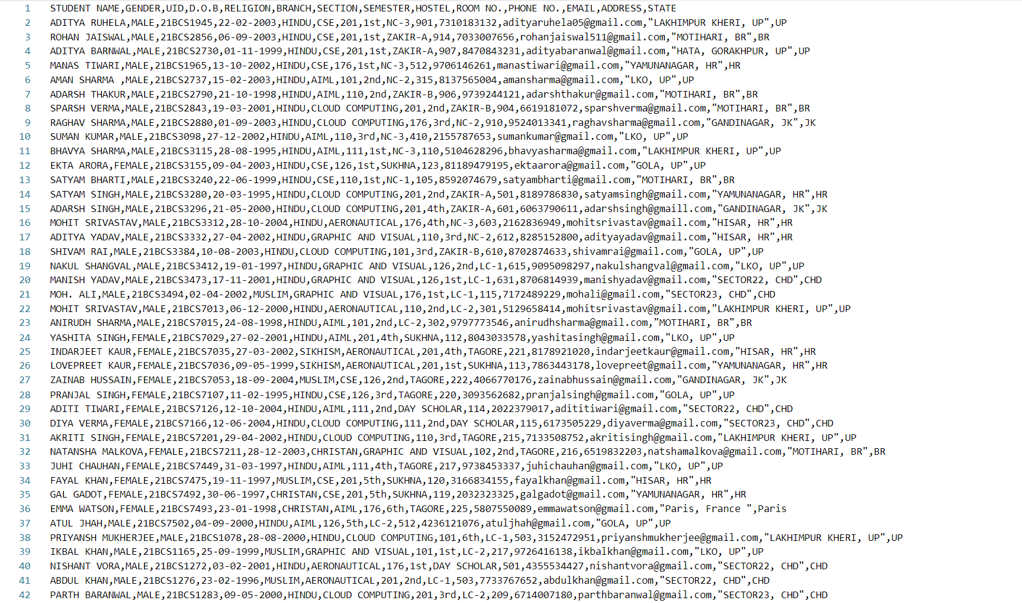
SCREENSHOTS
1. CSV FILE

Slide 10
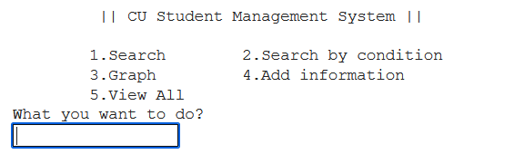
SCREENSHOTS
2. MAIN MENU SCREEN

Slide 11
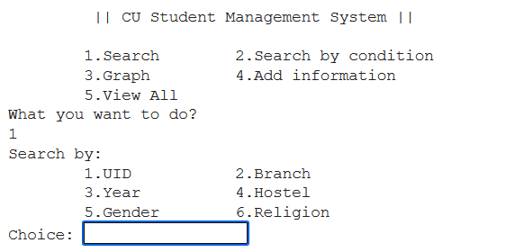
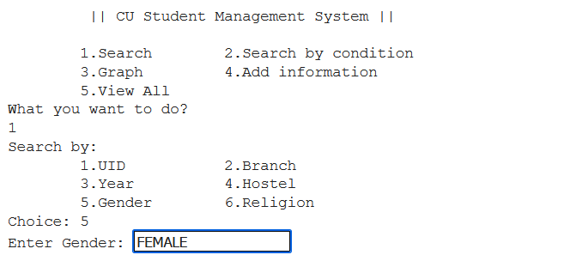
SCREENSHOTS
3. SEARCH FUNCTION

Slide 12
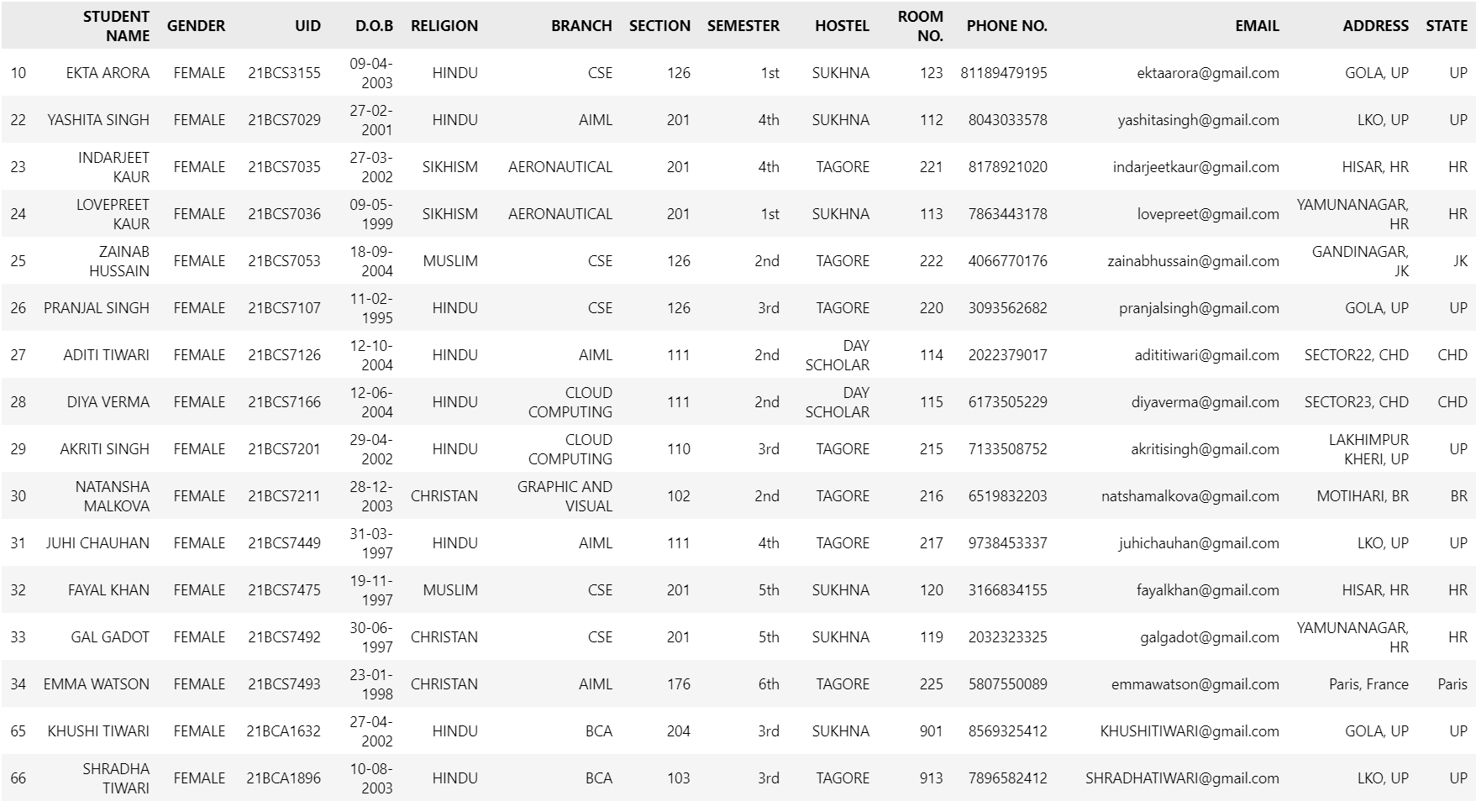
SCREENSHOTS
OUTPUT:

Slide 13
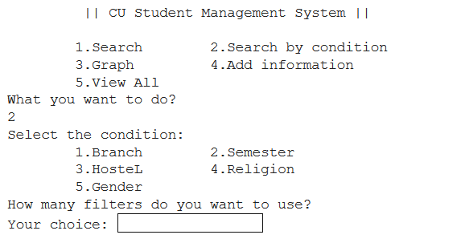
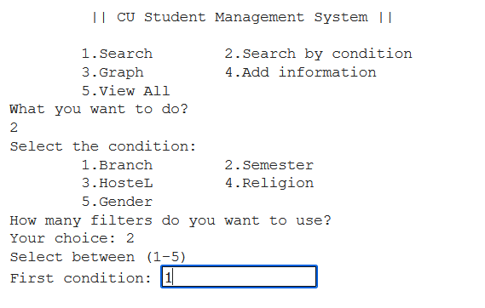
SCREENSHOTS
4. SEARCH BY CONDITION FUNCTION

Slide 14
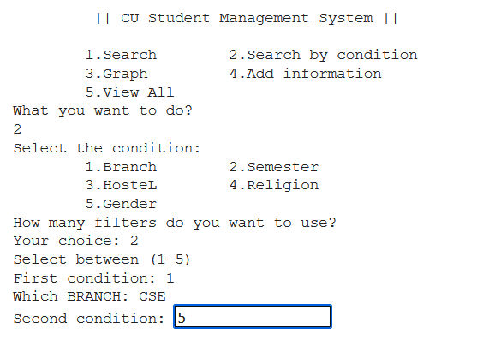
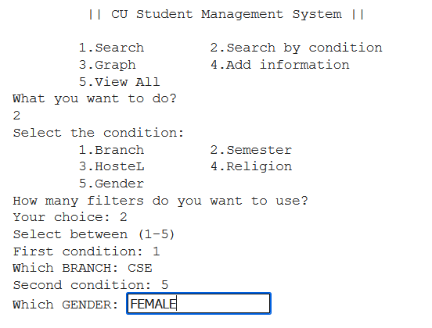
SCREENSHOTS

Slide 15
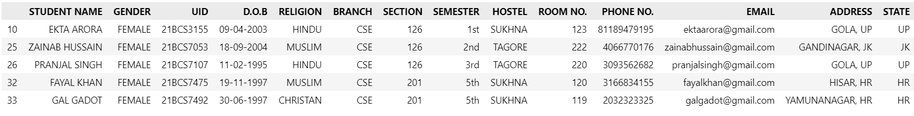
SCREENSHOTS
OUTPUT:

Slide 16
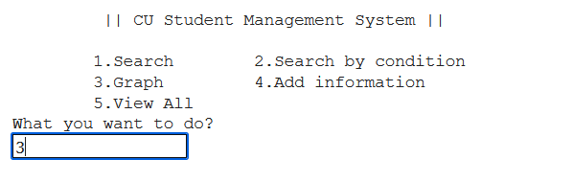
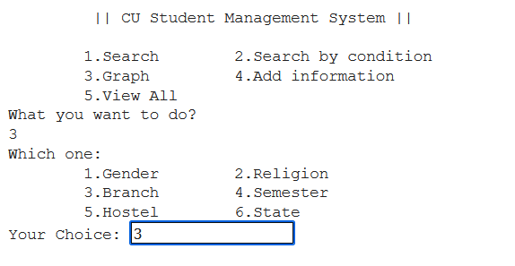
SCREENSHOTS
5. GRAPH FUNCTION

Slide 17
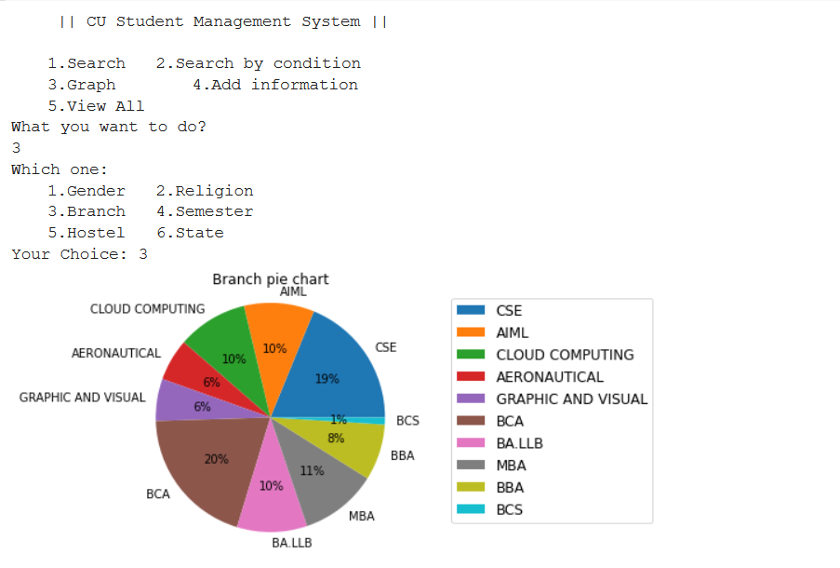
SCREENSHOTS
OUTPUT:

Slide 18
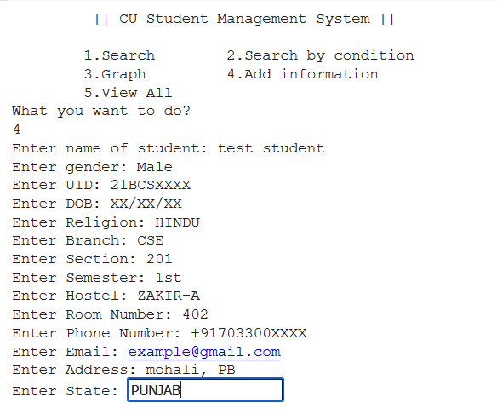
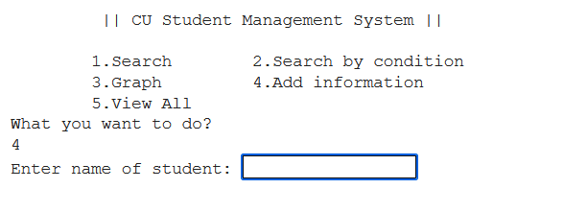
SCREENSHOTS
6. ADD INFO FUNCTION

Slide 19
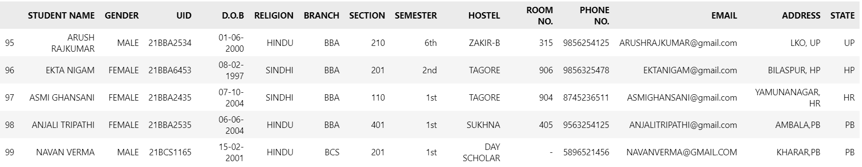
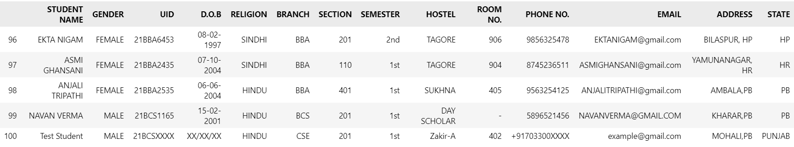
SCREENSHOTS
Before adding:
After adding:

Slide 20
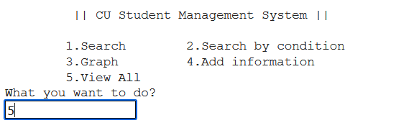
SCREENSHOTS
7. View all FUNCTION

Slide 21
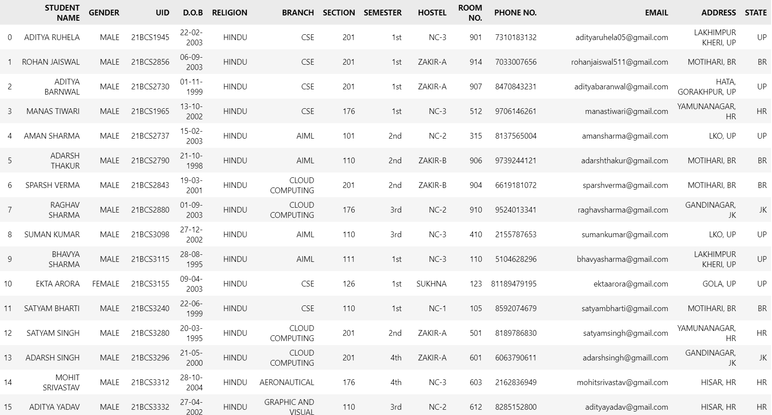
SCREENSHOTS
OUTPUT:

Slide 22
THANK YOU

