Slide 1
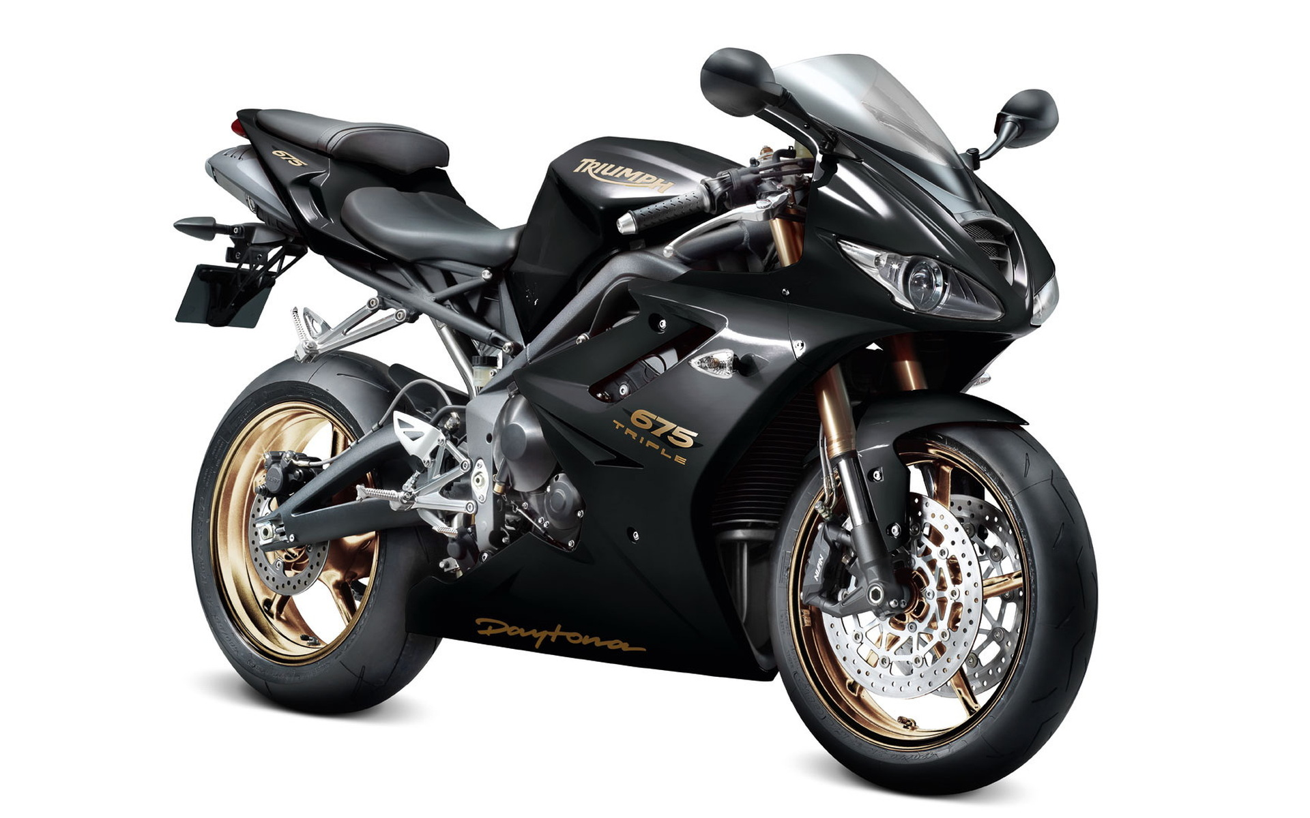
Track Rider
Developed by,
Indra Chawaria &
Pankaj Makhija

Slide 2
Introduction
Back in the day, Riding & Touring was not popular.
Now-a-days, Vehicles are basic necessity.
Riding Community growing faster than ever.
Need for products which eases riding or touring.

Slide 3
Objectives
Share live location of riders with each other.
Can be used as an alternate to Google Maps.
Can also be used by people to share & see location of other people.

Slide 4
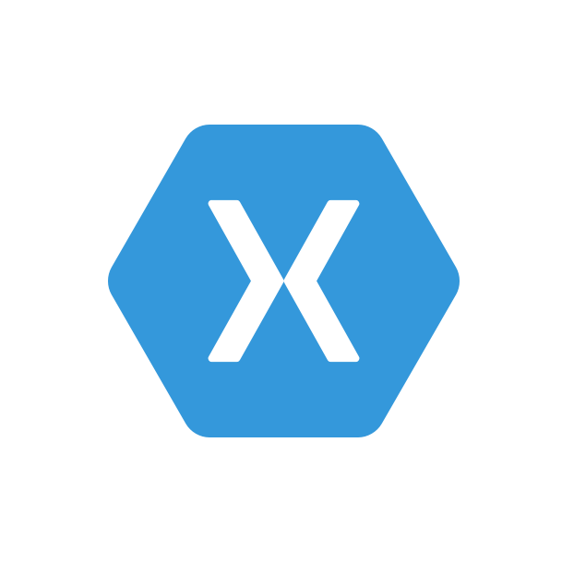




Technologies
(Available)

Slide 5
Technologies
(used)

Slide 6

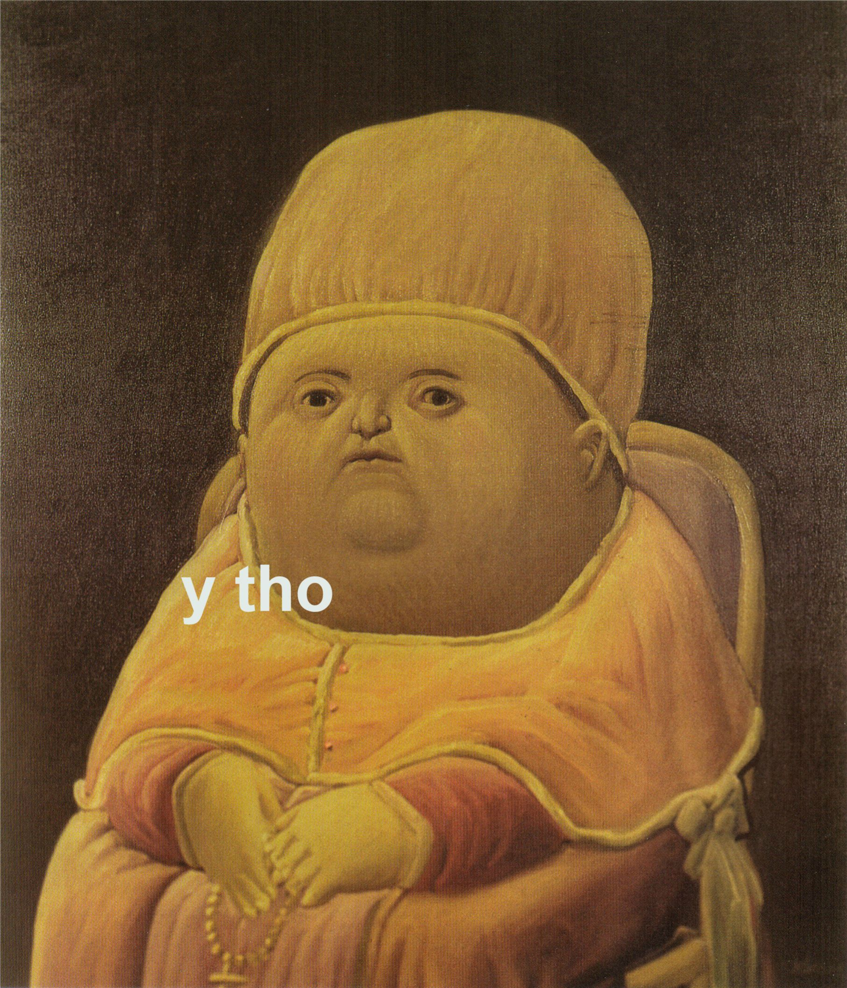
Why
Java - Kotlin?
Java & Kotlin are the official languages for Android Development.
Java & Kotlin works on JVM.
Interoperable.
Productive, less boilerplate code & concise.
Huge Community Support base for Java

Slide 7
How It Works?

Slide 8
Thank You!

