Slide 1
Test Case Design

Slide 2
Testing - Overview
Unit Testing
Ad-Hoc Integration
System Testing
User Acceptance Tests

Slide 3
White-Box Testing
Performed by team
Every team member tested “unknown” unit
Results documented
Found bugs summarized and eliminated

Slide 4
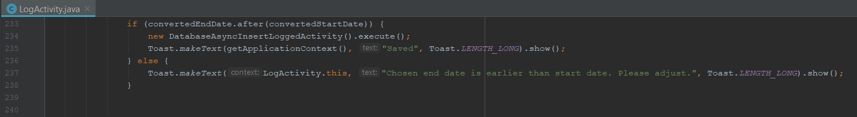
White-Box Testing
233
234
235
236
237
238
Scenario 1
convertedStartDate | convertedEndDate | Path (line numbers)
2018-07-02 08:00 | 2018-07-02 08:30 | 233->234->235
Notes:
IF: test TRUE and FALSE part
Statement coverage -> fulfilled
Branch coverage -> fulfilled
Path coverage -> fulfilled

Slide 5
White-Box Testing
233
234
235
236
237
238
Scenario 2
convertedStartDate | convertedEndDate | Path (line numbers)
2018-07-02 08:00 | 2018-07-02 07:30 | 233->236->237->238
Notes:
IF: test TRUE and FALSE part
Statement coverage -> fulfilled
Branch coverage -> fulfilled
Path coverage -> fulfilled

Slide 6

Black-Box Testing
Two test subjects
Both apply to our persona „Student“
Johannes – DE Student

Slide 7
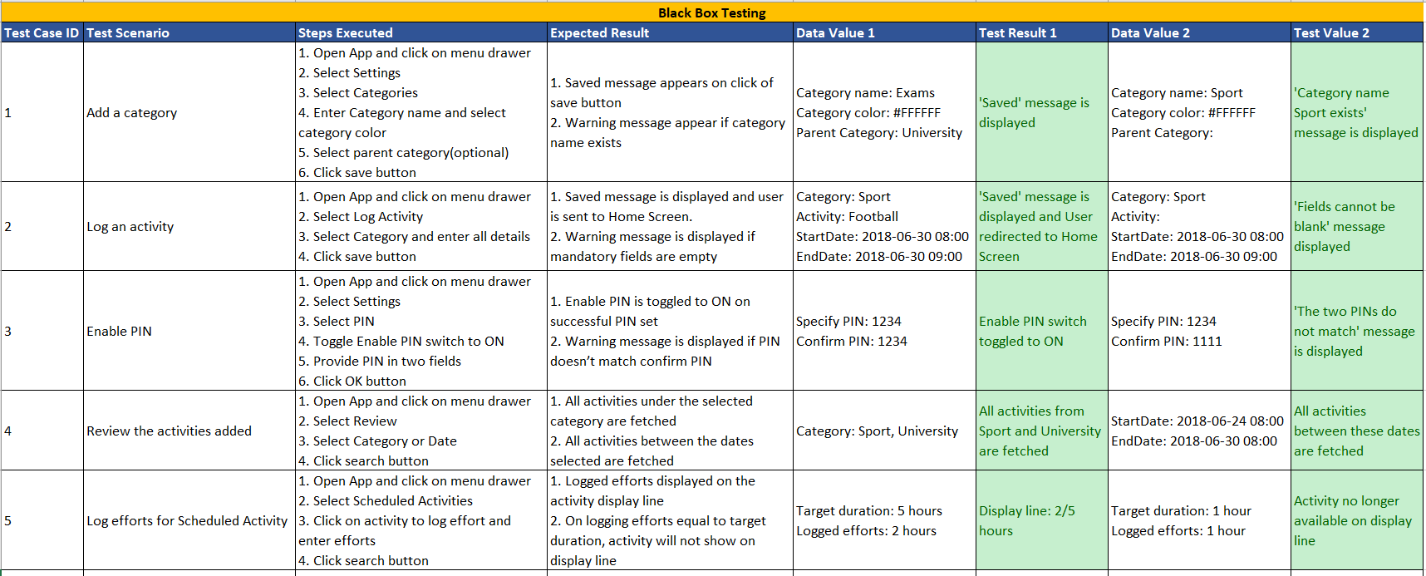

Slide 8
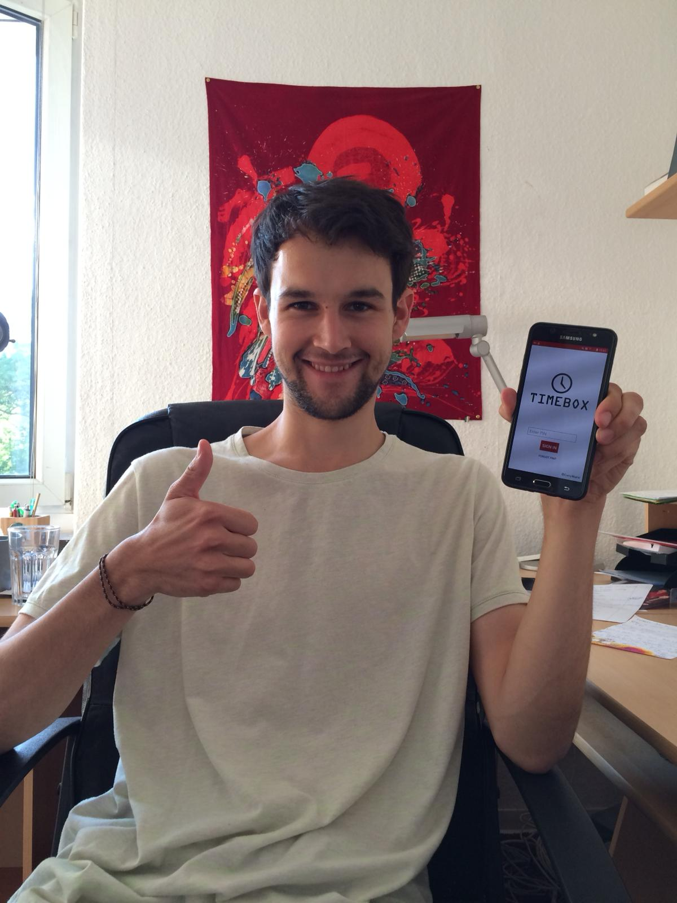
Black-Box Testing
Collected test feedback
Resolved bugs
Happy User

Slide 9
Changes
Subcategories
Black-Box tester‘s feedback

Slide 10
Thank you for your attention!

