Slide 1
Team Presentation
CurryWurst

Slide 2

Team & Roles
Quang – Quality Control
Dean – Quality Control
Moritz – Scrum Master
Jahnavi – Communication with
the Product Owner

Slide 3
Motivation
Experience in software and requirement engineering
Team work and soft skills
Programming (for Android)

Slide 4
Team Work - Skills
All team members have different backgrounds and experiences
Exchange knowledge

Slide 5
Communication
Slack
Comment user stories on ZenHub
Weekly meetings

Slide 6
Flexibility
At least two team members will have knowledge about a specific topic
Applying agile methods (Scrum)

Slide 7
Slack
Chatroom
Integrates many apps
Easier for follow-up documentation

Slide 8
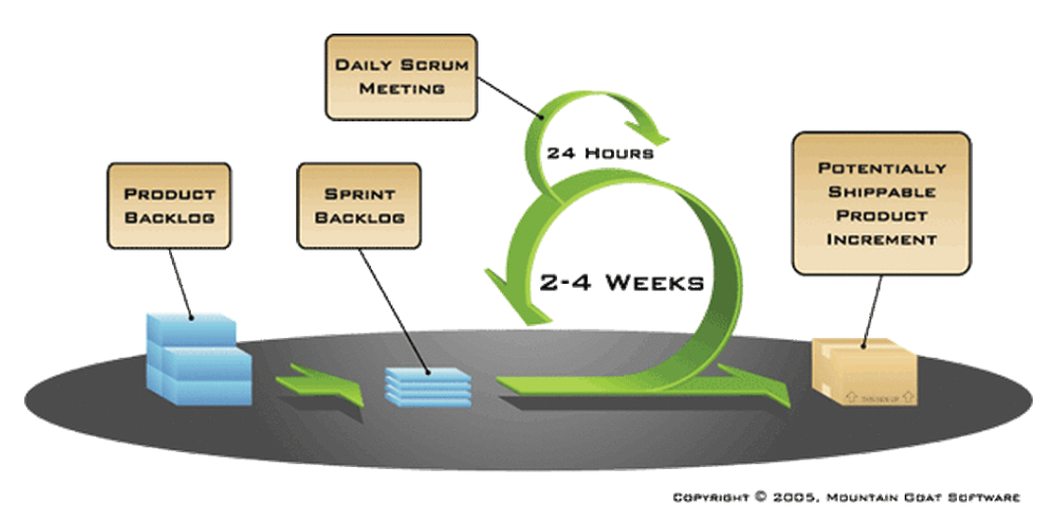
Scrum

Slide 9
Slide Title
Product A
Product B
Feature 1
Feature 2
Feature 3
Feature 1
Feature 2
Feature 3

Slide 10
Thank you for your attention!
Questions?

