Slide 1
CORRELATION

Slide 2
Contents
What is Correlation?
Correlation Coefficient
Scatter Diagram
Karl Pearson’s Coefficient of Correlation
Spearman’s Rank Correlation

Slide 3
What is Correlation?

Slide 4


Means → Association
Method to find relations between variables
Establishes relationships
Measures
Nature, Degree & Extent
Cause & Effect
POINTER not PROOF
Existence → Change
“Whenever some definite connection exists between the two or more groups, classes or series or data, there is said to be correlation.” –Boddington
Employment
Output
CAUSE
EFFECT
Correlation
Positive
Negative
Zero

Slide 5
Kinds of Correlation
Direction of change
Change in proportion
Number of variables
Positive
Negative
Linear
Non-linear
Simple
Partial
Multiple

Slide 6
Correlation Coefficient

Slide 7
Measures degree of association
Returns values in the range of -1 to 1
Indicates the strength of a relation
Lower degree of Correlation
No Correlation
-1
-0.75
-0.25
0
0.25
0.75
1
Higher degree of Correlation
Moderate degree of Correlation

Slide 8
Methods to calculate Correlation
Karl Pearson’s Coefficient of Correlation
Scatter Diagram
Spearman’s Rank Correlation
When Ranks are given
When Ranks are not given
When Ranks are equal
Actual Mean
Assumed Mean

Slide 9
Scatter Diagram

Slide 10
Graphical Representation
Represents direction & degree
Y-axis → independent variables
X-axis → dependent variables
Each value represented by a dot
Perfect Negative Correlation
Perfect Positive Correlation
Limited Positive Correlation

Slide 11
Limited Negative Correlation
Absence of Correlation

Slide 12
Q: Find the relation for the given data,
Price | 10 | 20 | 30 | 40 | 50 | 60
Quantity | 25 | 50 | 75 | 100 | 125 | 150
r = +1

Slide 13
Karl Pearson’s Coefficient of Correlation

Slide 14
Quantitative method
Based on Mean & Standard Deviation
Widely used
Correlation ranges between -1 to +1
Karl Pearson’s Coefficient of Correlation
Direct Method/Actual Mean Method
Shortcut Method/Assumed Mean Method

Slide 15
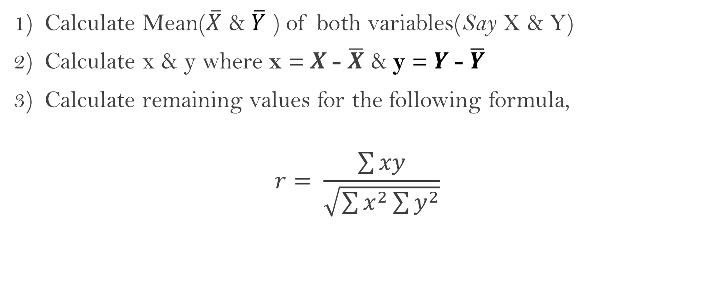
Actual Mean Method
Calculate Mean($\overline{X}$ & $\overline{Y}$ ) of both variables(Say X & Y)
Calculate x & y where x = $X$- $\overline{X}$ & y = $Y$- $\overline{Y}$
Calculate remaining values for the following formula,
$$r= \frac{\sum{xy}}{\sqrt{\sum{x^{2}}\sum{y^{2}}}}$$

Slide 16
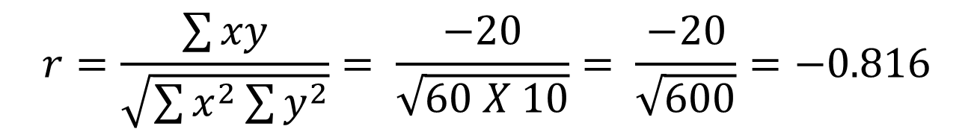
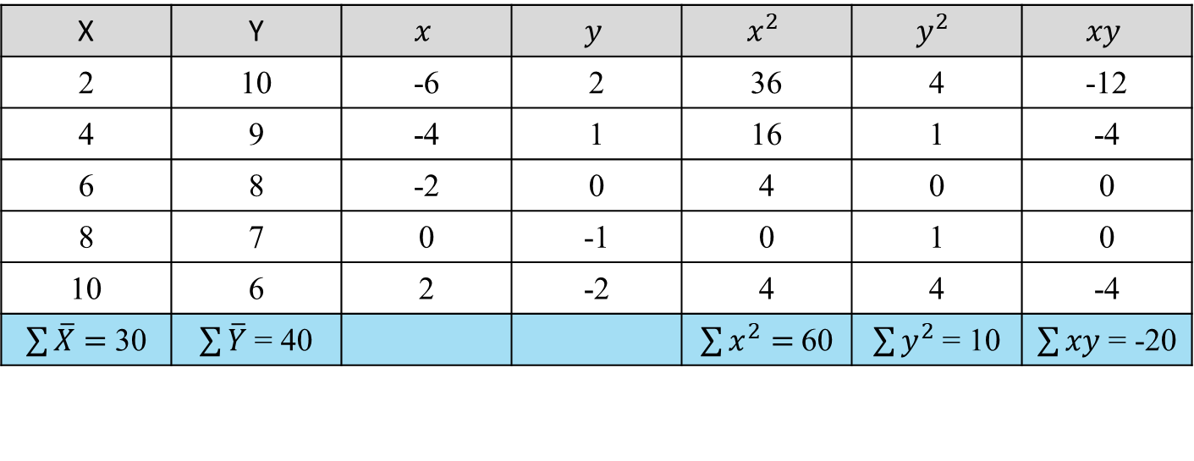
Q: Find the relation for the given data,
Working Hours | 2 | 4 | 6 | 8 | 10
Study Hours | 10 | 9 | 8 | 7 | 6
X | Y | $$x$$ | $$y$$ | $$x^{2}$$ | $$y^{2}$$ | $$xy$$
2 | 10 | -6 | 2 | 36 | 4 | -12
4 | 9 | -4 | 1 | 16 | 1 | -4
6 | 8 | -2 | 0 | 4 | 0 | 0
8 | 7 | 0 | -1 | 0 | 1 | 0
10 | 6 | 2 | -2 | 4 | 4 | -4
$\sum{\overline{X}}=$30 | $\sum{\overline{Y}}$ = 40 |  |  | $\sum{x^{2}}=$60 | $\sum{y^{2}}$ = 10 | $\sum{xy}$ = -20
$$r=\frac{\sum{xy}}{\sqrt{\sum{x^{2}}\sum{y^{2}}}}= \frac{−20}{\sqrt{60 X 10}}= \frac{−20}{\sqrt{600}}=−0.816$$

Slide 17
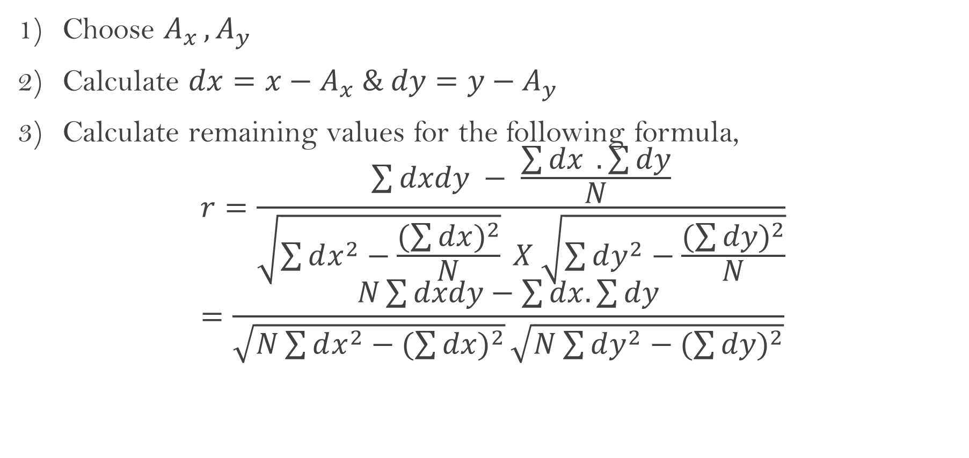
Assumed Mean Method
Choose $A_{x }, A_{y}$
Calculate $dx=x−A_{x} \& dy=y−A_{y}$
Calculate remaining values for the following formula,
$$r=\frac{\sum{dxdy} − \frac{\sum{dx} . \sum{dy}}{N}}{\sqrt{\sum{dx^{2}−\frac{(\sum{dx})^{2}}{N}}} X \sqrt{\sum{dy^{2}−\frac{(\sum{dy})^{2}}{N}}}}=\frac{N\sum{dxdy−\sum{dx.\sum{dy}}}}{\sqrt{N\sum{dx^{2}}−(\sum{dx)^{2}}}\sqrt{N\sum{dy^{2}}−(\sum{dy)^{2}}}}$$

Slide 18
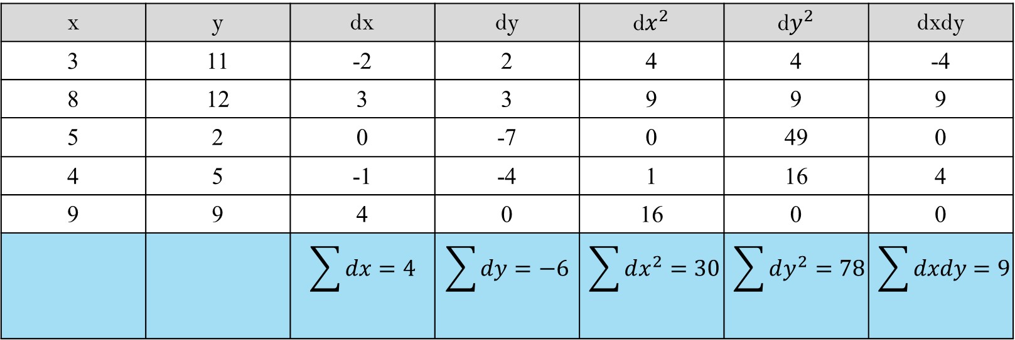
Q: Find the relation for the given data,
Working Hours | 3 | 8 | 5 | 4 | 9
Study Hours | 11 | 12 | 2 | 5 | 9
x | y | dx | dy | d$x^{2}$ | d$y^{2}$ | dxdy
3 | 11 | -2 | 2 | 4 | 4 | -4
8 | 12 | 3 | 3 | 9 | 9 | 9
5 | 2 | 0 | -7 | 0 | 49 | 0
4 | 5 | -1 | -4 | 1 | 16 | 4
9 | 9 | 4 | 0 | 16 | 0 | 0
 |  | $$\sum{dx}=4$$ | $$\sum{dy}=−6$$ | $$\sum{dx^{2}=30}$$ | $$\sum{dy^{2}=78}$$ | $$\sum{dxdy=9}$$
$$=\frac{N\sum{dxdy−\sum{dx.\sum{dy}}}}{\sqrt{N\sum{dx^{2}}−(\sum{dx)^{2}}}\sqrt{N\sum{dy^{2}}−(\sum{dy)^{2}}}}=\frac{45+24}{\sqrt{134}\sqrt{354}}=0.31$$

Slide 19
Spearman’s Rank Correlation

Slide 20
Developed by Charles Edward Spearman in 1904
Alternative Method
Handle qualitative variables like vanity, bravery & honesty
Calculated by Rank differences
Quicker Computation
Spearman’s Rank Correlation
Ranks are given
Ranks are not given
Ranks are equal

Slide 21
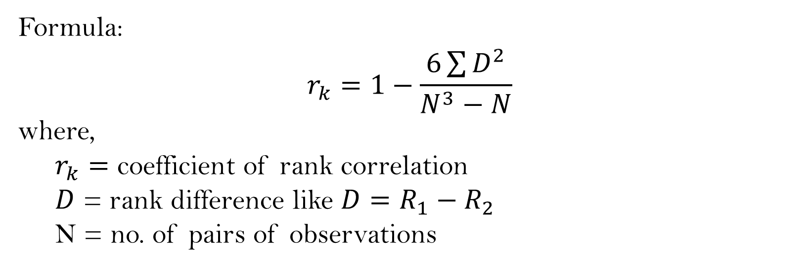
When Ranks are Given:
Formula:
$$r_{k}=1−\frac{6\sum{D^{2}}}{N^{3}−N}$$
where,
$r_{k}=$ coefficient of rank correlation
$D$ = rank difference like $D=R_{1}−R_{2}$
N = no. of pairs of observations

Slide 22
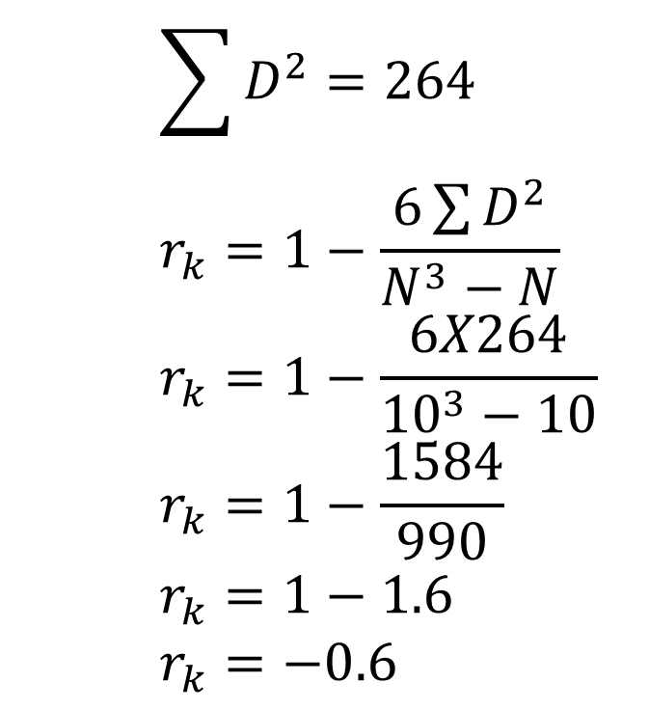
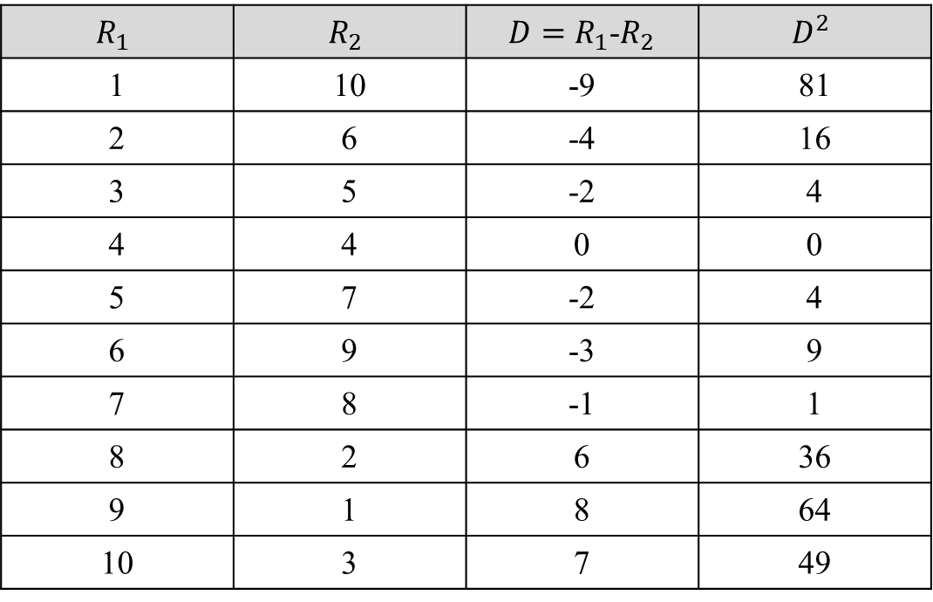
Q: Find the relation for the given data,
$$R_{1}$$ | $$R_{2}$$ | ${D=R}_{1}$-$R_{2}$ | $$D^{2}$$
1 | 10 | -9 | 81
2 | 6 | -4 | 16
3 | 5 | -2 | 4
4 | 4 | 0 | 0
5 | 7 | -2 | 4
6 | 9 | -3 | 9
7 | 8 | -1 | 1
8 | 2 | 6 | 36
9 | 1 | 8 | 64
10 | 3 | 7 | 49
$$\sum{D^{2}=264}$$
$$r_{k}=1−\frac{6\sum{D^{2}}}{N^{3}−N}$$
$$r_{k}=1−\frac{6X264}{{10}^{3}−10}$$
$$r_{k}=1−\frac{1584}{990}$$
$$r_{k}=1−1.6$$
$$r_{k}=−0.6$$

Slide 23
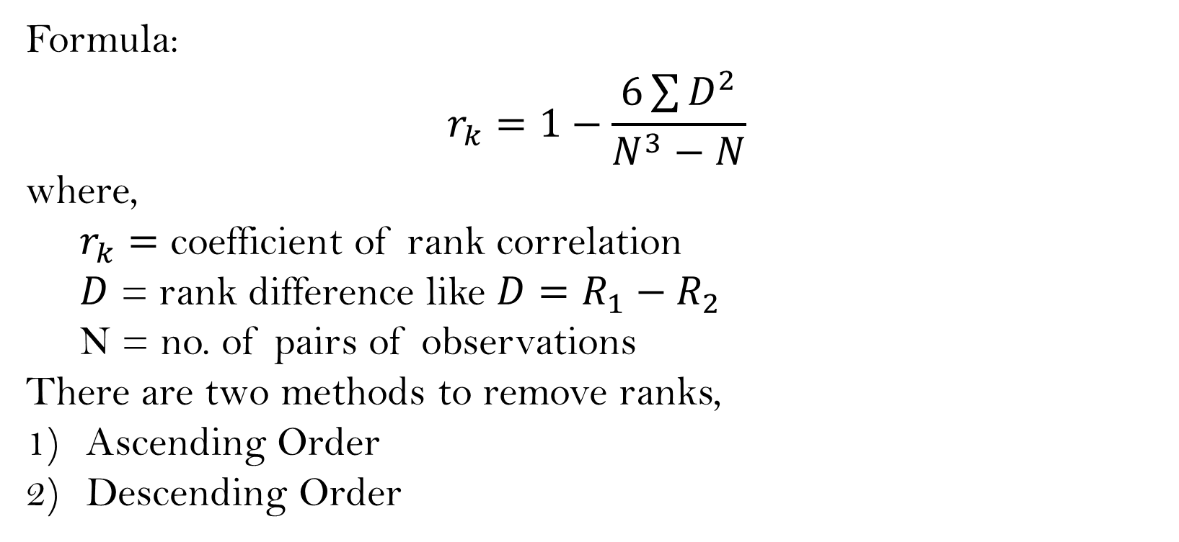
When Ranks are not Given:
Formula:
$$r_{k}=1−\frac{6\sum{D^{2}}}{N^{3}−N}$$
where,
$r_{k}=$ coefficient of rank correlation
$D$ = rank difference like $D=R_{1}−R_{2}$
N = no. of pairs of observations
There are two methods to remove ranks,
Ascending Order
Descending Order

Slide 24
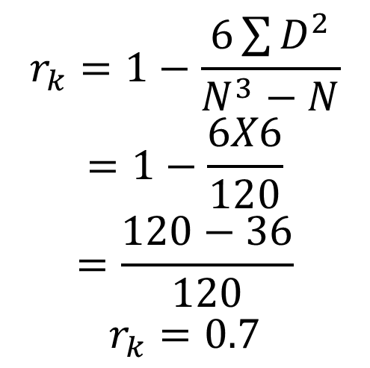
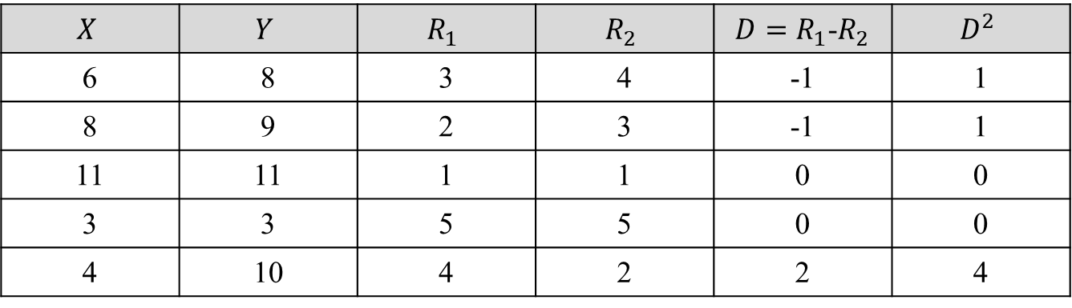
Q: Find the relation for the given data,
$$X$$ | $$Y$$ | $$R_{1}$$ | $$R_{2}$$ | ${D=R}_{1}$-$R_{2}$ | $$D^{2}$$
6 | 8 | 3 | 4 | -1 | 1
8 | 9 | 2 | 3 | -1 | 1
11 | 11 | 1 | 1 | 0 | 0
3 | 3 | 5 | 5 | 0 | 0
4 | 10 | 4 | 2 | 2 | 4
$$r_{k}=1−\frac{6\sum{D^{2}}}{N^{3}−N}$$
$$=1−\frac{6X6}{120}$$
$$=\frac{120−36}{120}$$
$$r_{k}=0.7$$
Rank No. | X | Y
1 | 11 | 11
2 | 8 | 10
3 | 6 | 9
4 | 4 | 8
5 | 3 | 3

Slide 25
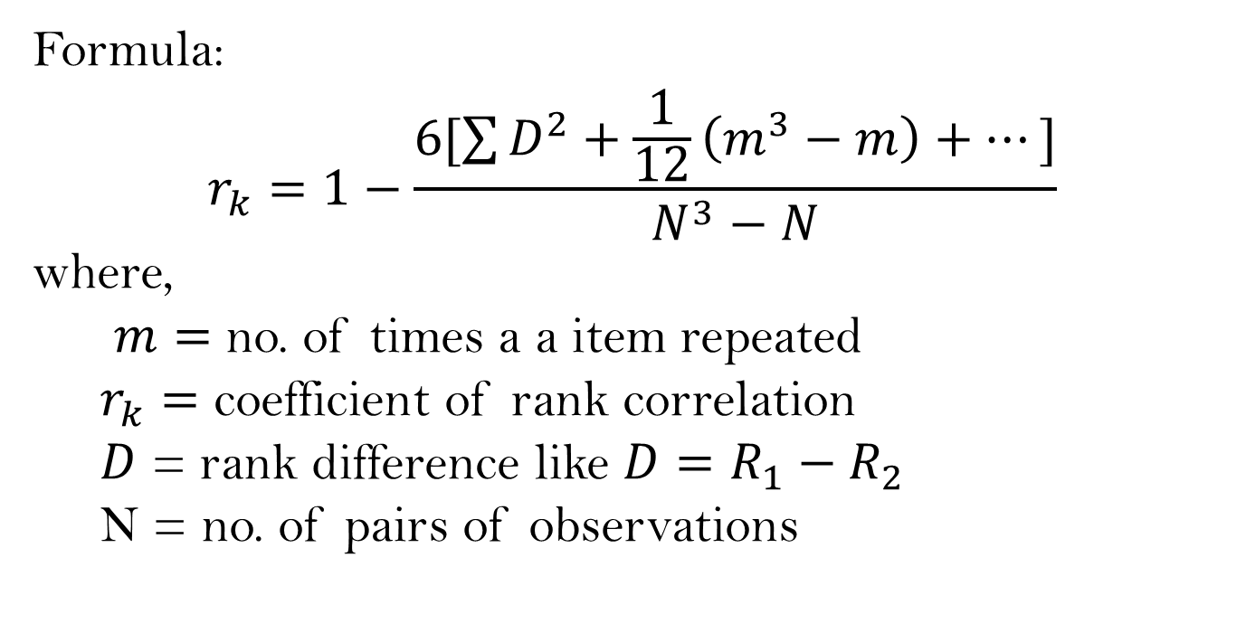
When Ranks are Equal:
Formula:
$$r_{k}=1−\frac{6[\sum{D^{2}+\frac{1}{12}\left(m^{3}−m\right)+…]}}{N^{3}−N}$$
where,
$m=$ no. of times a a item repeated
$r_{k}=$ coefficient of rank correlation
$D$ = rank difference like $D=R_{1}−R_{2}$
N = no. of pairs of observations

Slide 26
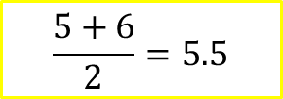
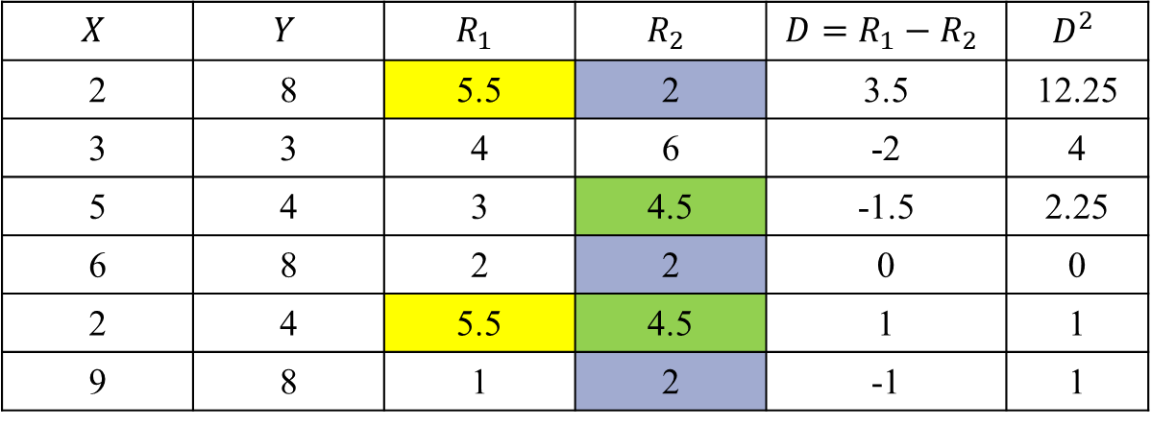

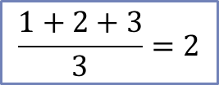
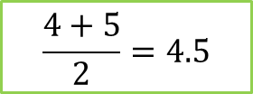
Q: Find the relation for the given data,
$$X$$ | $$Y$$ | $$R_{1}$$ | $$R_{2}$$ | $${D=R}_{1}−R_{2}$$ | $$D^{2}$$
2 | 8 | 5.5 | 2 | 3.5 | 12.25
3 | 3 | 4 | 6 | -2 | 4
5 | 4 | 3 | 4.5 | -1.5 | 2.25
6 | 8 | 2 | 2 | 0 | 0
2 | 4 | 5.5 | 4.5 | 1 | 1
9 | 8 | 1 | 2 | -1 | 1
$$\sum{D^{2}}=20.5$$
Rank No. | X | Y
1 | 9 | 8
2 | 6 | 8
3 | 5 | 8
4 | 3 | 4
5 | 2 | 4
6 | 2 | 3
$$\frac{1+2+3}{3}=2$$
$$\frac{4+5}{2}=4.5$$
$$\frac{5+6}{2}=5.5$$

Slide 27
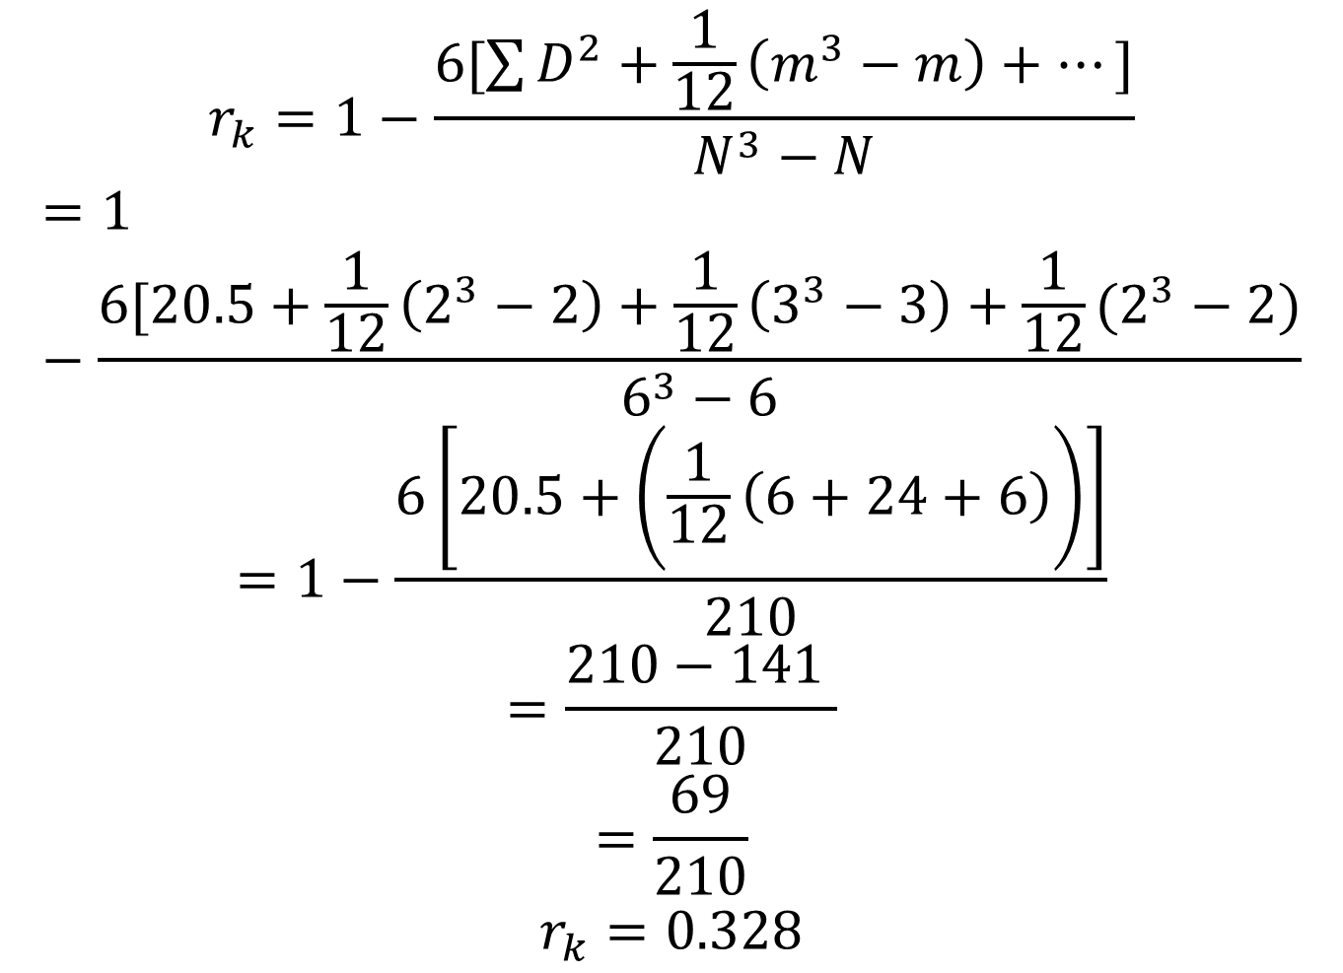
$$r_{k}=1−\frac{6[\sum{D^{2}+\frac{1}{12}\left(m^{3}−m\right)+…]}}{N^{3}−N}$$
$$=1−\frac{6[20.5+\frac{1}{12}\left(2^{3}−2\right)+\frac{1}{12}\left(3^{3}−3\right)+\frac{1}{12}(2^{3}−2)}{6^{3}−6}$$
$$=1−\frac{6\left[20.5+\left(\frac{1}{12}\left(6+24+6\right)\right)\right]}{210}$$
$$=\frac{210−141 }{210}$$
$$=\frac{69}{210}$$
$$r_{k}=0.328$$

Slide 28
Thank You

