Slide 1

GAUSSIAN: A FUTURE OF HPC

Slide 2
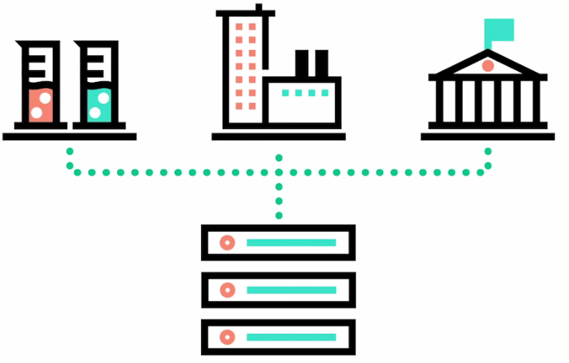
HPC – High Performance Computing
“Use of parallel processing for running advanced application programs efficiently, reliably and quickly.”

Slide 3
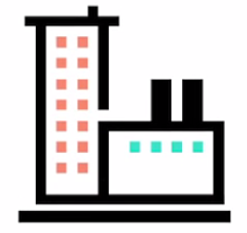
Scenarios of HPC usage
Model economic equations
Complete Financial transactions in milliseconds
React quickly to market movements
Use algorithms to detect credit card fraud
Create molecular chemistry models

Slide 4
GAUSSIAN

Slide 5

What is it?
Computational Chemistry Application
Widely used electronic structure program
Uses OpenACC (G16)
Released in 1970, by John Pople (Carnegie Mellon University)
Named after the use of Gaussian Orbitals to speed up molecular electronic structure

Slide 6
RUNNING GAUSSIAN
Setting up ENVIRONMENT VARIABLE i.e. GAUSS_SCRDIR
Loading module file i.e. $ module load Applications/Gaussian
To run program in parallel,
$ par_g09 [num_proc_shared] < g09_input > g09_output
%LindaWorkers: List of nodes (parallel workers)
%num_proc_shared : Number of shared-memory processes per worker

Slide 7
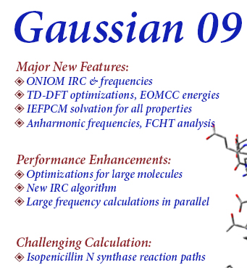
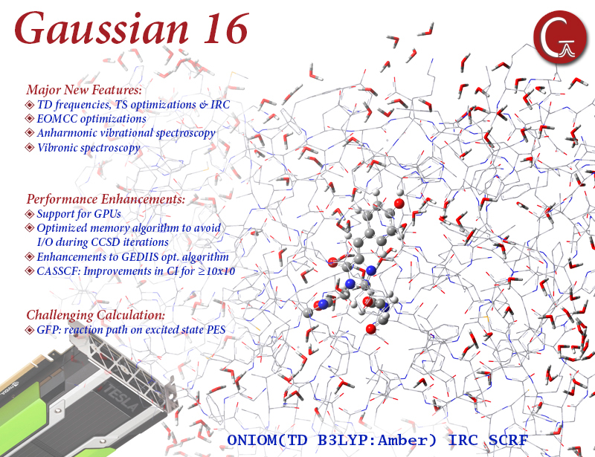

Slide 8
REFERENCES
https://research.computing.yale.edu/support/hpc/user-guide/gaussian
http://gaussian.com
https://www.nextplatform.com/2016/11/07/chasing-dream-code-hpc-run-anywhere/
https://en.wikipedia.org/wiki/Gaussian_(software)

Slide 9


