Slide 1
HASHING

Slide 2
EXISTING PROBLEM

Slide 3
Three tasks to be performed:
Insert Employee Record
Search for an Employee
Delete Employee Record
Phone No. | Name | City | Dept
9879369722 | Jane Smith | NYC | Sales
9879396671 | Jane Smith | DC | Sales

Slide 4
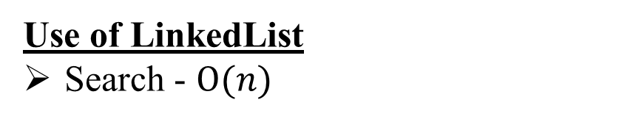
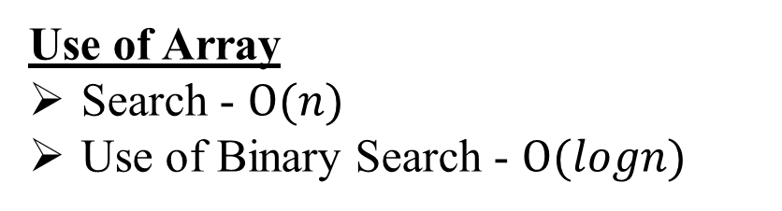
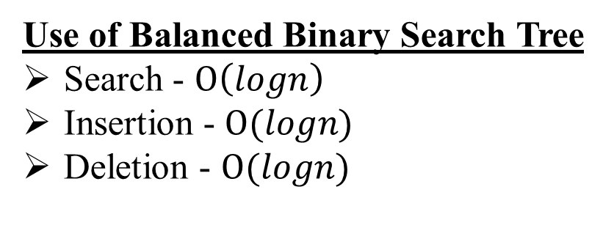
Use of Array
Search - $Ο(n)$
Use of Binary Search - $Ο(logn)$
Use of LinkedList
Search - $Ο(n)$
i =
A[i] =
0 | 1 | 2 | 3 | 4
50 | 700 | 76 | 85 | 92
50
120
23
…
4
/ \
2 6
/ \ / \
1 3 5 7
Use of Balanced Binary Search Tree
Search - $Ο\left(logn\right)$
Insertion - $Ο(logn)$
Deletion - $Ο(logn)$

Slide 5
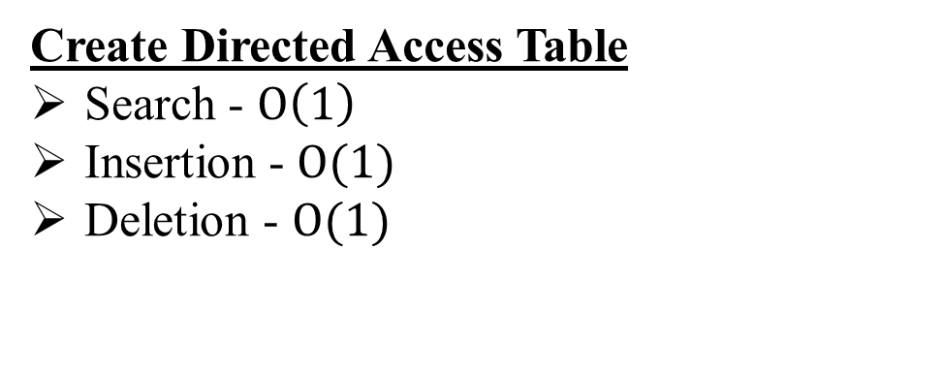
Create Directed Access Table
Search - $Ο\left(1\right)$
Insertion - $Ο(1)$
Deletion - $Ο(1)$
Phone No | Address
9879369722 | 0x12…
9879396671 | 0x24…
Jane Smith | NYC | Sales
Jane Smith | DC | Sales
Key
Value

Slide 6
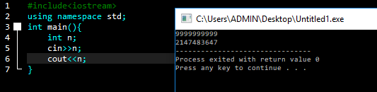
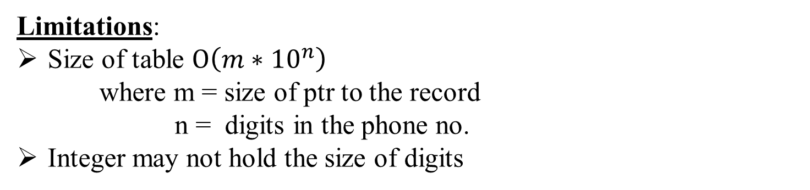
Limitations:
Size of table $Ο\left(m∗{10}^{n}\right)$
where m = size of ptr to the record
n = digits in the phone no.
Integer may not hold the size of digits

Slide 7
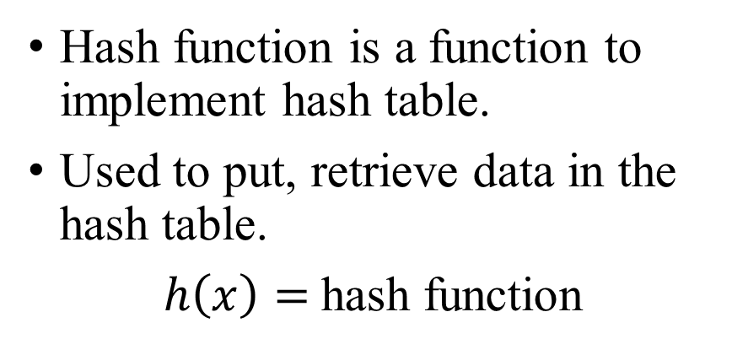
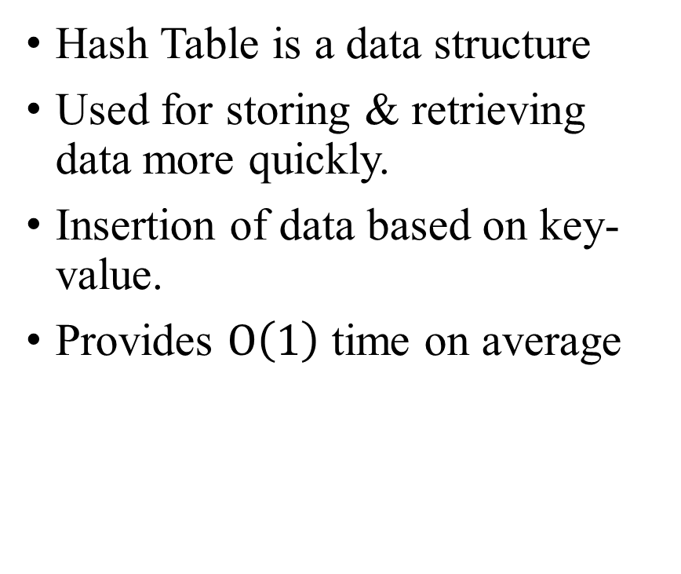
HASHING
Hash Table is a data structure
Used for storing & retrieving data more quickly.
Insertion of data based on key-value.
Provides $Ο\left(1\right)$ time on average
Hash function is a function to implement hash table.
Used to put, retrieve data in the hash table.
$h\left(x\right)=$hash function

Slide 8
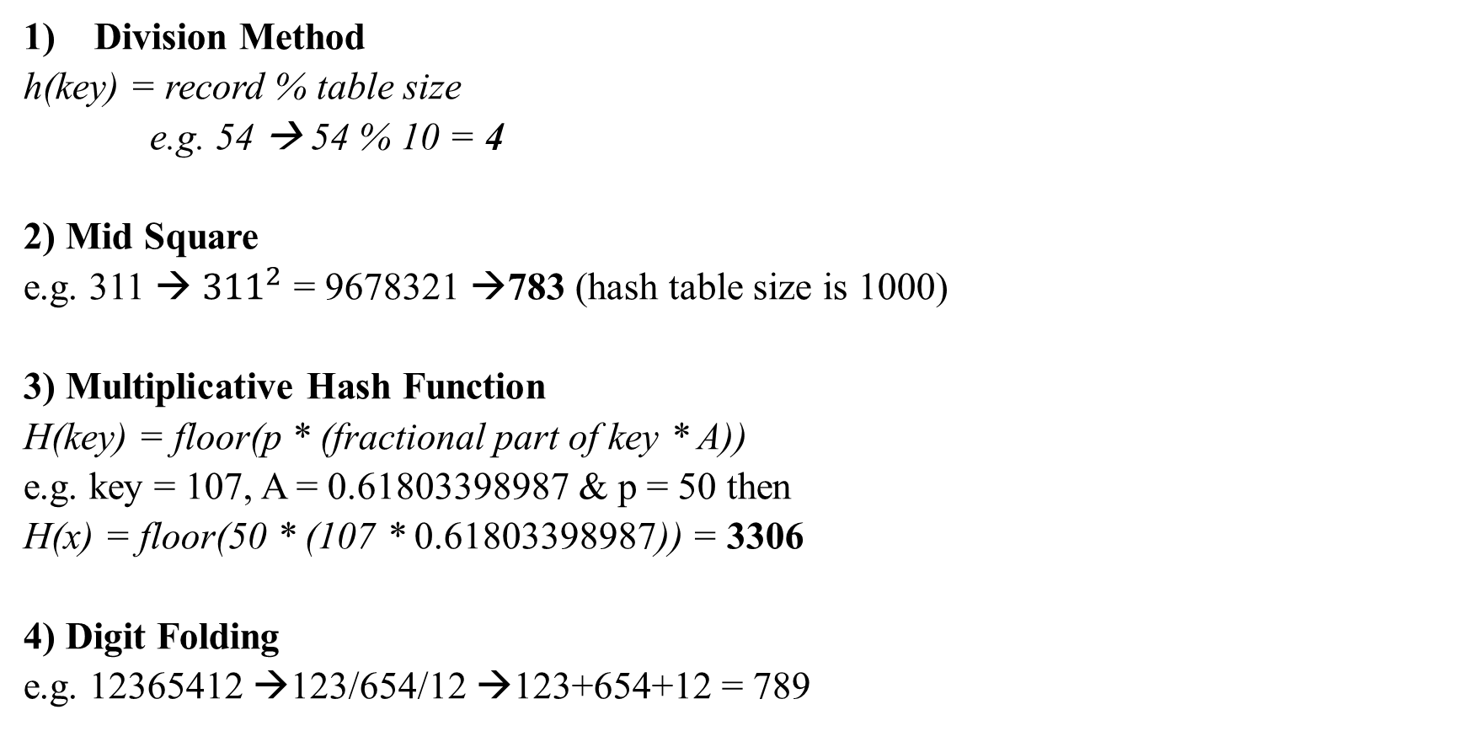
Methods of Hashing
Division Method
h(key) = record % table size
e.g. 54 → 54 % 10 = 4
2) Mid Square
e.g. 311 → ${311}^{2}$ = 9678321 →783 (hash table size is 1000)
3) Multiplicative Hash Function
H(key) = floor(p * (fractional part of key * A))
e.g. key = 107, A = 0.61803398987 & p = 50 then
H(x) = floor(50 * (107 * 0.61803398987)) = 3306
4) Digit Folding
e.g. 12365412 →123/654/12 →123+654+12 = 789
4
54
783
311
3306
107
789
12365412

Slide 9

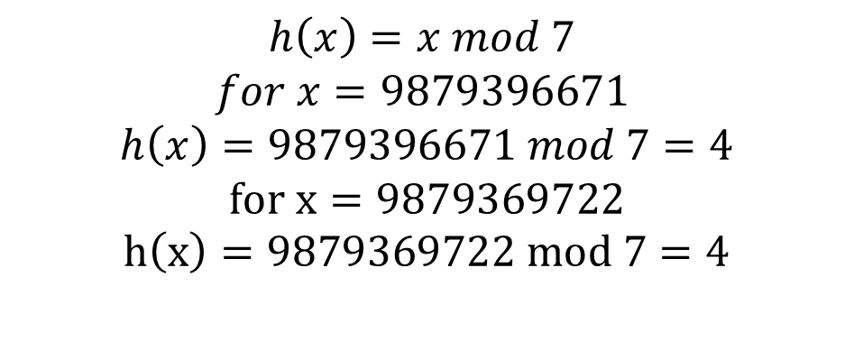
$$h\left(x\right)=x mod 7$$
$$for x=9879396671$$
$$h\left(x\right)=9879396671 mod 7=4$$
$$for x=9879369722$$
$$h\left(x\right)=9879369722 mod 7=4$$
Properties of a good hash function:
Simple to compute
#collisions should be less
Keys which will get distributed uniformly over an array.
h(x) should depend on every bit of the key
0
1
2
3
4
5
6
7
9879396671
$$9879369722$$

Slide 10
COLLISION HANDLING

Slide 11
Separate Chaining:
e.g. h(x) = x mod 7
keys: 50, 700, 76, 85, 92, 73, 101
0
1
2
3
4
5
6
700
50
85
92
h(50) = 50 mod 7 = 1
h(700) = 700 mod 7 = 0
h(76) = 76 mod 7 = 6
h(85) = 85 mod 7 = 1
h(92) = 92 mod 7 = 1
h(73) = 73 mod 7 = 3
h(101) = 101 mod 7 = 3
73
101
76

Slide 12
Advantages:
Simple to implement
Hash Table never fills up
Used when unaware of the #operations
Disadvantages:
Not as good as Open Addressing
Wastage of space.
If chain becomes long (i.e. O(n))
Use of extra space
Performance:
Complexity:
n = #keys stored in table
m = #slots in table
α = load factor
= Average keys per slot
= n/m
Expected time to insert/search/delete:
O(1+α)
0
1
700
50
85
92
…
…

Slide 13
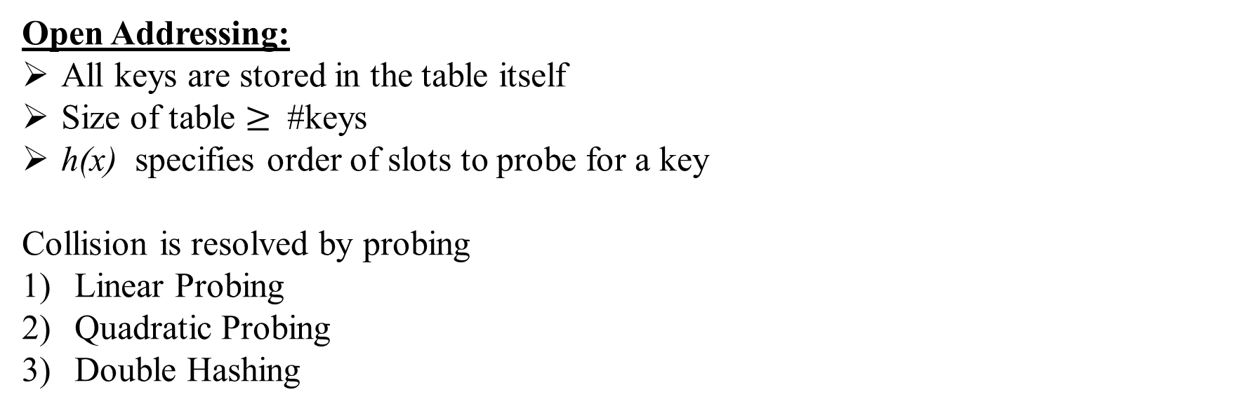
Open Addressing:
All keys are stored in the table itself
Size of table $≥$ #keys
h(x) specifies order of slots to probe for a key
Collision is resolved by probing
Linear Probing
Quadratic Probing
Double Hashing
0
1
2
3
4
5
6
7
X
X
X

Slide 14
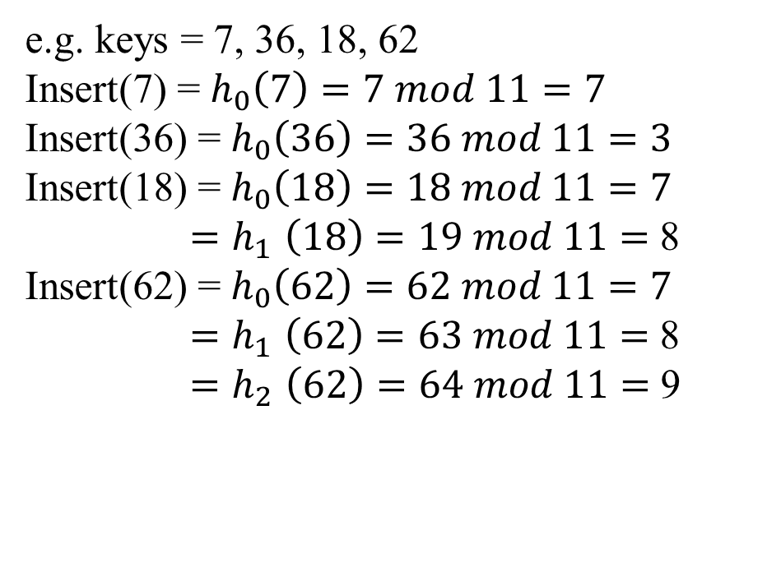
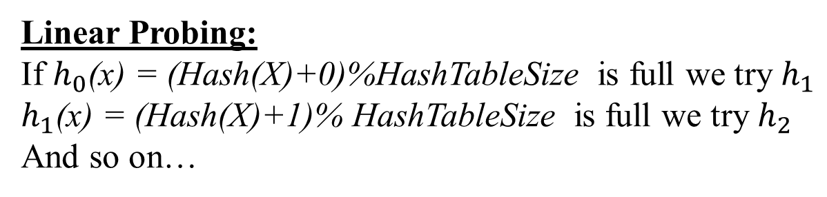
0
1
2
3
4
5
6
7
8
9
10
36
7
18
62
Linear Probing:
If $h_{0}$(x) = (Hash(X)+0)%HashTableSize is full we try $h_{1}$
$h_{1}$(x) = (Hash(X)+1)% HashTableSize is full we try $h_{2}$
And so on…
e.g. keys = 7, 36, 18, 62
Insert(7) = $h_{0}\left(7\right)=7 mod 11=7$
Insert(36) = $h_{0}\left(36\right)=36 mod 11=3$
Insert(18) = $h_{0}\left(18\right)=18 mod 11=7$
${=h}_{1}\left(18\right)=19 mod 11=$ 8
Insert(62) = $h_{0}\left(62\right)=62 mod 11=7$
${=h}_{1}\left(62\right)=63 mod 11=$ 8
${=h}_{2}\left(62\right)=64 mod 11=$ 9

Slide 15
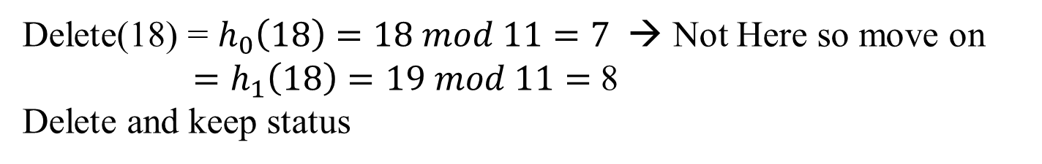
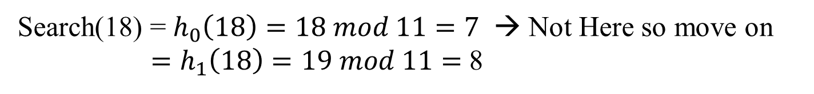
0
1
2
3
4
5
6
7
8
9
10
36
7
18
62
0
1
2
3
4
5
6
7
8
9
10
36
7
62
Search(18) = $h_{0}\left(18\right)=18 mod 11=7$ → Not Here so move on
${ =h}_{1}\left(18\right)=19 mod 11=$ 8
Delete(18) = $h_{0}\left(18\right)=18 mod 11=7$ → Not Here so move on
${ =h}_{1}\left(18\right)=19 mod 11=$ 8
Delete and keep status

Slide 16
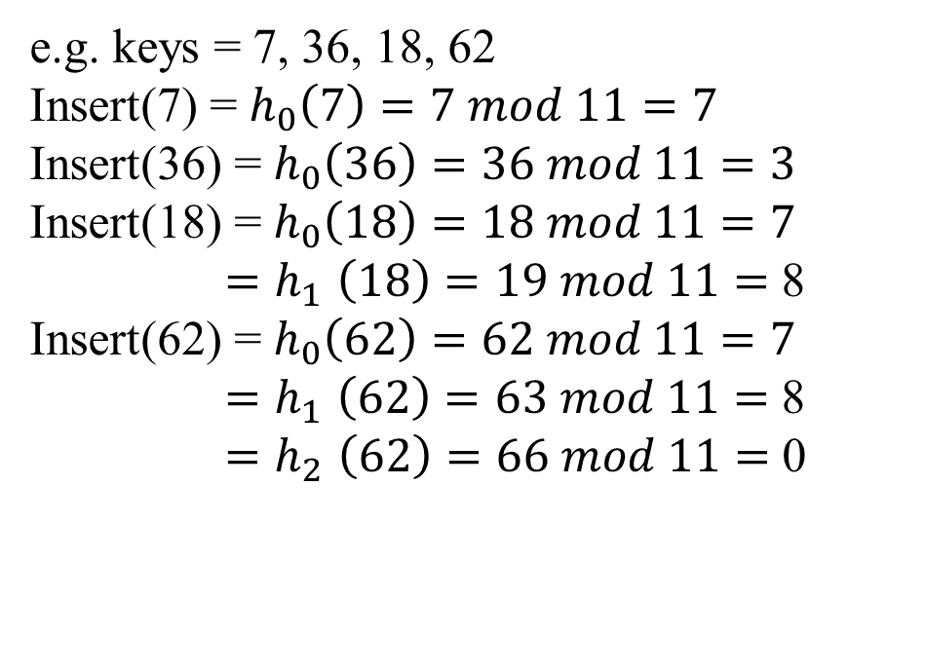
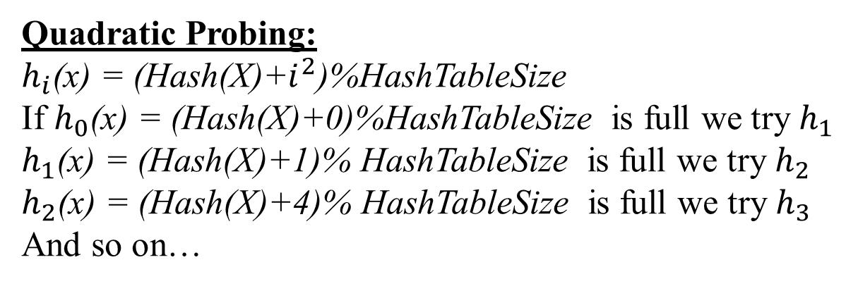
0
1
2
3
4
5
6
7
8
9
10
62
36
7
18
Quadratic Probing:
$h_{i}$(x) = (Hash(X)+$i^{2}$)%HashTableSize
If $h_{0}$(x) = (Hash(X)+0)%HashTableSize is full we try $h_{1}$
$h_{1}$(x) = (Hash(X)+1)% HashTableSize is full we try $h_{2}$
$h_{2}$(x) = (Hash(X)+4)% HashTableSize is full we try $h_{3}$
And so on…
e.g. keys = 7, 36, 18, 62
Insert(7) = $h_{0}\left(7\right)=7 mod 11=7$
Insert(36) = $h_{0}\left(36\right)=36 mod 11=3$
Insert(18) = $h_{0}\left(18\right)=18 mod 11=7$
${=h}_{1}\left(18\right)=19 mod 11=$ 8
Insert(62) = $h_{0}\left(62\right)=62 mod 11=7$
${=h}_{1}\left(62\right)=63 mod 11=$ 8
${=h}_{2}\left(62\right)=66 mod 11=$ 0

Slide 17
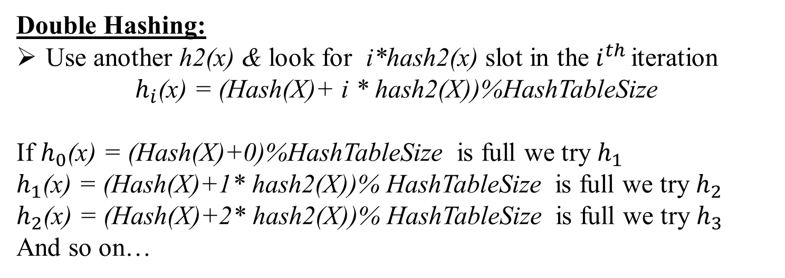
Double Hashing:
Use another h2(x) & look for i*hash2(x) slot in the $i^{th }$iteration
$h_{i}$(x) = (Hash(X)+ i * hash2(X))%HashTableSize
If $h_{0}$(x) = (Hash(X)+0)%HashTableSize is full we try $h_{1}$
$h_{1}$(x) = (Hash(X)+1* hash2(X))% HashTableSize is full we try $h_{2}$
$h_{2}$(x) = (Hash(X)+2* hash2(X))% HashTableSize is full we try $h_{3}$
And so on…
Complexity of Open Addressing:
Complexity:
n = #keys stored in table
m = #slots in table
α = n/m (load factor)
Expected time to insert/search/delete:
O(1/(1-α))

Slide 18
Binary Hashing for Approximate Nearest Neighbor Search on Big Data: A Survey

Slide 19
Efficient hashing based methods should have several properties.
The algorithms should map similar points in original space into similar binary codes in Hamming space.
It should ensure to preserve the similarity between the two spaces.
The dataset should be encoded into a small number of bits to increase retrieval speed and reduce memory storage.
Three main streams to increase hashing accuracy.
Try to construct more efficient hash function, one stream aims at learning new quantization method subsequent to projection process, the other stream
Concentrate on re-ranking hash codes with new distances.
Hash codes with deep learning framework.

Slide 20
Applications of Hashing
In compilers to keep track of declared variables.
For online spelling checking the hashing functions are used.
Hashing helps in Game playing programs to store the moves made.
For browser program while caching the web pages, hashing is used.

Slide 21
Summary
Linear Probing
Easy to implement
Best Cache performance
Suffers from clustering
Quadratic Probing
Average Cache Performance
Suffers a lesser clustering than linear probing
Double Hashing
Poor cache performance
No clustering
Requires more computation time

Slide 22
REFERENCES
Yuan Cao, Heng Qi1, Wenrui Zhou1, Jien Kato, Keqiu Li, Xiulong Liu, and Jie Gui, “Binary Hashing for Approximate Nearest Neighbor Search on Big Data: A Survey”, DOI 10.1109/ACCESS.2017.2781360, IEEE Access
https://en.wikipedia.org/wiki/Hamming_space
https://en.wikibooks.org/wiki/Data_Structures/Hash_Tables

Slide 23
THANK YOU

