Slide 1
Advanced Project Presentation 3
ANLY:515-90 Spring 2017 Risk Modelling and Assessment
Dean D’souza
H.U. ID: 168424

Slide 2
Bristol Myers Squibb Co. - BMY

Slide 3
Bristol Myers Squibb Co. - BMY

Slide 4
Bristol Myers Squibb Co. - BMY

Slide 5
Cardinal Health Inc. - CAH

Slide 6
Cardinal Health Inc. - CAH

Slide 7
Cardinal Health Inc. - CAH

Slide 8
Agilent Technologies Inc. - A

Slide 9
Agilent Technologies Inc. - A

Slide 10
Agilent Technologies Inc. - A

Slide 11
Abbott Laboratories - ABT

Slide 12
Abbott Laboratories - ABT

Slide 13
Abbott Laboratories - ABT

Slide 14
Becton Dickinson - BDX

Slide 15
Becton Dickinson - BDX

Slide 16
Becton Dickinson - BDX

Slide 17
Bristol Myers Squibb Co. - BMY

Slide 18
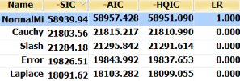
Bristol Myers Squibb Co. - BMY
 |  |  | Historic 5% | Historic 1%
Average |  |  | -0.020616527 | -0.034454454
0.000526588
 |  |  | Data Object
Variance |  |  | VoseDataObject('[AdjClosedAll.xlsx]BMYCorrected'!C3:C1259)
0.000223109
 |  | I | Static Fit
Standard Deviation |  |  | VoseNormalMix(0.0004103104638559902,0.01522526940351023,1.810957360306858)
0.014930907 |  |  | static 5% | static 1%
 |  |  | -0.025616666 | -0.041271833
 |  | II | Parameter Uncertainty
 |  |  | VoseNormalMix(0.0001718131927476502,0.01549440977484482,1.86272149097016)
 |  |  | -0.027205346 | -0.043997881
 |  |  | No simulation results | No simulation results

Slide 19
Cardinal Health Inc. - CAH

Slide 20
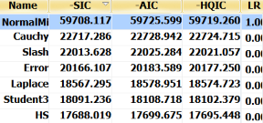
Cardinal Health Inc. - CAH
 |  |  | Historic 5% | Historic 1%
Average |  |  | -0.01898 | -0.03497
0.000522
 |  |  | Data Object
Variance |  |  | VoseDataObject('[AdjClosedAll.xlsx]CAHCorrected'!C3:C1259)
0.000169
 |  | I | Static Fit
Standard Deviation |  |  | VoseNormalMix(0.0008249336543409615,0.01319829220769234,1.490258650649915)
0.013003 |  |  | static 5% | static 1%
 |  |  | -0.02136 | -0.03457
 |  | II | Parameter Uncertainty
 |  |  | VoseNormalMix(0.0008351799559739909,0.01320371631567407,1.498079207020018)
 |  |  | -0.02136 | -0.03459
 |  |  | No simulation results | No simulation results

Slide 21
Agilent Technologies Inc. - A

Slide 22
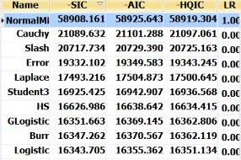
Agilent Technologies Inc. - A
 |  |  | Historic 5% | Historic 1%
Average |  |  | -0.02394 | -0.03849
0.000484
 |  |  | Data Object
Variance |  |  | VoseDataObject('[AdjClosedAll.xlsx]ACorrected'!C3:C1259)
0.000229
 |  | I | Static Fit
Standard Deviation |  |  | VoseNormalMix(0.0006190285237976964,0.01517625331539879,1.040099149162515)
0.015137 |  |  | static 5% | static 1%
 |  |  | -0.02445 | -0.03868
 |  | II | Parameter Uncertainty
 |  |  | VoseNormalMix(0.0006015925849775076,0.01517732495080005,1.04734269002106)
 |  |  | -0.02448 | -0.03872
 |  |  | No simulation results | No simulation results

Slide 23
Abbott Laboratories - ABT

Slide 24
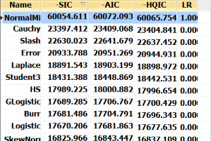
Abbott Laboratories - ABT
 |  |  | Historic 5% | Historic 1%
Average |  |  | -0.01883 | -0.03532
0.000367
 |  |  | Data Object
Variance |  |  | VoseDataObject('[AdjClosedAll.xlsx]ABTCorrected'!C3:C1259)
0.00015
 |  | I | Static Fit
Standard Deviation |  |  | VoseNormalMix(0.0005197034668293209,0.01232379965816179,1.693027030460224)
0.012231 |  |  | static 5% | static 1%
 |  |  | -0.02041 | -0.03297
 |  | II | Parameter Uncertainty
 |  |  | VoseNormalMix(0.0005427189120647401,0.01233409266422694,1.693868639881258)
 |  |  | -0.02041 | -0.03298
 |  |  | No simulation results | No simulation results

Slide 25
Becton Dickinson - BDX

Slide 26
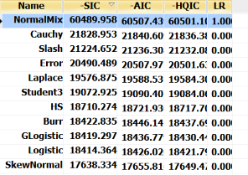
Becton Dickinson - BDX
 |  |  | Historic 5% | Historic 1%
Average |  |  | -0.01553 | -0.02754
0.000713
 |  |  | Data Object
Variance |  |  | VoseDataObject('[AdjClosedAll.xlsx]BDXCorrected'!C3:C1259)
0.000105
 |  | I | Static Fit
Standard Deviation |  |  | VoseNormalMix(0.0008690655367010197,0.01033195796931351,1.366831972191721)
0.010256 |  |  | static 5% | static 1%
 |  |  | -0.0164 | -0.02659
 |  | II | Parameter Uncertainty
 |  |  | VoseNormalMix(0.0008811251791056361,0.0103299602674164,1.368756273321537)
 |  |  | -0.01638 | -0.02658
 |  |  | No simulation results | No simulation results

