Slide 1
Advanced Project Presentation 3
ANLY:515-90 Spring 2017 Risk Modelling and Assessment
Dean D’souza
H.U. ID: 168424

Slide 2
Bristol Myers Squibb Co. - BMY
 | Year | Sales/Revenue | Cost of Goods Sold (COGS) incl. D&A | COGS excluding D&A | Depreciation & Amortization Expense | Depreciation | Amortization of Intangibles | Gross Income | SG&A Expense | Research & Development | Other SG&A | Other Operating Expense | Unusual Expense | EBIT after Unusual Expense | Non Operating Income/Expense | Non-Operating Interest Income | Equity in Affiliates (Pretax) | Interest Expense | Gross Interest Expense | Interest Capitalized | Pretax Income | Income Tax | Income Tax - Current Domestic | Income Tax - Current Foreign | Income Tax - Deferred Domestic | Income Tax - Deferred Foreign | Income Tax Credits | Other After Tax Income (Expense) | Consolidated Net Income | Minority Interest Expense | Net Income
Year | 1
Sales/Revenue | 0.424945 | 1
Cost of Goods Sold (COGS) incl. D&A | 0.002908 | 0.735958 | 1
COGS excluding D&A | 0.404521 | 0.963237 | 0.866492 | 1
Depreciation & Amortization Expense | -0.77801 | -0.43497 | 0.263036 | -0.25369 | 1
Depreciation | 0.467971 | -0.55221 | -0.69565 | -0.53711 | -0.31223 | 1
Amortization of Intangibles | -0.80855 | -0.28803 | 0.382173 | -0.12444 | 0.981509 | -0.4883 | 1
Gross Income | 0.555947 | 0.939562 | 0.459677 | 0.825325 | -0.70359 | -0.37257 | -0.57109 | 1
SG&A Expense | 0.663723 | 0.888332 | 0.409033 | 0.799289 | -0.75213 | -0.16415 | -0.65767 | 0.958411 | 1
Research & Development | 0.838954 | 0.718209 | 0.17219 | 0.626394 | -0.87759 | 0.149509 | -0.8361 | 0.855028 | 0.947454 | 1
Other SG&A | -0.63135 | 0.410105 | 0.68862 | 0.432732 | 0.500142 | -0.96555 | 0.653905 | 0.18971 | 0.016508 | -0.30388 | 1
Other Operating Expense | #DIV/0! | #DIV/0! | #DIV/0! | #DIV/0! | #DIV/0! | #DIV/0! | #DIV/0! | #DIV/0! | #DIV/0! | #DIV/0! | #DIV/0! | 1
Unusual Expense | -0.18733 | -0.30469 | -0.73724 | -0.5455 | -0.37211 | 0.078918 | -0.35822 | -0.02685 | -0.13719 | -0.07979 | -0.16099 | #DIV/0! | 1
EBIT after Unusual Expense | 0.474862 | 0.834061 | 0.86761 | 0.944321 | -0.14495 | -0.33119 | -0.06594 | 0.655315 | 0.700053 | 0.581911 | 0.273817 | #DIV/0! | -0.77128 | 1
Non Operating Income/Expense | 0.852841 | 0.53039 | -0.03686 | 0.432182 | -0.90764 | 0.368021 | -0.90781 | 0.714374 | 0.852672 | 0.969537 | -0.49654 | #DIV/0! | -0.00069 | 0.424456 | 1
Non-Operating Interest Income | -0.3434 | 0.68366 | 0.862091 | 0.715952 | 0.288376 | -0.9362 | 0.453599 | 0.460818 | 0.332768 | 0.018196 | 0.93556 | #DIV/0! | -0.3447 | 0.578121 | -0.19748 | 1
Equity in Affiliates (Pretax) | -0.96112 | -0.23915 | 0.264438 | -0.17412 | 0.850594 | -0.62709 | 0.907443 | -0.44743 | -0.57002 | -0.79604 | 0.781402 | #DIV/0! | -0.03548 | -0.23181 | -0.86637 | 0.542849 | 1
Interest Expense | -0.49275 | -0.92842 | -0.51432 | -0.82472 | 0.596283 | 0.502126 | 0.446325 | -0.95776 | -0.8467 | -0.71973 | -0.2912 | #DIV/0! | 0.013397 | -0.63057 | -0.54113 | -0.51892 | 0.356757 | 1
Gross Interest Expense | -0.44685 | -0.94075 | -0.57393 | -0.85073 | 0.53099 | 0.558849 | 0.374902 | -0.94379 | -0.82423 | -0.6778 | -0.35588 | #DIV/0! | 0.059162 | -0.6587 | -0.48643 | -0.57811 | 0.294896 | 0.996817 | 1
Interest Capitalized | 0.843661 | 0.749008 | 0.372505 | 0.737689 | -0.7052 | 0.131336 | -0.67393 | 0.794127 | 0.916295 | 0.953078 | -0.24945 | #DIV/0! | -0.37732 | 0.76872 | 0.904136 | 0.105351 | -0.7384 | -0.66347 | -0.63762 | 1
Pretax Income | 0.630897 | 0.862817 | 0.733382 | 0.927615 | -0.37282 | -0.19279 | -0.30319 | 0.760915 | 0.835109 | 0.762501 | 0.108652 | #DIV/0! | -0.65207 | 0.968853 | 0.635008 | 0.449406 | -0.42745 | -0.69171 | -0.70095 | 0.901839 | 1
Income Tax | 0.833845 | 0.807543 | 0.513622 | 0.827586 | -0.60551 | 0.012129 | -0.55822 | 0.799545 | 0.881872 | 0.890216 | -0.14687 | #DIV/0! | -0.4826 | 0.860552 | 0.799462 | 0.205758 | -0.67928 | -0.72751 | -0.71451 | 0.972533 | 0.950606 | 1
Income Tax - Current Domestic | 0.452904 | 0.983101 | 0.739747 | 0.965737 | -0.43284 | -0.46303 | -0.30405 | 0.915479 | 0.914496 | 0.759844 | 0.351491 | #DIV/0! | -0.39192 | 0.877653 | 0.59437 | 0.651328 | -0.27005 | -0.85845 | -0.86885 | 0.815139 | 0.917 | 0.849365 | 1
Income Tax - Current Foreign | 0.244992 | -0.30914 | -0.57015 | -0.36628 | -0.39807 | 0.743562 | -0.51583 | -0.11718 | 0.122858 | 0.315908 | -0.65574 | #DIV/0! | 0.182428 | -0.25665 | 0.520945 | -0.59037 | -0.42547 | 0.379549 | 0.435322 | 0.247054 | -0.07788 | 0.029952 | -0.17063 | 1
Income Tax - Deferred Domestic | -0.84425 | -0.14724 | -0.08633 | -0.26584 | 0.349513 | -0.60496 | 0.442424 | -0.14949 | -0.32187 | -0.52086 | 0.658599 | #DIV/0! | 0.558233 | -0.49559 | -0.5665 | 0.411093 | 0.76801 | 0.09297 | 0.069514 | -0.6642 | -0.56524 | -0.68813 | -0.2218 | -0.24359 | 1
Income Tax - Deferred Foreign | 0.088485 | -0.13402 | 0.060064 | -0.00327 | 0.120578 | 0.457437 | 0.018542 | -0.20617 | 0.061373 | 0.135521 | -0.27459 | #DIV/0! | -0.53497 | 0.237779 | 0.251408 | -0.15011 | -0.09084 | 0.438436 | 0.441374 | 0.293516 | 0.268303 | 0.178517 | 0.048601 | 0.693352 | -0.39524 | 1
Income Tax Credits | #DIV/0! | #DIV/0! | #DIV/0! | #DIV/0! | #DIV/0! | #DIV/0! | #DIV/0! | #DIV/0! | #DIV/0! | #DIV/0! | #DIV/0! | #DIV/0! | #DIV/0! | #DIV/0! | #DIV/0! | #DIV/0! | #DIV/0! | #DIV/0! | #DIV/0! | #DIV/0! | #DIV/0! | #DIV/0! | #DIV/0! | #DIV/0! | #DIV/0! | #DIV/0! | 1
Other After Tax Income (Expense) | -0.70711 | 0.176007 | 0.15218 | 0.04733 | 0.206554 | -0.76903 | 0.344234 | 0.153918 | -0.02347 | -0.27654 | 0.784644 | #DIV/0! | 0.446576 | -0.21801 | -0.37782 | 0.631336 | 0.68883 | -0.19357 | -0.22045 | -0.40674 | -0.27469 | -0.41988 | 0.104373 | -0.30583 | 0.946572 | -0.39418 | #DIV/0! | 1
Consolidated Net Income | 0.438044 | 0.897934 | 0.842146 | 0.965573 | -0.23493 | -0.38195 | -0.13848 | 0.751977 | 0.798825 | 0.657846 | 0.324307 | #DIV/0! | -0.66226 | 0.975903 | 0.502607 | 0.635019 | -0.21779 | -0.68981 | -0.71247 | 0.804345 | 0.972597 | 0.860145 | 0.94794 | -0.16412 | -0.37904 | 0.255604 | #DIV/0! | -0.07567 | 1
Minority Interest Expense | -0.65527 | 0.209849 | 0.134467 | 0.065169 | 0.137833 | -0.76818 | 0.280947 | 0.207267 | 0.019625 | -0.22739 | 0.761658 | #DIV/0! | 0.490489 | -0.21672 | -0.3329 | 0.61665 | 0.634091 | -0.25371 | -0.27669 | -0.37437 | -0.26127 | -0.38599 | 0.128512 | -0.32018 | 0.934253 | -0.45363 | #DIV/0! | 0.996222 | -0.07231 | 1
Net Income | 0.553369 | 0.828063 | 0.787466 | 0.921318 | -0.25596 | -0.21928 | -0.1905 | 0.687977 | 0.769373 | 0.681583 | 0.163954 | #DIV/0! | -0.73484 | 0.985879 | 0.551862 | 0.49284 | -0.33626 | -0.61939 | -0.63672 | 0.851476 | 0.991617 | 0.908022 | 0.891807 | -0.09763 | -0.5497 | 0.332925 | #DIV/0! | -0.26834 | 0.980769 | -0.26555 | 1

Slide 3
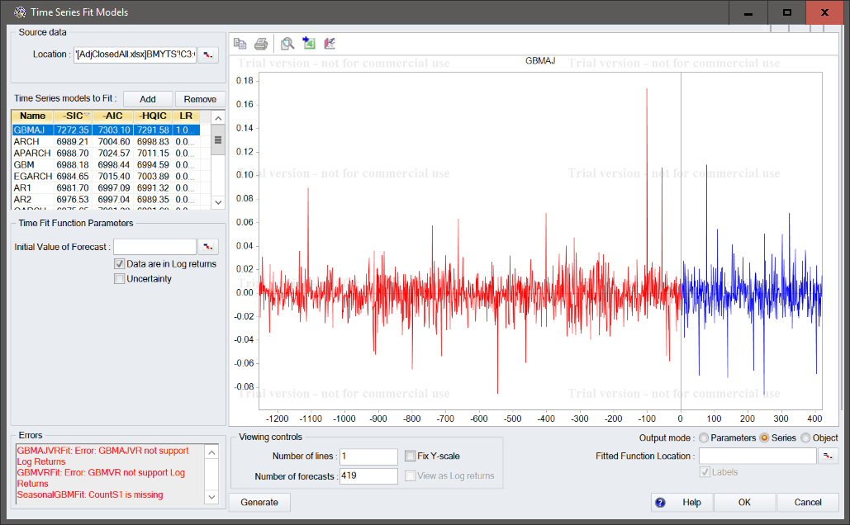
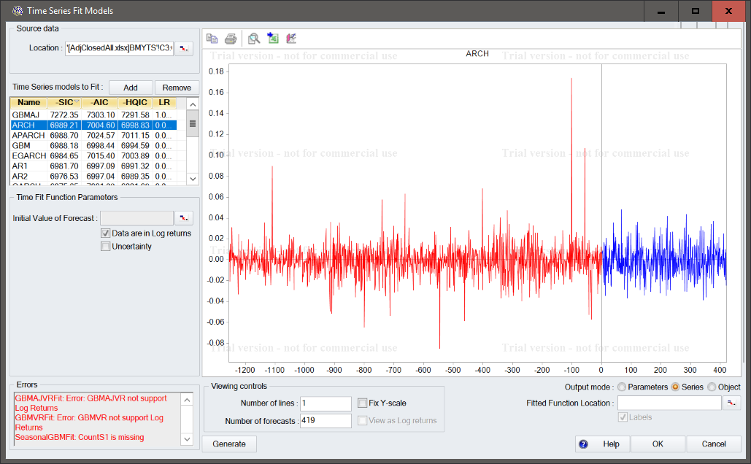
Bristol Myers Squibb Co. - BMY

Slide 4
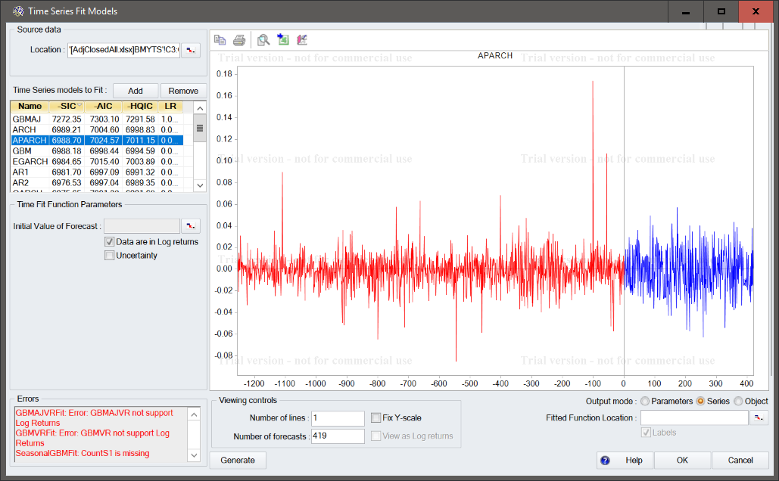
Bristol Myers Squibb Co. - BMY

Slide 5
Bristol Myers Squibb Co. - BMY

Slide 6
Cardinal Health Inc. - CAH
 | Year | Sales/Revenue | Cost of Goods Sold (COGS) incl. D&A | COGS excluding D&A | Depreciation & Amortization Expense | Depreciation | Amortization of Intangibles | Gross Income | SG&A Expense | Research & Development | Other SG&A | Other Operating Expense | Unusual Expense | EBIT after Unusual Expense | Non Operating Income/Expense | Non-Operating Interest Income | Equity in Affiliates (Pretax) | Interest Expense | Gross Interest Expense | Interest Capitalized | Pretax Income | Income Tax | Income Tax - Current Domestic | Income Tax - Current Foreign | Income Tax - Deferred Domestic | Income Tax - Deferred Foreign | Income Tax Credits | Other After Tax Income (Expense) | Consolidated Net Income | Minority Interest Expense | Net Income
Year | 1
Sales/Revenue | 0.418327 | 1
Cost of Goods Sold (COGS) incl. D&A | 0.376389 | 0.998942 | 1
COGS excluding D&A | 0.368153 | 0.998489 | 0.999954 | 1
Depreciation & Amortization Expense | 0.925918 | 0.561428 | 0.525781 | 0.517613 | 1
Depreciation | 0.812663 | 0.451277 | 0.418229 | 0.409964 | 0.956221 | 1
Amortization of Intangibles | 0.936719 | 0.574738 | 0.538963 | 0.530879 | 0.998861 | 0.941171 | 1
Gross Income | 0.962119 | 0.63681 | 0.600681 | 0.593575 | 0.944408 | 0.832138 | 0.954895 | 1
SG&A Expense | 0.98825 | 0.530516 | 0.491556 | 0.483579 | 0.962963 | 0.852991 | 0.972922 | 0.981431 | 1
Research & Development | #DIV/0! | #DIV/0! | #DIV/0! | #DIV/0! | #DIV/0! | #DIV/0! | #DIV/0! | #DIV/0! | #DIV/0! | 1
Other SG&A | 0.98825 | 0.530516 | 0.491556 | 0.483579 | 0.962963 | 0.852991 | 0.972922 | 0.981431 | 1 | #DIV/0! | 1
Other Operating Expense | #DIV/0! | #DIV/0! | #DIV/0! | #DIV/0! | #DIV/0! | #DIV/0! | #DIV/0! | #DIV/0! | #DIV/0! | #DIV/0! | #DIV/0! | 1
Unusual Expense | -0.36244 | -0.16824 | -0.15819 | -0.15516 | -0.33643 | -0.16793 | -0.36111 | -0.27204 | -0.39784 | #DIV/0! | -0.39784 | #DIV/0! | 1
EBIT after Unusual Expense | 0.721097 | 0.507045 | 0.484323 | 0.479189 | 0.696523 | 0.501888 | 0.722489 | 0.694561 | 0.765166 | #DIV/0! | 0.765166 | #DIV/0! | -0.87467 | 1
Non Operating Income/Expense | 0.291987 | -0.18533 | -0.20163 | -0.2021 | -0.0736 | -0.3131 | -0.03394 | 0.160509 | 0.194129 | #DIV/0! | 0.194129 | #DIV/0! | -0.34423 | 0.338771 | 1
Non-Operating Interest Income | #DIV/0! | #DIV/0! | #DIV/0! | #DIV/0! | #DIV/0! | #DIV/0! | #DIV/0! | #DIV/0! | #DIV/0! | #DIV/0! | #DIV/0! | #DIV/0! | #DIV/0! | #DIV/0! | #DIV/0! | 1
Equity in Affiliates (Pretax) | #DIV/0! | #DIV/0! | #DIV/0! | #DIV/0! | #DIV/0! | #DIV/0! | #DIV/0! | #DIV/0! | #DIV/0! | #DIV/0! | #DIV/0! | #DIV/0! | #DIV/0! | #DIV/0! | #DIV/0! | #DIV/0! | 1
Interest Expense | 0.963585 | 0.497343 | 0.45797 | 0.449633 | 0.980939 | 0.929816 | 0.981156 | 0.967559 | 0.975586 | #DIV/0! | 0.975586 | #DIV/0! | -0.23157 | 0.626259 | 0.032618 | #DIV/0! | #DIV/0! | 1
Gross Interest Expense | 0.95608 | 0.558033 | 0.52041 | 0.512346 | 0.988867 | 0.93053 | 0.990193 | 0.975781 | 0.978816 | #DIV/0! | 0.978816 | #DIV/0! | -0.2594 | 0.657088 | 0.010948 | #DIV/0! | #DIV/0! | 0.996999 | 1
Interest Capitalized | -0.04742 | 0.809468 | 0.830032 | 0.833128 | 0.152802 | 0.056994 | 0.167156 | 0.155916 | 0.091856 | #DIV/0! | 0.091856 | #DIV/0! | -0.37132 | 0.430383 | -0.27823 | #DIV/0! | #DIV/0! | 0.012627 | 0.089997 | 1
Pretax Income | 0.683856 | 0.465844 | 0.444438 | 0.439746 | 0.635459 | 0.42676 | 0.664223 | 0.647117 | 0.721723 | #DIV/0! | 0.721723 | #DIV/0! | -0.89872 | 0.995981 | 0.403496 | #DIV/0! | #DIV/0! | 0.568592 | 0.598703 | 0.418149 | 1
Income Tax | 0.86825 | 0.686647 | 0.658405 | 0.652991 | 0.817063 | 0.615274 | 0.843197 | 0.898819 | 0.904123 | #DIV/0! | 0.904123 | #DIV/0! | -0.60316 | 0.910894 | 0.354937 | #DIV/0! | #DIV/0! | 0.799685 | 0.826928 | 0.392977 | 0.89166 | 1
Income Tax - Current Domestic | 0.814491 | 0.498406 | 0.467031 | 0.458898 | 0.967415 | 0.986024 | 0.956376 | 0.833168 | 0.867789 | #DIV/0! | 0.867789 | #DIV/0! | -0.31787 | 0.618801 | -0.28851 | #DIV/0! | #DIV/0! | 0.916561 | 0.925849 | 0.167068 | 0.548634 | 0.683119 | 1
Income Tax - Current Foreign | 0.872346 | 0.592489 | 0.560745 | 0.552924 | 0.986003 | 0.944375 | 0.984629 | 0.897938 | 0.928094 | #DIV/0! | 0.928094 | #DIV/0! | -0.43561 | 0.750713 | -0.14092 | #DIV/0! | #DIV/0! | 0.935202 | 0.951977 | 0.264739 | 0.690228 | 0.817032 | 0.978595 | 1
Income Tax - Deferred Domestic | 0.205092 | 0.345707 | 0.344818 | 0.347171 | -0.03977 | -0.32704 | 0.00739 | 0.230906 | 0.190836 | #DIV/0! | 0.190836 | #DIV/0! | -0.39849 | 0.470133 | 0.797808 | #DIV/0! | #DIV/0! | 9.91E-05 | 0.02541 | 0.326934 | 0.524769 | 0.528736 | -0.25804 | -0.05682 | 1
Income Tax - Deferred Foreign | 0.537775 | 0.911921 | 0.903453 | 0.900237 | 0.75649 | 0.70563 | 0.758521 | 0.705567 | 0.659155 | #DIV/0! | 0.659155 | #DIV/0! | -0.32734 | 0.628429 | -0.36501 | #DIV/0! | #DIV/0! | 0.654014 | 0.708734 | 0.740397 | 0.569611 | 0.716384 | 0.765667 | 0.814811 | 0.065248 | 1
Income Tax Credits | #DIV/0! | #DIV/0! | #DIV/0! | #DIV/0! | #DIV/0! | #DIV/0! | #DIV/0! | #DIV/0! | #DIV/0! | #DIV/0! | #DIV/0! | #DIV/0! | #DIV/0! | #DIV/0! | #DIV/0! | #DIV/0! | #DIV/0! | #DIV/0! | #DIV/0! | #DIV/0! | #DIV/0! | #DIV/0! | #DIV/0! | #DIV/0! | #DIV/0! | #DIV/0! | 1
Other After Tax Income (Expense) | #DIV/0! | #DIV/0! | #DIV/0! | #DIV/0! | #DIV/0! | #DIV/0! | #DIV/0! | #DIV/0! | #DIV/0! | #DIV/0! | #DIV/0! | #DIV/0! | #DIV/0! | #DIV/0! | #DIV/0! | #DIV/0! | #DIV/0! | #DIV/0! | #DIV/0! | #DIV/0! | #DIV/0! | #DIV/0! | #DIV/0! | #DIV/0! | #DIV/0! | #DIV/0! | #DIV/0! | 1
Consolidated Net Income | 0.605751 | 0.388463 | 0.369849 | 0.365552 | 0.56044 | 0.357652 | 0.588861 | 0.552301 | 0.643036 | #DIV/0! | 0.643036 | #DIV/0! | -0.94659 | 0.981778 | 0.400752 | #DIV/0! | #DIV/0! | 0.482116 | 0.51205 | 0.411422 | 0.992088 | 0.827779 | 0.490051 | 0.628553 | 0.504319 | 0.508409 | #DIV/0! | #DIV/0! | 1
Minority Interest Expense | 0.707107 | 0.843497 | 0.824701 | 0.819536 | 0.889507 | 0.845058 | 0.889392 | 0.836374 | 0.804593 | #DIV/0! | 0.804593 | #DIV/0! | -0.30858 | 0.660972 | -0.29958 | #DIV/0! | #DIV/0! | 0.815395 | 0.85554 | 0.560431 | 0.595714 | 0.780946 | 0.884375 | 0.920517 | 0.013305 | 0.97033 | #DIV/0! | #DIV/0! | 0.522321 | 1
Net Income | 0.605751 | 0.388463 | 0.369849 | 0.365552 | 0.56044 | 0.357652 | 0.588861 | 0.552301 | 0.643036 | #DIV/0! | 0.643036 | #DIV/0! | -0.94659 | 0.981778 | 0.400752 | #DIV/0! | #DIV/0! | 0.482116 | 0.51205 | 0.411422 | 0.992088 | 0.827779 | 0.490051 | 0.628553 | 0.504319 | 0.508409 | #DIV/0! | #DIV/0! | 1 | 0.522321 | 1

Slide 7
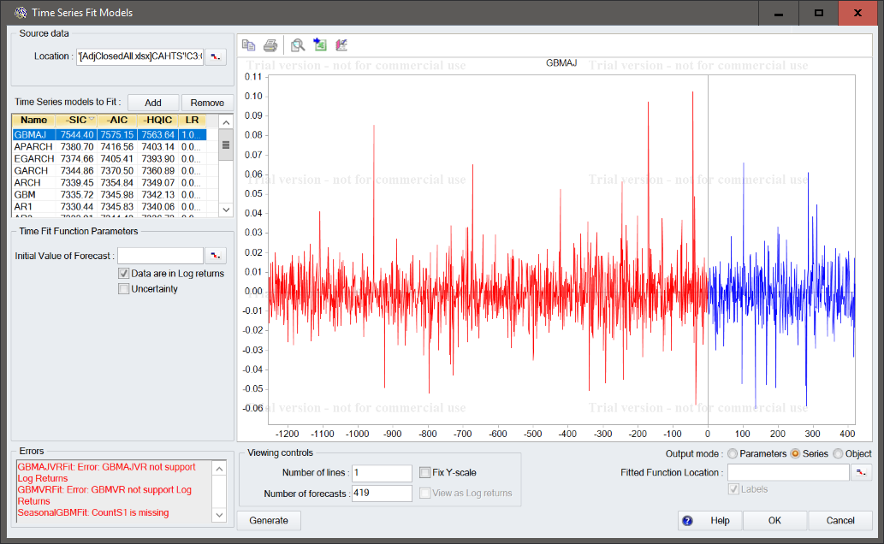
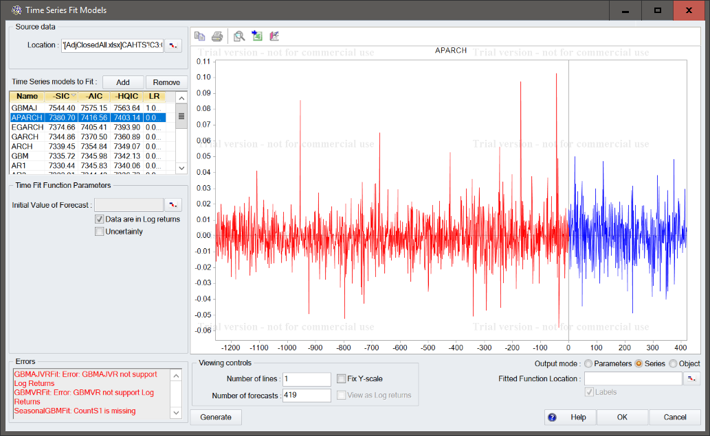
Cardinal Health Inc. - CAH

Slide 8
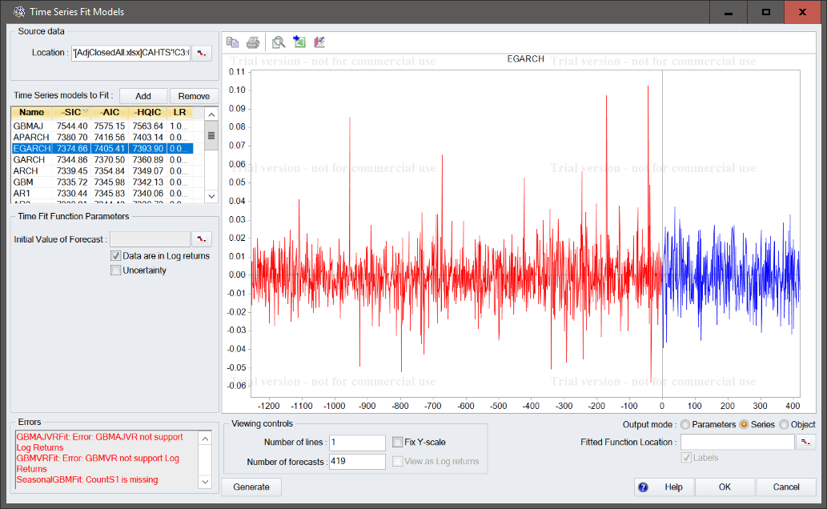
Cardinal Health Inc. - CAH

Slide 9
Cardinal Health Inc. - CAH

Slide 10
Agilent Technologies Inc. - A
 | Year | Sales/Revenue | Cost of Goods Sold (COGS) incl. D&A | COGS excluding D&A | Depreciation & Amortization Expense | Depreciation | Amortization of Intangibles | Gross Income | SG&A Expense | Research & Development | Other SG&A | Other Operating Expense | Unusual Expense | EBIT after Unusual Expense | Non Operating Income/Expense | Non-Operating Interest Income | Equity in Affiliates (Pretax) | Interest Expense | Gross Interest Expense | Interest Capitalized | Pretax Income | Income Tax | Income Tax - Current Domestic | Income Tax - Current Foreign | Income Tax - Deferred Domestic | Income Tax - Deferred Foreign | Income Tax Credits | Other After Tax Income (Expense) | Consolidated Net Income | Minority Interest Expense | Net Income
Year | 1
Sales/Revenue | -0.84352 | 1
Cost of Goods Sold (COGS) incl. D&A | -0.84642 | 0.998694 | 1
COGS excluding D&A | -0.86458 | 0.998707 | 0.998577 | 1
Depreciation & Amortization Expense | -0.54608 | 0.862621 | 0.874122 | 0.847176 | 1
Depreciation | -0.78148 | 0.987599 | 0.991805 | 0.984031 | 0.92532 | 1
Amortization of Intangibles | -0.00522 | 0.395803 | 0.415148 | 0.366559 | 0.803522 | 0.517795 | 1
Gross Income | -0.83933 | 0.999057 | 0.995534 | 0.996767 | 0.851075 | 0.981997 | 0.378548 | 1
SG&A Expense | -0.7851 | 0.989456 | 0.993072 | 0.986635 | 0.914467 | 0.999373 | 0.494292 | 0.98435 | 1
Research & Development | -0.82663 | 0.99675 | 0.998519 | 0.994506 | 0.89725 | 0.99559 | 0.461387 | 0.9932 | 0.995225 | 1
Other SG&A | -0.75886 | 0.981327 | 0.985919 | 0.978247 | 0.919465 | 0.997213 | 0.50896 | 0.97541 | 0.998476 | 0.988327 | 1
Other Operating Expense | 0.353553 | -0.64086 | -0.60333 | -0.61135 | -0.49412 | -0.58551 | -0.19565 | -0.67145 | -0.58985 | -0.60889 | -0.57704 | 1
Unusual Expense | 0.520039 | -0.1832 | -0.22317 | -0.21955 | -0.16827 | -0.20354 | -0.06011 | -0.14885 | -0.1934 | -0.21526 | -0.17968 | -0.57296 | 1
EBIT after Unusual Expense | -0.91659 | 0.885121 | 0.869399 | 0.889676 | 0.5713 | 0.803817 | 0.027052 | 0.896667 | 0.808569 | 0.854923 | 0.779614 | -0.69037 | -0.15398 | 1
Non Operating Income/Expense | -0.46523 | 0.259434 | 0.278383 | 0.302588 | -0.01703 | 0.236453 | -0.40963 | 0.242795 | 0.260922 | 0.235037 | 0.275912 | 0.294599 | -0.46733 | 0.217527 | 1
Non-Operating Interest Income | 0.377964 | -0.16772 | -0.2107 | -0.18968 | -0.32184 | -0.2275 | -0.36898 | -0.13084 | -0.20694 | -0.22241 | -0.19602 | -0.53452 | 0.934784 | -0.04927 | -0.18372 | 1
Equity in Affiliates (Pretax) | 0.353553 | -0.64086 | -0.60333 | -0.61135 | -0.49412 | -0.58551 | -0.19565 | -0.67145 | -0.58985 | -0.60889 | -0.57704 | 1 | -0.57296 | -0.69037 | 0.294599 | -0.53452 | 1
Interest Expense | -0.76473 | 0.991016 | 0.988989 | 0.983945 | 0.905015 | 0.99238 | 0.483945 | 0.990705 | 0.993097 | 0.992289 | 0.989397 | -0.6798 | -0.09715 | 0.834645 | 0.184591 | -0.11837 | -0.6798 | 1
Gross Interest Expense | -0.76473 | 0.991016 | 0.988989 | 0.983945 | 0.905015 | 0.99238 | 0.483945 | 0.990705 | 0.993097 | 0.992289 | 0.989397 | -0.6798 | -0.09715 | 0.834645 | 0.184591 | -0.11837 | -0.6798 | 1 | 1
Interest Capitalized | #DIV/0! | #DIV/0! | #DIV/0! | #DIV/0! | #DIV/0! | #DIV/0! | #DIV/0! | #DIV/0! | #DIV/0! | #DIV/0! | #DIV/0! | #DIV/0! | #DIV/0! | #DIV/0! | #DIV/0! | #DIV/0! | #DIV/0! | #DIV/0! | #DIV/0! | 1
Pretax Income | -0.93375 | 0.777812 | 0.762851 | 0.790568 | 0.404959 | 0.676399 | -0.14821 | 0.788932 | 0.682052 | 0.741418 | 0.646432 | -0.56298 | -0.25828 | 0.973987 | 0.279167 | -0.10451 | -0.56298 | 0.701568 | 0.701568 | #DIV/0! | 1
Income Tax | -0.57338 | 0.908766 | 0.897915 | 0.886496 | 0.90055 | 0.917951 | 0.590716 | 0.916124 | 0.914659 | 0.912795 | 0.911613 | -0.81905 | 0.151999 | 0.747412 | -0.09914 | 0.052361 | -0.81905 | 0.950289 | 0.950289 | #DIV/0! | 0.579568 | 1
Income Tax - Current Domestic | 0.233365 | -0.49436 | -0.45093 | -0.46765 | -0.28762 | -0.42199 | 0.013562 | -0.53025 | -0.43359 | -0.4475 | -0.4248 | 0.965175 | -0.70557 | -0.59126 | 0.223497 | -0.72393 | 0.965175 | -0.53009 | -0.53009 | #DIV/0! | -0.48362 | -0.67115 | 1
Income Tax - Current Foreign | 0.101519 | 0.38747 | 0.39827 | 0.367518 | 0.634908 | 0.495517 | 0.654554 | 0.377495 | 0.499328 | 0.416714 | 0.543566 | -0.26069 | 0.278443 | -0.0442 | 0.088301 | 0.139345 | -0.26069 | 0.4862 | 0.4862 | #DIV/0! | -0.25041 | 0.541831 | -0.21456 | 1
Income Tax - Deferred Domestic | -0.59193 | 0.084706 | 0.095103 | 0.13108 | -0.2856 | -0.00542 | -0.63585 | 0.075695 | 0.004992 | 0.054165 | -0.02177 | 0.352358 | -0.68921 | 0.345095 | 0.662671 | -0.40522 | 0.352358 | -0.04795 | -0.04795 | #DIV/0! | 0.529998 | -0.31623 | 0.325925 | -0.64836 | 1
Income Tax - Deferred Foreign | -0.04795 | 0.46588 | 0.48255 | 0.456578 | 0.653178 | 0.56774 | 0.582391 | 0.450755 | 0.574823 | 0.492441 | 0.618832 | -0.17996 | 0.107904 | 0.034999 | 0.298113 | 0.026487 | -0.17996 | 0.541933 | 0.541933 | #DIV/0! | -0.14975 | 0.526183 | -0.1322 | 0.974088 | -0.46027 | 1
Income Tax Credits | #DIV/0! | #DIV/0! | #DIV/0! | #DIV/0! | #DIV/0! | #DIV/0! | #DIV/0! | #DIV/0! | #DIV/0! | #DIV/0! | #DIV/0! | #DIV/0! | #DIV/0! | #DIV/0! | #DIV/0! | #DIV/0! | #DIV/0! | #DIV/0! | #DIV/0! | #DIV/0! | #DIV/0! | #DIV/0! | #DIV/0! | #DIV/0! | #DIV/0! | #DIV/0! | 1
Other After Tax Income (Expense) | #DIV/0! | #DIV/0! | #DIV/0! | #DIV/0! | #DIV/0! | #DIV/0! | #DIV/0! | #DIV/0! | #DIV/0! | #DIV/0! | #DIV/0! | #DIV/0! | #DIV/0! | #DIV/0! | #DIV/0! | #DIV/0! | #DIV/0! | #DIV/0! | #DIV/0! | #DIV/0! | #DIV/0! | #DIV/0! | #DIV/0! | #DIV/0! | #DIV/0! | #DIV/0! | #DIV/0! | 1
Consolidated Net Income | -0.87972 | 0.61209 | 0.59654 | 0.635391 | 0.154748 | 0.489257 | -0.41894 | 0.624051 | 0.501702 | 0.562154 | 0.466699 | -0.40722 | -0.2836 | 0.879007 | 0.440831 | -0.04441 | -0.40722 | 0.512911 | 0.512911 | #DIV/0! | 0.956165 | 0.34783 | -0.39122 | -0.39856 | 0.708608 | -0.2695 | #DIV/0! | #DIV/0! | 1
Minority Interest Expense | #DIV/0! | #DIV/0! | #DIV/0! | #DIV/0! | #DIV/0! | #DIV/0! | #DIV/0! | #DIV/0! | #DIV/0! | #DIV/0! | #DIV/0! | #DIV/0! | #DIV/0! | #DIV/0! | #DIV/0! | #DIV/0! | #DIV/0! | #DIV/0! | #DIV/0! | #DIV/0! | #DIV/0! | #DIV/0! | #DIV/0! | #DIV/0! | #DIV/0! | #DIV/0! | #DIV/0! | #DIV/0! | #DIV/0! | 1
Net Income | -0.87972 | 0.61209 | 0.59654 | 0.635391 | 0.154748 | 0.489257 | -0.41894 | 0.624051 | 0.501702 | 0.562154 | 0.466699 | -0.40722 | -0.2836 | 0.879007 | 0.440831 | -0.04441 | -0.40722 | 0.512911 | 0.512911 | #DIV/0! | 0.956165 | 0.34783 | -0.39122 | -0.39856 | 0.708608 | -0.2695 | #DIV/0! | #DIV/0! | 1 | #DIV/0! | 1

Slide 11
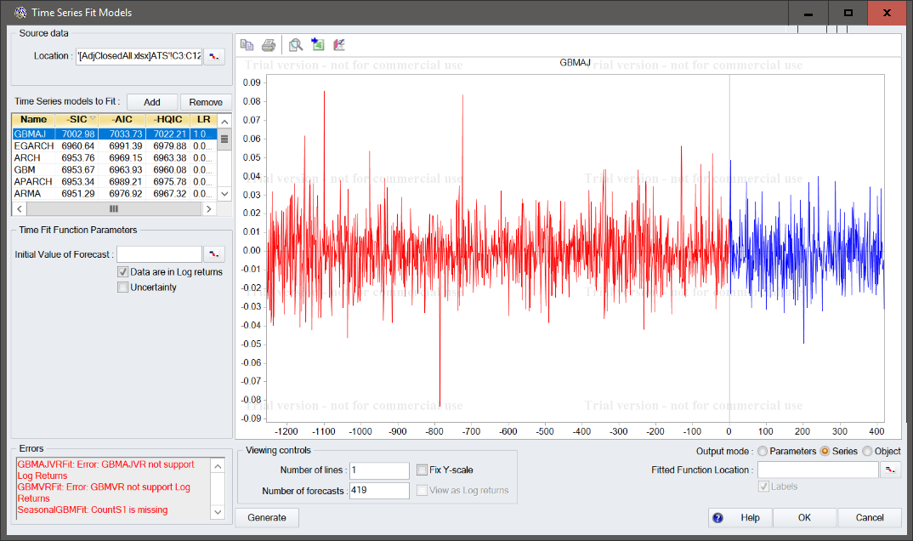
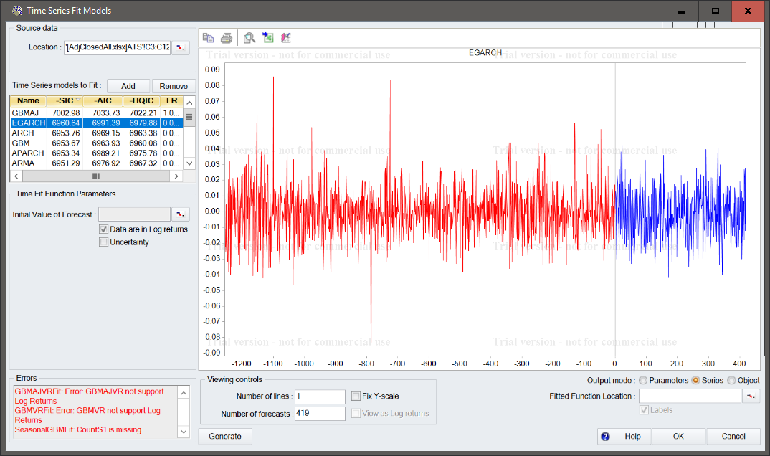
Agilent Technologies Inc. - A

Slide 12
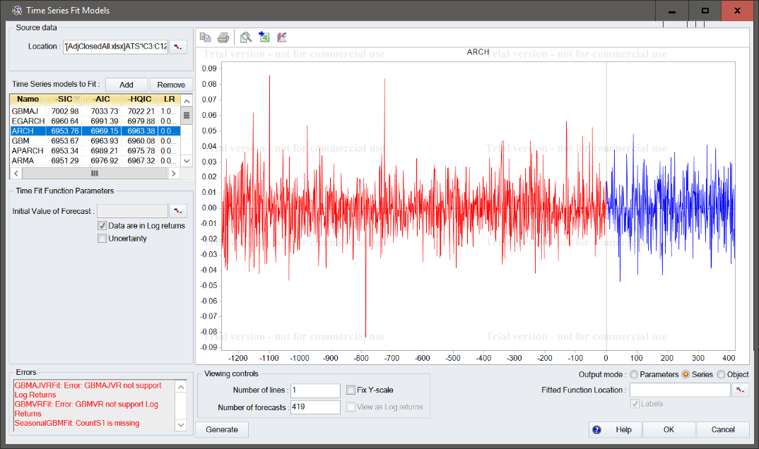
Agilent Technologies Inc. - A

Slide 13
Agilent Technologies Inc. - A

Slide 14
Abbott Laboratories - ABT
 | Year | Sales/Revenue | Cost of Goods Sold (COGS) incl. D&A | COGS excluding D&A | Depreciation & Amortization Expense | Depreciation | Amortization of Intangibles | Gross Income | SG&A Expense | Research & Development | Other SG&A | Other Operating Expense | Unusual Expense | EBIT after Unusual Expense | Non Operating Income/Expense | Non-Operating Interest Income | Equity in Affiliates (Pretax) | Interest Expense | Gross Interest Expense | Interest Capitalized | Pretax Income | Income Tax | Income Tax - Current Domestic | Income Tax - Current Foreign | Income Tax - Deferred Domestic | Income Tax - Deferred Foreign | Income Tax Credits | Other After Tax Income (Expense) | Consolidated Net Income | Minority Interest Expense | Net Income
Year | 1
Sales/Revenue | -0.12244 | 1
Cost of Goods Sold (COGS) incl. D&A | -0.95875 | 0.365315 | 1
COGS excluding D&A | 0.746962 | 0.022849 | -0.75622 | 1
Depreciation & Amortization Expense | -0.83771 | 0.621542 | 0.923155 | -0.58236 | 1
Depreciation | -0.84056 | 0.63659 | 0.945449 | -0.60755 | 0.989563 | 1
Amortization of Intangibles | -0.82655 | 0.609137 | 0.900541 | -0.56051 | 0.996511 | 0.97409 | 1
Gross Income | 0.674717 | 0.641339 | -0.47994 | 0.644915 | -0.1749 | -0.17923 | -0.16788 | 1
SG&A Expense | -0.40754 | 0.882276 | 0.578953 | -0.26286 | 0.836726 | 0.804779 | 0.848659 | 0.354627 | 1
Research & Development | -0.41232 | 0.799038 | 0.532127 | -0.16932 | 0.816223 | 0.755593 | 0.844834 | 0.314953 | 0.971332 | 1
Other SG&A | -0.40553 | 0.896441 | 0.588309 | -0.28288 | 0.836412 | 0.812376 | 0.843787 | 0.360215 | 0.998212 | 0.955485 | 1
Other Operating Expense | 0.707107 | 0.259737 | -0.67053 | 0.941436 | -0.38855 | -0.43905 | -0.3534 | 0.797719 | 0.037977 | 0.133631 | 0.013655 | 1
Unusual Expense | -0.71684 | 0.763955 | 0.876786 | -0.51239 | 0.940035 | 0.972233 | 0.912952 | -0.00274 | 0.827921 | 0.741328 | 0.84495 | -0.34553 | 1
EBIT after Unusual Expense | -0.03353 | 0.307931 | 0.198305 | -0.60841 | 0.229953 | 0.254713 | 0.213693 | 0.126613 | 0.389315 | 0.22674 | 0.422002 | -0.42908 | 0.29887 | 1
Non Operating Income/Expense | 0.75937 | 0.343114 | -0.68325 | 0.84855 | -0.3648 | -0.41894 | -0.32756 | 0.886806 | 0.143895 | 0.210646 | 0.124372 | 0.966483 | -0.31442 | -0.18719 | 1
Non-Operating Interest Income | 0.934274 | -0.09043 | -0.86089 | 0.474773 | -0.74763 | -0.74895 | -0.73841 | 0.624222 | -0.30096 | -0.3504 | -0.2905 | 0.492675 | -0.63466 | 0.311726 | 0.626858 | 1
Equity in Affiliates (Pretax) | #DIV/0! | #DIV/0! | #DIV/0! | #DIV/0! | #DIV/0! | #DIV/0! | #DIV/0! | #DIV/0! | #DIV/0! | #DIV/0! | #DIV/0! | #DIV/0! | #DIV/0! | #DIV/0! | #DIV/0! | #DIV/0! | 1
Interest Expense | -0.02526 | 0.985538 | 0.254913 | 0.185028 | 0.539149 | 0.545212 | 0.532937 | 0.718753 | 0.837785 | 0.780548 | 0.846094 | 0.411573 | 0.677864 | 0.177022 | 0.472319 | -0.04487 | #DIV/0! | 1
Gross Interest Expense | -0.05499 | 0.991171 | 0.286919 | 0.14696 | 0.564974 | 0.572759 | 0.557468 | 0.697674 | 0.851932 | 0.789906 | 0.861304 | 0.376118 | 0.703216 | 0.201302 | 0.440373 | -0.06454 | #DIV/0! | 0.999242 | 1
Interest Capitalized | 0.766131 | 0.08594 | -0.77288 | 0.896381 | -0.49573 | -0.56919 | -0.44662 | 0.718409 | -0.05621 | 0.062886 | -0.08712 | 0.963087 | -0.51452 | -0.36198 | 0.957176 | 0.595806 | #DIV/0! | 0.233715 | 0.197929 | 1
Pretax Income | 0.482221 | -0.71062 | -0.55076 | -0.06501 | -0.76875 | -0.72824 | -0.78601 | -0.21615 | -0.78193 | -0.8507 | -0.76118 | -0.24479 | -0.72021 | 0.261744 | -0.18427 | 0.599121 | #DIV/0! | -0.74104 | -0.74246 | -0.08902 | 1
Income Tax | 0.373713 | 0.041416 | -0.22409 | 0.038828 | -0.38791 | -0.2567 | -0.45964 | 0.222855 | -0.34179 | -0.5424 | -0.28764 | -0.11766 | -0.07345 | 0.281189 | -0.08619 | 0.410114 | #DIV/0! | 0.003916 | 0.006494 | -0.21709 | 0.517295 | 1
Income Tax - Current Domestic | 0.8769 | 0.301164 | -0.72082 | 0.550012 | -0.49995 | -0.49951 | -0.4932 | 0.877858 | 0.037711 | -0.02599 | 0.049743 | 0.651065 | -0.33894 | 0.326194 | 0.792842 | 0.916987 | #DIV/0! | 0.355536 | 0.335593 | 0.673686 | 0.257329 | 0.380416 | 1
Income Tax - Current Foreign | -0.79029 | 0.632615 | 0.863183 | -0.33859 | 0.934985 | 0.936004 | 0.925729 | -0.11511 | 0.746231 | 0.749742 | 0.742791 | -0.20837 | 0.911364 | -0.08307 | -0.26491 | -0.82623 | #DIV/0! | 0.593842 | 0.611366 | -0.37865 | -0.8873 | -0.34825 | -0.53919 | 1
Income Tax - Deferred Domestic | -0.87238 | 0.486374 | 0.964819 | -0.80683 | 0.936975 | 0.95809 | 0.915282 | -0.33684 | 0.698156 | 0.61877 | 0.713214 | -0.65921 | 0.912941 | 0.432599 | -0.60505 | -0.70177 | #DIV/0! | 0.358575 | 0.392806 | -0.74429 | -0.50692 | -0.16722 | -0.53766 | 0.807969 | 1
Income Tax - Deferred Foreign | -0.78086 | 0.685209 | 0.87877 | -0.50377 | 0.994255 | 0.977959 | 0.994496 | -0.07828 | 0.882677 | 0.868543 | 0.880299 | -0.29063 | 0.939652 | 0.213684 | -0.26326 | -0.7043 | #DIV/0! | 0.614944 | 0.637992 | -0.40444 | -0.81925 | -0.40788 | -0.42755 | 0.94038 | 0.901228 | 1
Income Tax Credits | #DIV/0! | #DIV/0! | #DIV/0! | #DIV/0! | #DIV/0! | #DIV/0! | #DIV/0! | #DIV/0! | #DIV/0! | #DIV/0! | #DIV/0! | #DIV/0! | #DIV/0! | #DIV/0! | #DIV/0! | #DIV/0! | #DIV/0! | #DIV/0! | #DIV/0! | #DIV/0! | #DIV/0! | #DIV/0! | #DIV/0! | #DIV/0! | #DIV/0! | #DIV/0! | 1
Other After Tax Income (Expense) | -0.83707 | 0.490545 | 0.925334 | -0.81278 | 0.936966 | 0.938815 | 0.926491 | -0.30025 | 0.748987 | 0.683901 | 0.759021 | -0.62478 | 0.879151 | 0.499288 | -0.54255 | -0.63772 | #DIV/0! | 0.363015 | 0.396715 | -0.67694 | -0.50306 | -0.26244 | -0.47814 | 0.768078 | 0.986338 | 0.907336 | #DIV/0! | 1
Consolidated Net Income | 0.331149 | -0.76244 | -0.4373 | -0.22988 | -0.63995 | -0.63103 | -0.64056 | -0.35829 | -0.68922 | -0.7251 | -0.67851 | -0.35851 | -0.68392 | 0.335585 | -0.27497 | 0.500397 | #DIV/0! | -0.81049 | -0.8071 | -0.15019 | 0.954616 | 0.277063 | 0.132126 | -0.82853 | -0.38438 | -0.69797 | #DIV/0! | -0.34606 | 1
Minority Interest Expense | #DIV/0! | #DIV/0! | #DIV/0! | #DIV/0! | #DIV/0! | #DIV/0! | #DIV/0! | #DIV/0! | #DIV/0! | #DIV/0! | #DIV/0! | #DIV/0! | #DIV/0! | #DIV/0! | #DIV/0! | #DIV/0! | #DIV/0! | #DIV/0! | #DIV/0! | #DIV/0! | #DIV/0! | #DIV/0! | #DIV/0! | #DIV/0! | #DIV/0! | #DIV/0! | #DIV/0! | #DIV/0! | #DIV/0! | 1
Net Income | 0.331149 | -0.76244 | -0.4373 | -0.22988 | -0.63995 | -0.63103 | -0.64056 | -0.35829 | -0.68922 | -0.7251 | -0.67851 | -0.35851 | -0.68392 | 0.335585 | -0.27497 | 0.500397 | #DIV/0! | -0.81049 | -0.8071 | -0.15019 | 0.954616 | 0.277063 | 0.132126 | -0.82853 | -0.38438 | -0.69797 | #DIV/0! | -0.34606 | 1 | #DIV/0! | 1

Slide 15
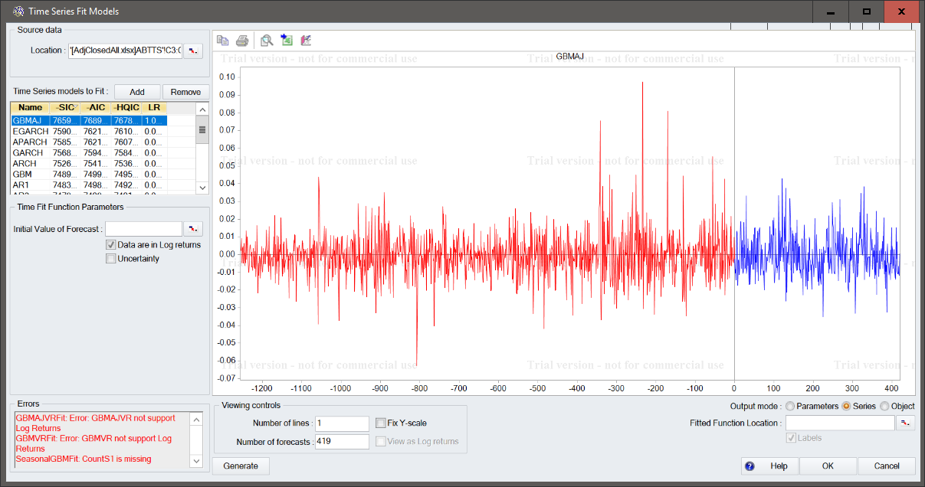
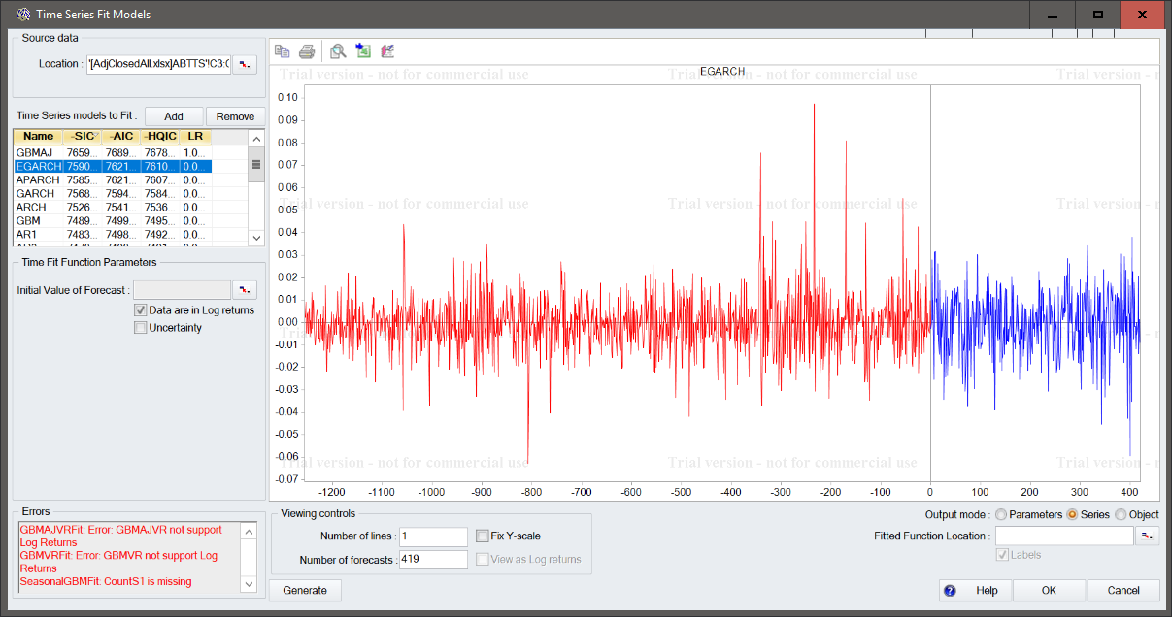
Abbott Laboratories - ABT

Slide 16
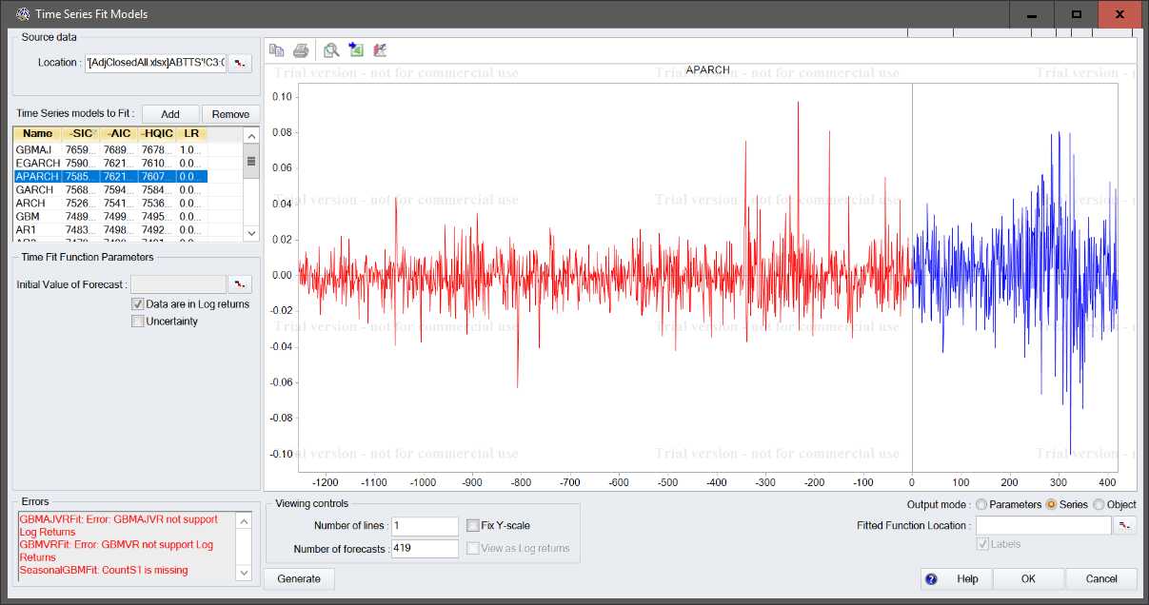
Abbott Laboratories - ABT

Slide 17
Abbott Laboratories - ABT

Slide 18
Becton Dickinson - BDX
 | Year | Sales/Revenue | Cost of Goods Sold (COGS) incl. D&A | COGS excluding D&A | Depreciation & Amortization Expense | Depreciation | Amortization of Intangibles | Gross Income | SG&A Expense | Research & Development | Other SG&A | Other Operating Expense | Unusual Expense | EBIT after Unusual Expense | Non Operating Income/Expense | Non-Operating Interest Income | Equity in Affiliates (Pretax) | Interest Expense | Gross Interest Expense | Interest Capitalized | Pretax Income | Income Tax | Income Tax - Current Domestic | Income Tax - Current Foreign | Income Tax - Deferred Domestic | Income Tax - Deferred Foreign | Income Tax Credits | Other After Tax Income (Expense) | Consolidated Net Income | Minority Interest Expense | Net Income
Year | 1
Sales/Revenue | 0.934015 | 1
Cost of Goods Sold (COGS) incl. D&A | 0.938247 | 0.990534 | 1
COGS excluding D&A | 0.943614 | 0.989332 | 0.99981 | 1
Depreciation & Amortization Expense | 0.921849 | 0.992384 | 0.997905 | 0.996512 | 1
Depreciation | 0.970579 | 0.951502 | 0.976675 | 0.979772 | 0.96613 | 1
Amortization of Intangibles | 0.899579 | 0.992399 | 0.992359 | 0.989821 | 0.997717 | 0.946515 | 1
Gross Income | 0.896609 | 0.980046 | 0.943484 | 0.940861 | 0.950989 | 0.883149 | 0.959026 | 1
SG&A Expense | 0.92228 | 0.997672 | 0.988981 | 0.986932 | 0.994247 | 0.949645 | 0.995126 | 0.976706 | 1
Research & Development | 0.917306 | 0.995801 | 0.974204 | 0.972272 | 0.978446 | 0.922082 | 0.982877 | 0.993535 | 0.992204 | 1
Other SG&A | 0.917813 | 0.994356 | 0.989555 | 0.987319 | 0.995666 | 0.953466 | 0.995795 | 0.967885 | 0.999064 | 0.985978 | 1
Other Operating Expense | #DIV/0! | #DIV/0! | #DIV/0! | #DIV/0! | #DIV/0! | #DIV/0! | #DIV/0! | #DIV/0! | #DIV/0! | #DIV/0! | #DIV/0! | 1
Unusual Expense | 0.837786 | 0.893054 | 0.884772 | 0.880967 | 0.902556 | 0.880672 | 0.89844 | 0.875324 | 0.918272 | 0.880536 | 0.928968 | #DIV/0! | 1
EBIT after Unusual Expense | -0.29144 | -0.27009 | -0.35935 | -0.35824 | -0.36937 | -0.45574 | -0.34068 | -0.13222 | -0.31747 | -0.19749 | -0.35726 | #DIV/0! | -0.55118 | 1
Non Operating Income/Expense | 0.480597 | 0.229783 | 0.316149 | 0.333308 | 0.255943 | 0.452475 | 0.201334 | 0.096954 | 0.189494 | 0.172138 | 0.186986 | #DIV/0! | 0.022227 | -0.16039 | 1
Non-Operating Interest Income | -0.847 | -0.83616 | -0.89213 | -0.89374 | -0.88802 | -0.94032 | -0.86358 | -0.72721 | -0.8523 | -0.78522 | -0.87053 | #DIV/0! | -0.87543 | 0.72784 | -0.41012 | 1
Equity in Affiliates (Pretax) | -0.20391 | -0.26234 | -0.24342 | -0.2346 | -0.28644 | -0.26645 | -0.28843 | -0.28158 | -0.32209 | -0.25487 | -0.348 | #DIV/0! | -0.66221 | 0.653806 | 0.470814 | 0.428409 | 1
Interest Expense | 0.889063 | 0.940465 | 0.976345 | 0.97611 | 0.974165 | 0.970868 | 0.96355 | 0.85688 | 0.946382 | 0.906923 | 0.955414 | #DIV/0! | 0.873278 | -0.52791 | 0.35978 | -0.95563 | -0.28398 | 1
Gross Interest Expense | 0.886765 | 0.940131 | 0.975996 | 0.975665 | 0.974076 | 0.96955 | 0.963773 | 0.856577 | 0.946218 | 0.906675 | 0.955314 | #DIV/0! | 0.872926 | -0.52814 | 0.356206 | -0.95493 | -0.28442 | 0.999983 | 1
Interest Capitalized | -0.97372 | -0.87493 | -0.9085 | -0.91547 | -0.8873 | -0.97523 | -0.85463 | -0.7971 | -0.86782 | -0.83829 | -0.87117 | #DIV/0! | -0.81557 | 0.459842 | -0.58948 | 0.915709 | 0.224706 | -0.90534 | -0.90288 | 1
Pretax Income | -0.61137 | -0.60401 | -0.68184 | -0.68169 | -0.68593 | -0.75396 | -0.65892 | -0.47135 | -0.63836 | -0.53817 | -0.66953 | #DIV/0! | -0.77089 | 0.926271 | -0.29598 | 0.931849 | 0.578039 | -0.80681 | -0.80672 | 0.736735 | 1
Income Tax | -0.80634 | -0.80447 | -0.85723 | -0.85753 | -0.85913 | -0.9069 | -0.83617 | -0.7013 | -0.82827 | -0.75408 | -0.84967 | #DIV/0! | -0.89814 | 0.782548 | -0.32333 | 0.992355 | 0.534064 | -0.9275 | -0.92696 | 0.878524 | 0.956523 | 1
Income Tax - Current Domestic | 0.287211 | 0.404269 | 0.275348 | 0.268547 | 0.299773 | 0.151021 | 0.337864 | 0.577279 | 0.393891 | 0.484968 | 0.364689 | #DIV/0! | 0.324992 | 0.55293 | -0.46846 | 0.108634 | -0.14234 | 0.077739 | 0.077785 | -0.06685 | 0.349846 | 0.10674 | 1
Income Tax - Current Foreign | 0.646707 | 0.800891 | 0.813511 | 0.811053 | 0.808247 | 0.711679 | 0.823946 | 0.755151 | 0.780573 | 0.797694 | 0.771511 | #DIV/0! | 0.498762 | -0.0121 | 0.280014 | -0.58273 | 0.230615 | 0.785688 | 0.787317 | -0.58991 | -0.34033 | -0.50794 | 0.229826 | 1
Income Tax - Deferred Domestic | 0.868888 | 0.959086 | 0.937441 | 0.93303 | 0.953906 | 0.897716 | 0.958397 | 0.958314 | 0.974008 | 0.958862 | 0.976899 | #DIV/0! | 0.974003 | -0.3825 | 0.019064 | -0.83044 | -0.51759 | 0.894869 | 0.894868 | -0.80919 | -0.66013 | -0.83366 | 0.451387 | 0.647864 | 1
Income Tax - Deferred Foreign | 0.823886 | 0.899333 | 0.869472 | 0.869843 | 0.860647 | 0.790121 | 0.870368 | 0.911995 | 0.871432 | 0.917141 | 0.851636 | #DIV/0! | 0.619094 | 0.142367 | 0.276623 | -0.56358 | 0.134821 | 0.76476 | 0.764498 | -0.71078 | -0.23879 | -0.49254 | 0.536944 | 0.892343 | 0.769641 | 1
Income Tax Credits | #DIV/0! | #DIV/0! | #DIV/0! | #DIV/0! | #DIV/0! | #DIV/0! | #DIV/0! | #DIV/0! | #DIV/0! | #DIV/0! | #DIV/0! | #DIV/0! | #DIV/0! | #DIV/0! | #DIV/0! | #DIV/0! | #DIV/0! | #DIV/0! | #DIV/0! | #DIV/0! | #DIV/0! | #DIV/0! | #DIV/0! | #DIV/0! | #DIV/0! | #DIV/0! | 1
Other After Tax Income (Expense) | #DIV/0! | #DIV/0! | #DIV/0! | #DIV/0! | #DIV/0! | #DIV/0! | #DIV/0! | #DIV/0! | #DIV/0! | #DIV/0! | #DIV/0! | #DIV/0! | #DIV/0! | #DIV/0! | #DIV/0! | #DIV/0! | #DIV/0! | #DIV/0! | #DIV/0! | #DIV/0! | #DIV/0! | #DIV/0! | #DIV/0! | #DIV/0! | #DIV/0! | #DIV/0! | #DIV/0! | 1
Consolidated Net Income | -0.41712 | -0.40727 | -0.49884 | -0.49818 | -0.50521 | -0.58378 | -0.47704 | -0.26136 | -0.4486 | -0.3339 | -0.4857 | #DIV/0! | -0.62736 | 0.984863 | -0.24366 | 0.824745 | 0.589908 | -0.65867 | -0.65894 | 0.575683 | 0.972791 | 0.863078 | 0.513304 | -0.17937 | -0.48544 | -0.01897 | #DIV/0! | #DIV/0! | 1
Minority Interest Expense | #DIV/0! | #DIV/0! | #DIV/0! | #DIV/0! | #DIV/0! | #DIV/0! | #DIV/0! | #DIV/0! | #DIV/0! | #DIV/0! | #DIV/0! | #DIV/0! | #DIV/0! | #DIV/0! | #DIV/0! | #DIV/0! | #DIV/0! | #DIV/0! | #DIV/0! | #DIV/0! | #DIV/0! | #DIV/0! | #DIV/0! | #DIV/0! | #DIV/0! | #DIV/0! | #DIV/0! | #DIV/0! | #DIV/0! | 1
Net Income | -0.41712 | -0.40727 | -0.49884 | -0.49818 | -0.50521 | -0.58378 | -0.47704 | -0.26136 | -0.4486 | -0.3339 | -0.4857 | #DIV/0! | -0.62736 | 0.984863 | -0.24366 | 0.824745 | 0.589908 | -0.65867 | -0.65894 | 0.575683 | 0.972791 | 0.863078 | 0.513304 | -0.17937 | -0.48544 | -0.01897 | #DIV/0! | #DIV/0! | 1 | #DIV/0! | 1

Slide 19
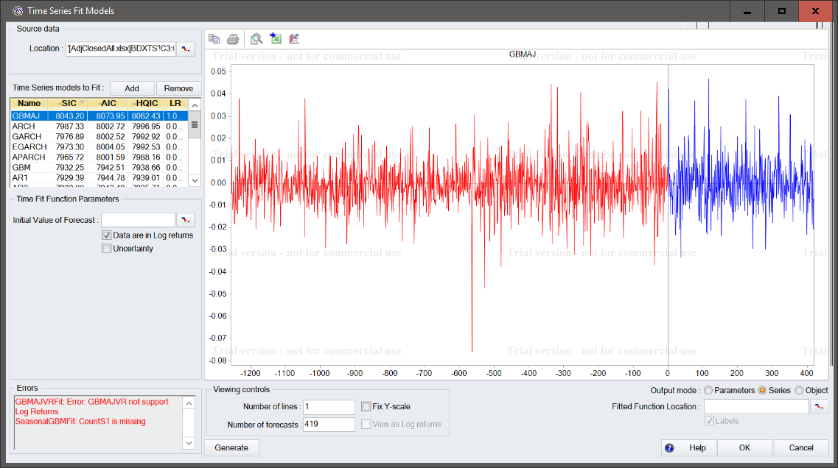
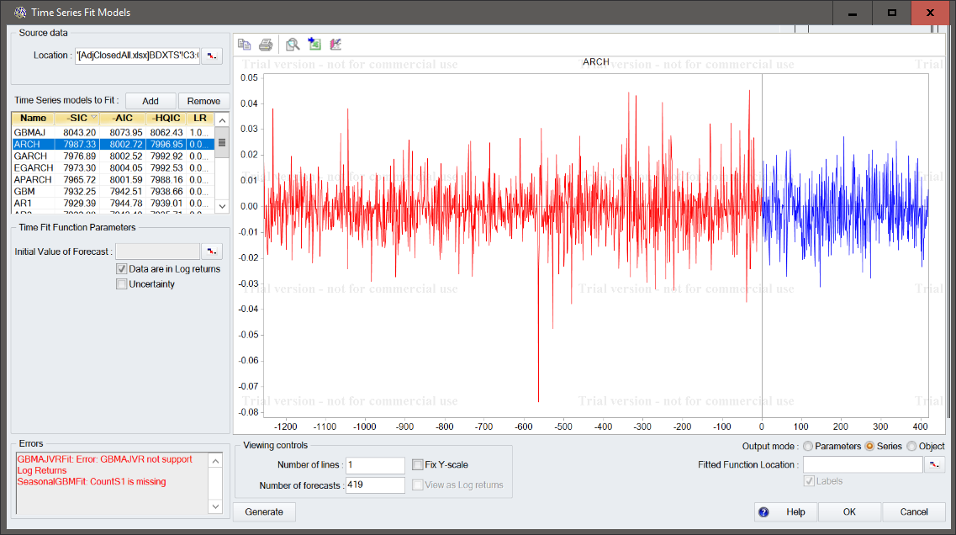
Becton Dickinson - BDX

Slide 20
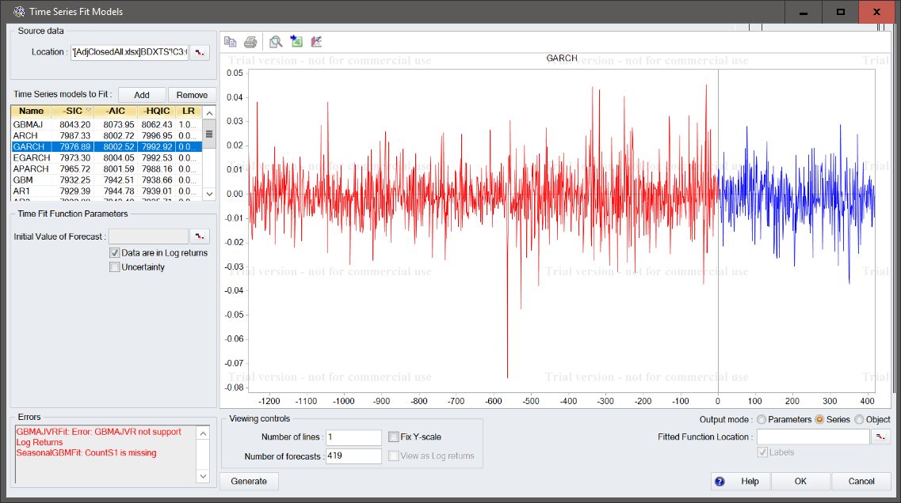
Becton Dickinson - BDX

Slide 21
Becton Dickinson - BDX

