Slide 1
Advanced Project Presentation
ANLY:515-90 Spring 2017 Risk Modelling and Assessment
Dean D’souza
H.U. ID: 168424

Slide 2
Sector Overview
Health Care Sector (Health Care Distributors and Services)
Plays a critical role in improving access to medicines and quality care
Facilitates development of rural critical access hospitals
Facilitates growth of telemedicine which affects various healthcare services
Plays a critical role in expanding economic opportunities especially in developing areas
Helps in creating more job opportunities
Has an affect on the manufacturing industry
Volatile sector due to sensitivity of business cycles
Government policies
Harsher regulatory environment
Very Competitive landscape

Slide 3
Company and Competitors
Chosen Company for Analysis is Bristol-Myers Squibb Co. (BMY)
Squibb founded in 1858
Bristol-Myers was founded from Clinton Pharmaceutical Company (in 1887) which was renamed in 1898.
The two companies merged in 1989
One of the most famous product Opvido (immune-deficiency booster for cancer patients)
Competitors:
Cardinal Health Inc. (CAH)
Agilent Technologies Inc. (A)
Abbott Laboratories (ABT)
Becton Dickinson (BDX)

Slide 4
SWOT Analysis
Bristol-Myers Squibb Co. (BMY)
Strengths:
Clinical Studies
Technology
Brand Name
Innovative Culture
Unique Products
Weaknesses:
Low cost of development for new drugs
Tarnished Reputation
Opportunities:
Innovation
New Services
New Technology
New Products
Emerging Markets
Threats:
Bad Economy
Government Regulations

Slide 5
Net Income Comparison (ALL)

Slide 6
Adjusted Closed Index Comparison (all)

Slide 7
Bristol-Myers Squibb Co.-BMY (Adj. CI)

Slide 8
Bristol Myers Squibb Co. - BMY

Slide 9
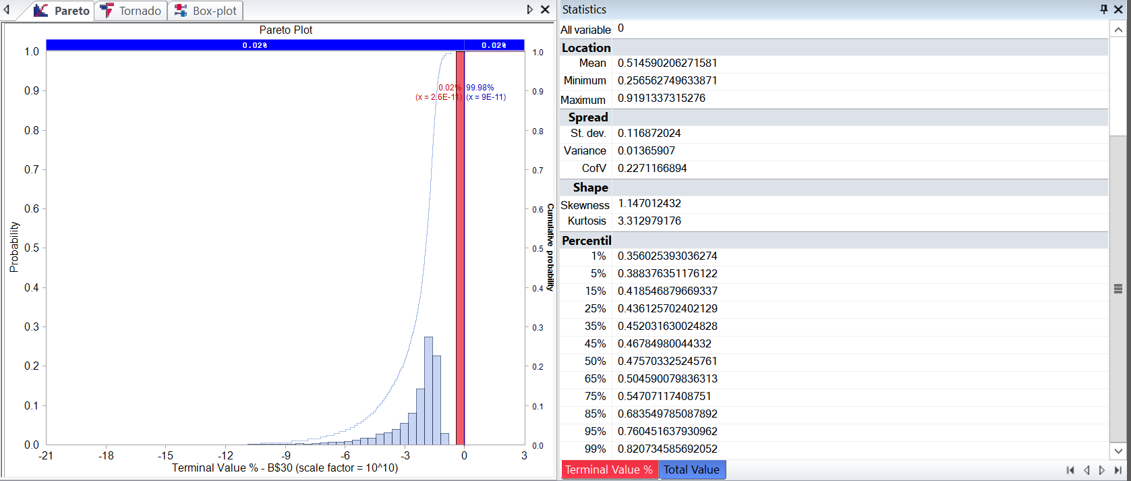
Net Income Simulation Results

Slide 10
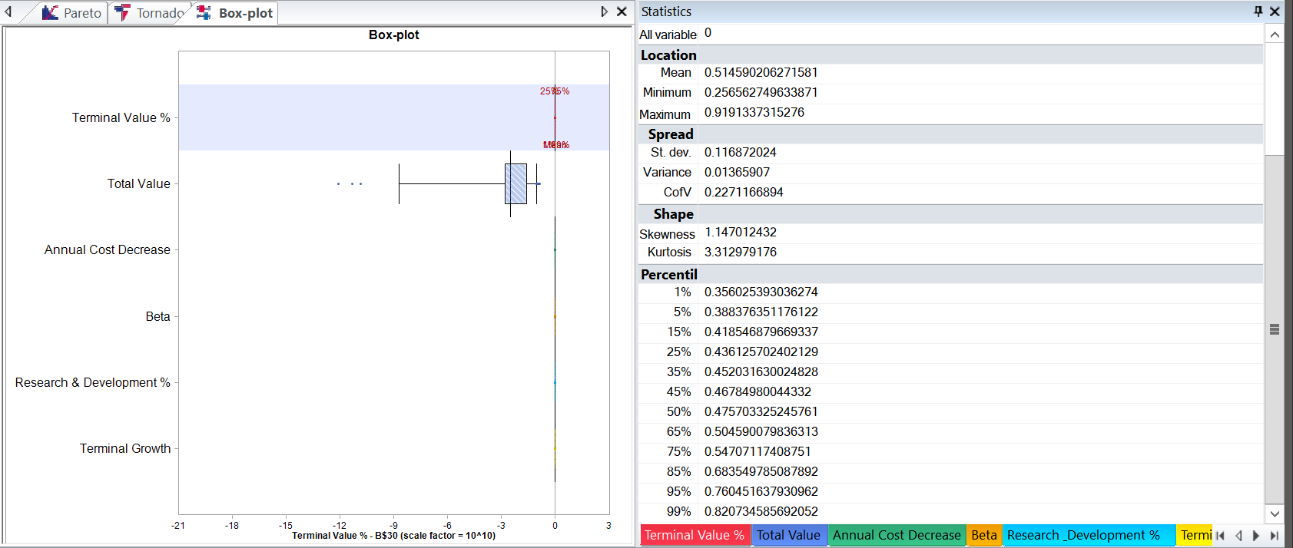
Net Income Simulation Results

Slide 11
Comparison of Stock Price Statistics
BMY | CAH | A | ABT | BDX
Average | Average | Average | Average | Average
0.000526588 | 0.000522 | 0.000484 | 0.000367 | 0.000713
Variance | Variance | Variance | Variance | Variance
0.000223109 | 0.000169 | 0.000229 | 0.00015 | 0.000105
Standard Deviation | Standard Deviation | Standard Deviation | Standard Deviation | Standard Deviation
0.014930907 | 0.013003 | 0.015137 | 0.012231 | 0.010256

Slide 12
Copula Results
Copula Based on T Copula
0.92677214 | 0.933334254 | 0.903762769 | 0.206800995 | 0.620115986
Copula Parameter Fit
1 | 0.319148486 | 0.301383329 | 0.364098989 | 0.349151323
0.319148486 | 1 | 0.395314738 | 0.438047724 | 0.419008429
0.301383329 | 0.395314738 | 1 | 0.430245364 | 0.491512571
0.364098989 | 0.438047724 | 0.430245364 | 1 | 0.545342013
0.349151323 | 0.419008429 | 0.491512571 | 0.545342013 | 1

Slide 13
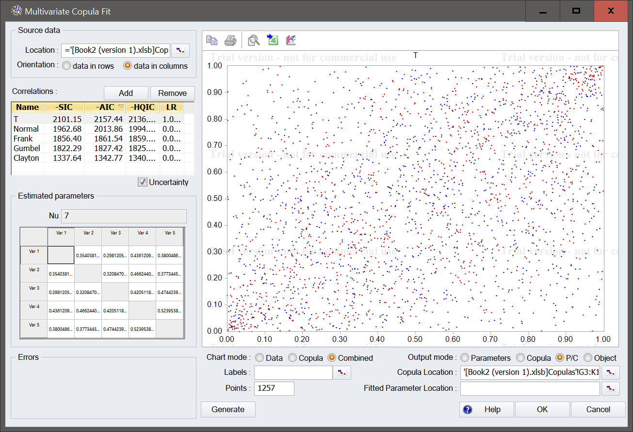
Copula Results

Slide 14
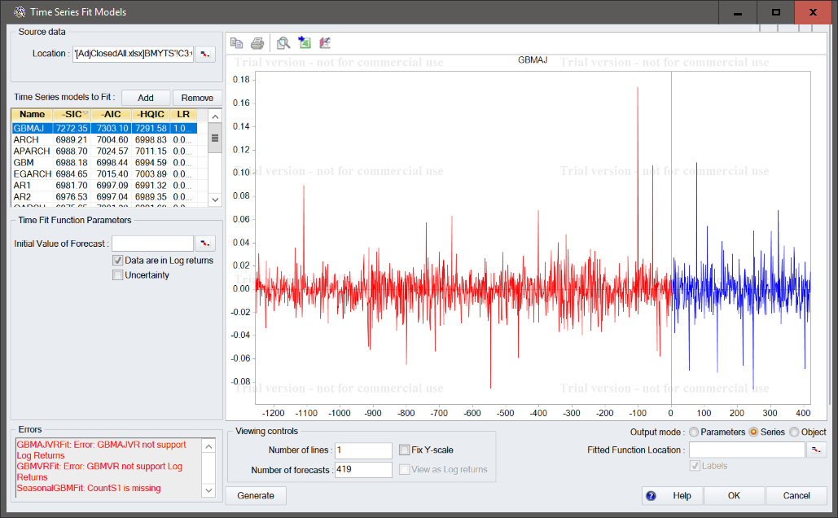
Time Series Fit

Slide 15
Time Series Fit Report
Time series models | GBMAJ | ARCH | APARCH | GBM | EGARCH
MLE fits | VoseTimeGBMAJ(-0.000670003942495512,0.0116281907441399,-0.00333007476329273,0.0450124420886681,0.043067560369421,2.49333281125575E-6,TRUE,) | VoseTimeARCH(-0.000526587646296588,0.000214131577137442,0.0385251529244072,0,TRUE,) | VoseTimeAPARCH(-0.000526587646296588,0.0278865597514873,0.270038793829496,0.276164257439437,0.0572150724629743,0.866299749133819,0.0142005547880481,0.00784054950055424,TRUE,) | VoseTimeGBM(-0.000526587646296588,0.0149368492562974,0,,TRUE) | VoseTimeEGARCH(-0.000526587646296588,-0.823453783594196,-0.0767881255586238,0.116194822342404,0.900504852298038,0.0141374162759083,0.591843444626396,TRUE,)
Goodness of fit
AIC | -7303.100199 | -7004.600282 | -7024.569096 | -6998.443931 | -7015.400563
AIC ranking | 1 | 4 | 2 | 6 | 3
SIC | -7272.348499 | -6989.209986 | -6988.703386 | -6988.180534 | -6984.648864
SIC ranking | 1 | 2 | 3 | 4 | 5
HQIC | -7291.584757 | -6998.828115 | -7011.145687 | -6994.59262 | -7003.885122
HQIC ranking | 1 | 4 | 2 | 5 | 3
Log likelihood | 3657.583699 | 3505.309718 | 3519.329384 | 3501.22675 | 3513.733881
Log likelihood ranking | 1 | 5 | 2 | 11 | 3

Slide 16
Time Series Fit Result

Slide 17
Optimization Results (Without simulation)
Index | ID | Feasible | Objective value | Decision variables
 |  |  |  | varA | varABT | varBDX | varBMY | varCAH | constTotal Investment
1 | 1 | TRUE | 0.015073483 | 0.2 | 0.2 | 0.2 | 0.2 | 0.2 | 1
2 | 2 | FALSE | N/A | 0.5 | 0.5 | 0.5 | 0.5 | 0.5 | 2.5
3 | 3 | FALSE | N/A | 0 | 0 | 0 | 0 | 0 | 0
4 | 4 | FALSE | N/A | 1 | 1 | 1 | 1 | 1 | 5
5 | 5 | FALSE | N/A | 0.25 | 0.25 | 0.25 | 0.25 | 0.25 | 1.25
Index | ID | Feasible | Objective value | Decision variables
 |  |  |  | varA | varABT | varBDX | varBMY | varCAH | constTotal Investment
1 | 3 | TRUE | 0 | 0 | 0 | 0 | 0 | 0 | 0
2 | 82 | TRUE | 0.001711456 | 0.04 | 0.03 | 0.01 | 0.01 | 0.02 | 0.11
3 | 88 | TRUE | 0.001772442 | 0.01 | 0.01 | 0.08 | 0.01 | 0.02 | 0.13
4 | 78 | TRUE | 0.002125336 | 0.02 | 0.03 | 0.02 | 0.04 | 0.03 | 0.14
5 | 51 | TRUE | 0.002275505 | 0.03 | 0.01 | 0.05 | 0.06 | 0 | 0.15
6 | 63 | TRUE | 0.002661849 | 0.04 | 0.01 | 0.03 | 0.07 | 0.02 | 0.17
7 | 66 | TRUE | 0.002694598 | 0 | 0.19 | 0 | 0 | 0 | 0.19
8 | 67 | TRUE | 0.002877027 | 0.04 | 0.02 | 0.09 | 0.02 | 0.03 | 0.2
9 | 19 | TRUE | 0.003179496 | 0.04 | 0.02 | 0.08 | 0.01 | 0.07 | 0.22
10 | 33 | TRUE | 0.003341521 | 0.01 | 0.06 | 0 | 0.06 | 0.09 | 0.22
11 | 68 | TRUE | 0.003371279 | 0.04 | 0 | 0.01 | 0.11 | 0.05 | 0.21
12 | 21 | TRUE | 0.003572055 | 0.01 | 0.13 | 0.01 | 0.06 | 0.03 | 0.24
13 | 83 | TRUE | 0.003904842 | 0.05 | 0.05 | 0.09 | 0.01 | 0.07 | 0.27
14 | 53 | TRUE | 0.004034659 | 0.02 | 0.07 | 0.05 | 0.09 | 0.04 | 0.27
15 | 35 | TRUE | 0.00424697 | 0.01 | 0.05 | 0.1 | 0.12 | 0.01 | 0.29
16 | 52 | TRUE | 0.004354021 | 0.07 | 0.1 | 0 | 0.05 | 0.06 | 0.28
17 | 47 | TRUE | 0.004481306 | 0.06 | 0.05 | 0.08 | 0.06 | 0.05 | 0.3
18 | 69 | TRUE | 0.004750144 | 0.07 | 0.05 | 0.04 | 0.06 | 0.09 | 0.31
19 | 37 | TRUE | 0.005672856 | 0.1 | 0.2 | 0.05 | 0.01 | 0.02 | 0.38
20 | 81 | TRUE | 0.005819161 | 0.17 | 0.2 | 0 | 0 | 0 | 0.37
21 | 91 | TRUE | 0.005938211 | 0.17 | 0 | 0 | 0 | 0.2 | 0.37
22 | 36 | TRUE | 0.006670686 | 0.11 | 0.08 | 0.08 | 0.06 | 0.11 | 0.44
23 | 49 | TRUE | 0.007208156 | 0 | 0 | 0 | 0.25 | 0.21 | 0.46
24 | 22 | TRUE | 0.00891246 | 0.06 | 0.05 | 0.32 | 0.04 | 0.17 | 0.64
25 | 23 | TRUE | 0.008984381 | 0.14 | 0.01 | 0.12 | 0.28 | 0.02 | 0.57
26 | 50 | TRUE | 0.009762236 | 0.18 | 0.22 | 0.28 | 0 | 0 | 0.68
27 | 90 | TRUE | 0.009932721 | 0 | 0.2 | 0.28 | 0.22 | 0 | 0.7
28 | 80 | TRUE | 0.010215967 | 0 | 0 | 0.28 | 0.23 | 0.2 | 0.71
29 | 85 | TRUE | 0.012617668 | 0.14 | 0.15 | 0.23 | 0.18 | 0.15 | 0.85
30 | 65 | TRUE | 0.012722542 | 0.17 | 0 | 0.28 | 0.21 | 0.19 | 0.85
31 | 92 | TRUE | 0.012907263 | 0.14 | 0.16 | 0.23 | 0.18 | 0.16 | 0.87
32 | 75 | TRUE | 0.013485481 | 0.14 | 0.17 | 0.24 | 0.19 | 0.17 | 0.91
33 | 64 | TRUE | 0.013542277 | 0.14 | 0.15 | 0.27 | 0.17 | 0.19 | 0.92
34 | 89 | TRUE | 0.013700709 | 0.17 | 0.16 | 0.2 | 0.21 | 0.17 | 0.91
35 | 79 | TRUE | 0.014186697 | 0.16 | 0.2 | 0.23 | 0.22 | 0.14 | 0.95
36 | 48 | TRUE | 0.014187343 | 0.15 | 0.18 | 0.23 | 0.23 | 0.16 | 0.95
37 | 20 | TRUE | 0.01461453 | 0.23 | 0.18 | 0.17 | 0.18 | 0.2 | 0.96
38 | 1 | TRUE | 0.015073483 | 0.2 | 0.2 | 0.2 | 0.2 | 0.2 | 1
39 | 2 | FALSE | N/A | 0.5 | 0.5 | 0.5 | 0.5 | 0.5 | 2.5

Slide 18
Optimization Results (With Simulation)
Index | ID | Feasible | Objective value | Decision variables |  |  |  |  | Requirements | Constraints
 |  |  |  | varA | varABT | varBDX | varBMY | varCAH | reqRiskFreeRate | constTotal Investment
1 | 3 | TRUE | 0 | 0 | 0 | 0 | 0 | 0 | 0.024254806 | 0
2 | 82 | TRUE | 0.001711456 | 0.04 | 0.03 | 0.01 | 0.01 | 0.02 | 0.024254806 | 0.11
3 | 88 | TRUE | 0.001772442 | 0.01 | 0.01 | 0.08 | 0.01 | 0.02 | 0.024254806 | 0.13
4 | 78 | TRUE | 0.002125336 | 0.02 | 0.03 | 0.02 | 0.04 | 0.03 | 0.024254806 | 0.14
5 | 51 | TRUE | 0.002275505 | 0.03 | 0.01 | 0.05 | 0.06 | 0 | 0.024254806 | 0.15
6 | 63 | TRUE | 0.002661849 | 0.04 | 0.01 | 0.03 | 0.07 | 0.02 | 0.024254806 | 0.17
7 | 66 | TRUE | 0.002694598 | 0 | 0.19 | 0 | 0 | 0 | 0.024254806 | 0.19
8 | 67 | TRUE | 0.002877027 | 0.04 | 0.02 | 0.09 | 0.02 | 0.03 | 0.024254806 | 0.2
9 | 19 | TRUE | 0.003179496 | 0.04 | 0.02 | 0.08 | 0.01 | 0.07 | 0.024254806 | 0.22
10 | 33 | TRUE | 0.003341521 | 0.01 | 0.06 | 0 | 0.06 | 0.09 | 0.024254806 | 0.22
11 | 68 | TRUE | 0.003371279 | 0.04 | 0 | 0.01 | 0.11 | 0.05 | 0.024254806 | 0.21
12 | 21 | TRUE | 0.003572055 | 0.01 | 0.13 | 0.01 | 0.06 | 0.03 | 0.024254806 | 0.24
13 | 83 | TRUE | 0.003904842 | 0.05 | 0.05 | 0.09 | 0.01 | 0.07 | 0.024254806 | 0.27
14 | 53 | TRUE | 0.004034659 | 0.02 | 0.07 | 0.05 | 0.09 | 0.04 | 0.024254806 | 0.27
15 | 35 | TRUE | 0.00424697 | 0.01 | 0.05 | 0.1 | 0.12 | 0.01 | 0.024254806 | 0.29
16 | 52 | TRUE | 0.004354021 | 0.07 | 0.1 | 0 | 0.05 | 0.06 | 0.024254806 | 0.28
17 | 47 | TRUE | 0.004481306 | 0.06 | 0.05 | 0.08 | 0.06 | 0.05 | 0.024254806 | 0.3
18 | 69 | TRUE | 0.004750144 | 0.07 | 0.05 | 0.04 | 0.06 | 0.09 | 0.024254806 | 0.31
19 | 37 | TRUE | 0.005672856 | 0.1 | 0.2 | 0.05 | 0.01 | 0.02 | 0.024254806 | 0.38
20 | 81 | TRUE | 0.005819161 | 0.17 | 0.2 | 0 | 0 | 0 | 0.024254806 | 0.37
21 | 91 | TRUE | 0.005938211 | 0.17 | 0 | 0 | 0 | 0.2 | 0.024254806 | 0.37
22 | 36 | TRUE | 0.006670686 | 0.11 | 0.08 | 0.08 | 0.06 | 0.11 | 0.024254806 | 0.44
23 | 49 | TRUE | 0.007208156 | 0 | 0 | 0 | 0.25 | 0.21 | 0.024254806 | 0.46
24 | 22 | TRUE | 0.00891246 | 0.06 | 0.05 | 0.32 | 0.04 | 0.17 | 0.024254806 | 0.64
25 | 23 | TRUE | 0.008984381 | 0.14 | 0.01 | 0.12 | 0.28 | 0.02 | 0.024254806 | 0.57
26 | 50 | TRUE | 0.009762236 | 0.18 | 0.22 | 0.28 | 0 | 0 | 0.024254806 | 0.68
27 | 90 | TRUE | 0.009932721 | 0 | 0.2 | 0.28 | 0.22 | 0 | 0.024254806 | 0.7
28 | 80 | TRUE | 0.010215967 | 0 | 0 | 0.28 | 0.23 | 0.2 | 0.024254806 | 0.71
29 | 85 | TRUE | 0.012617668 | 0.14 | 0.15 | 0.23 | 0.18 | 0.15 | 0.024254806 | 0.85
30 | 65 | TRUE | 0.012722542 | 0.17 | 0 | 0.28 | 0.21 | 0.19 | 0.024254806 | 0.85
31 | 92 | TRUE | 0.012907263 | 0.14 | 0.16 | 0.23 | 0.18 | 0.16 | 0.024254806 | 0.87
32 | 75 | TRUE | 0.013485481 | 0.14 | 0.17 | 0.24 | 0.19 | 0.17 | 0.024254806 | 0.91
33 | 64 | TRUE | 0.013542277 | 0.14 | 0.15 | 0.27 | 0.17 | 0.19 | 0.024254806 | 0.92
34 | 89 | TRUE | 0.013700709 | 0.17 | 0.16 | 0.2 | 0.21 | 0.17 | 0.024254806 | 0.91
35 | 79 | TRUE | 0.014186697 | 0.16 | 0.2 | 0.23 | 0.22 | 0.14 | 0.024254806 | 0.95
36 | 48 | TRUE | 0.014187343 | 0.15 | 0.18 | 0.23 | 0.23 | 0.16 | 0.024254806 | 0.95
37 | 20 | TRUE | 0.01461453 | 0.23 | 0.18 | 0.17 | 0.18 | 0.2 | 0.024254806 | 0.96
38 | 1 | TRUE | 0.015073483 | 0.2 | 0.2 | 0.2 | 0.2 | 0.2 | 0.024254806 | 1
39 | 2 | FALSE | N/A | 0.5 | 0.5 | 0.5 | 0.5 | 0.5 | N/A | 2.5

Slide 19
References
Market Watch (https://www.marketwatch.com/investing/stock/...)
Yahoo! Finance (https://ca.finance.yahoo.com/quote/...)
Wiki Wealth collaborative research (https://www.wikiwealth.com/...)
“Bristol-Myers Squibb”, Wikipedia (https://en.wikipedia.org/wiki/Bristol-Myers_Squibb)

