Slide 1
ISEM:520-51 Human Centered Design
Gamestop Android App re-Design

Slide 2
Problem Statement
Gamestop is a popular video game and electronics store, with various locations throughout the U.S.A. It offers an android (as well as iphone) application for members to quickly access information on new releases as well as other services. However, not all the services can be easily accessed.

Slide 3
Issues
Switching between tabs takes a number of swipes due to the way the home tab is designed
Navigating to relevant products can be tedious
Navigating to relevant offers of member points takes some effort
Home tab banners open in the browser and not in app
Layout not completely suited for larger screens

Slide 4
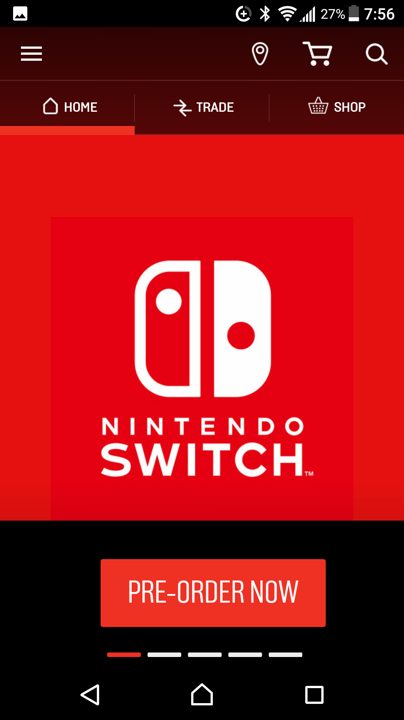
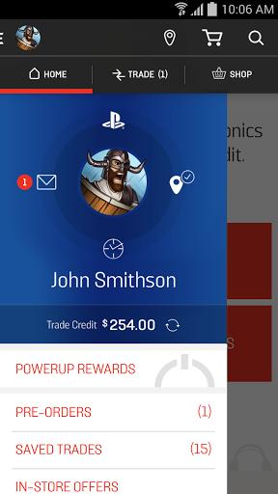
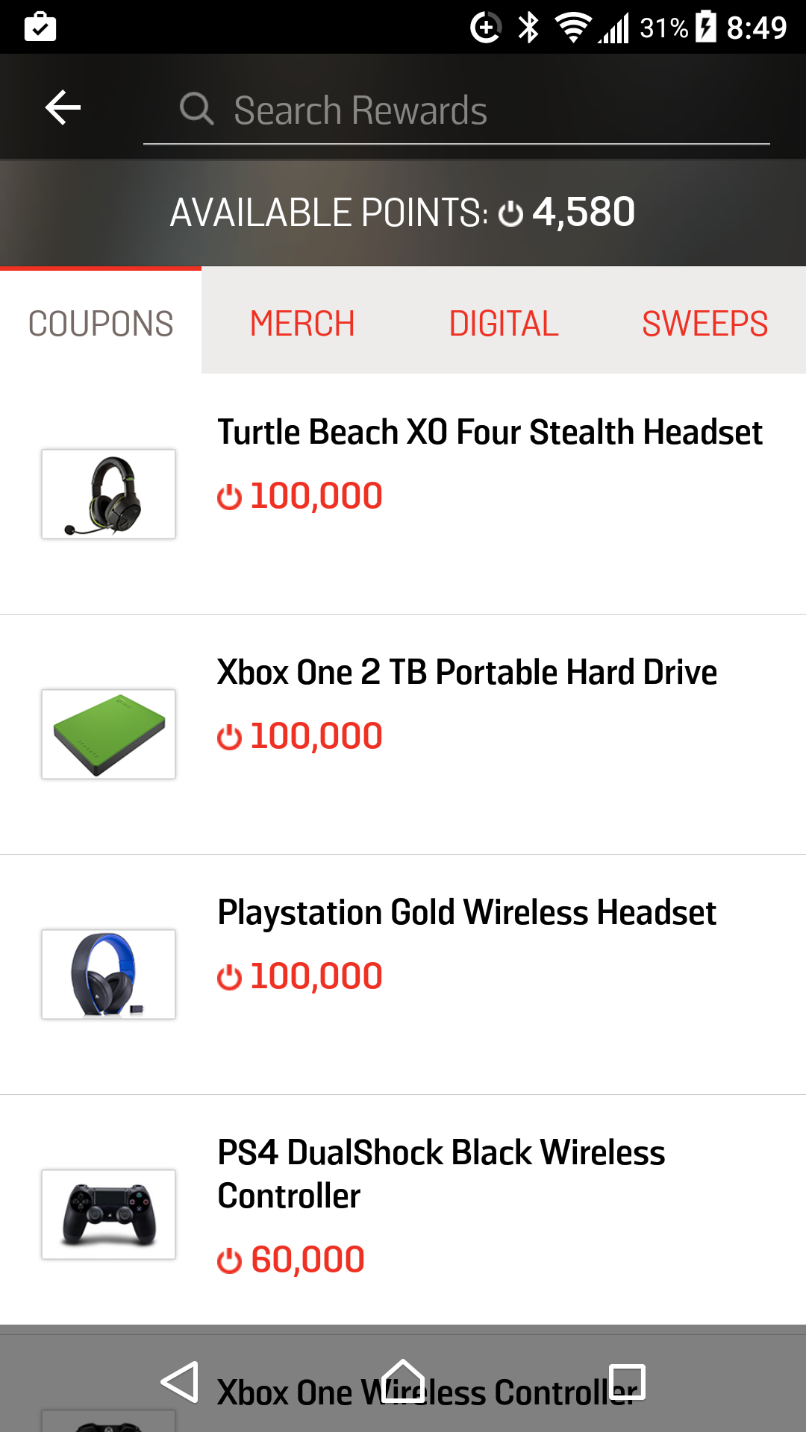

Slide 5
Possible Improvements
Re-Design the tab system of the application to keep most used tabs accessible with fewer swipes
Re-Design the layout to allow for easier accessibility even on larger screens
Faster and easier navigation to relevant products and services

Slide 6
Possible Challenges
Creating an interface that will be easy to use across all ages
Identifying the most relevant information for the user
Creating effective categories for various layouts

