Slide 1
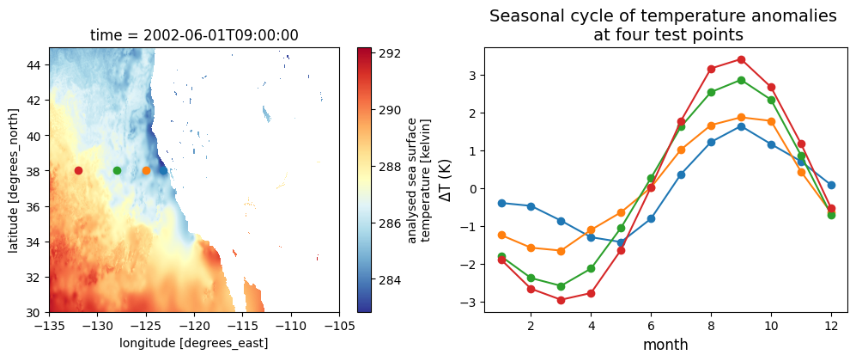
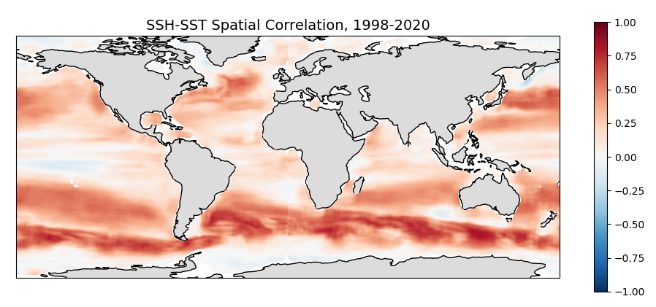



Exploring Coiled as a Solution for Earth Data Researchers to Utilize Cloud and Parallel Computing without being a Cloud Expert
Dean Henze, Ed Armstrong, Jinbo Wang
PO.DAAC, JPL, California Institute of Technology
Thanks to James Bourbeau
Coiled Team

Slide 2
Overview
Comparing traditional workflow to several cloud workflows in AWS.
Technical challenges of cloud workflows and utility of Coiled
Coiled-assisted AWS cloud workflows & demos

Slide 3
1. Traditional and AWS Cloud Workflows for Researchers

Slide 4
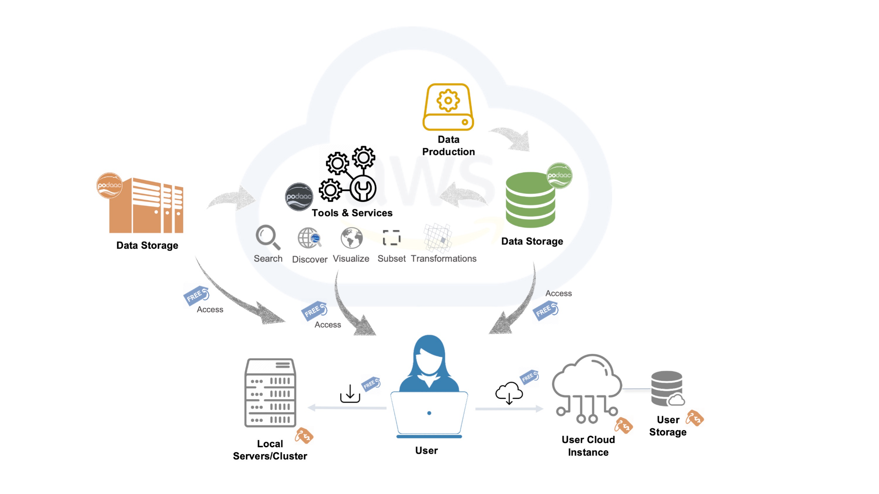
1. Workflows
Notes:
PO.DAAC’s data (and most/all NASA DAAC data) will be in the cloud. Ecosystem of tools and services to work either partially or fully in cloud.

Slide 5

1. Workflows
Traditional Workflow
Download data
(NASA egress costs)
Notes:
Classic way to access and analyze data for many researchers.
Limiting factors, download speeds, and compute power of laptop or local machine.
There is a charge to NASA in egress costs (egress=data transferred from a local network to an external location).

Slide 6
1. Workflows
EC2 Workflow (spinning up a single VM)
[ 2 ]
Virtual Machine (VM)
AWS EC2
[ 1 ]
[ 3 ]
Notes:
Access data directly in the cloud. Faster data access, and compute power tunable to the size of VM spun up
No egress costs if VM is spun up in same region as data. Replaced by costs of the VM and any additional cloud storage.

Slide 7
1. Workflows
EC2 Workflow (spinning up a single VM)
[ 2 ]
local cluster
[ 1 ]
[ 3 ]
Notes:
Access data directly in the cloud. Faster data access, and compute power tunable to the size of VM spun up
No egress costs if VM is spun up in same region as data. Replaced by costs of the VM and any additional cloud storage.

Slide 8

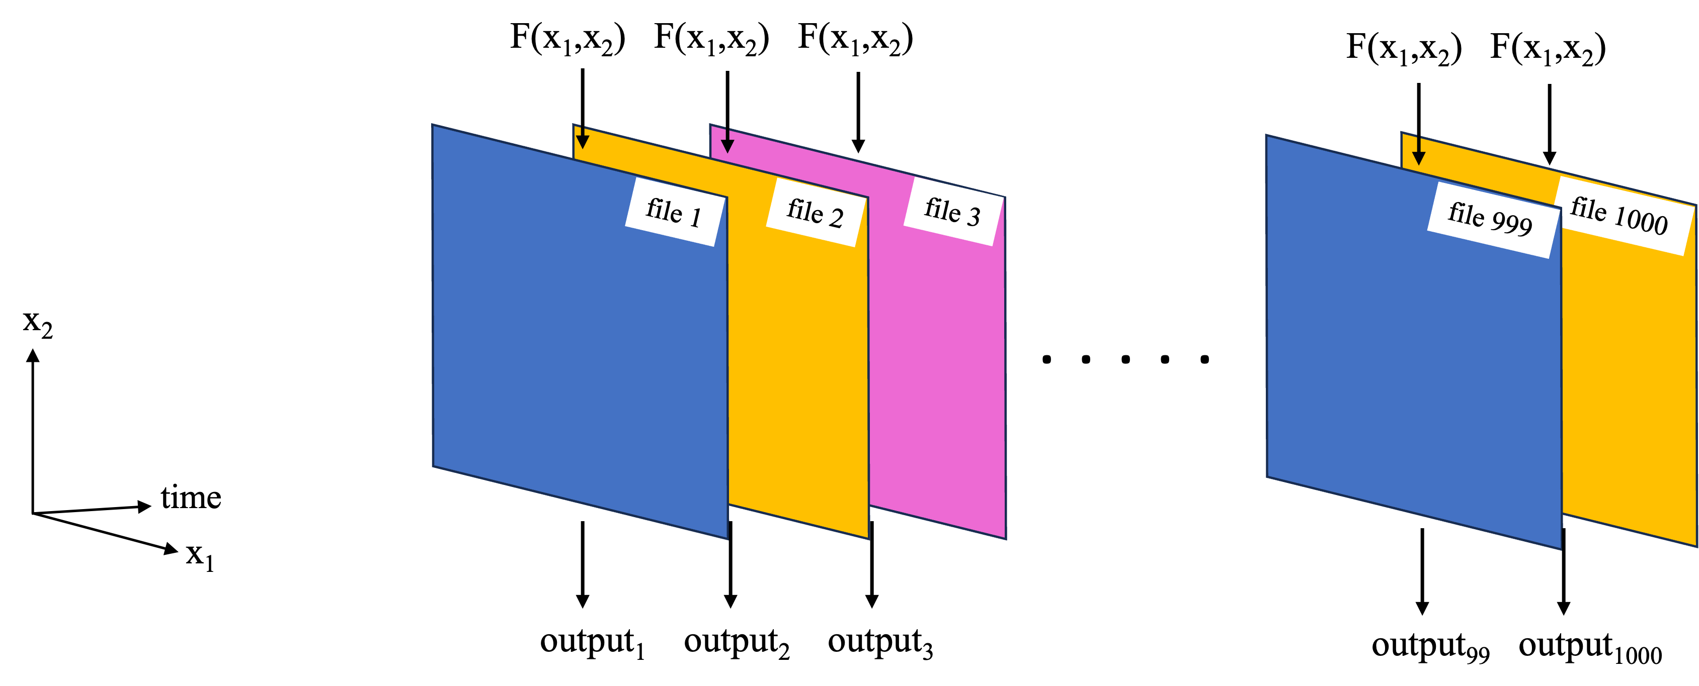
1. Workflows
Lambda Workflow
F(x₁, x₂)
F(x₁, x₂)
F(x₁, x₂)
F(x₁, x₂)
Notes:
Scientific computing case 1, replicate same analysis over 1000’s to 10,000’s (up to 100,000’s?) of files.
Code is replicated as many times as desired, one to each lambda function, which will each work on a separate file.
Lambda limits: 15 minutes of run time max.
Lambda costs? Proportional to number of lambda’s called.

Slide 9

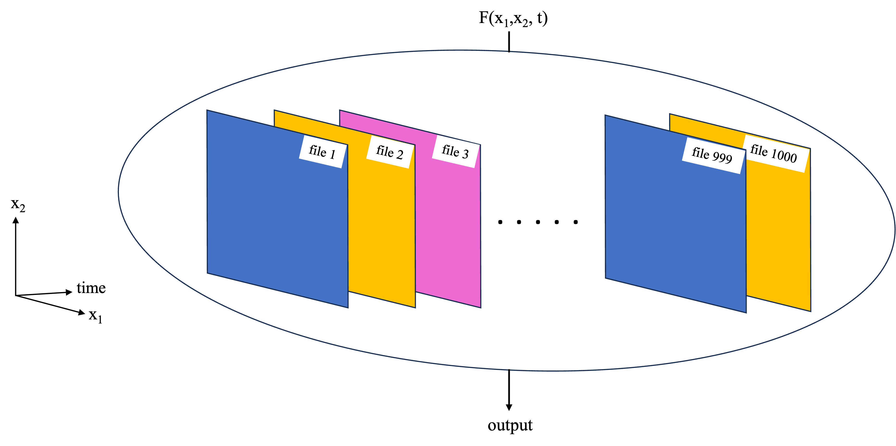

1. Workflows
Distributed Cluster
F(x₁, x₂, t)
F(x₁, x₂, t)
Notes:
Multi-node, distributed clusters
Scientific computing case 2: The analysis requires access to all data at once, e.g. an EOF, or time-lagged cross-correlation.
Spin up multiple VM’s, coordinate them so they can interact and tackle a large computation.
Costs proportional to number and size of VM’s spun up.
No compute time limits.
The VM’s can form a Dask cluster, so things like Xarray built in functions will naturally work with parallel computing.

Slide 10
2. Challenges with Cloud Workflows for Researchers

Slide 11
2. Challenges
Knowledge required establish these workflows
Scientific Computing with Python and Dask | AWS Infrastructure | Other software/technical knowledge
Effective Python, NumPy, Xarray, Dask syntax Understanding of parallelization methods and which one to apply Code and cluster optimization | Basic setup/usage Spinning up & connecting to EC2 instances Lambda functions Requirements for multi-VM, distributed clusters? Cost Tracking | Docker Linux shell / bash scripting Ensuring VM’s have EDL creds, AWS creds, software environments Anything else?
Notes:
The left column includes most of the stuff that researchers using Python are used to already, with the addition of some knowledge of parallelization.

Slide 12
2. Challenges
Knowledge required establish these workflows
Troubleshooting
Scientific Computing with Python and Dask | AWS Infrastructure | Other software/technical knowledge
Effective Python, NumPy, Xarray, Dask syntax Understanding of parallelization methods and which one to apply Code and cluster optimization | Basic setup/usage Spinning up & connecting to EC2 instances Lambda functions Requirements for multi-VM, distributed clusters? Cost Tracking | Docker Linux shell / bash scripting Ensuring VM’s have EDL creds, AWS creds, software environments Anything else?
Notes:
The left column includes most of the stuff that researchers using Python are used to already, with the addition of some knowledge of parallelization.

Slide 13
2. Challenges
Knowledge required establish these workflows
(A researcher may only be coming to the table with knowledge in these areas)
Troubleshooting
Scientific Computing with Python and Dask | AWS Infrastructure | Other software/technical knowledge
Effective Python, NumPy, Xarray, Dask syntax Understanding of parallelization methods and which one to apply Code and cluster optimization | Basic setup/usage Spinning up & connecting to EC2 instances Lambda functions Requirements for multi-VM, distributed clusters? Cost Tracking | Docker Linux shell / bash scripting Ensuring VM’s have EDL creds, AWS creds, software environments Anything else?
Notes:
The left column includes most of the stuff that researchers using Python are used to already, with the addition of some knowledge of parallelization.

Slide 14
2. Challenges
Knowledge required establish these workflows
With Coiled
Scientific Computing with Python and Dask | AWS Infrastructure | Other software/technical knowledge
Effective Python, NumPy, Xarray, Dask, and Coiled syntax Understanding of parallelization methods and which one to apply Code and cluster optimization | Basic setup/usage Spinning up & connecting to EC2 instances Lambda functions Requirements for multi-VM, distributed clusters? Cost Tracking | Docker Linux shell / bash scripting Ensuring VM’s have EDL creds, AWS creds, software environments Anything else?
Notes:
The left column includes most of the stuff that researchers using Python are used to already, with the addition of some knowledge of parallelization.

Slide 15
2. Challenges
Utility of Coiled
Summing up my view of Coiled in a few sentences:
Coiled is not an alternative to AWS services. Rather, it is a wrapper around them, making it easy to spin up resources from a Python Script or Jupyter Notebook and run your code on them, even if you are not a software/AWS expert. With Coiled dashboard it is easy to monitor resources and costs for yourself and teammates.
Notes:
The link provides Coiled’s explanation of their advantages in their words.

Slide 16
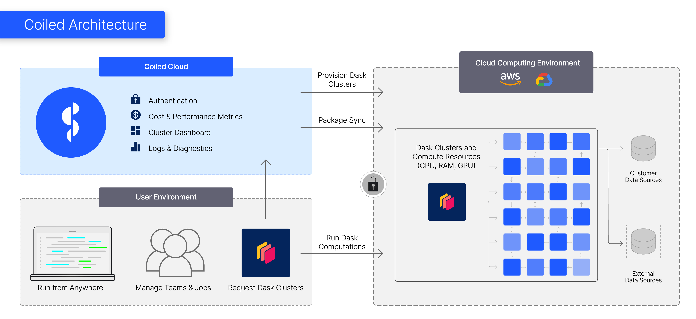

Coiled
Account Setup
Setup
Sign up (e.g. with Github / Google account)
Download Coiled: “pip install coiled”
Connect to an AWS account.
Multiple Coiled accounts can be part of the same workspace, connected to a single AWS account.
Pricing
All AWS costs incurred are your own.
Extra Coiled costs: First 10,000 CPU hours per month free, $0.05/CPU-hour beyond that .
1000 CPU hrs max
500 CPU hrs max
500 CPU hrs max
7000 CPU hrs max
Notes:
Demo my Coiled dashboard

Slide 17
3. Coiled Workflows

Slide 18

3. Coiled Workflows
Coiled Notebook + demo
Coiled Notebook = VM with all local packages installed and Jupyter Notebook interface.
Start one up from the command line.
Coiled Notebook
Notes:
Coiled notebooks (cloud version of a Jupyter Notebook). Great for exploratory analysis/coding typical in science and research.
coiled notebook start --region us-west-2 --vm-type m6i.xlarge
Don’t forget to open Coiled Dashboard
Basic demo: use earthaccess to locate and load some files with Xarray.

Slide 19
3. Coiled Workflows
Coiled Function Intro
Workflow:
Choose a function that Coiled will replicate over multiple VM’s.
F(x₁, x₂)
Notes:
Coiled Functions
Call a Coiled function from the notebook as additional resources are needed.
Alternately, the output from a Coiled function can be written to an S3 bucket.

Slide 20
3. Coiled Workflows
Coiled Function Intro
Workflow:
Choose a function that Coiled will replicate over multiple VM’s.
VM’s each access PO.DAAC data, process it with the function, and return to the notebook.
F(x₁, x₂)
F(x₁, x₂)
F(x₁, x₂)
results
Notes:
Coiled Functions
Call a Coiled function from the notebook as additional resources are needed.
Alternately, the output from a Coiled function can be written to an S3 bucket.

Slide 21
3. Coiled Workflows
Coiled Function Intro
Workflow:
Same as before but start up the Coiled Function cluster from a Coiled Notebook
F(x₁, x₂)
Coiled Notebook
Notes:
Coiled Functions
Call a Coiled function from the notebook as additional resources are needed.
Alternately, the output from a Coiled function can be written to an S3 bucket.

Slide 22
3. Coiled Workflows
Coiled Function Intro
Workflow:
Same as before but start up the Coiled Function cluster from a Coiled Notebook
F(x₁, x₂)
F(x₁, x₂)
F(x₁, x₂)
Coiled Notebook
Notes:
Coiled Functions
Call a Coiled function from the notebook as additional resources are needed.
Alternately, the output from a Coiled function can be written to an S3 bucket.

Slide 23
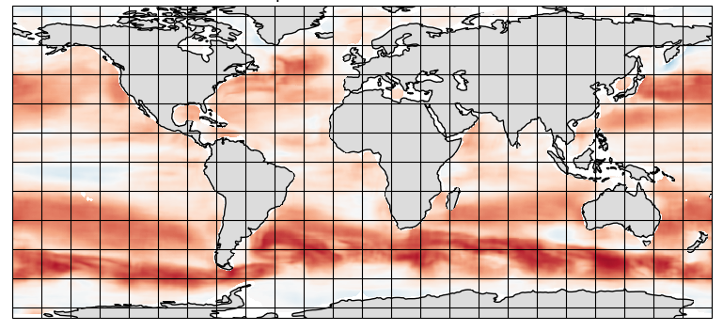
3. Coiled Workflows
Demo: SST-SSH spatial correlation map with Coiled Functions
PO.DAAC-hosted, gridded SSH and SST data sets
MEaSUREs gridded SSH Version 2205: 0.17° x 0.17°, 5-day period, https://doi.org/10.5067/SLREF-CDRV3
GHRSST Level 4 MW_OI Global Foundation SST, V5.0: 0.25° x 0.25°, daily, https://doi.org/10.5067/GHMWO-4FR05
Time period of overlap: 1998 – 2020
Analysis: Global map of spatial correlation for each overlapping pair of files, 1808 days in total (3616 files, ~20 GB). Then further statistical assessment of these maps in the future.
Computations for each lat-lon window (after interpolation of SST grid to SSH):
Locate SST, SSH data within window
Fit 2D linear surfaces to SSH, SST
Anomalies = deviations from 2D fit
Correlation between anomalies
~ 2 million windows per pair of files
6°
6°
Notes:
Show the empty results folder before it gets populated
Show Coiled dashboard before it finishes.

Slide 24
3. Coiled Workflows
Demo: SST-SSH spatial correlation map with Coiled Functions
Processing the entire record
Processed entire record (years 1998 – 2022, 1808 pairs of files) at 0.25° x 0.25° resolution, Link to Github.
At ~25 minutes processing time per pair, it would take ~1 month on a laptop or EC2 instance without parallel computing.
Ran with a Coiled function, 250 workers, saving output to an S3 bucket. Took ~5 hours for ~$20 (AWS costs, no Coiled costs).
Notes:
From my estimations, would still cost $20 for a single EC2 instance in the cloud, since it needs to be running for the whole month anyway.

Slide 25
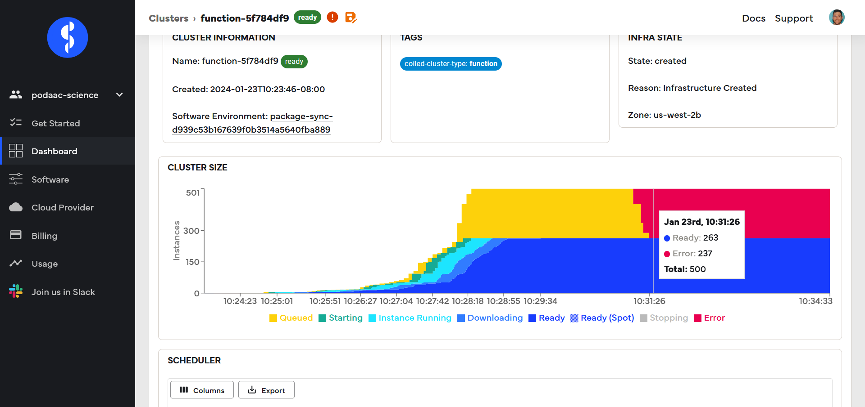
3. Coiled Workflows
Demo: SST-SSH spatial correlation map with Coiled Functions
Processing the entire record
Troubleshooting was easier with the Coiled dashboard

Slide 26
3. Coiled Workflows
Demo: SST-SSH spatial correlation map with Coiled Functions
An Additional Point
(statements on cloud vs local computing workflows in general, not limited to Coiled)
This SSH-SST correlation computation was a case of a “compute” limited analysis:
Low file count and low memory per file.
High computation requirements per file
For future work, do a memory-limited example (less complex computation on a data set with larger file count and memory requirements). E.g. data set with ~100,000 files and 100’s GB to TB’s of memory.
Notes:
Easy to make sure each worker has enough memory. This was sometimes a challenge for me when using a local cluster with Dask - Python did not seem good at memory management for local clusters? (need more investigation).
Estimate that with more I could make the code ~30 % more efficient?

Slide 27
3. Coiled Workflows
Coiled Cluster Intro
Workflow:
Start Coiled notebook
Run script / Jupyter notebook from the Coiled Notebook, having it call up a Coiled cluster.
F(x₁, x₂, t)
Coiled Notebook
Notes:
Coiled Cluster
Dask cluster, so will work with Xarray built-in functions, or NumPy/Dask built-in functions.

Slide 28
3. Coiled Workflows
Coiled Cluster Intro
F(x₁, x₂, t)
Workflow:
Start Coiled notebook
Run script / Jupyter notebook from the Coiled Notebook, having it call up a Coiled cluster.
Coiled cluster processes data and results are available in the notebook.
Coiled Notebook
Notes:
Coiled Cluster
Dask cluster, so will work with Xarray built-in functions, or NumPy/Dask built-in functions.

Slide 29
3. Coiled Workflows
Coiled Cluster Intro
Workflow:
Can call a Coiled cluster directly from local machine, although the way this demo was written, it’s much faster to call from the Coiled Notebook.
F(x₁, x₂, t)
Notes:
Coiled Cluster
Dask cluster, so will work with Xarray built-in functions, or NumPy/Dask built-in functions.

Slide 30
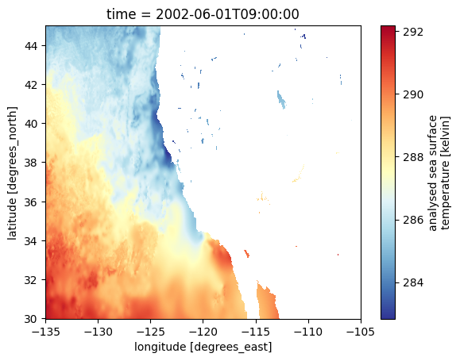
3. Coiled Workflows
Demo: SST seasonal cycle on a Coiled Cluster
PO.DAAC-hosted, gridded SST data set
MUR 0.01° resolution, daily product: https://podaac.jpl.nasa.gov/dataset/MUR-JPL-L4-GLOB-v4.1
Analysis: Seasonal cycle of SST at each MUR grid point in region off U.S.A. west coast.
Computations Overview
Open all files into a single Xarray dataset object.
Subset to U.S.A west coast region
Remove long-term, linear warming trend individually for each grid point.
Bin/average by month at each grid point.
These are also preprocessing steps for an EOF analysis
Notes:
These are preprocessing steps for an EOF analysis, which we look to complete later this year.
Don’t forget to open Coiled Dashboard.

Slide 31
3. Coiled Workflows
Demo: SST seasonal cycle on a Coiled Cluster
MUR 1 km SST seasonal cycle in multiple locations off U.S.A. west coast.
PO.DAAC-hosted, gridded SST data set
MUR 0.01° resolution, daily product: https://podaac.jpl.nasa.gov/dataset/MUR-JPL-L4-GLOB-v4.1
Analysis: Seasonal cycle of SST in region off U.S.A. west coast.
Notes:
Don’t forget to open Coiled Dashboard.

Slide 32
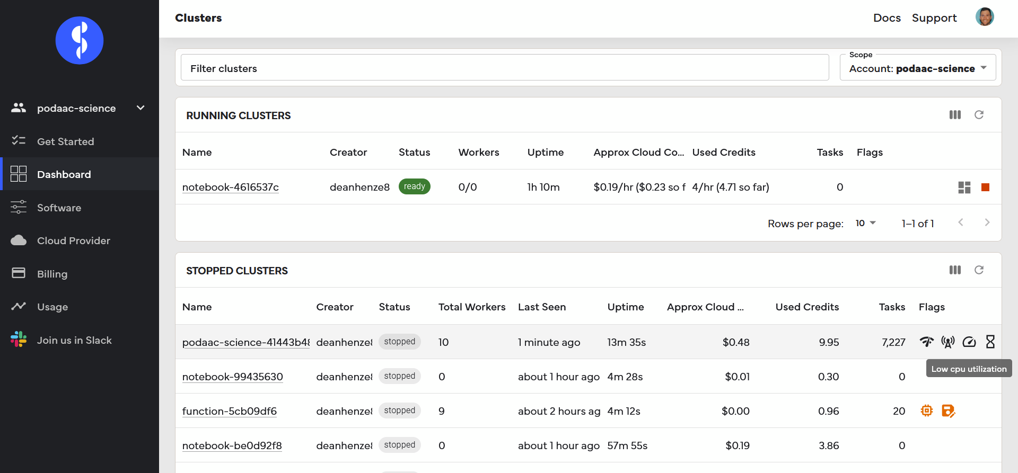
3. Coiled Workflows
Demo: SST seasonal cycle on a Coiled Cluster
Again, Coiled + dashboard made it easier to optimize parallelization - decreased demo time from 3.5 minutes to just over 2 minutes while decreasing costs from $0.35 to $0.18.
Notes:
Nothing extensive, but I was quickly able to see inefficiencies and correct them. Not a big issue for this demo, but easy to see how this would scale for larger computations.

Slide 33
Conclusions and Future Work
Big positives
Coiled goes a long way in making the cloud what it was meant to be – a gateway for all researchers to conduct bigger analyses with more data, rather than a barrier which only the technically savvy can hurdle.
None of the computations presented here have broken the free tier. If I had broken free tier, the SSH-SST computation (~2,000 CPU hours) would have been ~$100 on top of AWS costs.
Even with Coiled, I still needed to handle cluster optimization, Python syntax for use with Dask, choosing the right parallel computation method. However, I was able to focus on these instead of backend cloud tasks.
Some remaining challenges
Not a silver bullet - I still have analyses that I can’t get working with distributed clusters even though they are working on a local cluster. Bugs to work out on my end? On Coiled’s end?
My Coiled account does not currently work on JPL VPN
Future Work
(1) SST seasonal cycle with more data; (2) EOF analysis (Coiled cluster); (3) memory-limited computation with Coiled functions.
Repeat these analyses on a single, large VM with a local cluster, and compare performance/cost to distributed computing workflows used with Coiled.
Notes:
Even more points
There is minimal syntax that needs to be inserted into existing code to get it working with Coiled. Therefore, no one is ‘locked in’ to Coiled workflows if they choose to try something else.

