Slide 1
Experiences with Coiled for Cloud Computing
Dean Henze, Ed Armstrong, Jinbo Wang, James
PO.DAAC, JPL, Caltech

Slide 2
Overview
Comparing traditional workflow to several cloud workflows in AWS.
Technical challenges of cloud workflows and utility of Coiled
Coiled-assisted AWS cloud workflows & demos
Notes:
Classic way to access and analyze data for many researchers
Limiting factors, download speeds, and compute power of laptop or local machine.
There is a charge to NASA in egress costs (egress=data transferred from a local network to an external location).

Slide 3
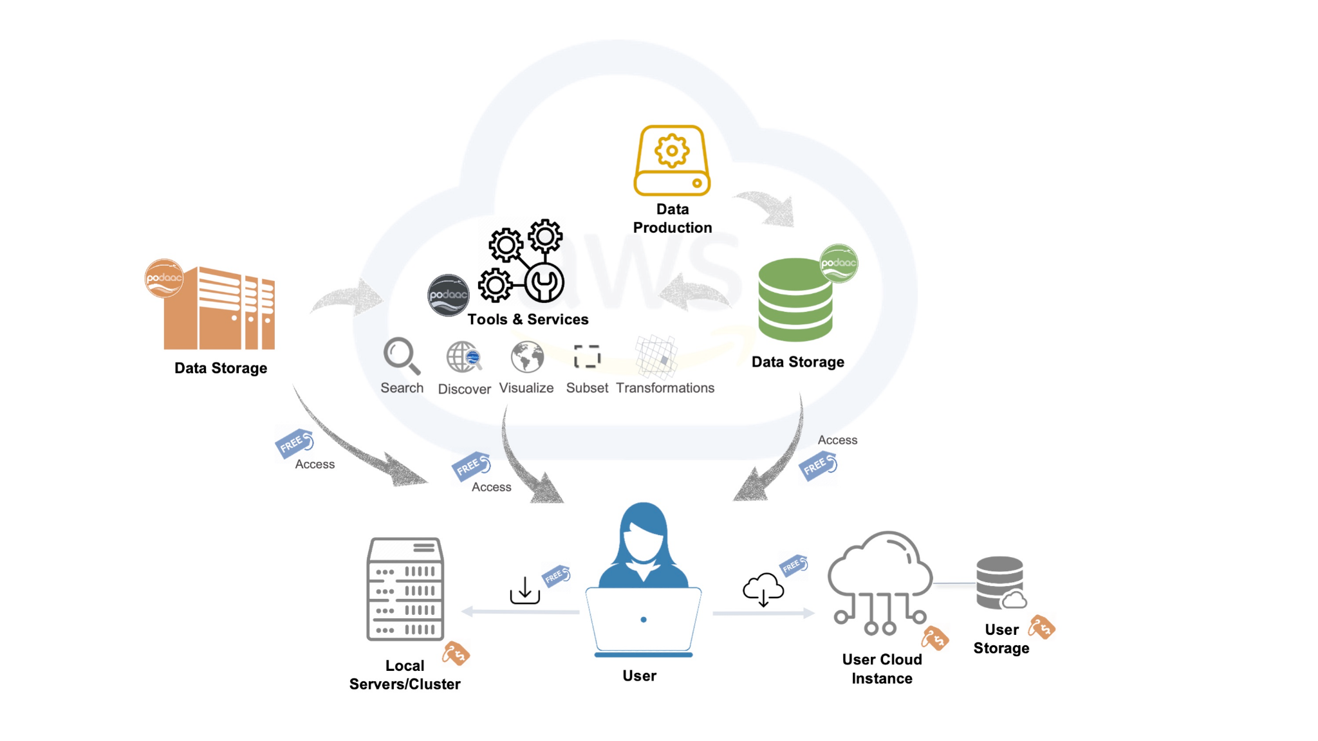
1. Workflows
Notes:
PO.DAAC’s data (and most/all NASA DAAC data) will be in the cloud. Ecosystem of tools and services to work either partially or fully in cloud.

Slide 4

1. Workflows
Traditional Workflow
Download data
(NASA egress costs)
Notes:
Classic way to access and analyze data for many researchers.
Limiting factors, download speeds, and compute power of laptop or local machine.
There is a charge to NASA in egress costs (egress=data transferred from a local network to an external location).

Slide 5
1. Workflows
EC2 Workflow (spinning up a single VM)
Notes:
New ways to access/analyze data
Cost considerations
Access data directly in the cloud. Faster data access, and compute power tunable to the size of VM spun up
No egress costs if VM is spun up in same region as data. Replaced by costs of the VM and any additional cloud storage.

Slide 6
1. Workflows
EC2 Workflow (spinning up a single VM)
Notes:
Can get more compute power with a bigger VM. Can utilized parallel computing with the additional processors and memory.
Additional costs of the bigger VM, and any additional cloud storage required for your processing output.
In my experience, the distributed clusters seem more efficient than trying to achieve the same compute capabilities from a local cluster on a large EC2 instance. Is this true? E.g. for local clusters, workers just seem to use more memory than they should be.

Slide 7

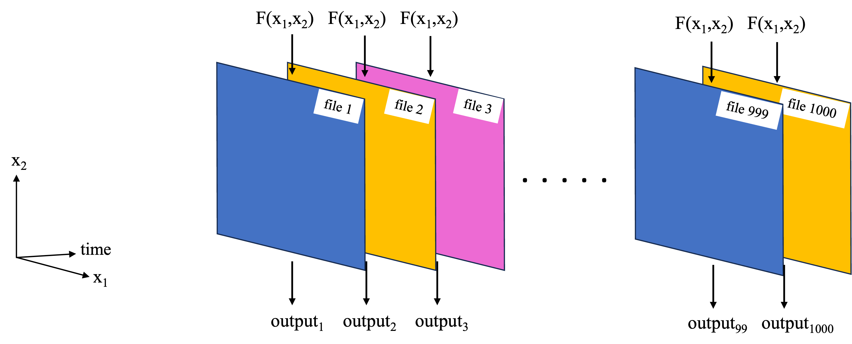
1. Workflows
Lambda Workflow
Send code to lambda functions
Notes:
Scientific computing case 1, replicate same analysis over 1000’s to 10,000’s (up to 100,000’s?) of files.
Code is replicated as many times as desired, one to each lambda function, which will each work on a separate file.
Lambda limits: 15 minutes of run time max.
Lambda costs? Proportional to number of lambda’s called.

Slide 8
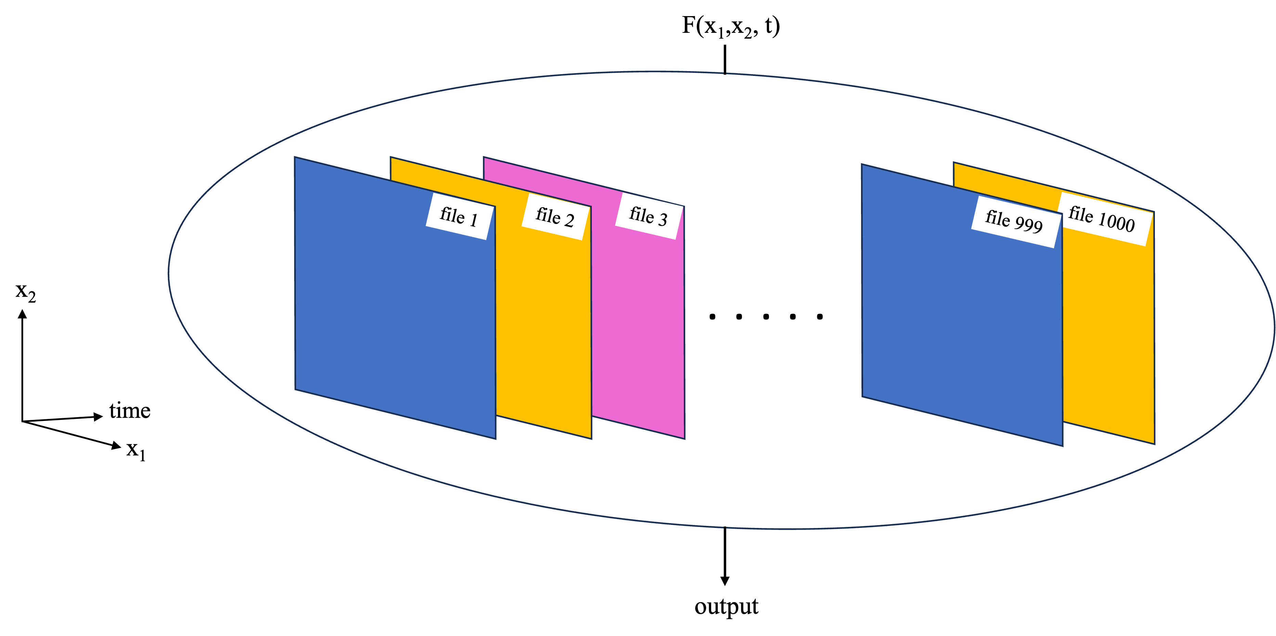
1. Workflows
Distributed Cluster
Notes:
Multi-node, distributed clusters
Scientific computing case 2: The analysis requires access to all data at once, e.g. an EOF, or time-lagged cross-correlation.
Spin up multiple VM’s, coordinate them so they can interact and tackle a large computation.
Costs proportional to number and size of VM’s spun up.
No compute time limits.
The VM’s can form a Dask cluster, so things like Xarray built in functions will naturally work with parallel computing.

Slide 9


1. Workflows
Distributed Cluster
Notes:
Multi-node, distributed clusters
The VM’s can form a Dask cluster, so things like Xarray built in functions will naturally work with parallel computing.

Slide 10
2. Challenges
Knowledge required establish these workflows
Scientific Computing with Python and Dask | AWS Infrastructure | Other software/technical knowledge
Translate analysis to code Effective Python, NumPy, Xarray, Dask syntax Understanding of parallelization methods and which one to apply Code and cluster optimization | Basic setup/usage Spinning up & connecting to EC2 instances Lambda functions Requirements for multi-node, distributed clusters? Cost Tracking | Docker Linux shell / bash scripting Ensuring VM’s have EDL creds, AWS creds, software environments Anything else?
Notes:
The left column includes most of the stuff that researchers using Python are used to already, with the addition of some knowledge of parallelization.

Slide 11
2. Challenges
Knowledge required establish these workflows
Troubleshooting
Scientific Computing with Python and Dask | AWS Infrastructure | Other software/technical knowledge
Translate analysis to code Effective Python, NumPy, Xarray, Dask syntax Understanding of parallelization methods and which one to apply Code and cluster optimization | Basic setup/usage Spinning up & connecting to EC2 instances Lambda functions Requirements for multi-node, distributed clusters? Cost Tracking | Docker Linux shell / bash scripting Ensuring VM’s have EDL creds, AWS creds, software environments Anything else?
Notes:
Emphasize cost tracking?

Slide 12
2. Challenges
Utility of Coiled
With Coiled
Scientific Computing with Python and Dask | AWS Infrastructure | Other software/technical knowledge
Translate analysis to code Effective Python, NumPy, Xarray, Dask, and Coiled syntax Understanding of parallelization methods and which one to apply Code and cluster optimization | Basic setup/usage Spinning up & connecting to EC2 instances Lambda functions Requirements for multi-node, distributed clusters? Cost Tracking | Docker Linux shell / bash scripting Ensuring VM’s have EDL creds, AWS creds, software environments Anything else?
Notes:
With Coiled, majority of required knowledge of AWS infrastructure and other software is replaced with knowing some Coiled syntax, typically within a Python script or Jupyter Notebook.

Slide 13
2. Challenges
Utility of Coiled
Summing up my understanding of Coiled in a couple sentences:
Coiled is not an alternative to AWS services. Rather, it is a wrapper around them, making it easy to summon those resources from a Python Script or Jupyter Notebook, even if you are not a software/AWS expert. With your Coiled dashboard it is also easy to monitor resources used and estimate costs for yourself and teammates.
https://docs.coiled.io/user_guide/why.html
Notes:
The link provides Coiled’s explanation of their advantages in their words.

Slide 14
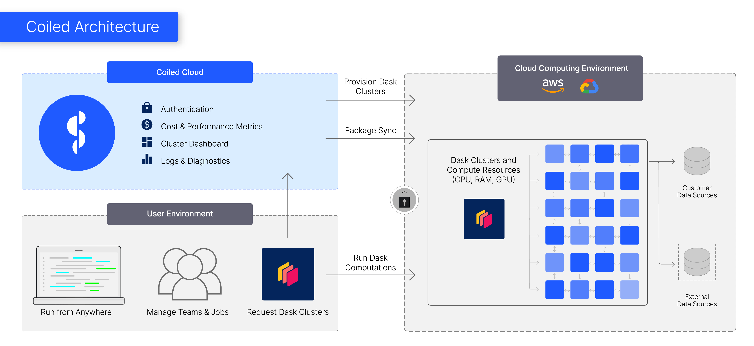

Coiled
Account Setup
Setup
Sign up (e.g. with Github / Google account)
Download Coiled: “pip install coiled”
Connect to an AWS account.
Multiple Coiled accounts can be part of the same workspace, which is connected to a single AWS account.
Pricing
All AWS costs incurred are your own.
Extra Coiled costs: First 10,000 CPU hours per month free, $0.05/CPU-hour beyond that (pricing link).
1000 CPU hrs max
500 CPU hrs max
500 CPU hrs max
7000 CPU hrs max
Notes:
Need to have a Coiled account, but don’t need an AWS account necessarily, only need to be part of a team with an AWS account that all Coiled accounts are connected to.
All users can have resource limitations as set by the AWS account, e.g. no starting up 5,000 vCPUs.
As a metric, none of the computations I have done so far have broken the free tier.
Take this opportunity to show my Coiled account dashboard?

Slide 15
3. Coiled Workflows
Coiled Notebook + demo
Coiled Notebook = EC2 instance with all local packages installed and Jupyter Notebook interface.
Start one up from the command line.
Can spend a whole work day in the cloud for ~$1.00 (less if needed)
Opportunity to sync files on the notebook to your local file system (mine was working until recently)
Coiled Notebook
Notes:
Coiled notebooks (cloud version of a Jupyter Notebook). Great for exploratory analysis/coding typical in science and research.
coiled notebook start --region us-west-2 --vm-type m6i.xlarge
Don’t forget to open Coiled Dashboard
Basic demo: use earthaccess to locate and load some files with Xarray.

Slide 16
3. Coiled Workflows
Coiled Function Intro
Workflow:
Choose a function that Coiled will replicate over multiple VM’s.
Coiled Function Call
F(x₁, x₂)
Coiled Notebook
Notes:
Coiled Functions
Call a Coiled function from the notebook as additional resources are needed.
Alternately, the output from a Coiled function can be written to an S3 bucket.

Slide 17
3. Coiled Workflows
Coiled Function Intro
F(x₁, x₂)
F(x₁, x₂)
F(x₁, x₂)
Workflow:
Choose a function that Coiled will replicate over multiple VM’s.
VM’s each access PO.DAAC data, process it with the function, and return to the notebook.
Coiled Notebook
Notes:
Coiled Functions
Call a Coiled function from the notebook as additional resources are needed.
Alternately, the output from a Coiled function can be written to an S3 bucket.
Feels like a lambda function, but doesn’t have the 15-minute limit.

Slide 18
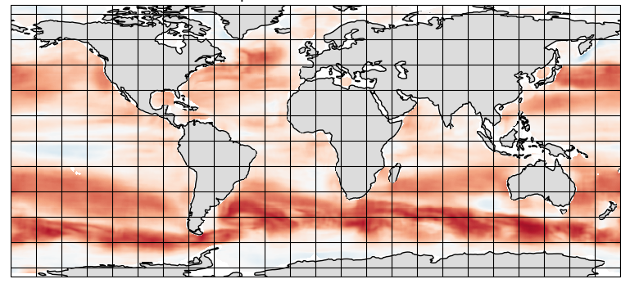
3. Coiled Workflows
Demo: SST-SSH spatial correlation map with Coiled Functions
PO.DAAC-hosted, gridded SSH and SST data sets
MEaSUREs gridded SSH Version 2205: 0.17° x 0.17°, 5-day period, https://doi.org/10.5067/SLREF-CDRV3
GHRSST Level 4 MW_OI Global Foundation SST, V5.0: 0.25° x 0.25°, daily, https://doi.org/10.5067/GHMWO-4FR05
Time period of overlap: 1998 – 2020
Analysis: Global map of spatial correlation for each overlapping pair of files, 1808 days in total (3616 files, ~20 GB). Then further statistical assessment of these maps in the future.
Computations for each lat-lon window (after interpolation of SST grid to SSH):
Locate SST, SSH data within window
Fit 2D linear surfaces to SSH, SST
Anomalies = deviations from 2D fit
Correlation between anomalies
~ 2 million windows per pair of files
6°
6°
Notes:
Using Coiled Functions with the SST-SSH correlation code for 73 files took ~9 minutes and cost ~$1 (without parallelization it’ll take 8 hours, and if you’re hanging out in the cloud for a full work day it’ll cost ~$1 anyway).
Don’t forget to open Coiled Dashboard.

Slide 19
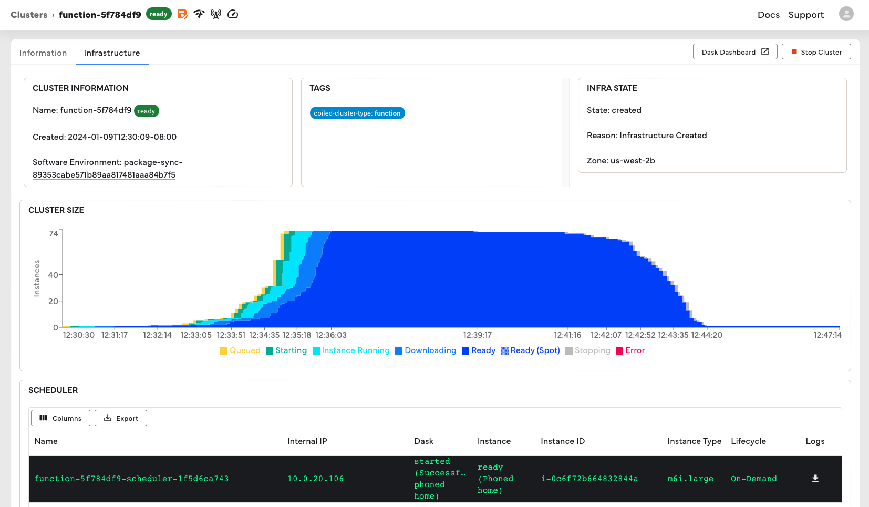
3. Coiled Workflows
Demo: SST-SSH spatial correlation map with Coiled Functions
Adaptive scaling run for the SSH-SST correlation computation
Notes:
For the demo, use manual scaling to 73 workers. On this slide, show screenshot from when I used adaptive scaling instead.
The adaptive scaling spins up enough workers with the goal of completing the computation in ~5 minutes, if possible. Then it will naturally scale back down once workers are not needed.

Slide 20
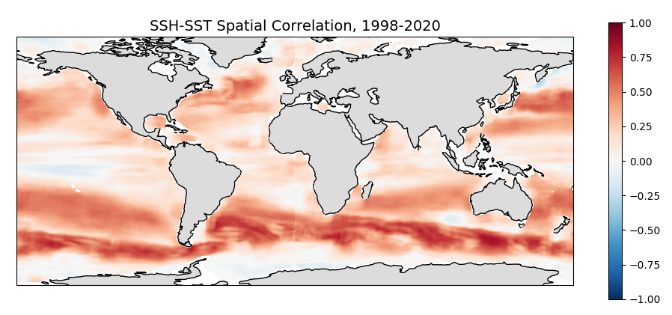
3. Coiled Workflows
Demo: SST-SSH spatial correlation map with Coiled Functions
Processing the entire record
Processed entire record (years 1998 – 2022, 1808 pairs of files) at 0.25° x 0.25° resolution, Link to Github.
At ~25 minutes processing time per pair, it would take ~1 month on a laptop or EC2 instance without parallel computing.
Ran with a Coiled function, 250 workers, saving output to an S3 bucket. Took ~5 hours for ~$20 (AWS costs, no Coiled costs).
Estimated to cost $20 for a single EC2 instance, since it needs to be running for the whole month anyway.
Notes:
From my estimations, would still cost $20 for a single EC2 instance in the cloud, since it needs to be running for the whole month anyway.

Slide 21
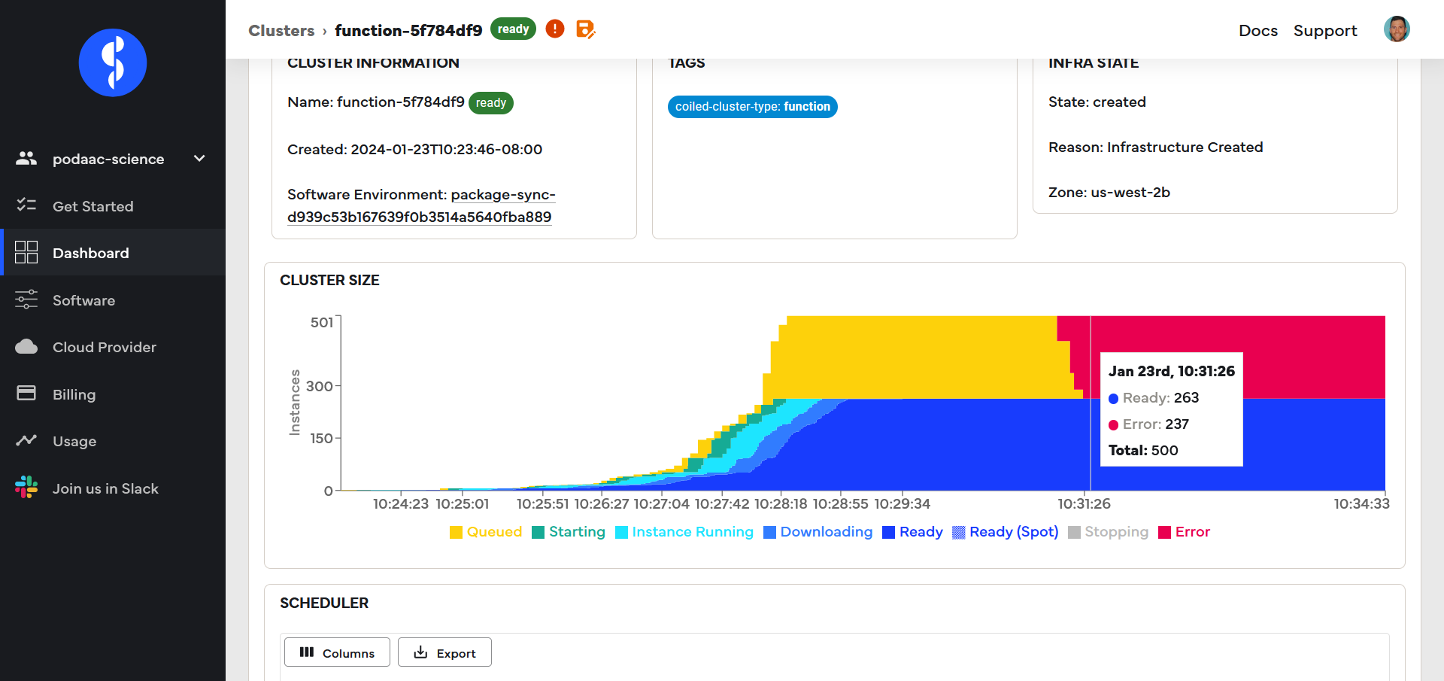
3. Coiled Workflows
Demo: SST-SSH spatial correlation map with Coiled Functions
Processing the entire record
Troubleshooting was easier with the Coiled dashboard

Slide 22
3. Coiled Workflows
Demo: SST-SSH spatial correlation map with Coiled Functions
Additional thoughts
This computation was a case of:
Low file count and low disk space per file.
High computation requirements per file (e.g. compute limited)
From a cost perspective (compared to a laptop), there is an additional $20 to process (low egress costs for this case), although it would take a month on the laptop.
The costing considerations of this workflow start to shift when dealing with high file count and/or high memory per file. In this case, Coiled Function workflow will potentially be less expensive, because egress costs for downloading to a laptop will go up.
The above considerations are more a statement on Cloud computing workflows vs local machines in general, not limited to Coiled.
Notes:
Easy to make sure each worker has enough memory. This was sometimes a challenge for me when using a local cluster with Dask - Python did not seem good at memory management for local clusters? (need more investigation).
Estimate that with more I could make the code ~30 % more efficient?

Slide 23
3. Coiled Workflows
Coiled Cluster Intro
Coiled Cluster Call
F(x₁, x₂, t)
Coiled Notebook
Notes:
Coiled Cluster
Dask cluster, so will work with Xarray built-in functions, or NumPy/Dask built-in functions.

Slide 24
3. Coiled Workflows
Coiled Cluster Intro
F(x₁, x₂, t)
Coiled Cluster Call
Coiled Notebook
Notes:
Coiled Cluster
Dask cluster, so will work with Xarray built-in functions, or NumPy/Dask built-in functions.

Slide 25
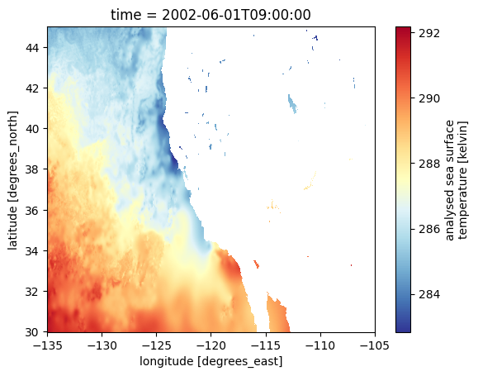
3. Coiled Workflows
Demo: SST seasonal cycle on a Coiled Cluster
PO.DAAC-hosted, gridded SST data set
MUR 0.01° resolution, daily product: https://podaac.jpl.nasa.gov/dataset/MUR-JPL-L4-GLOB-v4.1
Analysis: Seasonal cycle of SST at each MUR grid point in region off U.S.A. west coast.
Computations Overview
Open all files into a single Xarray dataset object.
Subset to U.S.A west coast region
Remove long-term, linear warming trend individually for each grid point.
Bin/average by month at each grid point.
These are also preprocessing steps for an EOF analysis
Notes:
These are preprocessing steps for an EOF analysis, which we look to complete later this year.
Don’t forget to open Coiled Dashboard.

Slide 26
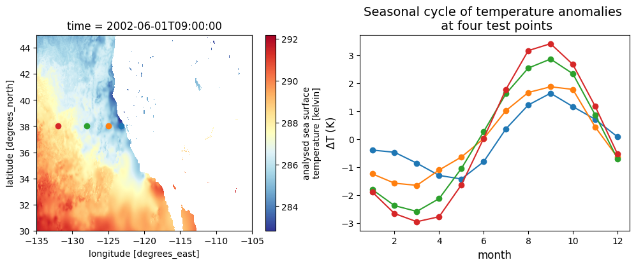
3. Coiled Workflows
Demo: SST seasonal cycle on a Coiled Cluster
MUR 1 km SST seasonal cycle in multiple locations off U.S.A. west coast.
PO.DAAC-hosted, gridded SST data set
MUR 0.01° resolution, daily product: https://podaac.jpl.nasa.gov/dataset/MUR-JPL-L4-GLOB-v4.1
Analysis: Seasonal cycle of SST in region off U.S.A. west coast.
Notes:
Don’t forget to open Coiled Dashboard.

Slide 27
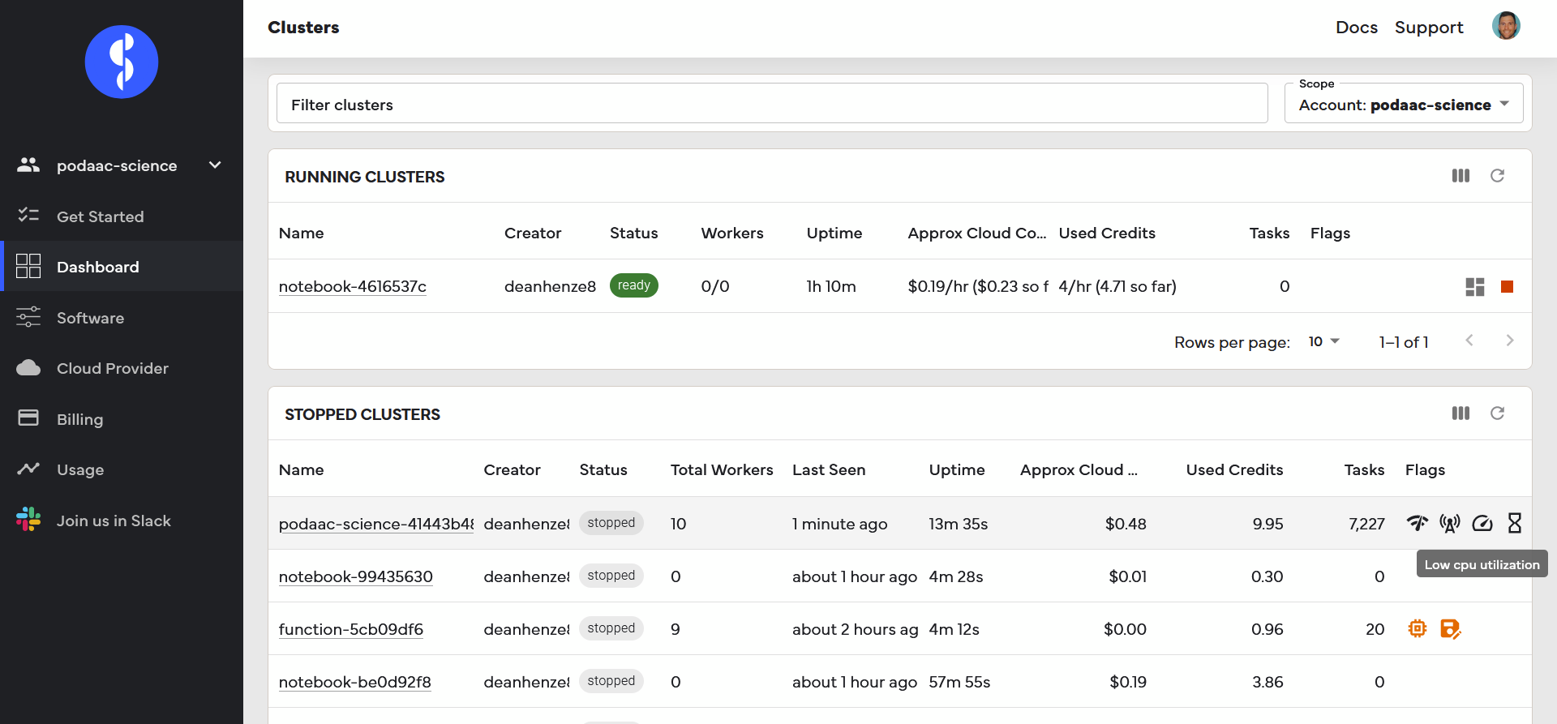
3. Coiled Workflows
Demo: SST seasonal cycle on a Coiled Cluster
Again, Coiled + dashboard made it easier to optimize parallelization - decreased demo time from 3.5 minutes to just over 2 minutes while decreasing costs from $0.35 to $0.18.
Notes:
Nothing extensive, but I was quickly able to see inefficiencies and correct them. Not a big issue for this demo, but easy to see how this would scale for larger computations.

Slide 28
Coiled Cluster
other notes
Easy to scale workers up and down in real time from a Notebook. Makes it easy to play around and test within the Notebook without running up a bill.
Not necessarily the case that Xarray can use a local cluster to parallelize opening multiple data files. This is possible with the distributed cluster spun up with Coiled.
Notes:
Even more notes
So much more data than Coiled Functions demo, but so much less compute time? Probably because Xarray built in functions are optimized to run on Dask clusters? Also the Coiled Functions demo is a burly calc.

Slide 29
Other Points
None of the computations presented here have broken the free tier. If I had broken free tier, the SSH-SST computation (~1,000 CPU hours) would have been ~$50 on top of AWS costs.
Troubleshooting some things regarding scaling an analysis do not go away even with Coiled: memory utilization, worker/VM optimization, proper Python syntax for efficient use with Dask. Coiled does not fix this, but made these tasks much more approachable for my coding/AWS level.
The Coiled team has been proactive about updates to the earthaccess package so that it works with distributed computing (e.g. credentials being passed on to VM’s as needed).
Coiled does not currently work on JPL VPN
Notes:
Even more points
There is minimal syntax that needs to be inserted into existing code to get it working with Coiled. Therefore, no one is ‘locked in’ to Coiled workflows if they choose to try something else.

Slide 30
Conclusions and Future Work
Reiterating: Coiled is not an alternative to AWS, it is a tool to make AWS accessible to those of us that are not highly knowledgeable. For example, I started off with a little parallel computing knowledge, and close to no AWS experience.
Made troubleshooting a doable challenge, rather than a large road block.
A viable way of letting research/science community enter cloud computing world without large knowledge barriers to entry.
Future Work:
EOF analysis
Repeat these analyses on a single, large VM with a local cluster, and compare performance/cost to distributed computing workflows used with Coiled.
Notes:
Even more points
There is minimal syntax that needs to be inserted into existing code to get it working with Coiled. Therefore, no one is ‘locked in’ to Coiled workflows if they choose to try something else.

Slide 31
Extra Slides

Slide 32
Coiled advantages:
If kernel dies, cluster remains, so can restart the kernel then reconnect to the cluster
Dashboard is very handy for cost monitoring and checking if cluster resources are being used. Can also make sure clusters have shutdown easily.
Scaling is easy. Increase cluster size as needed.
Coiled blog post about estimating cost: https://medium.com/coiled-hq/ten-cents-per-terabyte-91ff24363612
An example of scaling up an Earthdata calc using dask+Xarray for 250 TB of soil moisture data: https://medium.com/coiled-hq/processing-a-250-tb-dataset-with-coiled-dask-and-xarray-574370ba5bde
Coiled available on AWS Marketplace: https://aws.amazon.com/marketplace/pp/prodview-mabwpxwtyerxs?utm_campaign=Sarah%20Newsletter&utm_medium=email&_hsmi=278010505&_hsenc=p2ANqtz-_Ks1SUgH_pHG_nH-GJtTZhR9YuF0gO7GPSERSb84df4ucCzpnif09eL5vImxsOxXOSUR32v_nERRmiH0gJZUxQgjbrjv2Sj-xYyYSnm8ZTcdozTtc&utm_content=278010505&utm_source=hs_email
Minimal lock-in. That is, very little coiled-specific syntax goes into these notebooks. So in the hypothetical where NASA doesn’t want to use Coiled anymore, just take your notebooks and code and switch to another service/infrastructure.
Possible errors when using Coiled but more generally dask and the cloud
If kernel unexpectedly dies, could be due to not enough memeory (RAM and/or harddrive?) available on the VM.

Slide 33
workflow
Intro slides
Start up coiled notebook
Talk about Coiled Notebook
Upload and start running SST-SSH correlation notebook on the Coiled Notebook from 2
Talk about Coiled Functions
Upload and start running Coiled Cluster demo on the Coiled Notebook from 2
Talk about Coiled Clusters

Slide 34
Workflows
EC2 Workflow with Distributed Cluster
Xarray + Dask Icons
Direct access to data
Connect to VM in the cloud
(VM can have more compute power than local machine)
Notes:
Get James’ input on this slide, is this correct work flow for multi-node, distributed clusters?
New ways to access/analyze data
Cost considerations

