Slide 1
Graph Rewrite
Stav Roth & Ofek Bengal Shmueli
Project Overview
September 2023

Slide 2
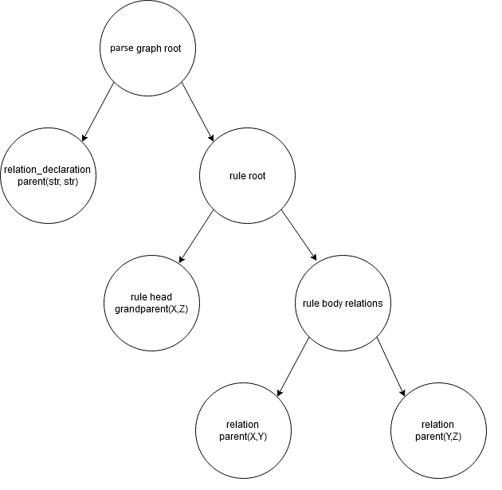
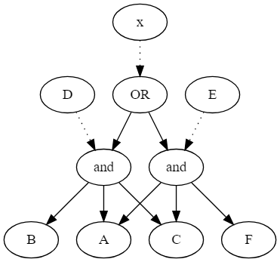
Motivation
Original motivation is allowing a simple, easy way to write compilers for new PLs
As in the Spanner Workbench project
During compilation, we construct internal graphs such as AST
Denote parsing of the code, calculation dependencies, etc.
Furthermore, we run through these graphs, execute code based on them and potentially transform them
For semantic checks, executions, updating an internal state, etc.

Slide 3
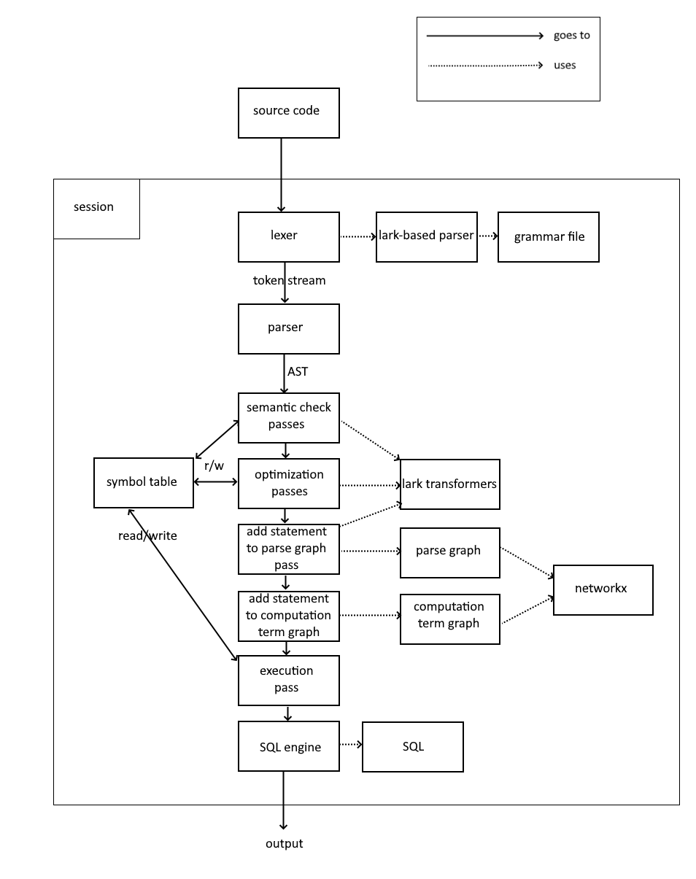
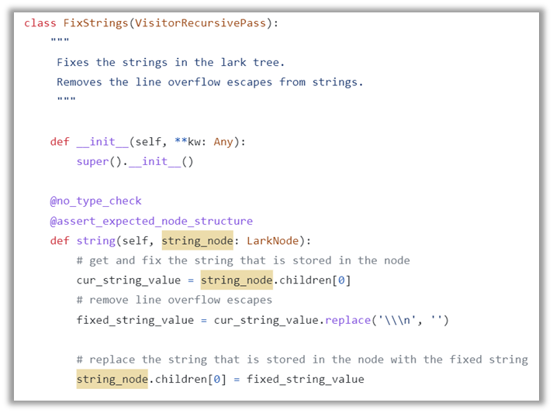
Motivation
We can do all that in a single pass
But that’s impractical when a lot of calculations and transformations need to be done
Otherwise, we can split the process into several small micro-passes, each with a specific goal
Each pass searches for one (or more) patterns in one of the graphs
For every matching subgraph, the micro-pass function is executed over it
In Spanner, micro-passes are implemented as a class with functions corresponding to tokens in the parse tree (Transformer).

Slide 4
Motivation
A micro-pass is therefore defined by the graph it passes through, the pattern in the graph it handles, the transformation done for each matching subgraph, plus some extra imperative code to execute.
We can use this notion to convert each micro-pass into a graph transformation rule, and use some transformation library to implement it
For example, ReGraph.
However, ReGraph allows defining transformation rules imperatively, which is less intuitive to read and write, especially when the rule handles larger patterns with more complex side effects.
It also has some limitations which we’ll discuss in a moment.
Our project’s goal: Designing and developing new graph transformation library with a declarative approach, plus some nice features suitable for most compilation passes.

Slide 5

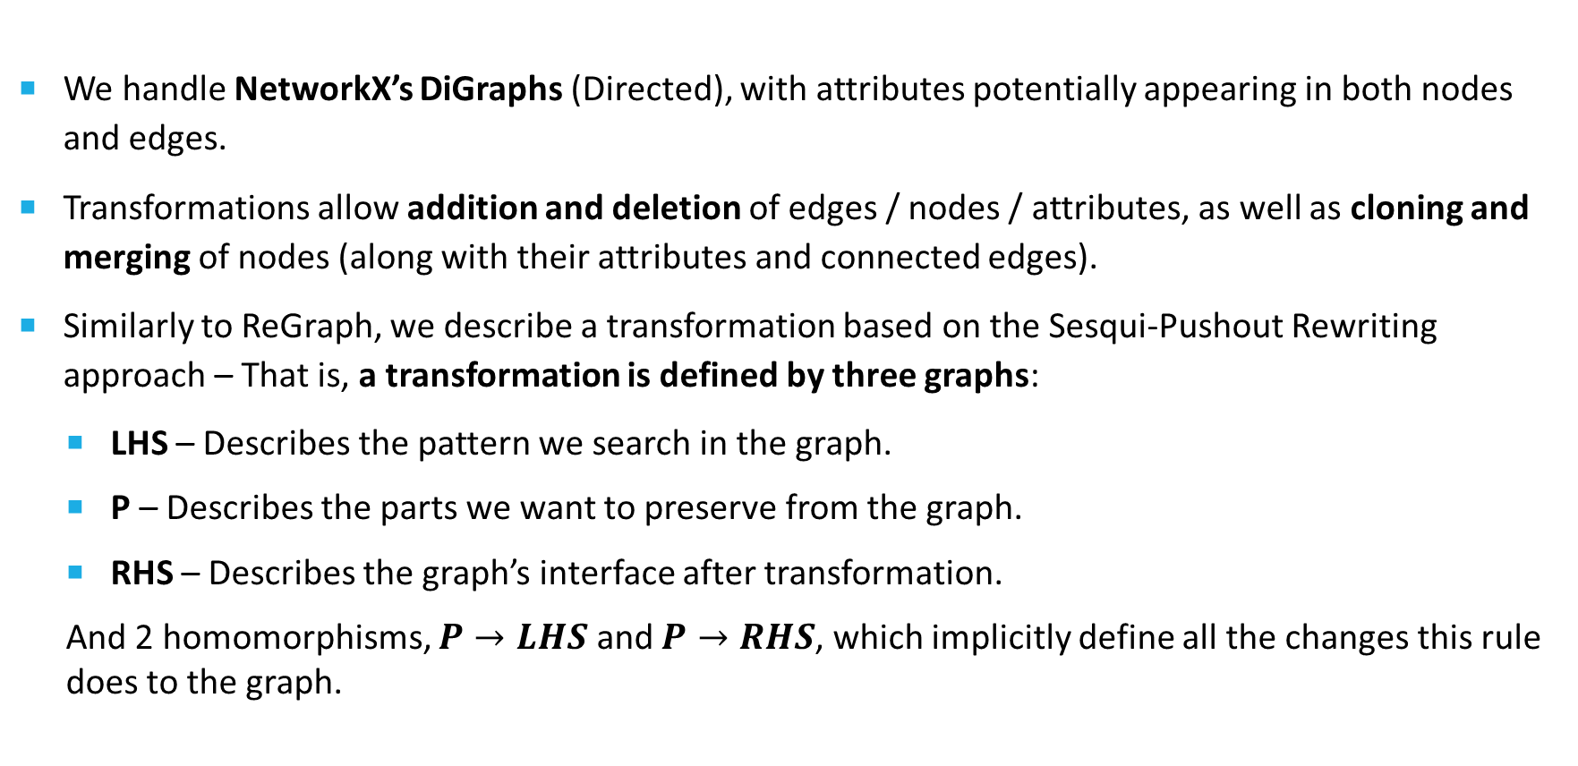
How Do We Define A Transformation?
$$LHS\underset{←}{P→LHS}P\underset{→}{P→RHS}RHS$$
We handle NetworkX’s DiGraphs (Directed), with attributes potentially appearing in both nodes and edges.
Transformations allow addition and deletion of edges / nodes / attributes, as well as cloning and merging of nodes (along with their attributes and connected edges).
Similarly to ReGraph, we describe a transformation based on the Sesqui-Pushout Rewriting approach – That is, a transformation is defined by three graphs:
LHS – Describes the pattern we search in the graph.
P – Describes the parts we want to preserve from the graph.
RHS – Describes the graph’s interface after transformation.
And 2 homomorphisms, $P→LHS$ and $P→RHS$, which implicitly define all the changes this rule does to the graph.

Slide 6
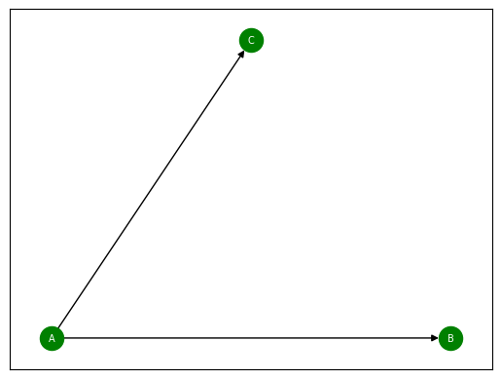
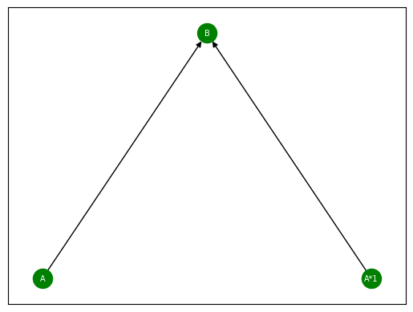
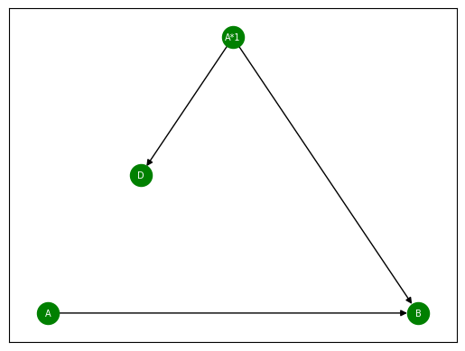

Transformation Rule - Example
$$LHS\underset{←}{P→LHS}P\underset{→}{P→RHS}RHS$$
Say we want to find all subgraphs with 3 nodes, $A,B,C$, and edges $\left(A,B\right), \left(A,C\right)$.
For each subgraph, we want to clone node $A$, remove node $C$, and finally add a new node $D$ as the clone’s child.
$$LHS$$
$$P$$
$$RHS$$
$$P→LHS:\left\{A→A, A∗1→A, B→B\right\} P→RHS:\left\{A→A, B→B, A∗1→A∗1\right\}$$

Slide 7
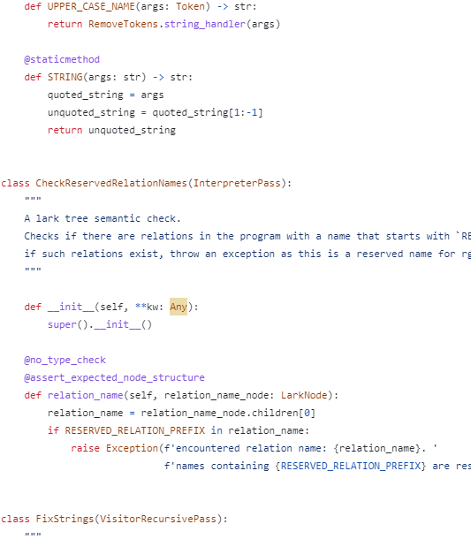
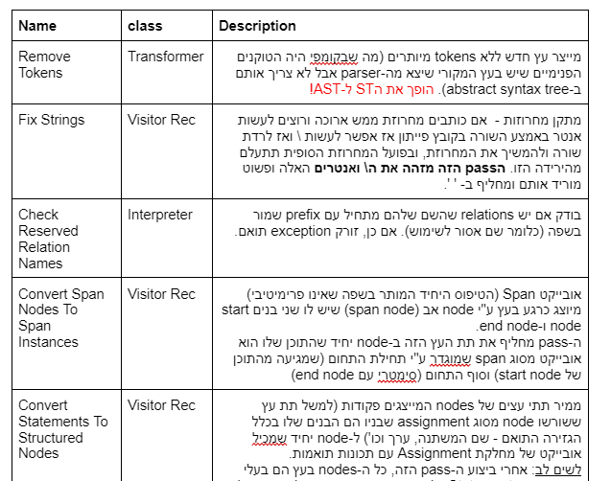
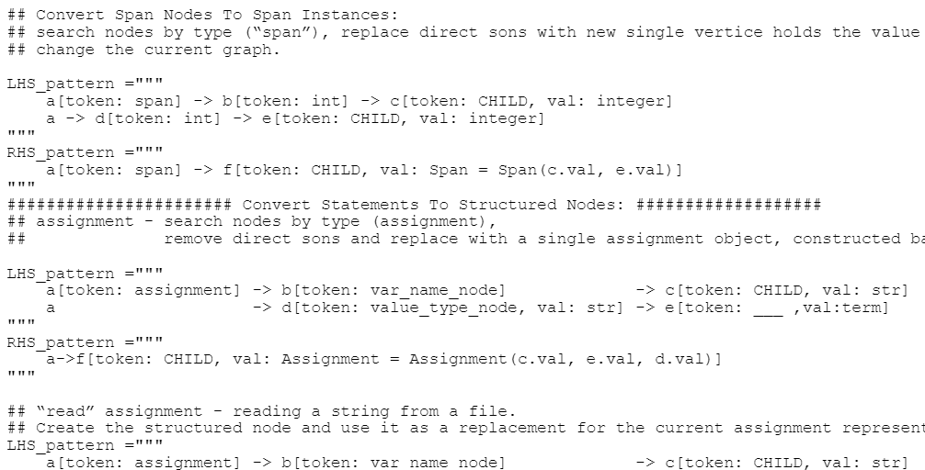
Our Work - Overview
Decided on a subgroup of functions and transformations on graphs which we want to handle
Dived into Spanner’s code and overviewed its micro-passes for inspiration
Designed the declarative syntax of our library so that it matches these needs
Initial POC – Converted RGXLog’s micropasses to transformations using our new syntax

Slide 8
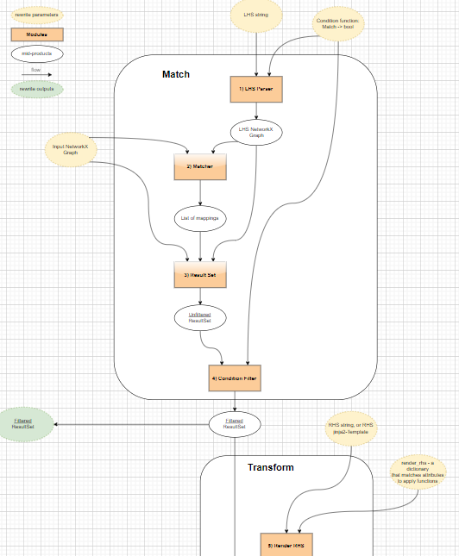
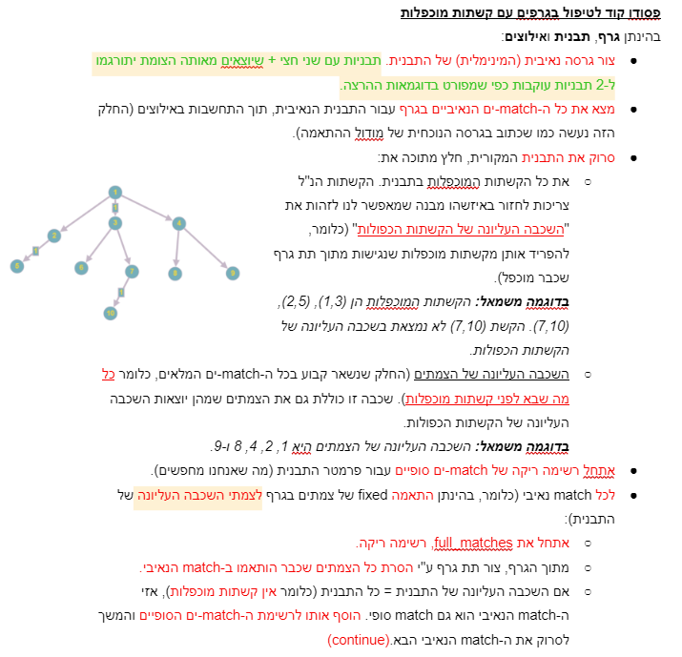
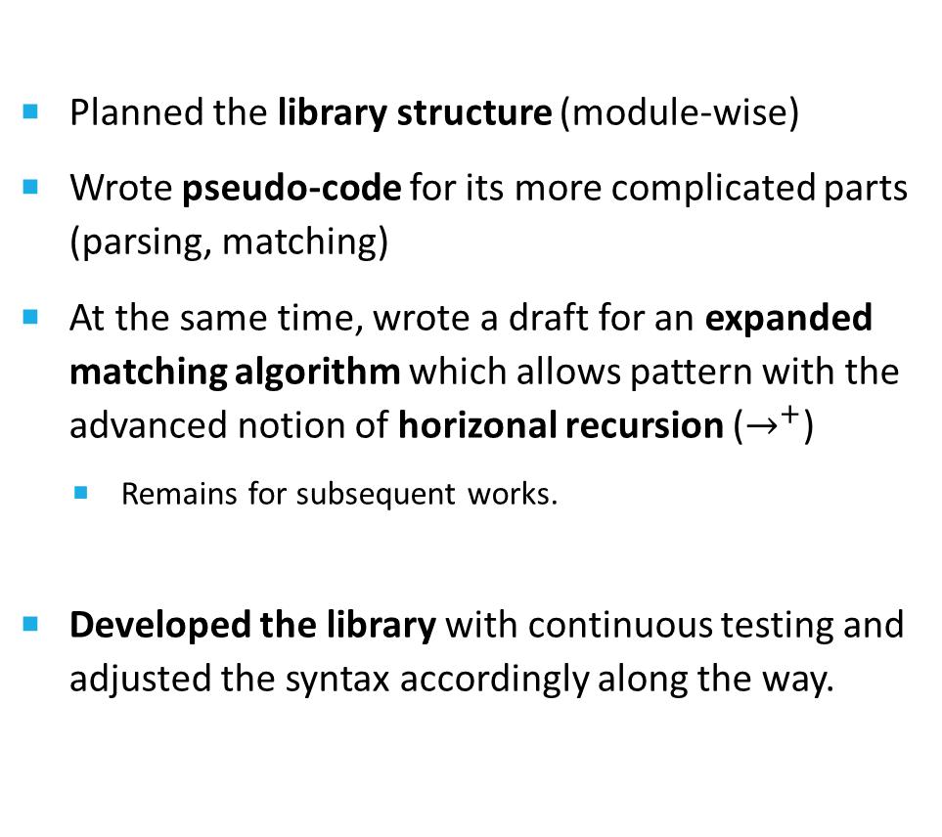
Our Work - Overview
Planned the library structure (module-wise)
Wrote pseudo-code for its more complicated parts (parsing, matching)
At the same time, wrote a draft for an expanded matching algorithm which allows pattern with the advanced notion of horizonal recursion ($→^{+}$)
Remains for subsequent works.
Developed the library with continuous testing and adjusted the syntax accordingly along the way.

Slide 9
Library Structure (In High Level)
The user provides as parameters the graph to transform, and (at most) three strings for LHS, P and RHS, written in our declarative syntax.
The library’s main function, rewrite, does the following:
Parses LHS string to a pattern graph
Searches the input graph for matches according to the pattern graph
For each match:
Parses P and RHS (with potential specifications for this specific match)
Analyzes the combination of parsed LHS, P and RHS to construct a transformation rule
Transforms the graph according to the match and the associated rule
LHS Parser
Matcher
P&RHS Parser
Rules
Transform

Slide 10
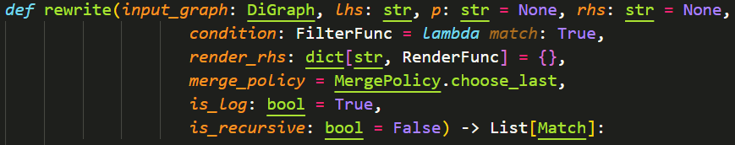
The rewrite function

Slide 11
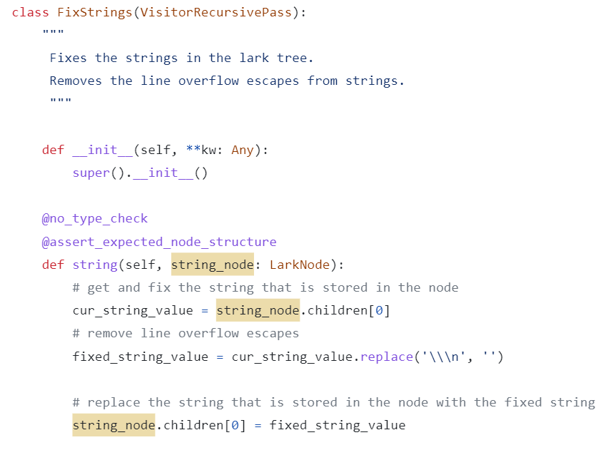
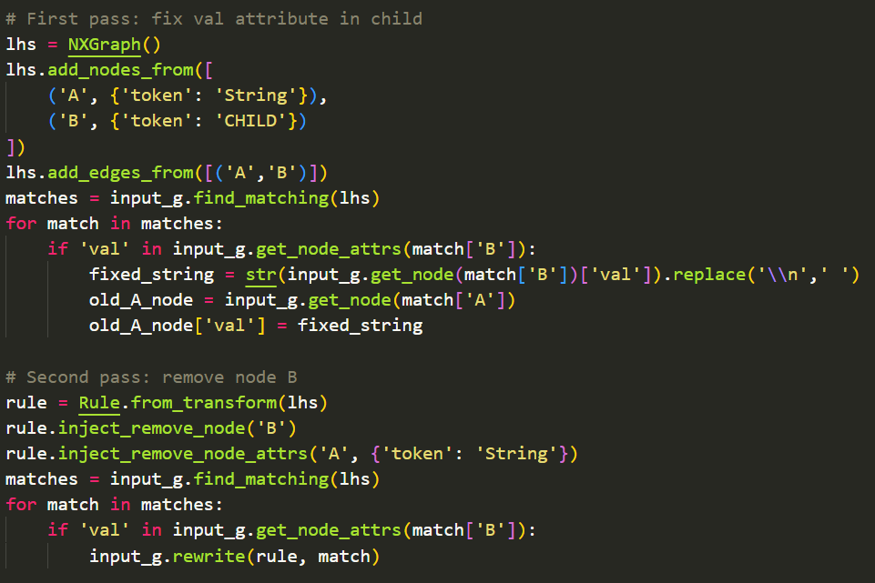
Test Case – Advanced FixStrings
A RGXLog micro-pass, which finds all appearances of string constants in the parse tree and removes the line overflows escapes \n from the strings.
We want to extend it with the functionality of storing the fixed value in the parent, removing the “token” attribute from the parent and removing the child. When implemented with ReGraph:
A
A
A
Token = “String”
Token = “String”
val = “hi you”
val = “hi you”
B
B
Token = “CHILD”
val = “hi\nyou”
Token = “CHILD”
val = “hi\nyou”

Slide 12
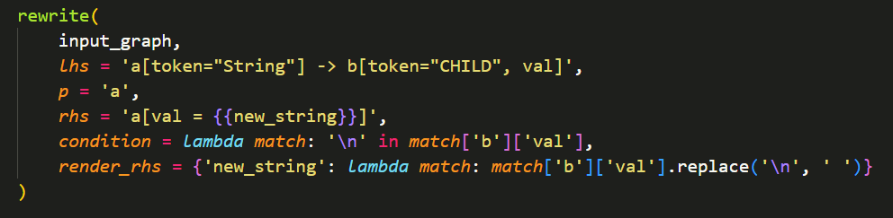
Test Case – Advanced FixStrings
When implemented with Graph Rewrite:
Short and concise!
Does all steps (fix “val”, remove “token” from parent, remove child) in a single match
Filters matches that shouldn’t be fixed with condition, good for performance
No need to iterate matches for assigning each match its own fixed value – render_rhs specifies the correct RHS for each match
A
Token = “String”
B
Token = “CHILD”
Val = “hi\nyou”
A
val = “hi you”

Slide 13

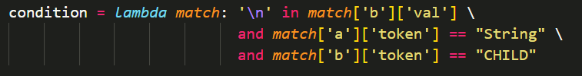
LHS Parser
LHS Parser
Matcher
P&RHS Parser
Rules
Transform
Parses the LHS string into a tree, using Lark grammar
The tree is passed through a transformer, which slowly builds a NetworkX graph accordingly
Constraints on the existence (and connections between) nodes and edges, as well as constraints on the existence of attributes in them, are taken into account while building the pattern graph
Constraint on the values and types of attributes are not included in the graph
Instead, the user-provided condition function is enhanced with extra conditions.
A
Token
B
Token
Val

Slide 14
Matcher
LHS Parser
Matcher
P&RHS Parser
Rules
Transform
Given the LHS graph, searches for matches in the input graph, where a match is
A mapping from pattern nodes to input graph nodes, which denote an input subgraph
The subgraph has the same structure (isomorphic) as the pattern
Each node in the pattern has exactly a single corresponding node in the matched subgraph, all pattern node attributes exist in its corresponding input node
The condition function, composed of user-defined condition and LHS Parser-generated constraints, holds for the match
In order to find matches, the matcher goes through all combinations of input-graph nodes and edges of the same size as the pattern
Optimization: First filters all input-graph nodes and edges which do not match the attribute of any element in the pattern
Significant improvement to runtime in large graphs!

Slide 15
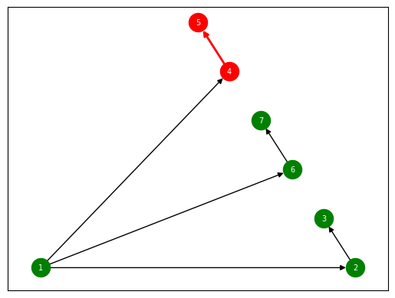
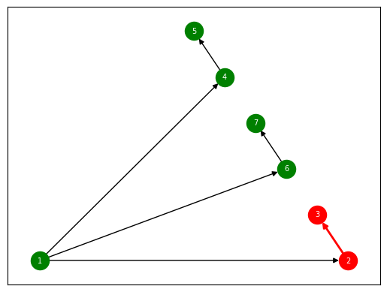
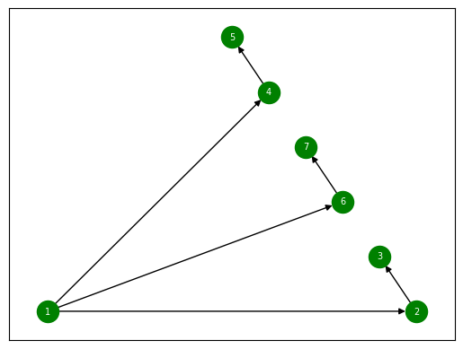
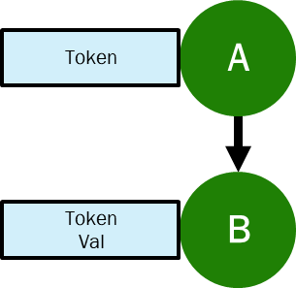
Matcher
LHS Parser
Matcher
P&RHS Parser
Rules
Transform
For example, if input graph as follows, with the attributes:
1 = {}
2 = {‘token’: ‘String’}
3 = {‘token’: ‘CHILD’, ‘val’: ‘a\nstring.’}
4 = {‘token’: ‘String’}
5 = {‘token’: ‘CHILD’, ‘val’: ‘another\nstring.’}
6 = {‘token’: ‘String’}
7 = {‘token’: ‘CHILD’, ‘val’: ‘regular string.’}

Slide 16


P & RHS Parser
LHS Parser
Matcher
P&RHS Parser
Rules
Transform
Parses P, equivalently to the LHS parsing (with minor grammar changes).
When specifying the RHS string, the user can leave placeholders to be filled by some predefined function which produces different results based on the current match.
Thus, we can specify different values for attributes of different matches – The module parses RHS and renders it for each match separately.
In our example:
E.g., the match with ‘a\nstring’ will have the following RHS after the rendering:

Slide 17
Rules
LHS Parser
Matcher
P&RHS Parser
Rules
Transform
We now have our LHS, P and RHS as NetworkX graphs.
Time to make sense out of their combination!
This module analyzes the three graphs and deduces what the transformation rule actually does, for example:
Which nodes should be added / removed?
Do we have clones? Which node is cloned by which node?
Same for merges
Is the rule even valid?
It does so by deducing from these graphs what are the homomorphisms from P to LHS and from P to RHS. These homomorphism provide us all the information we need.

Slide 18
Rules
LHS Parser
Matcher
P&RHS Parser
Rules
Transform
Intuitively:
LHS specifies the pattern.
Elements (nodes, edges, attributes) that appear in LHS but not in P are not preserved – Removed.
Nodes in P whose name is “<name>*<number>” are clones of an LHS node called <name>.
Elements that appear in RHS but not in P are added to the graph.
Nodes in RHS whose name is “<name>&…&<name>” are merges of P nodes with these names.
Everything else remains untouched in the graph.
In Homomorphism terms:
A node in LHS that isn’t mapped by any node in P is deleted.
A node in LHS that is mapped by some node in P, preserves it in P (if there are more than one – clone).
A node in RHS that isn’t mapped by any node in P is added.
A node in RHS that is mapped by some node in P, preserves it in RHS (if there are more than one – merge).

Slide 19
Rules
LHS Parser
Matcher
P&RHS Parser
Rules
Transform
For example:
From LHS, we only preserve the node A (without its attribute “token”).
In RHS, we add to A an attribute called “val”, whose value is a placeholder {{new_string}} that is filled by the RHS parser as we saw earlier.

Slide 20
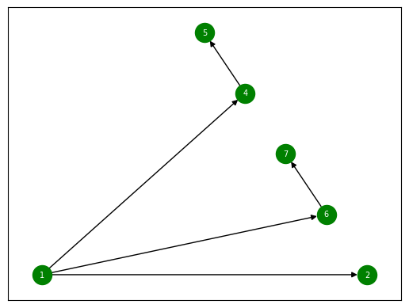
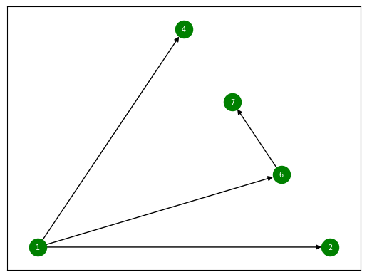
Transform
LHS Parser
Matcher
P&RHS Parser
Rules
Transform
Now that we know what the rule should do, the only thing left is to actually do it.
Using several auxiliary functions which operate on NetworkX graphs – add, remove, clone, merge for all elements – we follow the operations the rule specified and transform our graph.
1 = {}
2 = {‘val’: ‘a string’}
4 = {‘token’: ‘String’}
5 = {‘token’: ‘CHILD’, ‘val’: ‘another\nstring.’}
6 = {‘token’: ‘String’}
7 = {‘token’: ‘CHILD’, ‘val’: ‘regular string.’}
1 = {}
2 = {‘token’: ‘String’}
3 = {‘token’: ‘CHILD’, ‘val’: ‘a\nstring.’}
4 = {‘token’: ‘String’}
5 = {‘token’: ‘CHILD’, ‘val’: ‘another\nstring.’}
6 = {‘token’: ‘String’}
7 = {‘token’: ‘CHILD’, ‘val’: ‘regular string.’}
1 = {}
2 = {‘val’: ‘a string’}
4 = {‘val’, ‘another string’}
6 = {‘token’: ‘String’}
7 = {‘token’: ‘CHILD’, ‘val’: ‘regular string.’}

Slide 21
Transform
LHS Parser
Matcher
P&RHS Parser
Rules
Transform
This module presents some edge cases, which we can handle by passing special paramteres to the rewrite function:
Assume we merge two nodes which share an attribute, but each node has a different value for it. What should be the value of this attribute in the merged node?
A parameter called merge_policy provides two built-in decision policies to solve this ambiguity.
Different matches might overlap. Therefore, it is possible that by the time we handle some match, some of its nodes were removed when transforming the pervious one.
A boolean parameter is_recursive allows the user to search for the updated list of matches before each iteration of transforming. It will be costly, but it will solve this edge case.
Generally, Major parts of the rewrite function are implemented lazily, and so a transformation occurs only when the user asks for it.

Slide 22
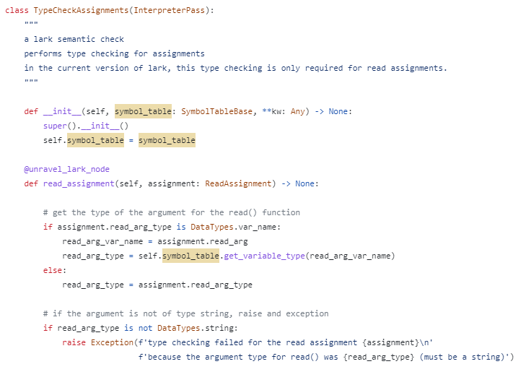
Imperative Side Effects
Consider the “TypeCheckAssignments” micro-pass from RGXLog.
Unlike the previous example, we do not change the graph at all – only find patterns and then perform some imperative calculation (here, type checking).
Therefore, we want our library to allow finding matches in the graph and then use the results to execute imperative code on the input graph.

Slide 23
The Match Class
Our library defines the Match class, that denotes a single match found in an input graph.
This class provides a subview to the input graph, that’s limited by the input nodes we’ve matched to our pattern node in a single match.
The subview is set such that R/W operations on the input graph can be done on nodes and edges imperatively, based on their symbolic (pattern) name rather than their actual input-graph name.
Right after a match is found by the Matcher, it is converted to an instance of the Match class which is passed to the next modules. When rewrite ends, it returns this Match instance to the user.
We’ve already seen it, in the condition, render_rhs parameters:
LHS Parser
Matcher
P&RHS Parser
Rules
Transform
Convert to Match Class

Slide 24
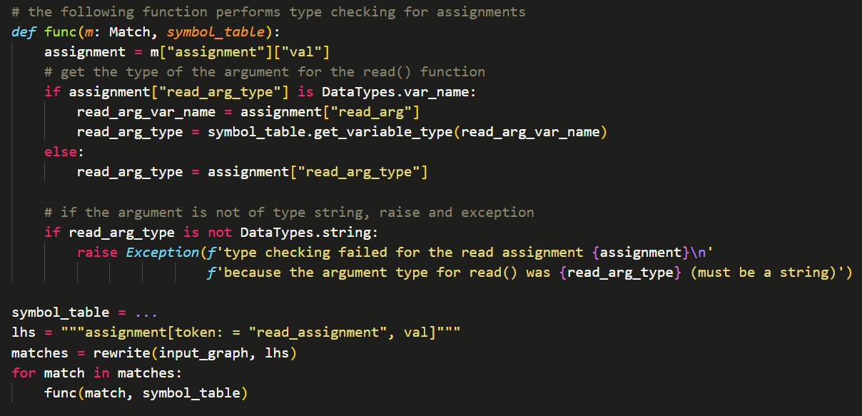
Imperative Side Effects with Match
Therefore, our implementation for this micro-pass will look something like this:

Slide 25
Thank You!

