Slide 1
EEECS Pathfinder
BY $GitSomeCache

Slide 2
PROBLEM ANALYSIS
Problem - Students studying EEECS courses at Queen’s are unsure of what modules to choose and what career path they want to pursue.
How it’s currently addressed - Students have to sort through a long document at the start of the year which contains all modules of EEECS for all years & courses. This makes it very hard to find what modules you want to do and the prerequisites for it.
Why the problem is important - It directly affects EEECS students and their future adult working life. This chatbot will help them in making sure they pick the right modules for their career path.
Solution - EEECS Pathfinder will be able to help students choose their modules based on previous module choices, grades, interests and career path.

Slide 3
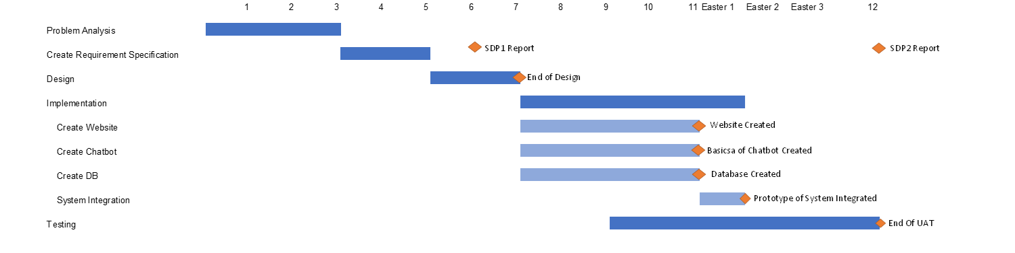
ROADMAP

Slide 4





TECHNOLOGY CHOICES
Project Management - Jira
Programming Language - Python 3.7.9
Version Control - GitHub
Server Design - Docker
Chatbot technology - ChatterBot, spaCy
(language model for chatterbot)
Database - SQLite
Framework - Django

Slide 5
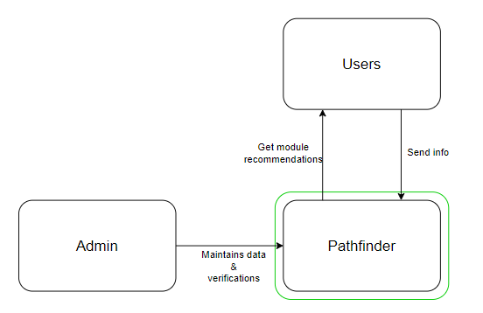
SOFTWARE ARCHITECTURE
Level 1: System Context diagram

Slide 6
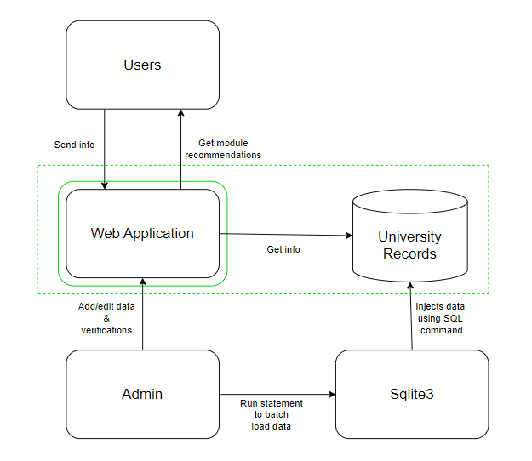
SOFTWARE ARCHITECTURE
Level 2: Container diagram

Slide 7
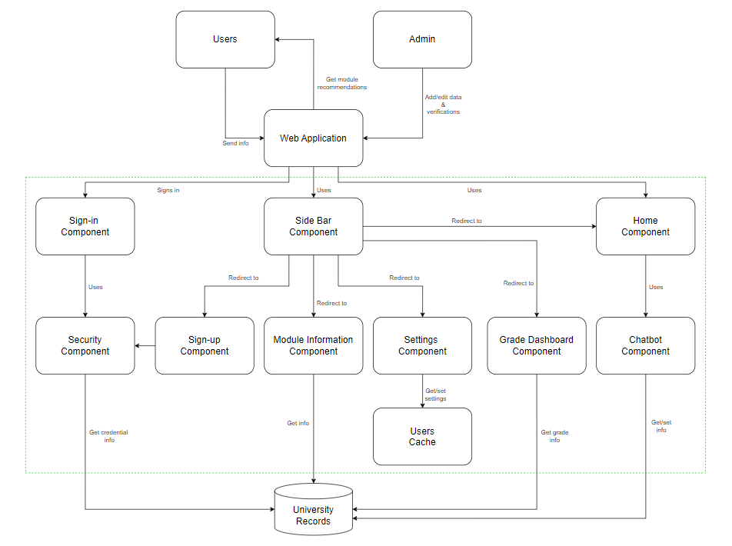
SOFTWARE ARCHITECTURE
Level 3: Component diagram

Slide 8
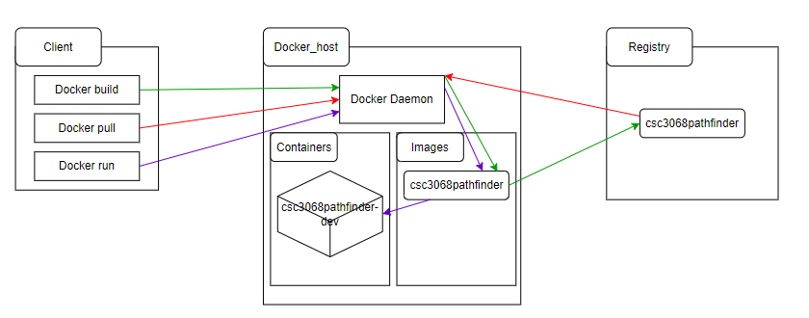
SOFTWARE ARCHITECTURE
Docker layout

Slide 9
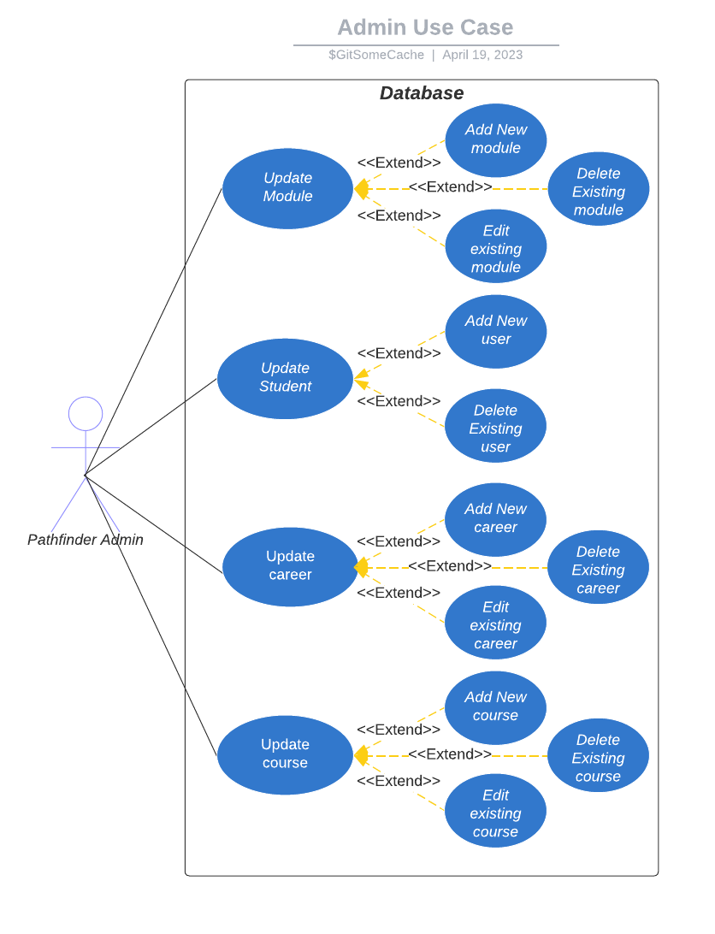
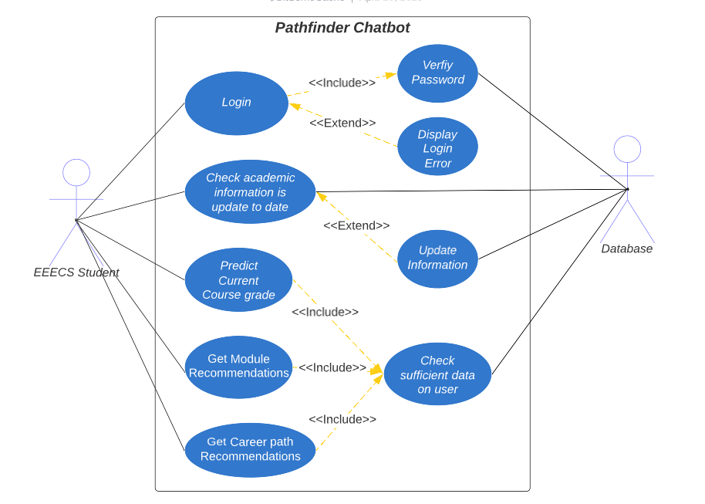
USE CASES

Slide 10
Key Sequence Diagrams

Slide 11
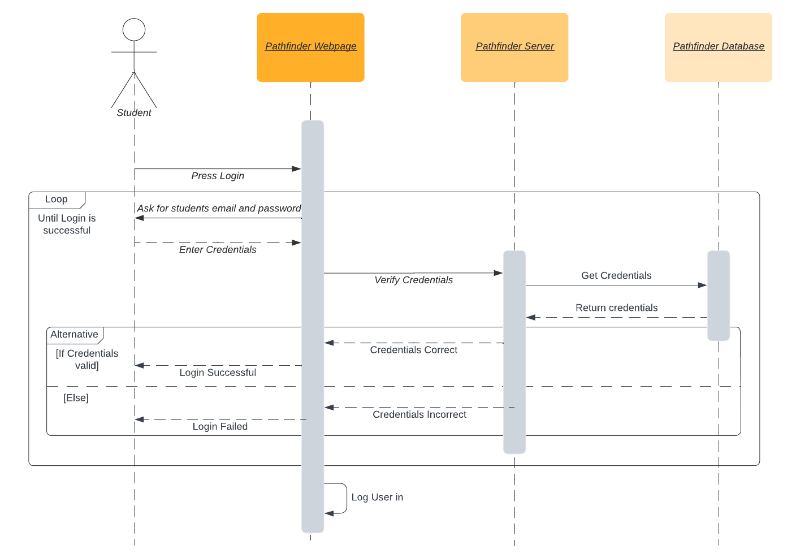
STUDENT LOGIN

Slide 12
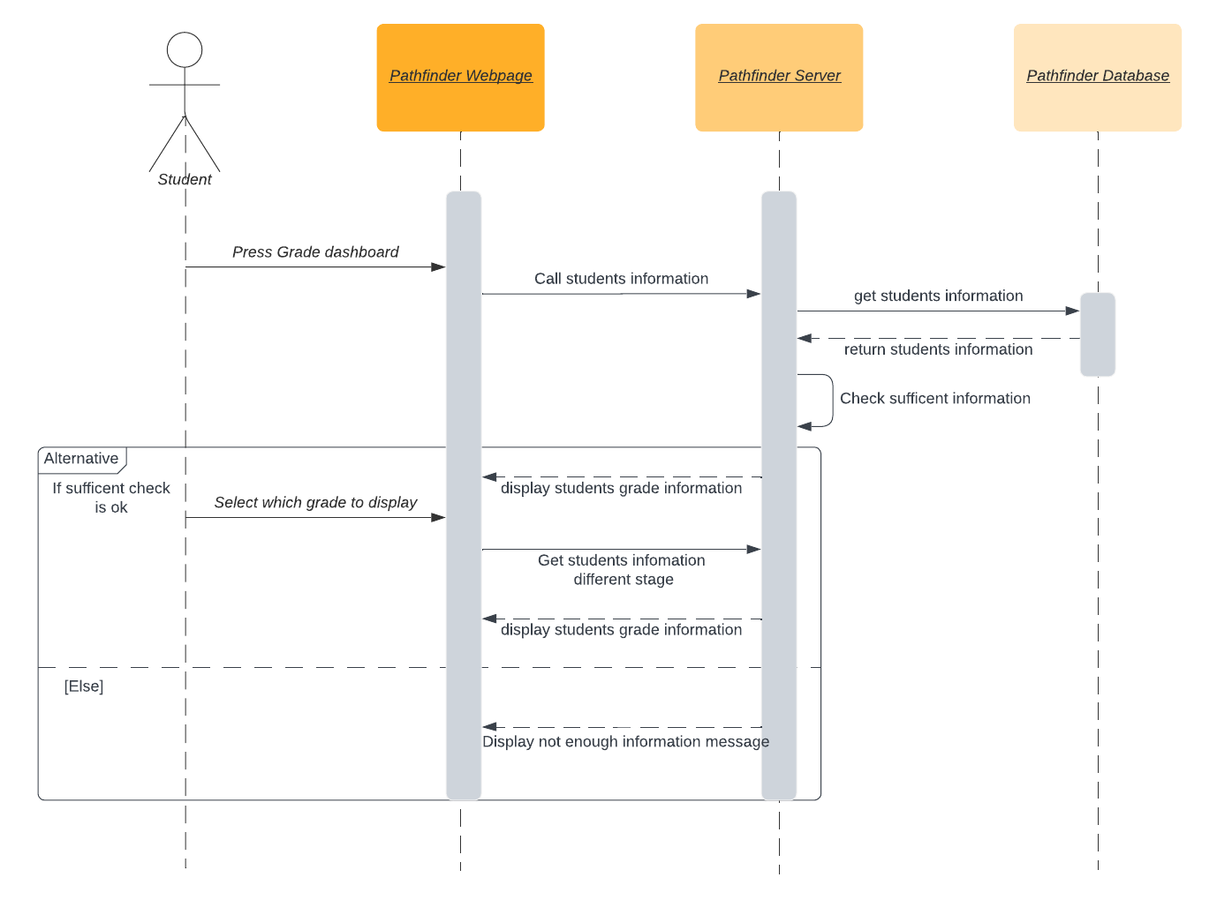
GET COURSE STATS

Slide 13
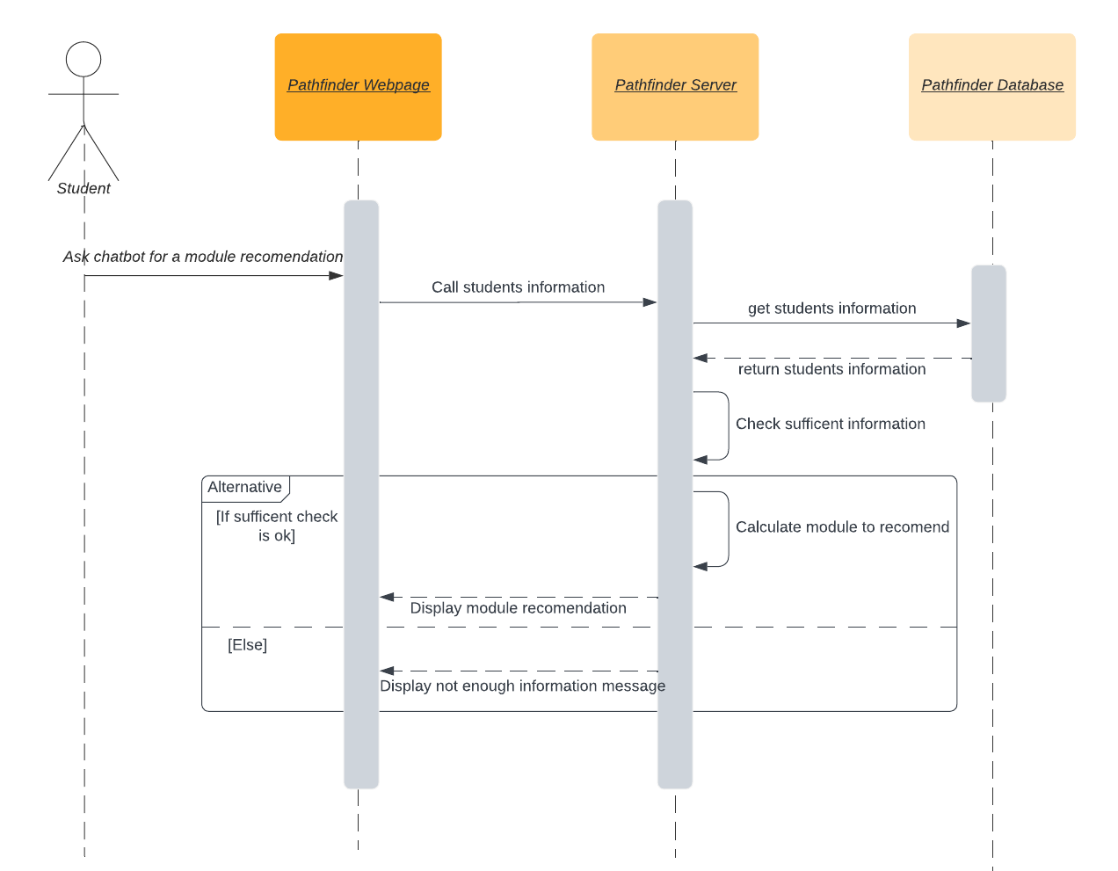
MODULE RECOMMENDATIONS

Slide 14
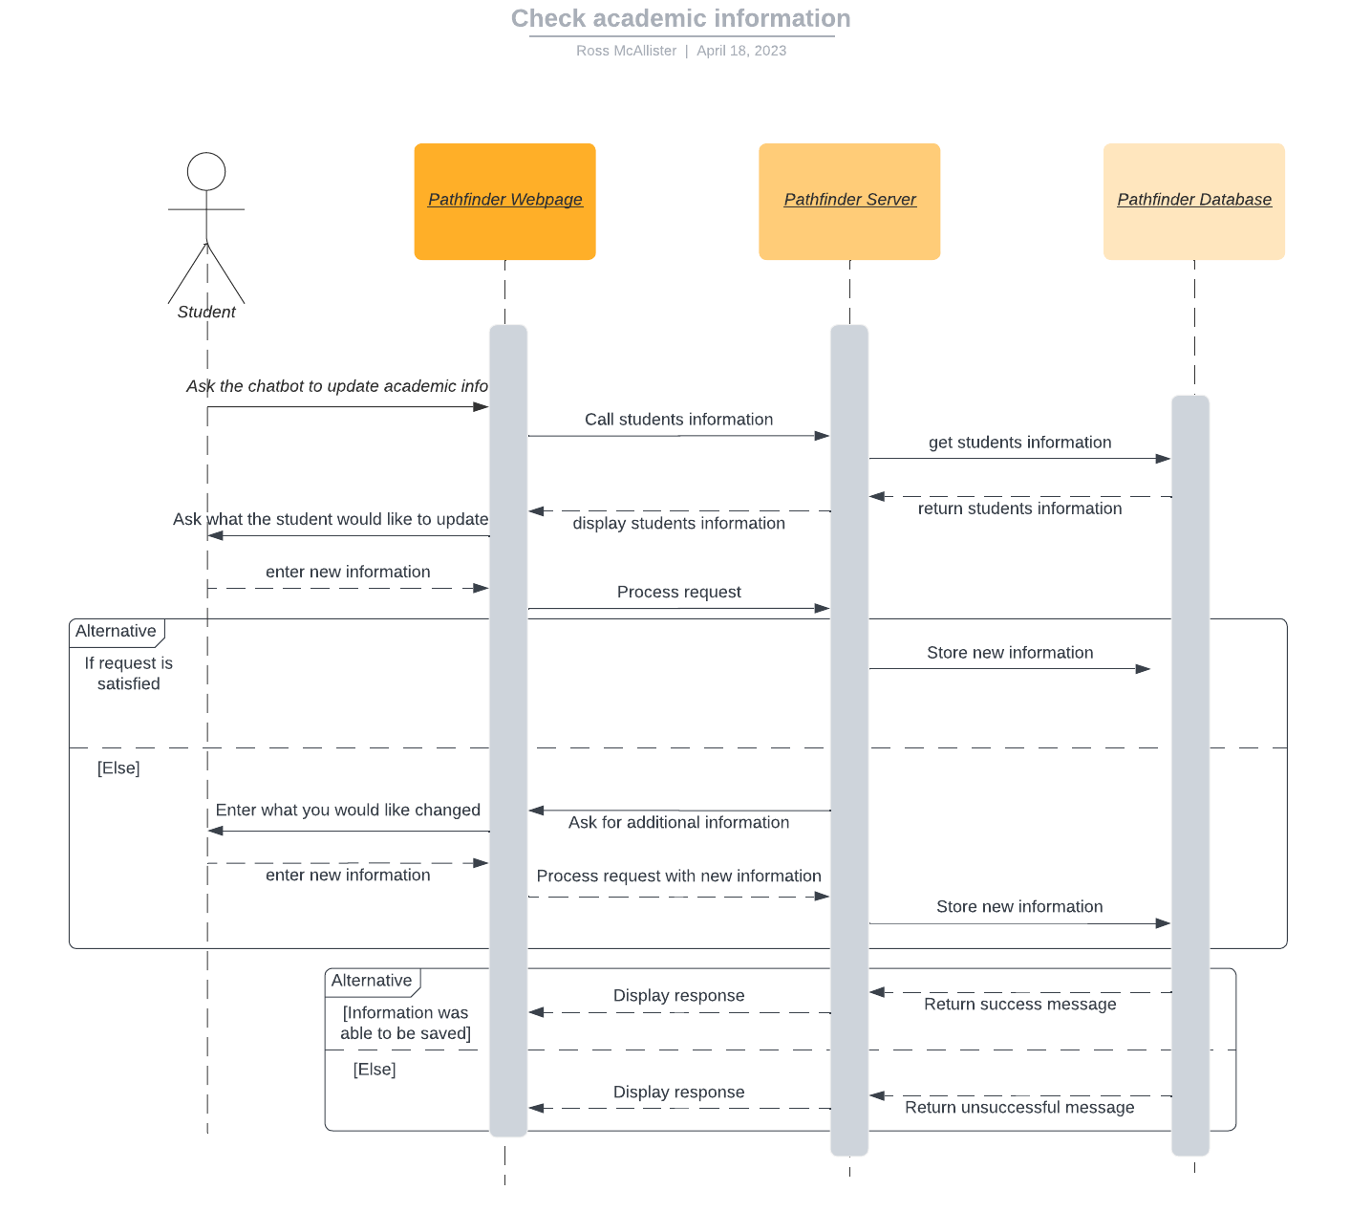
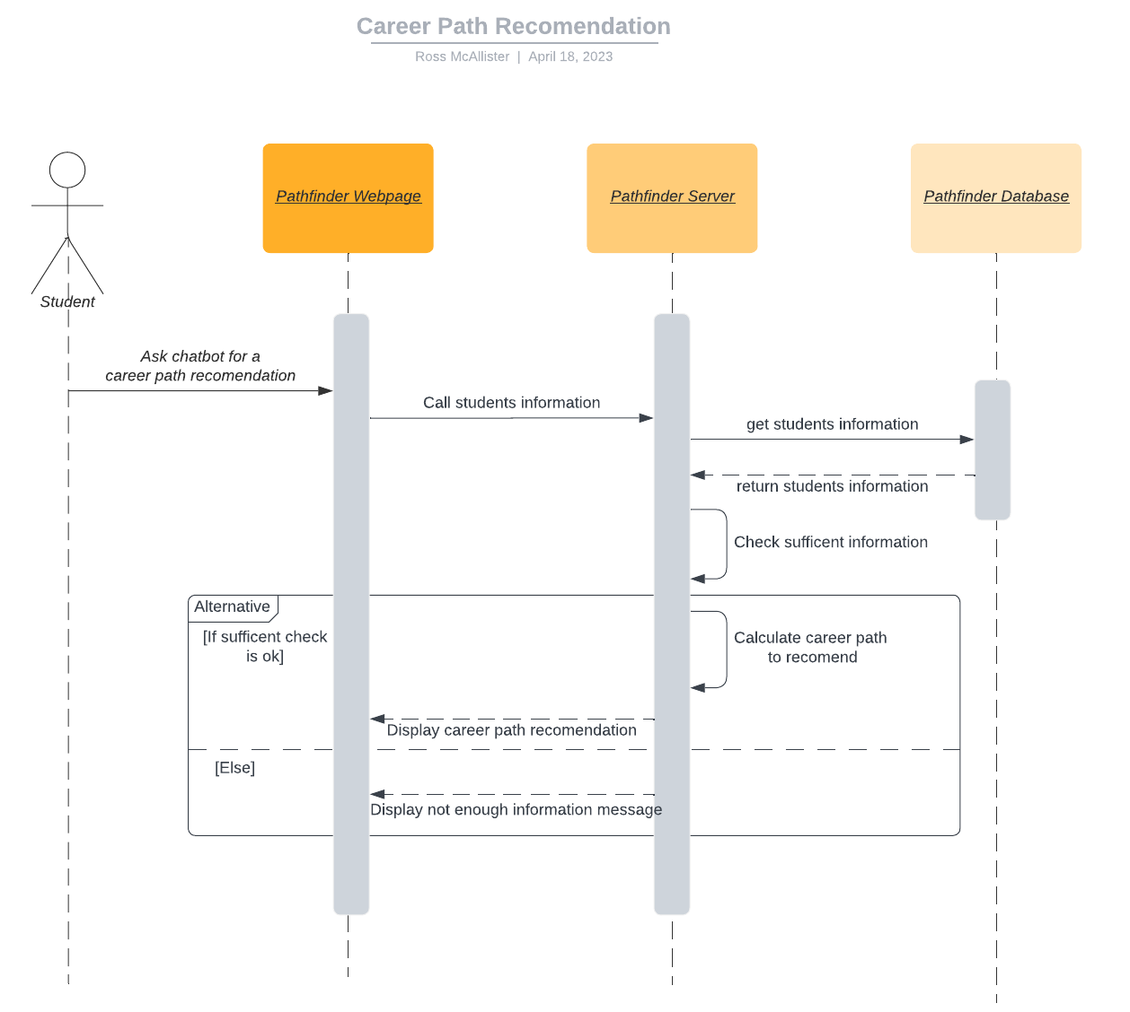
CHECK ACADEMIC INFORMATION AND CAREER PATH RECOMMENDATION

Slide 15
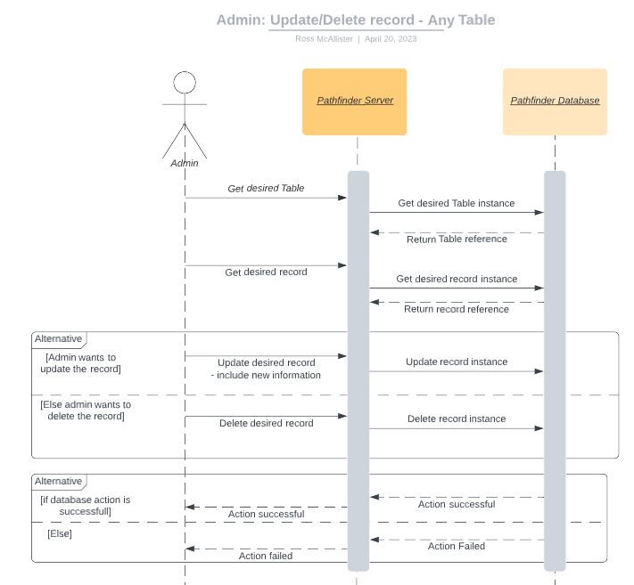
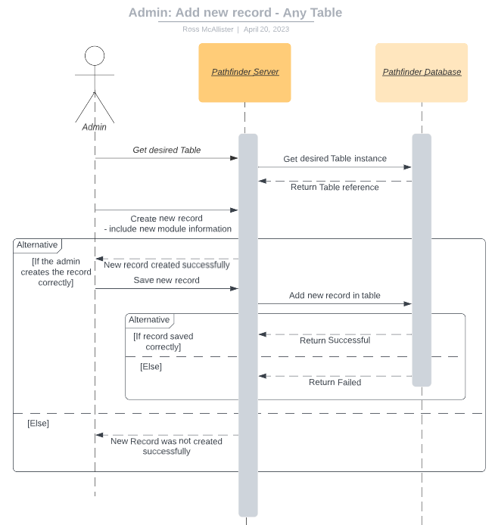
ADMIN: ANY TABLE
Command Line:
Command Line:

Slide 16
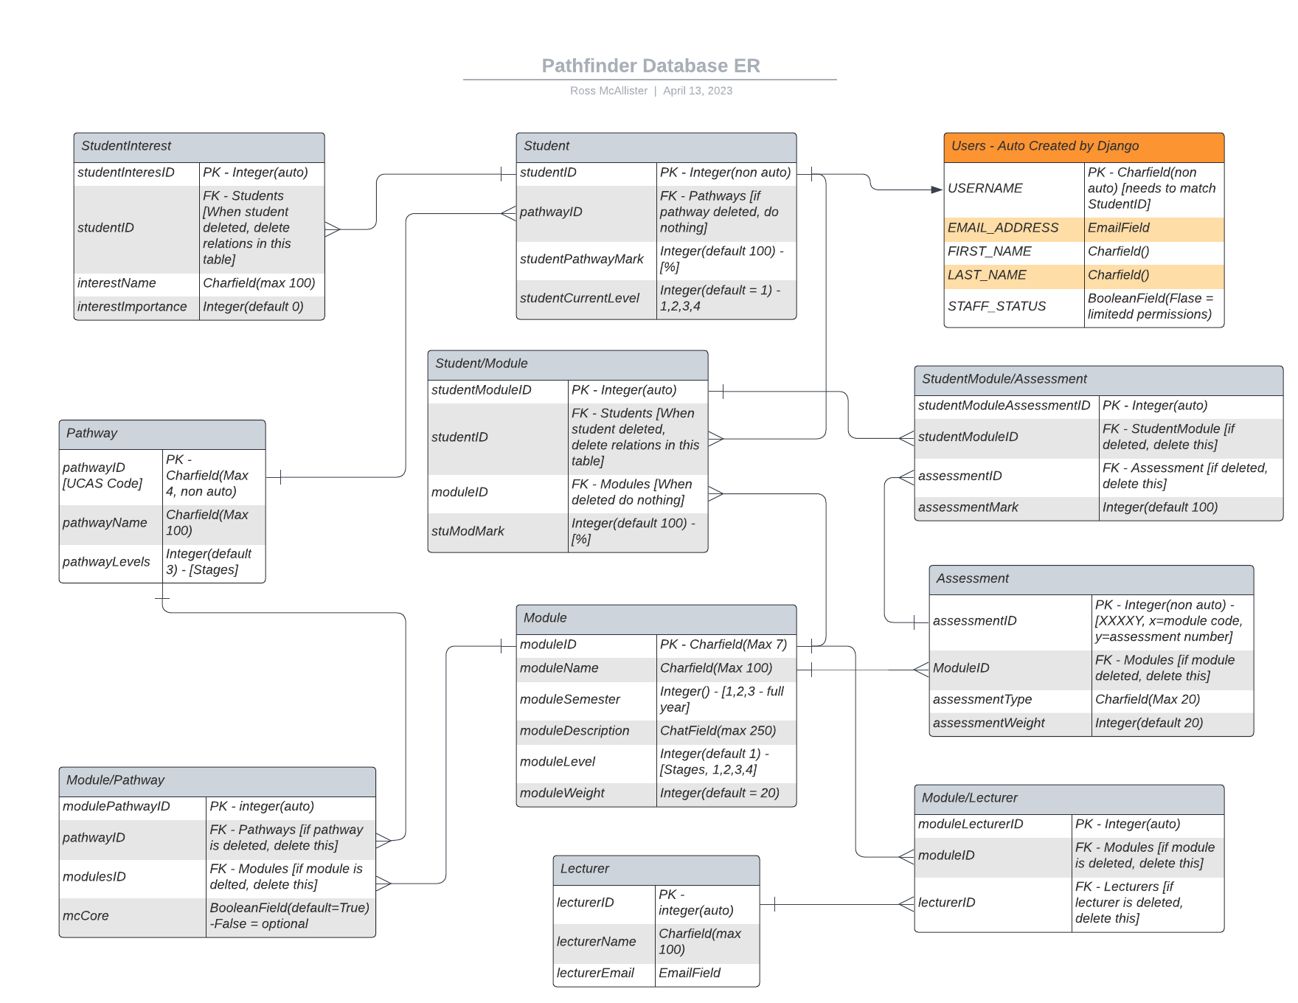
ER DIAGRAM

Slide 17
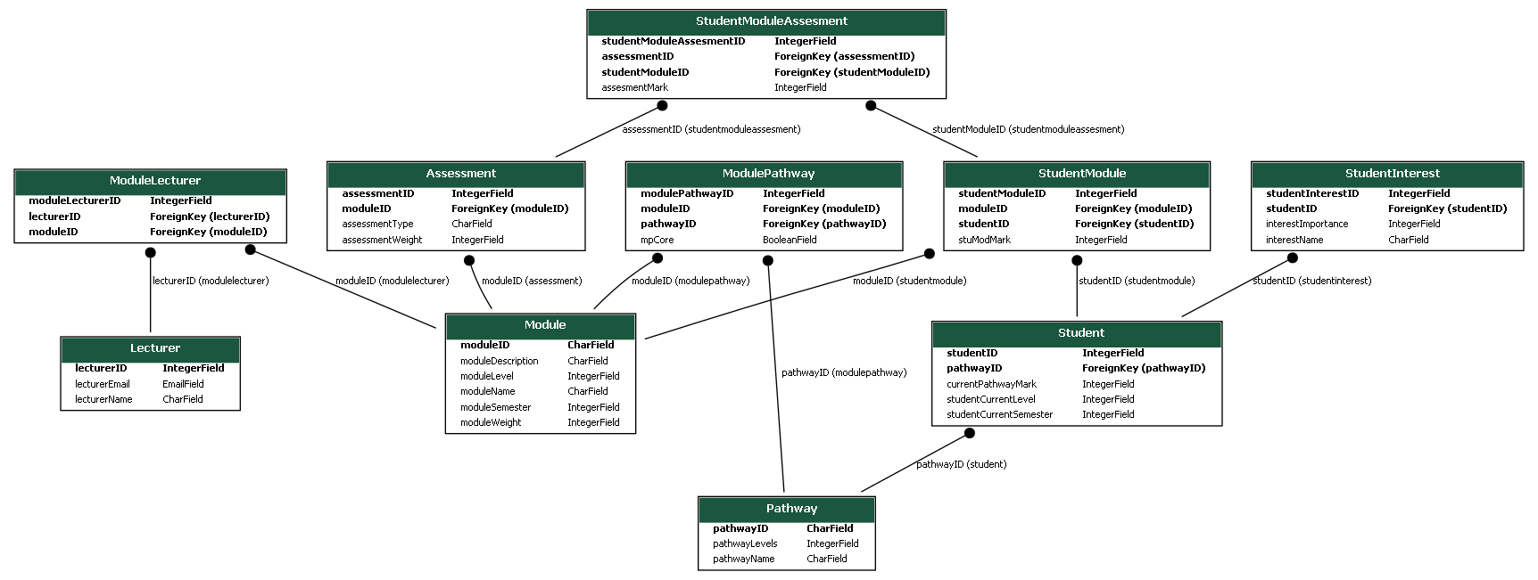
DATABASE CLASS DIAGRAM (ORM)

Slide 18
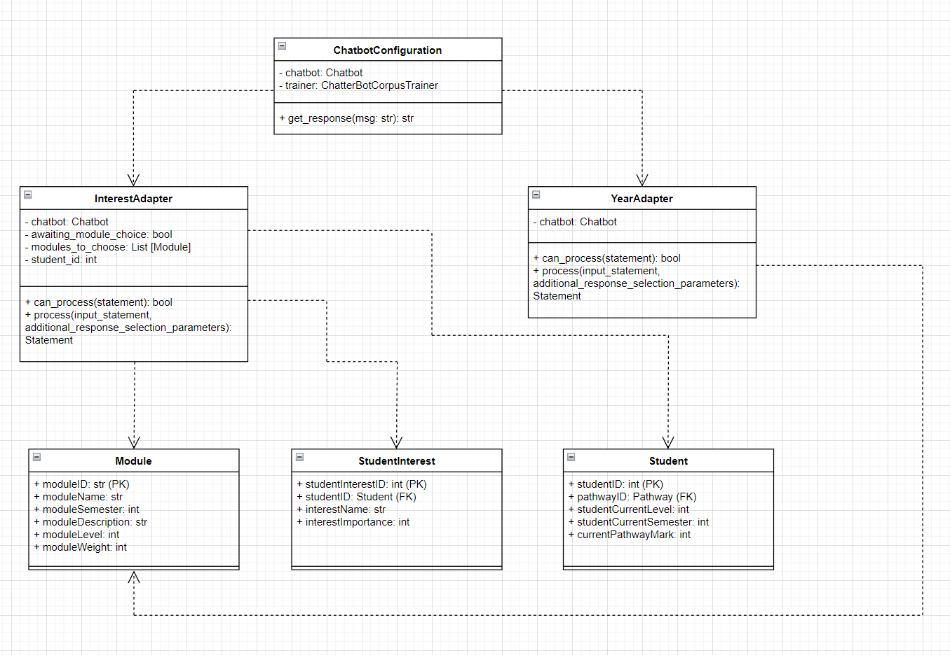
CLASS DIAGRAM

Slide 19
DEMO

Slide 20
Q&A

