Slide 1





PATHFINDER
CSC3069 - $GitSomeCache
MONDAY JANUARY 9th 2023

Slide 2
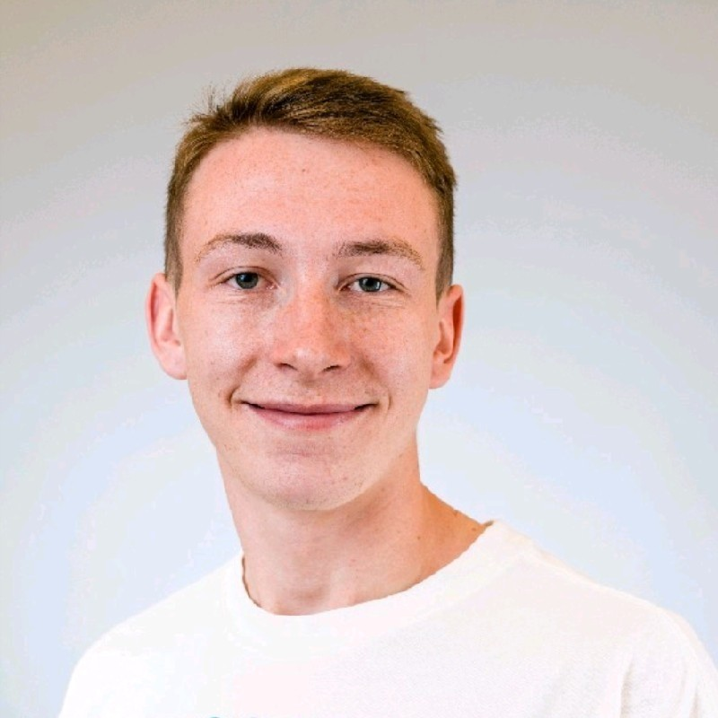



Our Team
Conor Nugent
Email:
cnugent23@qub.ac.uk
Student Number: 40296257
Ross McAllister
Email: rmcallister17@qub.ac.uk
Student Number: 40291577
Dean Logan
Email: deanlogan10@qub.ac.uk
Student Number: 40294254
Kyle McComb
Email: kmccomb11@qub.ac.uk
Student Number: 40295231

Slide 3
Overview of the Problem and why it's important
The discipline of Electronics, Electrical Engineering and Computer Science (EEECS) is vast, diverse, and always evolving. As a result, it encompasses many sub-disciples such as; Artificial Intelligence, Computer Networks, Cyber Security, Embedded Systems and so forth. A key challenge faced by students is making informed decisions about module selection and what career path they want to pursue due to the vast avenues that The School of Electronics, Electrical Engineering and Computer Science at Queen’s University Belfast offers.
The importance of the problem :
The modules that a student chooses can have a drastic impact on their academic and career goals. Therefore, it is important for students to be equipped with all the knowledge they can.
Some modules contain pre-requisties, therefore it’s important that the student is aware of this and can plan what modules they need to take accordingly.
Prospective students want to know if their interests align with the potential modules/pathways they
want to choose.

Slide 4
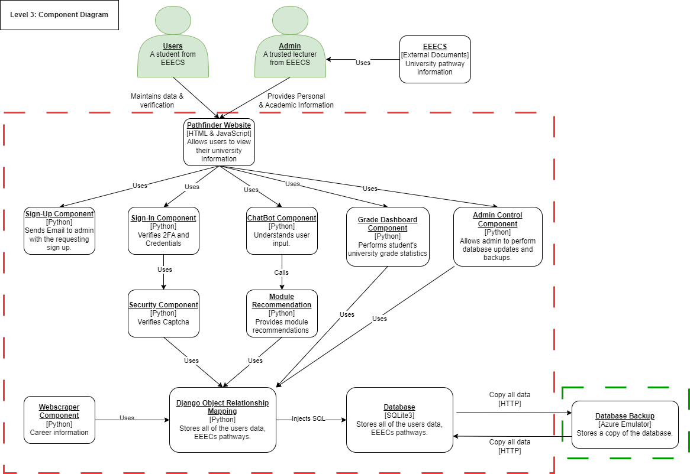
Overview of the solution
Pathfinder, a novel system developed by the team was designed to address this problem in CSC3068/CSC3069 by providing detailed module recommendations and career guidance based off the interests of EEECS students through a central chatbot. Distinctive features of the Pathfinder system include the following;
The central chatbot
Web-scraping spider
Grade Dashboard
Admin Interface
Login/Signup Page
2FA/TOTP
Database backup

Slide 5
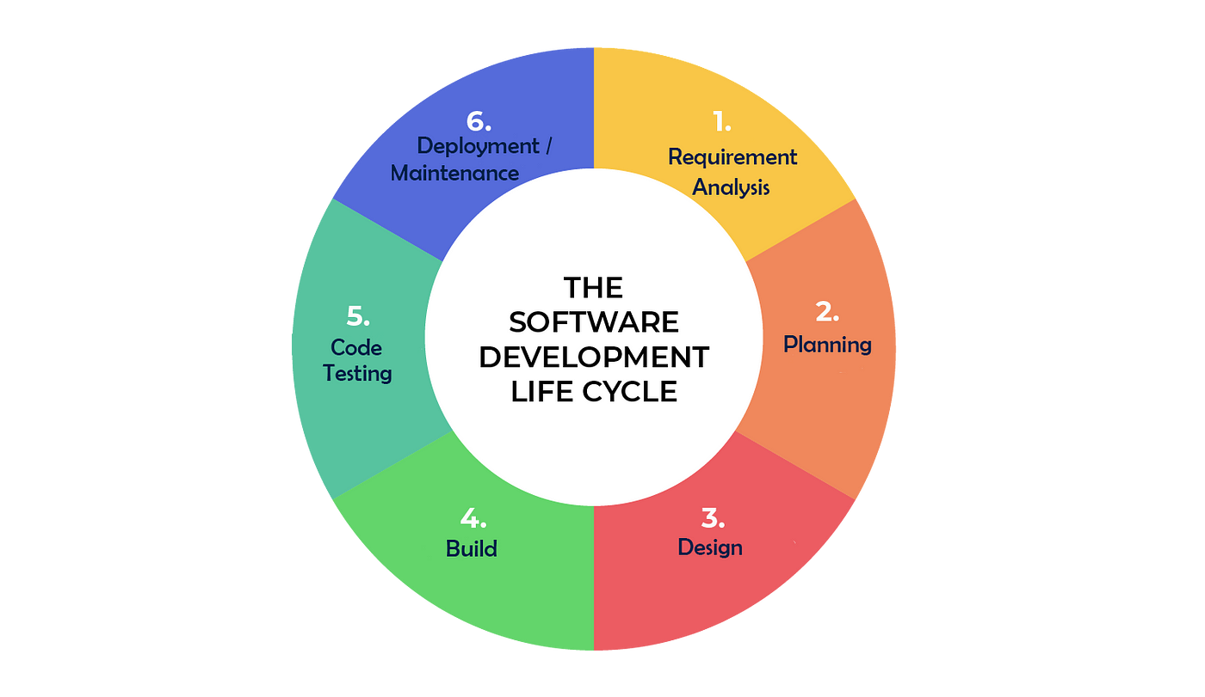
Overview of the process followed
For this project, the team followed the SDLC Model which included:
Requirement Analysis
Planning
Design
Developing the application
Testing
Deployment/Maintenance

Slide 6
Challenges Encountered
Web Scraping – Anti-bot protections.
Dealing with limited amount of sample data from the Chatbot when training the chatbot.
Limited library for backups
Categorising the web-scraping data and making it readable for the chatbot.
Re-design for mobile (UI) – didn’t use a framework
Chatbot library limitations - Chatterbot

Slide 7
Possible future directions for the project
Host database in a separate microservice for enhanced security and scalability e.g. Google Firestore/Firebase or Microsoft Azure.
Roll out the project to all university subjects, not just for EEECS. Allowing it to benefit all students at Queen’s University Belfast
Incorporate this into the Queen’s website via a designated portal. Link it with QSIS to better integrate with the university’s current system. Lecturer’s enter grades instead of students to stop data redundancy.
Have the chatbot be able to talk in and fully understand other languages in order to aid International Students.
Automatic signup without admin intervention.

Slide 8
Demonstration of our system - Pathfinder
Repository Link: https://github.com/KyleMcComb/Pathfinder

Slide 9
Any Questions?

Slide 10
Thank you
for listening!

