Slide 1
CEE 362G Project 1
Yimin Liu, Wentao Zhang

Slide 2
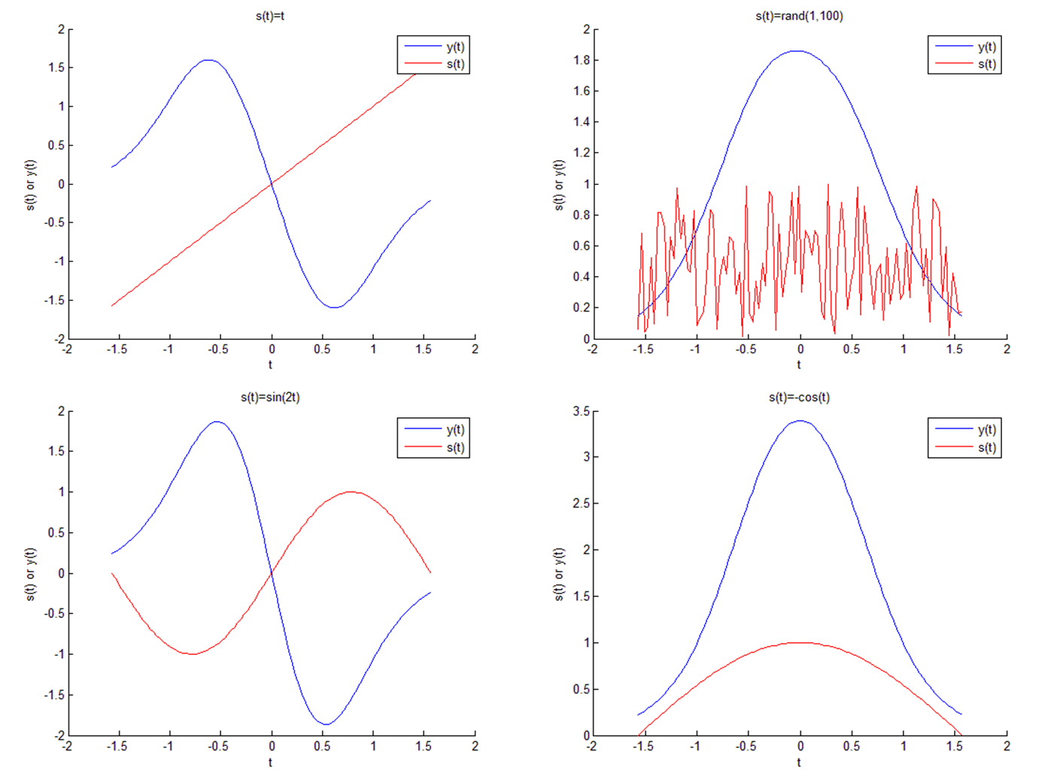
CEE 362G Project 1 Problem1
The blurred results infer that most information contained in the original image s(t) is lost. It is almost impossible to see what the original image s(t) looks like from the resulting blurred image y(t)
Examples of know s(t) and resulting y(t)

Slide 3
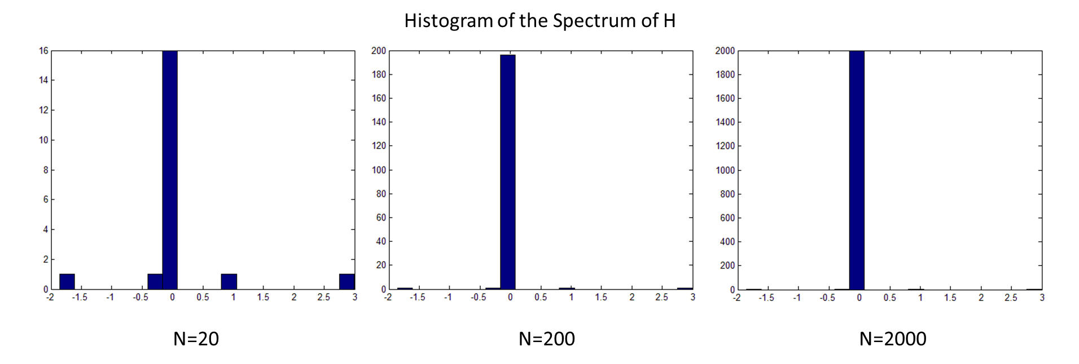
CEE 362G Project 1 Problem2
H has a low rank and a large condition number. Therefore, the linear equation Hs(t)=y(t) is very ill-conditioned

Slide 4
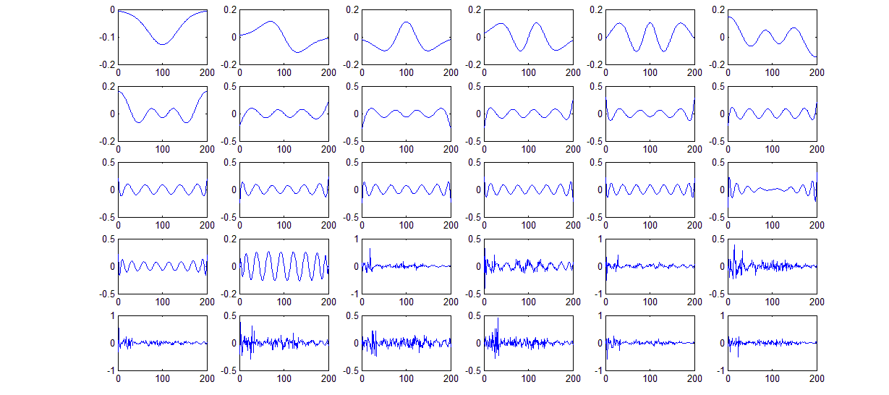
CEE 362G Project 1 Problem3
The rowspace of H is spanned by the first 20 vectors.

Slide 5
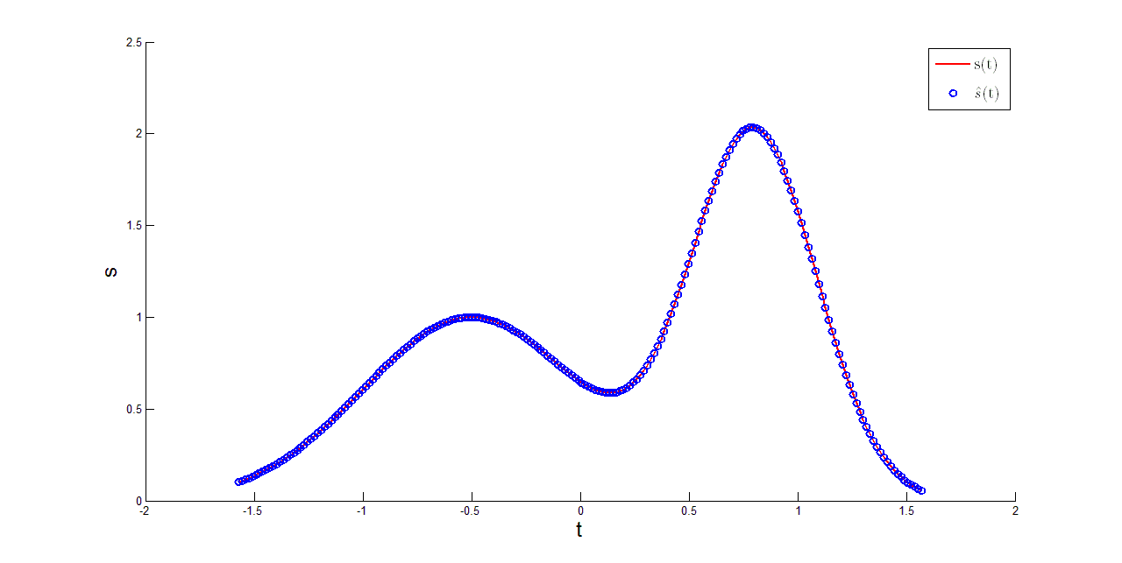
CEE 362G Project 1 Problem4
Comparison between the True s and the s from Pseudo-inverse (without noise)

Slide 6
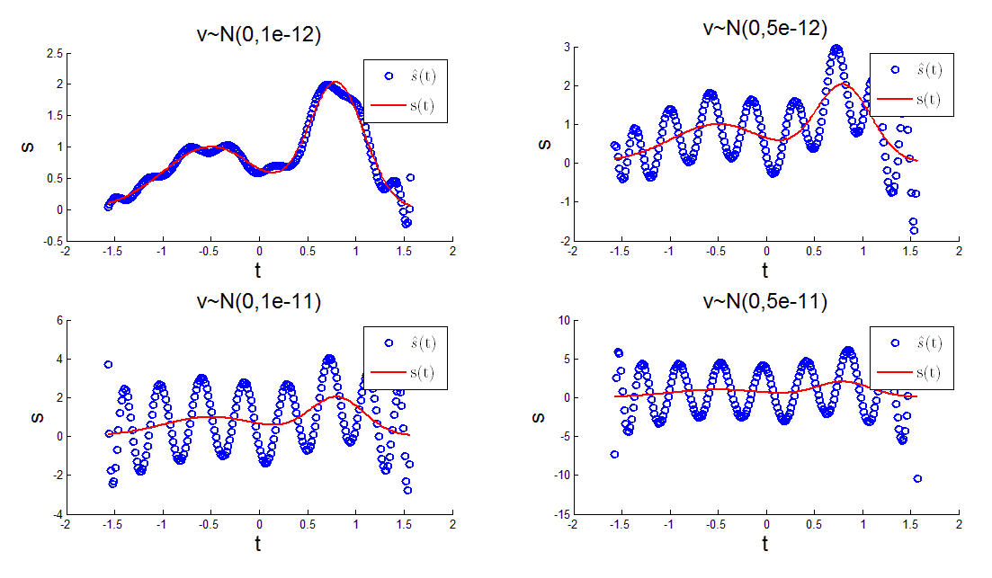
CEE 362G Project 1 Problem5
The pseudo-inverse solution deviates significantly from the true s(t) even with minute noise, indicating that H is ill-conditioned.
Comparison between the True s and the s from Pseudo-inverse (with noise)

Slide 7
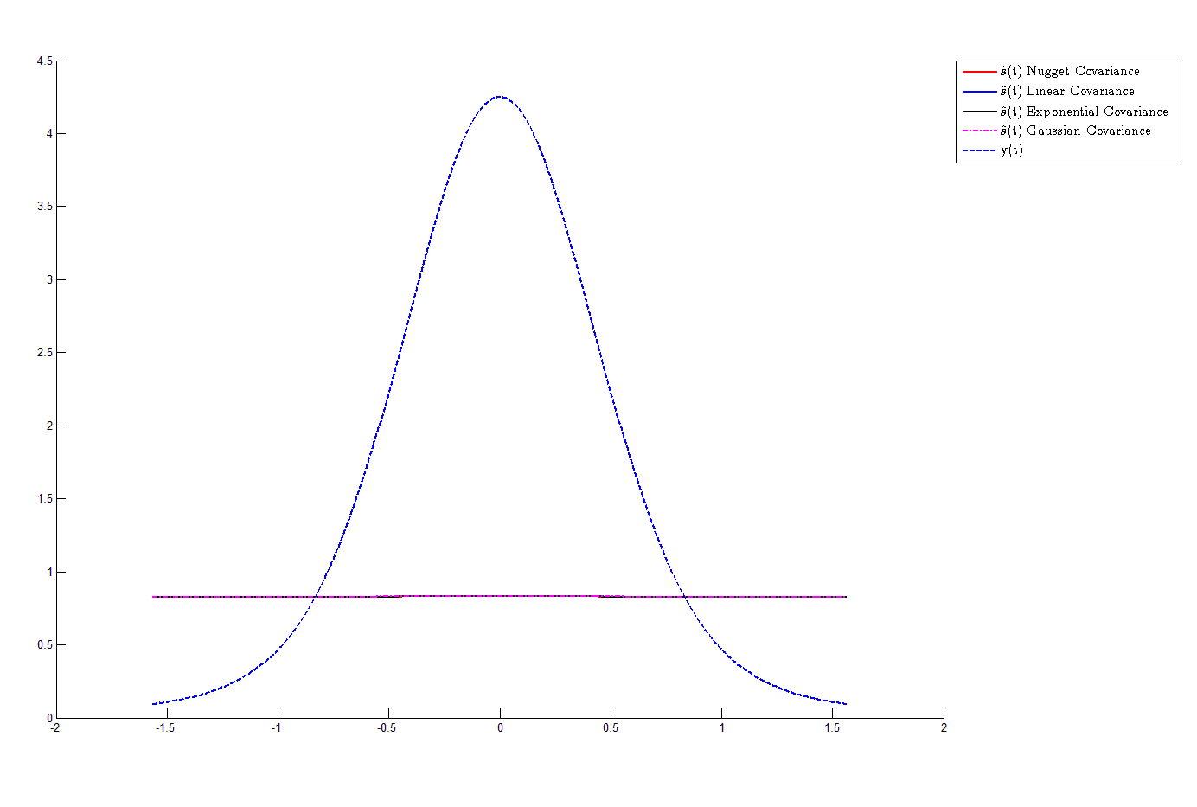
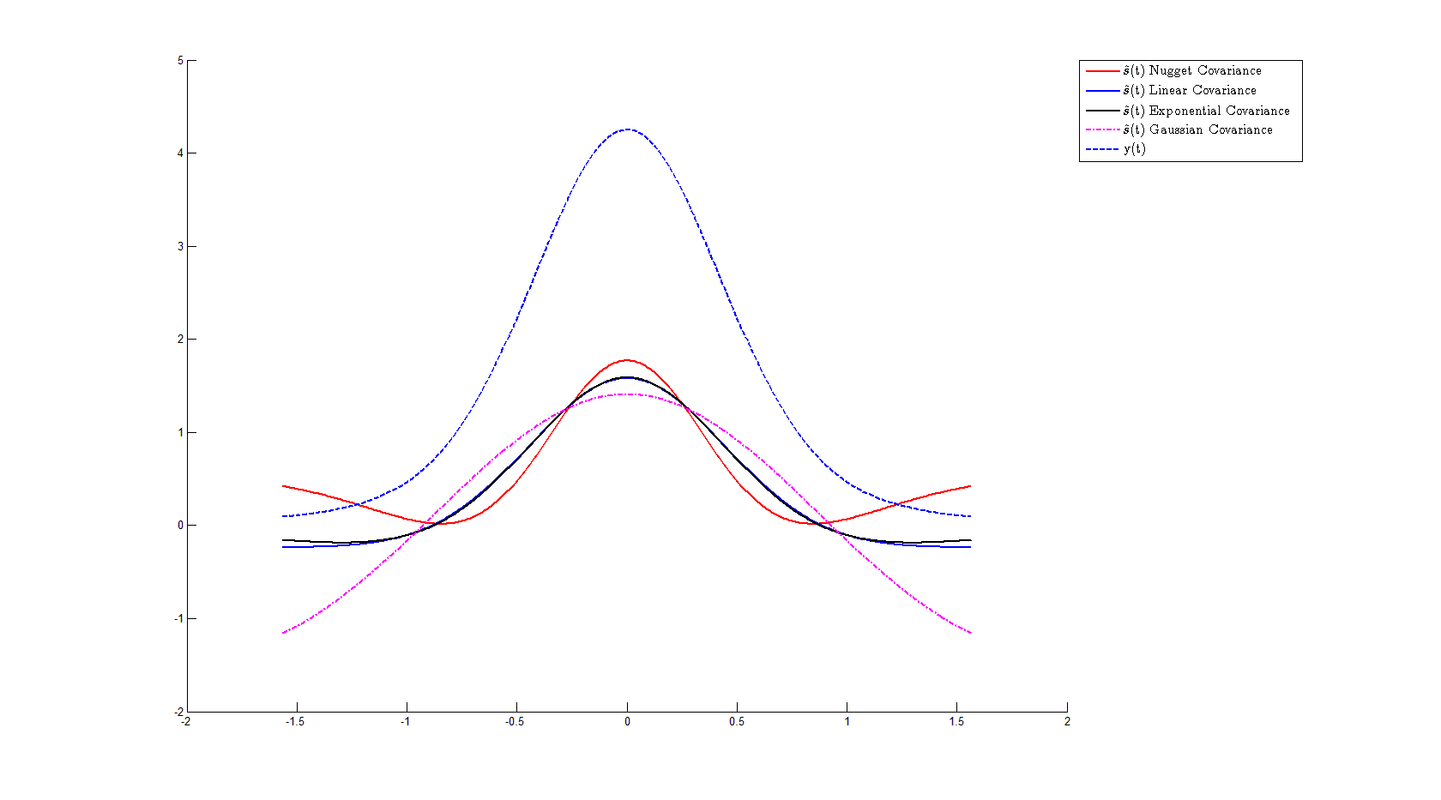
CEE 362G Project 1 Problem6
Comparison between different σ(s) (left: e-3 right: std_y)

Slide 8
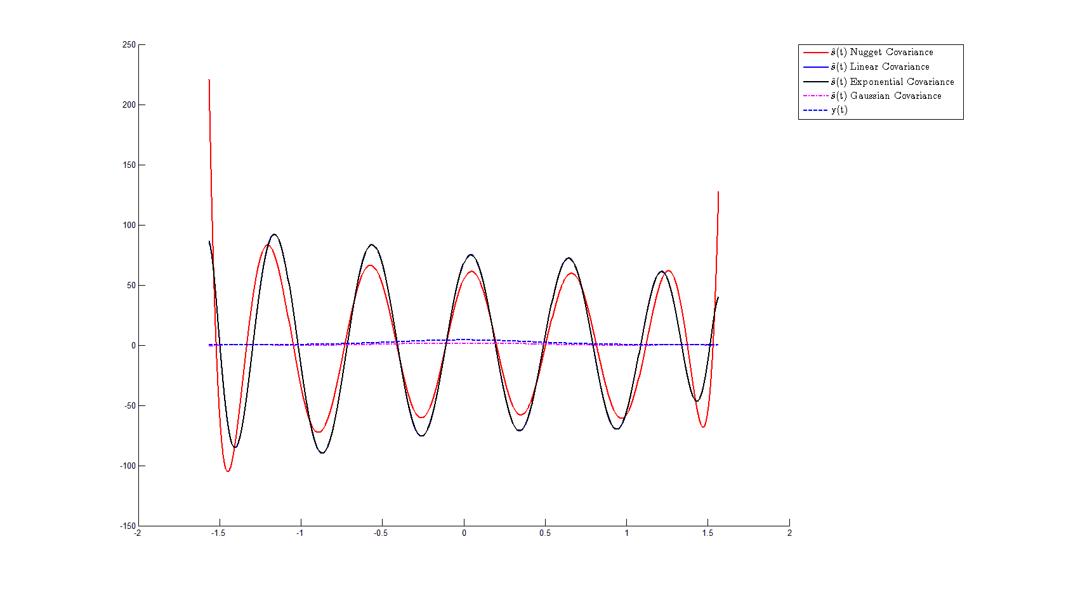
CEE 362G Project 1 Problem6
Comparison between different R (left: σ(v)=e-12 right: σ(v)=e-1 )

Slide 9
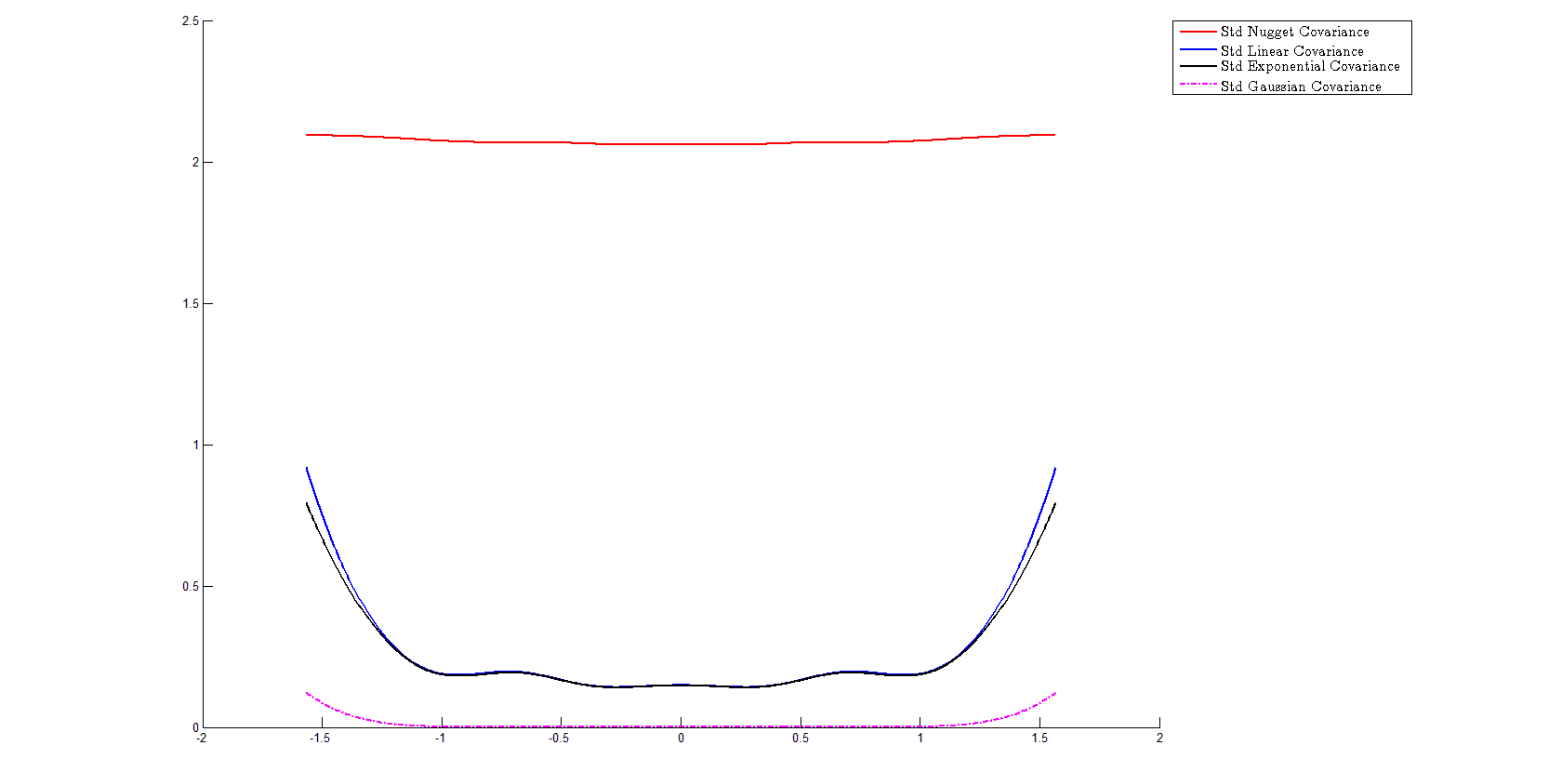
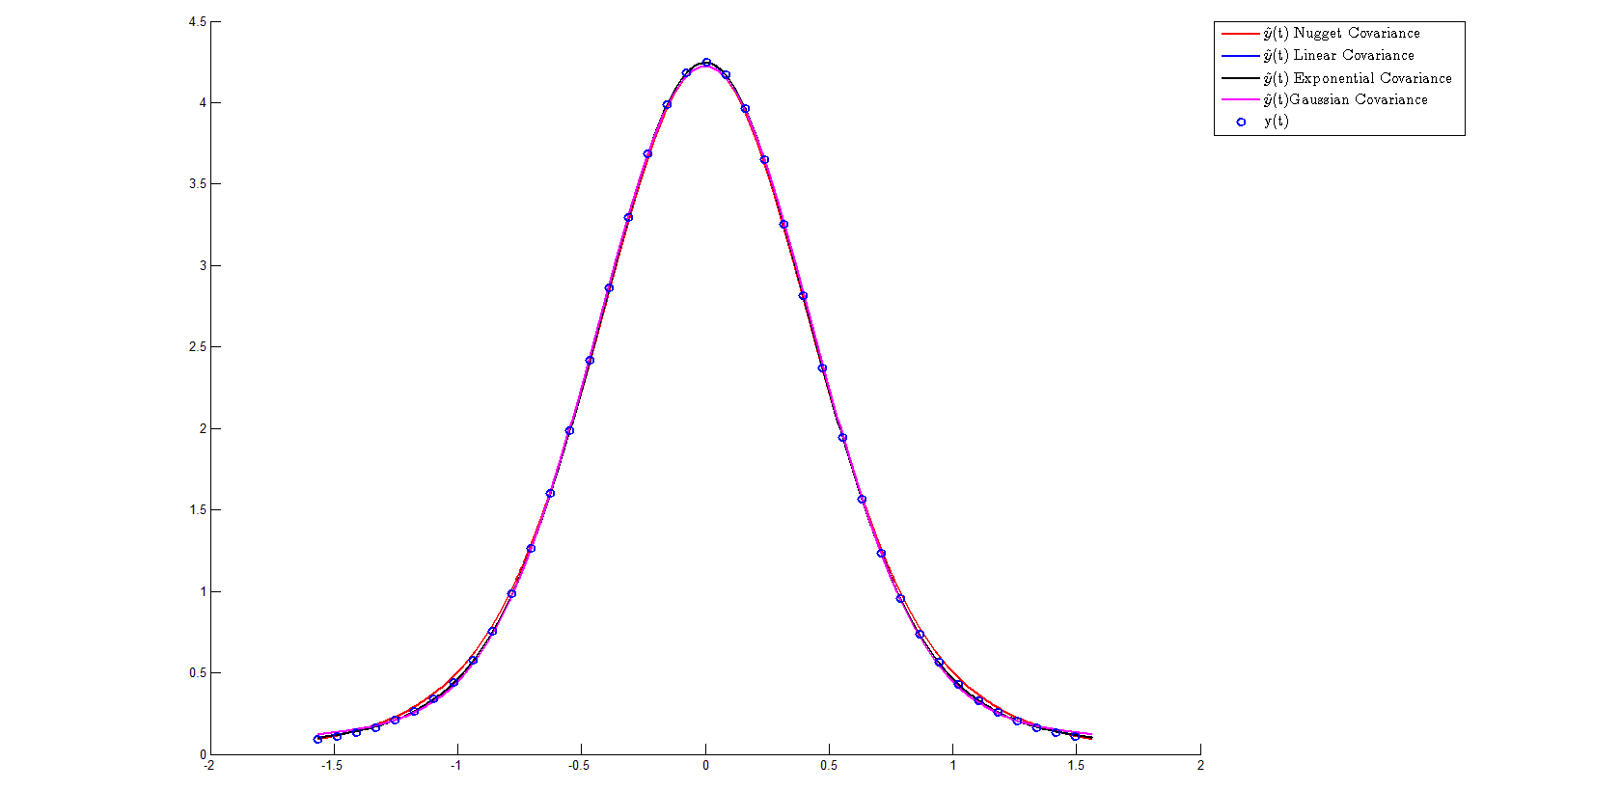

CEE 362G Project 1 Problem6
Posterior standard deviation of s(t)
$\hat{y}\left(t\right)$ compared with y(t)

Slide 10
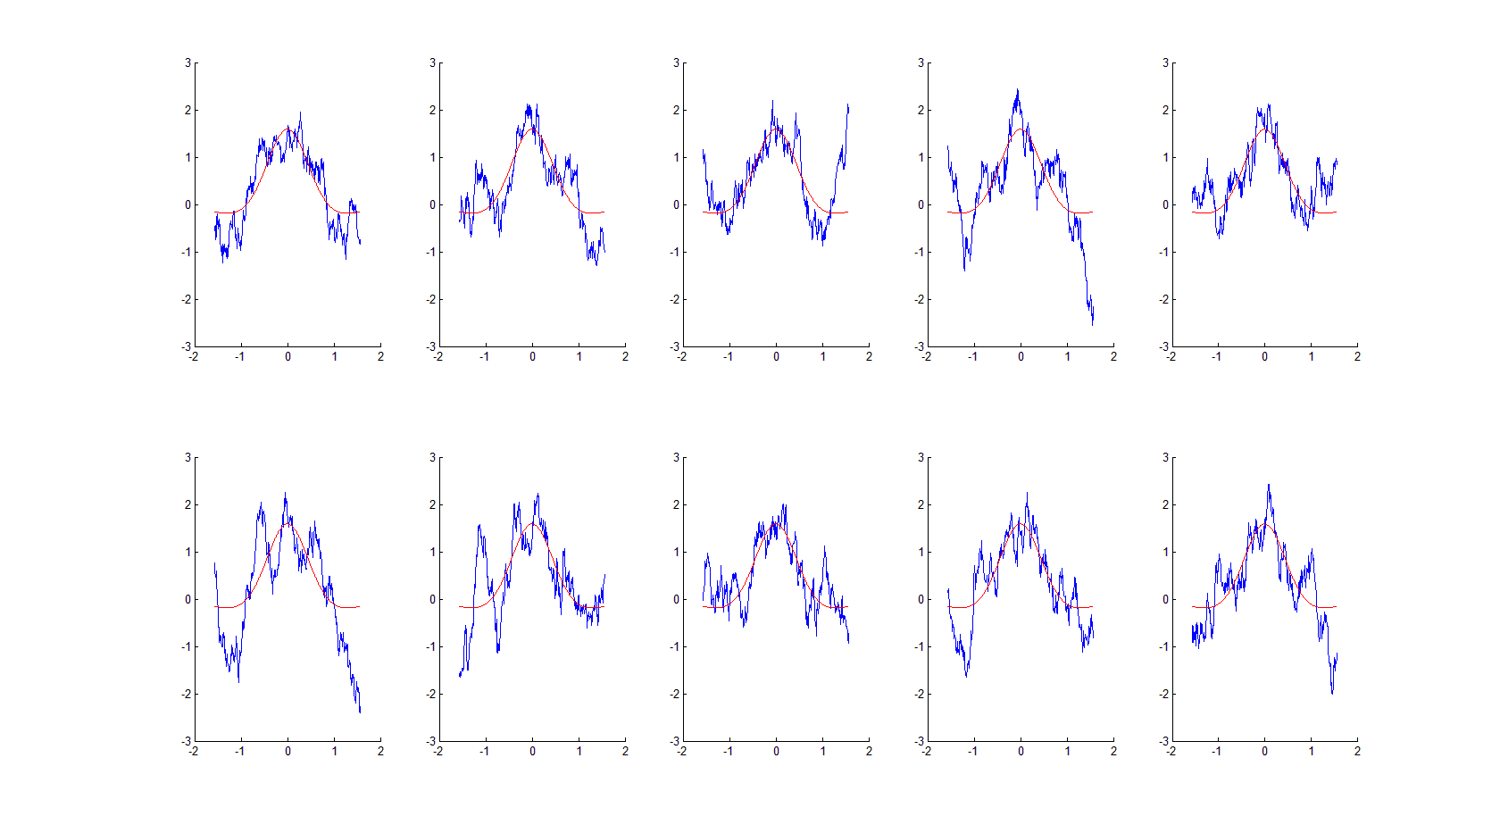
CEE 362G Project 1 Problem7
Ten conditional realizations of s(t) with exponential covariance

