Slide 1
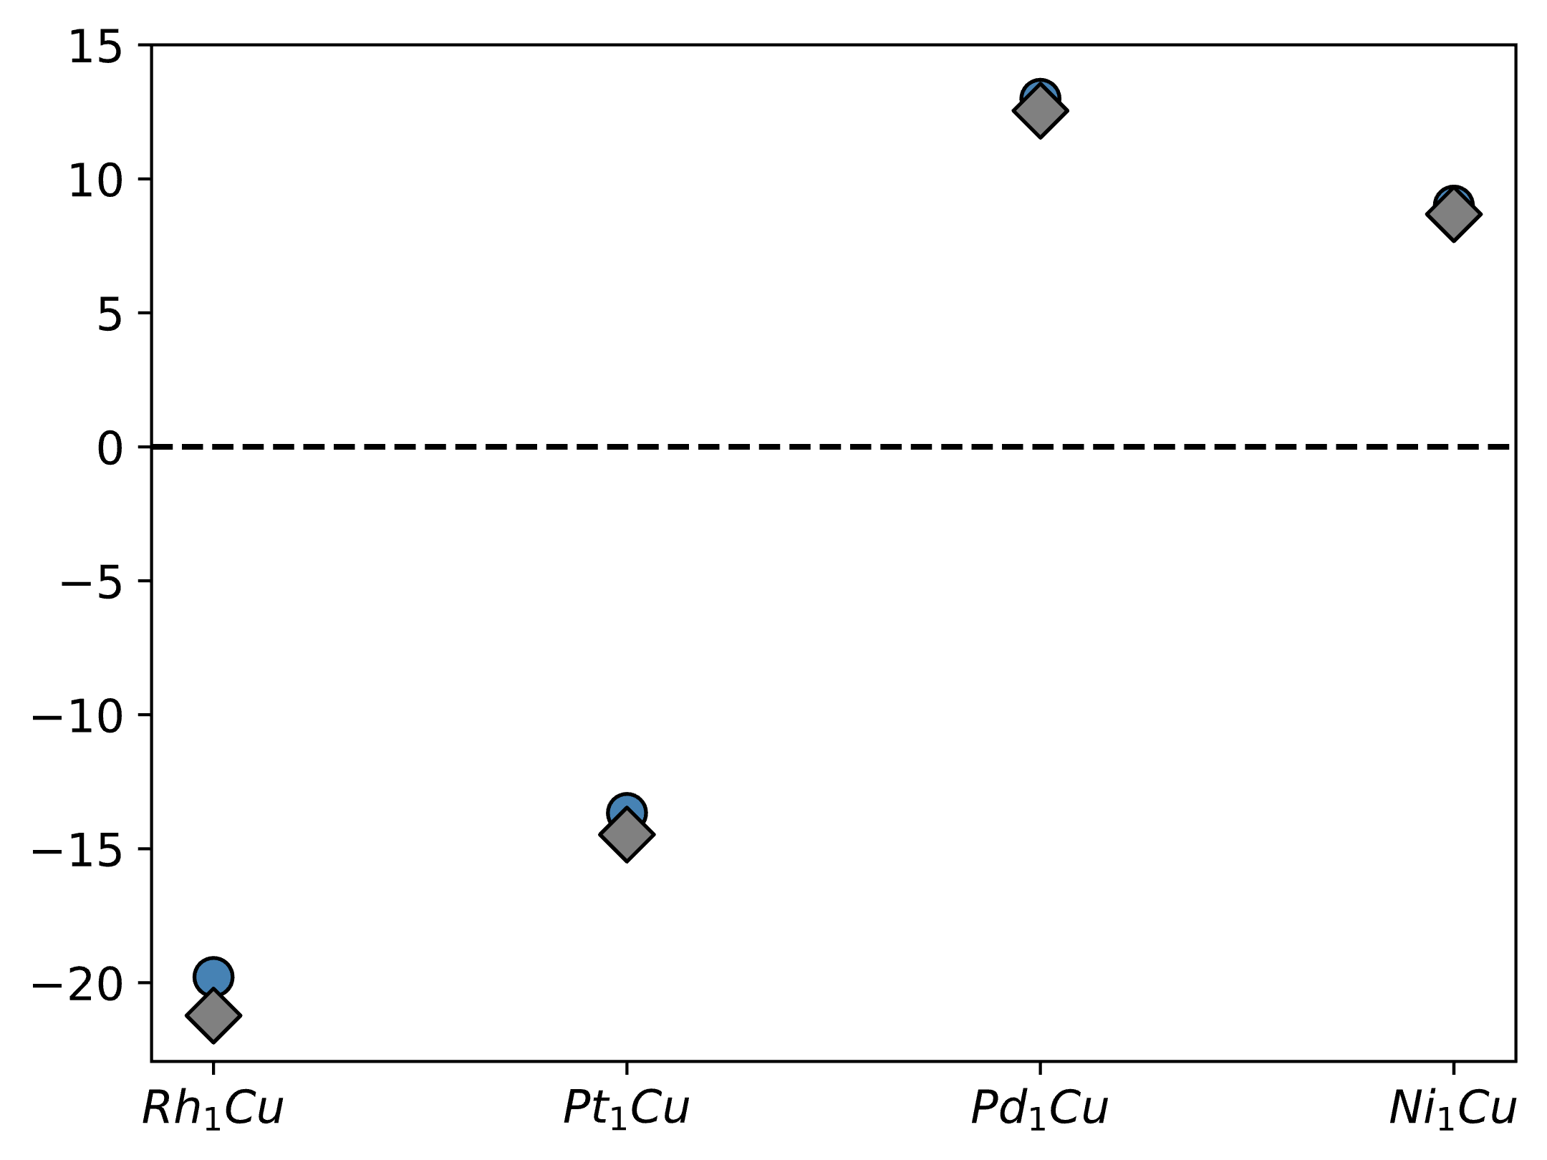
Stable
Vacuum Segregation Energy (kJ/mol)
Unstable
This work
Darby et al.
Rh₁
Pt₁
Pd₁
Ni₁

Slide 2
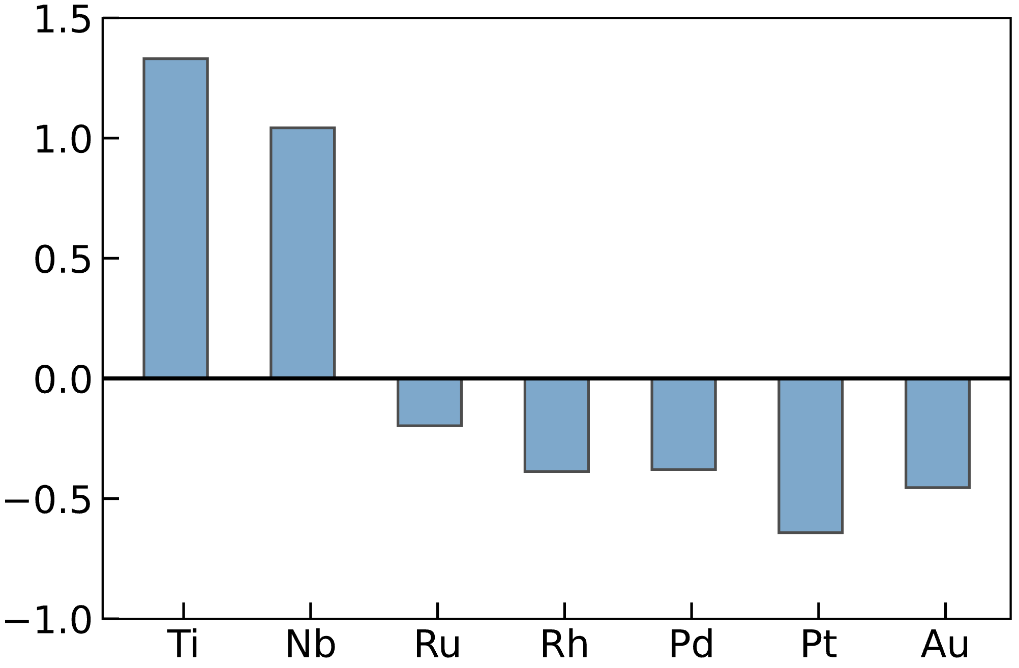
Bader Charge (e⁻)
1
1
1
1
1
1
1

Slide 3
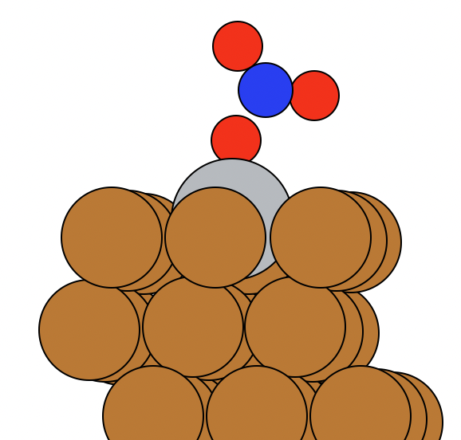
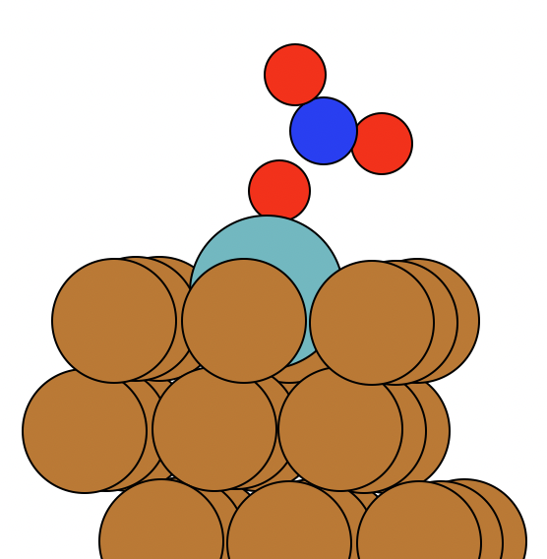
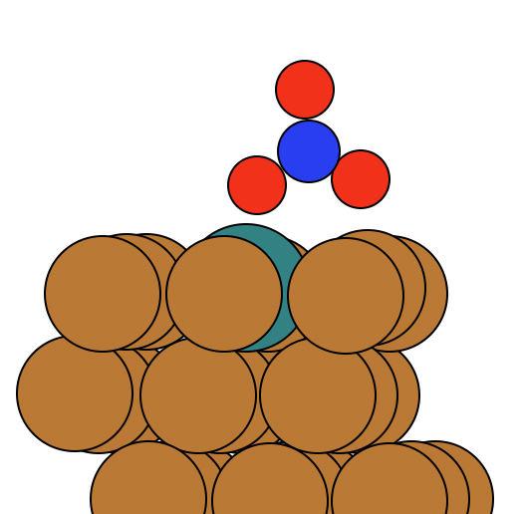
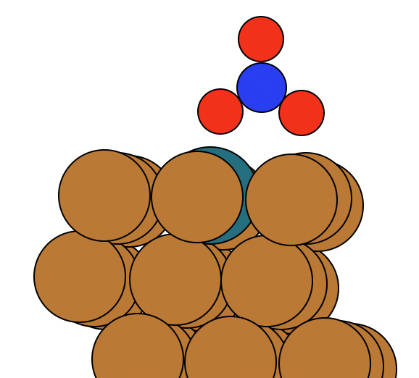
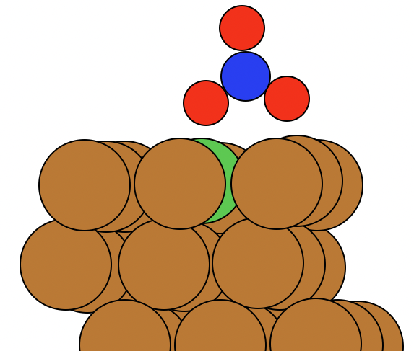
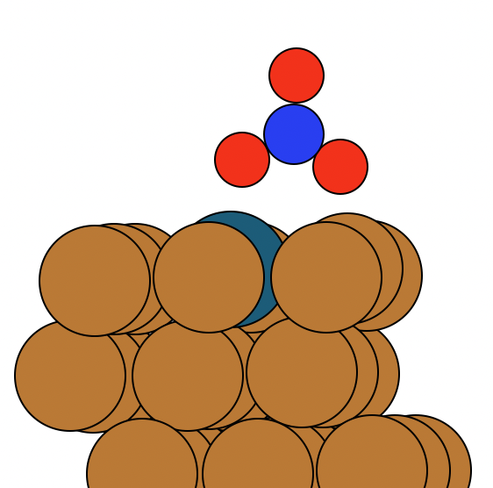
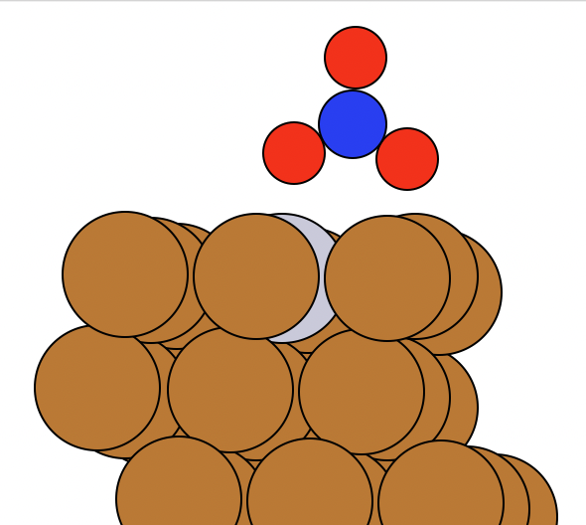
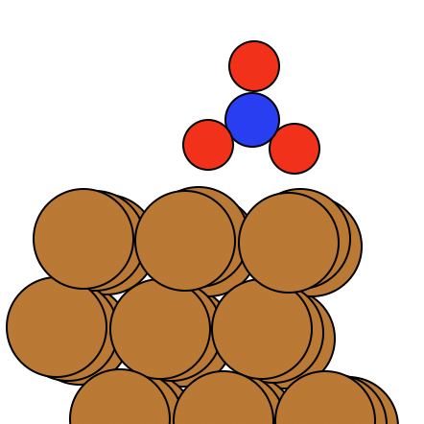
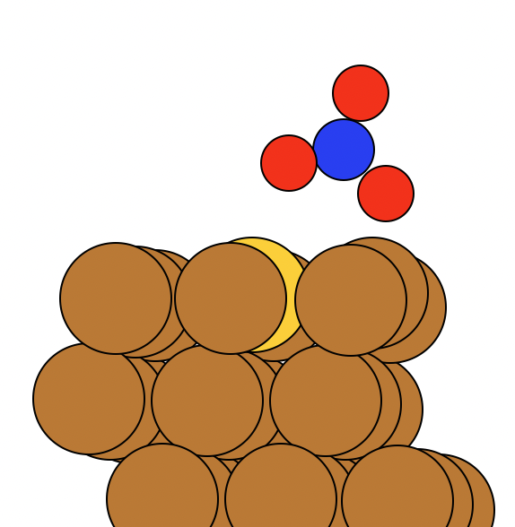
Ti
Nb
Ru
Rh
Ni
Pd
Pt
Cu
Au

Slide 4
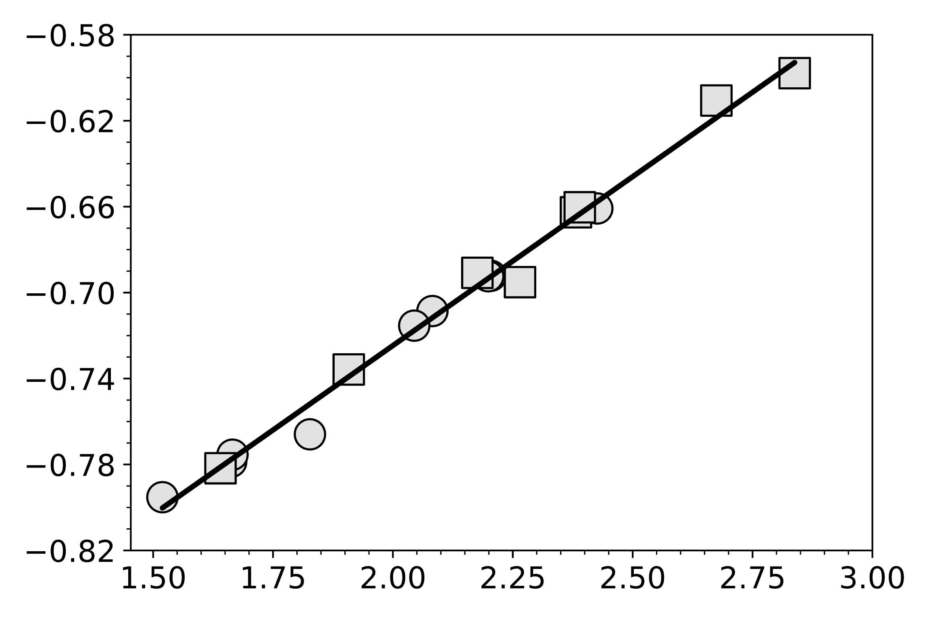




$$\text{m}\text{aGC}\text{−}\text{DFT}={∆μ}_{NO_{3}^{∗}}−0.002$$
R² $=0. 99$
m_{aGC-DFT}$(\frac{eV}{V})$
(111)/(0001)
(100)
$${∆μ}_{NO_{3}^{∗}}=μ_{NO_{3}^{∗}}−μ_{∗} (D)$$

Slide 5
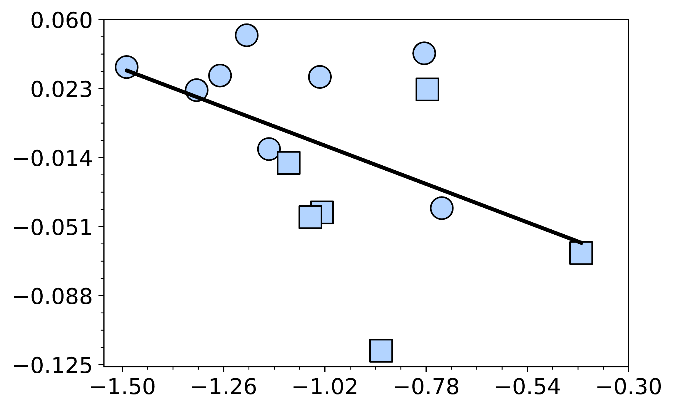



$${∆q}_{‡ }={q_{‡} −q}_{NO_{3}^{∗}} (D)$$
$${∆q}_{‡ }={−0.086∆μ}_{‡ }−\text{0.094}$$
R²$=0.24$
(111)/(0001)
(100)
$${∆μ}_{‡ }={μ_{‡} −μ}_{NO_{3}^{∗}} (D)$$

Slide 6








$$∆G_{0}$$
$${NO}_{3 (aq)}^{−}+H_{(aq)}^{+}+ ∗$$
$${NO}_{3 (aq)}^{∗}+H_{(aq)}^{+}+e^{−}$$
$$∆G_{1}$$
$$∆G_{3}$$
$$∆G_{2}$$
$$HNO_{3(aq)}+ ∗$$
$$HNO_{3(g)}+ ∗$$

