Slide 1
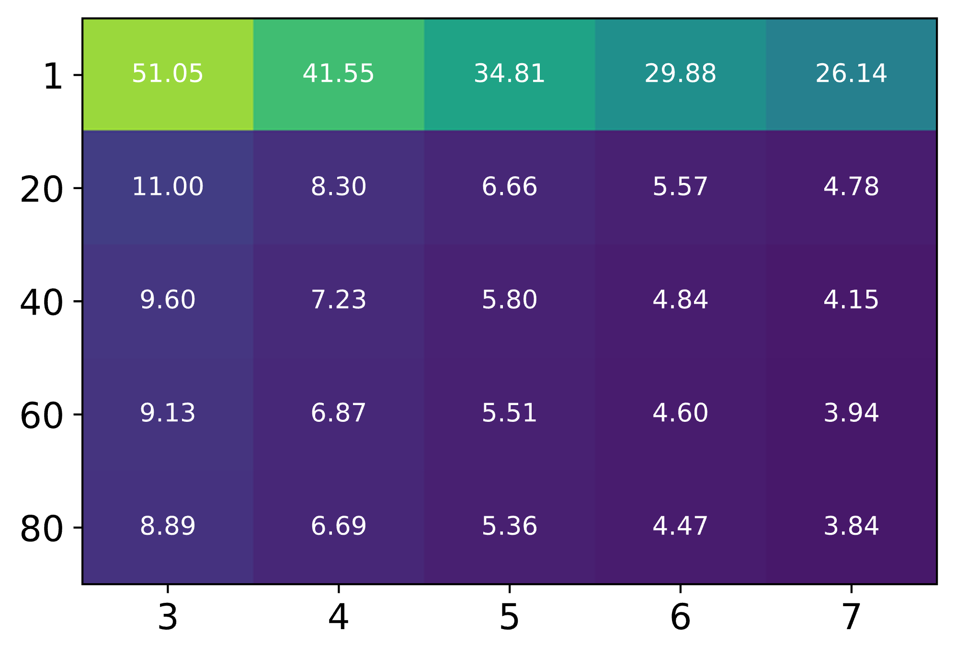
















(a)
$NO_{3}^{−}$ Adsorption
(b)
$NO_{3}^{−}$ Dissociation
$U_{min}≈U_{0}+\frac{3}{4εA}(μ_{NO_{3}^{∗}}+μ_{∗}$)
$U_{min}≈U_{0}+\frac{3}{4εA}(μ_{NO_{3}^{∗}}+μ_{‡}^{ }$)
Ni₁Cu(100)
Cu(111)
Ni₁Cu(111)
$|∆Φ_{aGC−DFT}−∆Φ_{CHE}|$ (kJ/mol)
$|∆Φ_{aGC−DFT}−∆Φ_{Null}|$ (kJ/mol)
Ni₁Cu(100)
Ni₁Cu(111)
Cu(111)
$$U_{min}$$
$$U_{min}$$
Potential (V vs SHE)
Potential (V vs SHE)
(c)
Ni₁Cu(111) $,U=−0.55 V$
(d)
Ni₁Cu(111) $,U=−0.55 V$
$$Dielectric Constant, ε_{r}$$
$|∆Φ_{aGC−DFT}−∆Φ_{CHE}|$ (kJ/mol)
$$Dielectric Constant, ε_{r}$$
$|∆Φ_{aGC−DFT}−∆Φ_{Null}|$ (kJ/mol)
Double layer thickness, d (Å)
Double layer thickness, d (Å)

