Slide 1
Content Based Audio Retrieval Progress Report II
Xi Cheng, Karthikeyan Ganesan, Pengfei Zhu

Slide 2
Previously Proposed
Interpret CNN learning and map it back to domain knowledge
Redesign existing architecture to achieve better classification accuracy
Explore wavelet and domain specific features for custom audio classification architecture
Compare performance of CNN and DNN based retrieval pipelines

Slide 3
Current CNN Architecture and Performance
One ConvLayer with 32 filters of size 9X9
Four FC layers with 32 neurons each
One FC layer to map to outputs
Very poor classification accuracy (~15%)

Slide 4
Modified CNN architecture and performance
One ConvLayer with 16 filters of size 9X9
One FC layer with size 128
One FC layer to map to 50 classes
Training accuracy (~ 33%) , validation accuracy (~17%)
More ConvLayers should be added

Slide 5
Domain Specific Features
Mel Frequency Cepstral Coefficients
Linear Predictive Coding (LPC) coefficients
MultiScale wavelet decomposition

Slide 6
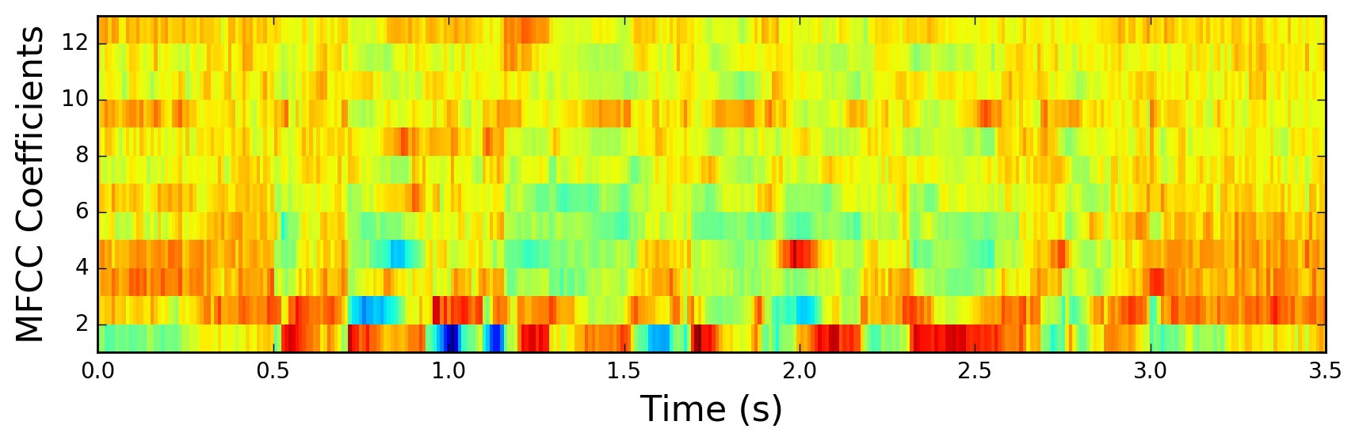
MFCC
Representation of short term power spectrum of sound
Maps original frequency scales to auditory perception frequency range
Helps model learn/mimic human auditory system
Number of Mels = 128

Slide 7
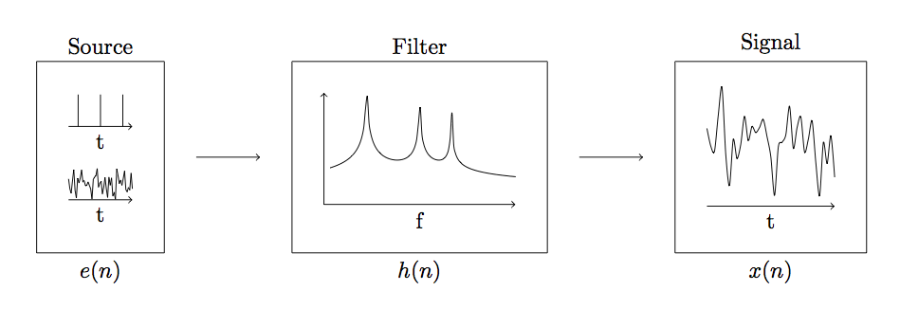
Linear Predictive Coefficients
Estimates current samples from linear combo of previous samples
Higher order of filter estimates better
Order used for audio analytics : 10

Slide 8
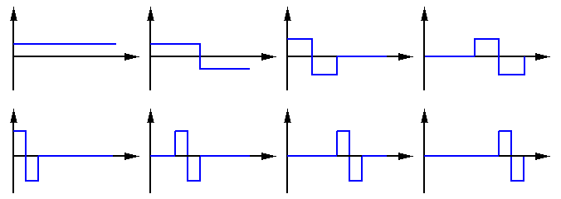
Wavelet Analysis
Used for multi-scale analysis of signals
Higher levels decompose to narrower bandwidths
Different wavelets represent signal better
Wavelet used : ‘Haar’

Slide 9
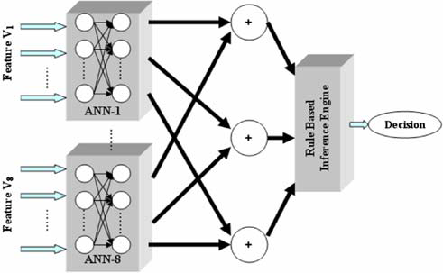
Custom NN architecture
Parallel NN architecture
Each vector of spectral features -> Unique Neural Network
One FC layer for Rule Based Inference Engine
Literature Accuracy of 87.3%

Slide 10
Future Directions
Deeper ConvNets and their inspections
Custom DNN based on proposed spectral features

Slide 11
QUESTIONS

