Slide 1
Leveraging StructureMap for Real World Success with Dependency Injection & Inversion of Control
Dean Poulin
Architect & Lead Developer
Yellowbook
dean.poulin@gmail.com

Slide 2
What Is Dependency Injection?
Inversion of Control Container
Dependency Inversion Principle (DIP) [1]
High-level modules should not depend on low-level modules. Both should depend on abstractions.
Abstractions should not depend upon details. Details should depend upon abstractions.
[1] - http://en.wikipedia.org/wiki/Dependency_inversion_principle

Slide 3
Why Should You Care?
Easier to Maintain / Refactor
Convention over Configuration
Loose Coupling
Testability, Testability, Testability
Results in Better Architecture
Object Lifecycle Management
Singleton / HttpContext Scoped

Slide 4
Why Should Those Who Pay You Care?
Lower Cost of Maintenance / Ownership
Higher Unit Test Coverage
Less Bugs
Higher Quality Code
Releasable Products Faster & With Less Stress

Slide 5
Sample Module Dependencies
Web Application (MVC 3)
Models
Views
Controllers
Core Services
Web Services
Data Access
Business Logic
APIs
Low Level Services / Components
File System
SQL Server Database
Security

Slide 6
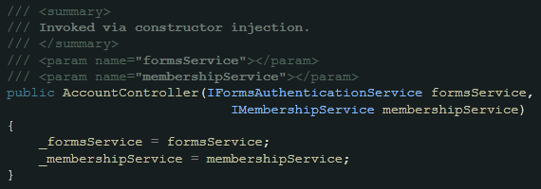
Types of Dependency Injection
Constructor Injection (Most Common)
Property / Setter Injection

Slide 7
Getting Started with Dependency Injection
Bootstrap StructureMap at application startup
Building blocks for data, security, etc.
Focus on scenarios
ServiceLocation starts the chain of Dependency Injection…

Slide 8
Simple Setup of DI with MVC 3 Preview
IControllerFactory
IServiceLocator
ObjectFactory & ServiceLocation
Why you should try to avoid ServiceLocation hooks?
Let your code Ride The DI Wave

Slide 9
More StructureMap Specifics
What are registries? How to use them.
Scanning your assemblies for AutoRegistration
Using Profiles
WhatDoIHave & AssertConfigurationIsValid
Managing the LifeCycle of your dependencies
Leveraging Moq & BDD Style techniques for unit tests

Slide 10
Seeing the StructureMap in the Code
demo

Slide 11
Resources
StructureMap
github: http://github.com/structuremap/structuremap
docs: http://structuremap.net/structuremap/index.html
Demo code here
http://github.com/deanis/StructureMap-Presentation
Moq
http://code.google.com/p/moq/
Contact
Dean Poulin
dean.poulin@gmail.com

Slide 12
Questions?
Contact
Dean Poulin
dean.poulin@gmail.com

