Slide 1
Pneumonia Detection
Dean Stokeld

Slide 2
Table of contents
About it
Business Context
01
02
Data Science
Conclusion
03
04
What is Pneumonia?
Business question
Project Pipeline & Data Science Processes
Future applications

Slide 3
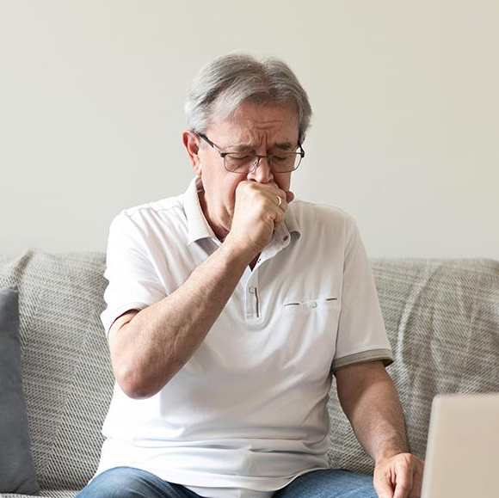
What is Pneumonia?
Pneumonia is a common infection that inflames the alveoli (air sacs) in the lungs. The alveoli can fill with purulent material (fluid or pus) which results in coughing, breathing difficulties, chills and fevers.
Bacteria, fungi and virus infections can cause pneumonia. Depending on the age and existing health conditions of a patient determines the severity of pneumonia. For example, young children and elderly and susceptible to pneumonia as well as those who have any underlying health conditions, especially conditions that affect the respiratory system.

Slide 4
Business Question
How can we detect the presence of pneumonia in chest x-rays to assist doctors to accurately diagnose patients so that they may receive the appropriate treatment?

Slide 5
Data Pipeline
Data Aquisition
Pre-processing
Summary & Future Application
01
02
03
04
05
Data Exploration
Modelling Data

Slide 6
Data
A dataset containing chest x-rays of people with and without pneumonia was used to demonstrate how different deep learning models would perform on detecting the presence of pneumonia.
Data source: University of California San Diego – Daniel Kermany, Kang Zhang & Michael Goldbaum
5, 856 images –Training: 5,216 images
Test: 624 images
Validation: 16 images
Image sizes: 1,317 x 1,857 pixels - greyscale

Slide 7
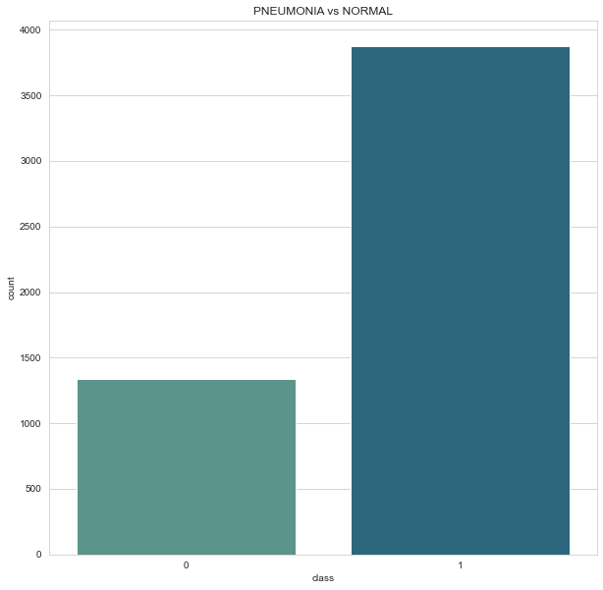
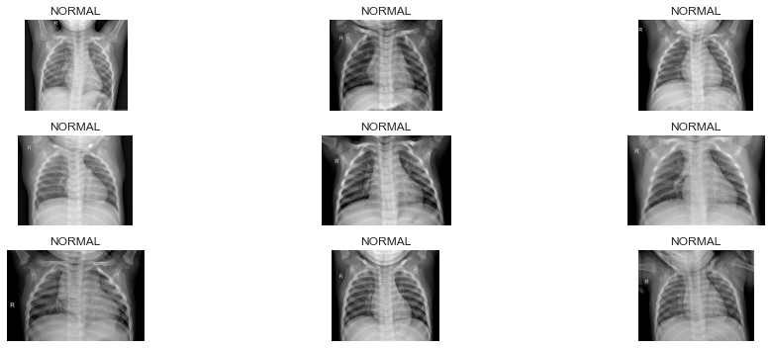
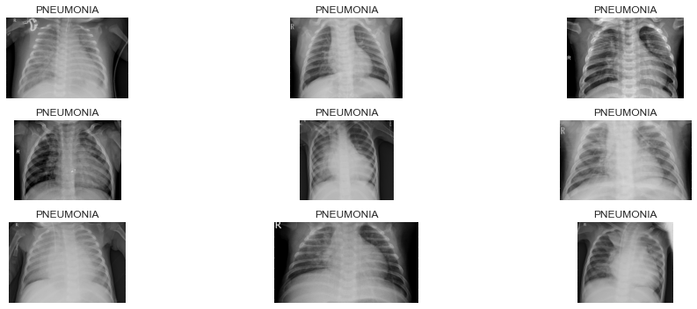
Data Exploration

Slide 8
Data Pre-processing
Due to the low number of normal x-rays in the data set we will need to augment the data through data augmentation to create a balanced dataset.
For the data augmentation, I chose to do the following to the training images:
- Randomly rotate some images by 20 degrees
- Randomly zoom by 30% on some images
- Randomly shift images horizontally by 20% of the width
- Randomly shift images vertically by 20% of the height
- Randomly flip images horizontally
- Randomly adjust the brightness of the images from 0.5 to 2.0
- Randomly shear the images by 10 degrees
In addition to this, images were scaled down to 256 x 256 pixels and were normalised.

Slide 9
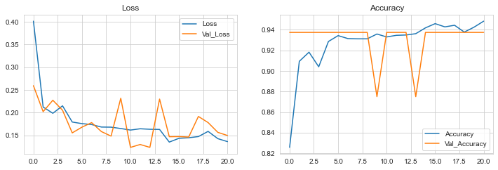
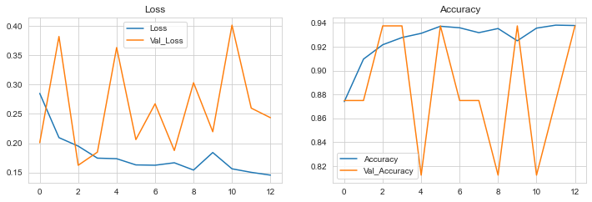
Modelling
VGG19
Train accuracy: 89.97%
Models used:
ResNet50V2
VGG19
Model hyperparameters:
VGG19 model was trained on 30 epochs and 64 batch size.
ResNet50V2 model was trained on 50 epochs and 32 batch size.
ResNet50V2
Train accuracy: 94.44%
Best model:
ResNet50V2
12 hours to train
94.44% accuracy

Slide 10
Conclusion
Much deeper models can outperform simpler models for pneumonia detection, in this case ResNet50V2 is the deeper model.
Image recognition for the detection of pneumonia is very important as it can give doctors assistance in accurately diagnosing patients via chest x-rays.
Artificial intelligence requires large amounts of data to make accurate predictions and decisions, therefore data augmentation was necessary to yield accurate and valid results.

Slide 11
Future Applications
Other models like the ones I used can be used to detect a many different serious health problems which will allow doctors to more accurately diagnose patients so that they may seek the appropriate treatment.

Slide 12
Thank you!

