Slide 1

‹#›

Slide 2
CSEE 4823 Lab#4
Ashish Shukla
15th October, 2021
Acknowledgement: Mingoo Seok & Jaebin Choi, Columbia

Slide 3
Topics covered in lab sessions
Lab#1: Design flow & Matlab®
Lab#2: Verilog HDL / ModelSim®
Lab#3: Synthesis / Design Compiler®
Lab#4: Timing and power analysis / PrimeTime®
Lab#5: Memory Compiler®

Slide 4
Semi-Custom Flow
*.m *.mdl
^{Lab#1}Matlab/Simulink
modeling and specification
testbench tb*.v
Lab#2
Behavioral Verilog
*.v
ModelSim
functional
verification
std. cell lib
*.db *.sldb
Lab#3 Design Compiler
constraints
*.sdc
Structural Verilog
*.nl.v
ModelSim
post-synthesis dynamic timing verification
Timing info.
*.sdf
Lab#4
post-synthesis static timing verification
PrimeTime
Encounter
Automatic Placement and Routing
post-synthesis power analysis

Slide 5
After synthesis, what to do next?
Post-synthesis dynamic timing verification
CAD tool: QuestaSim
Back-annotation
Compare with RTL-level verification, what’s the difference?
Post-synthesis static timing and power verification
CAD tool: Primetime
What you get:
the worst-case delay path
power consumption with detailed switching activities
setup/hold time violations

Slide 6
1 - ModelSim Simulation with Back Annotation
copy qsim_dc folder to your local space
/courses/ee6321/share/4823-Fall2021/qsim_dc/
check your file structure
[any, default is your home folder ~]
matlab
Example: in *.tcl file
../../rtl/$top_level/$top_level.v
lfsr1
rtl
lfsr1
You can have your own file structure style, but you need to
know what/where changes should be made in CAD tool scripts
make sure it is compatible with other colleagues’ codes when you are doing a group project!
dc
lfsr1
qsim_rtl
lfsr1
qsim_dc
lfsr1
pt
will be created later today
lfsr1

Slide 7
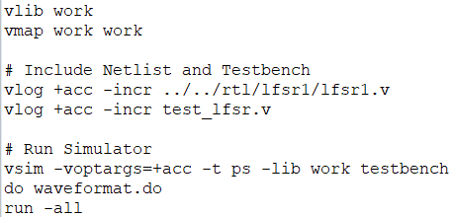
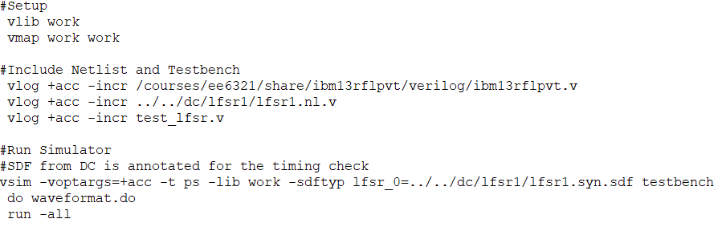
1 - ModelSim Simulation with Back Annotation
/qsim/lfsr1/runsim.do
/qsim_dc/lfsr1/runsim.do
std. cell Verilog library
RTL code
gate-level netlist
timing *.sdf
For simple verification, you can share same testbench file.
Please run ModelSim and check the waveform.
See the transcript for any timing violations

Slide 8
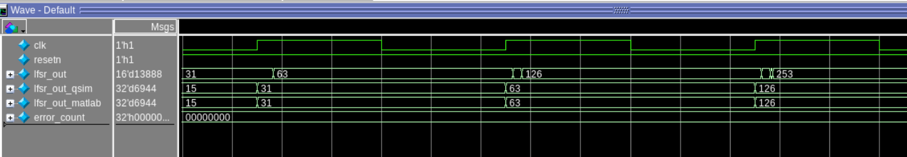
What’s New in Waveform
Delays
Glitches
If you cannot observe delay, try to change time unit to ps

Slide 9
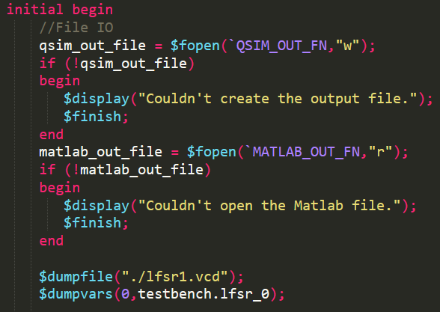
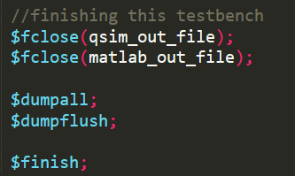
Switching Activity from Modelsim Simulation
Modify the testbench Create the vcd file
Look up the usage of $dumpvars command
.vcd file contains the switching activity for the inputs provided
.vcd file will be used to obtain an estimate of power using pt
To obtain realistic estimate of power given proper inputs
You should find lfsr1.vcd generated after you run run.sh
Notes:
$dumpvars(0, module_instance) -> “0” means a dump of all variables in the specified module and in all module instances below the specified module.

Slide 10
2 - Post-synthesis static timing/power verification
Copy pt (Primetime) folder to your local space
/courses/ee6321/share/4823-fall2020/pt/
Main files
lfsr1.tcl (CAD tool script)
timing.tcl (define timing)
run_sta.sh (script to run pt)
lfsr1_pt.rpt (report file)
lfsr1.log (log file for pt, contains instructions and results)
Nuke.sh (delete all files generated by pt, run it before you run pt)
Go back to compile phase if any violations occurs
Check power, timing

Slide 11
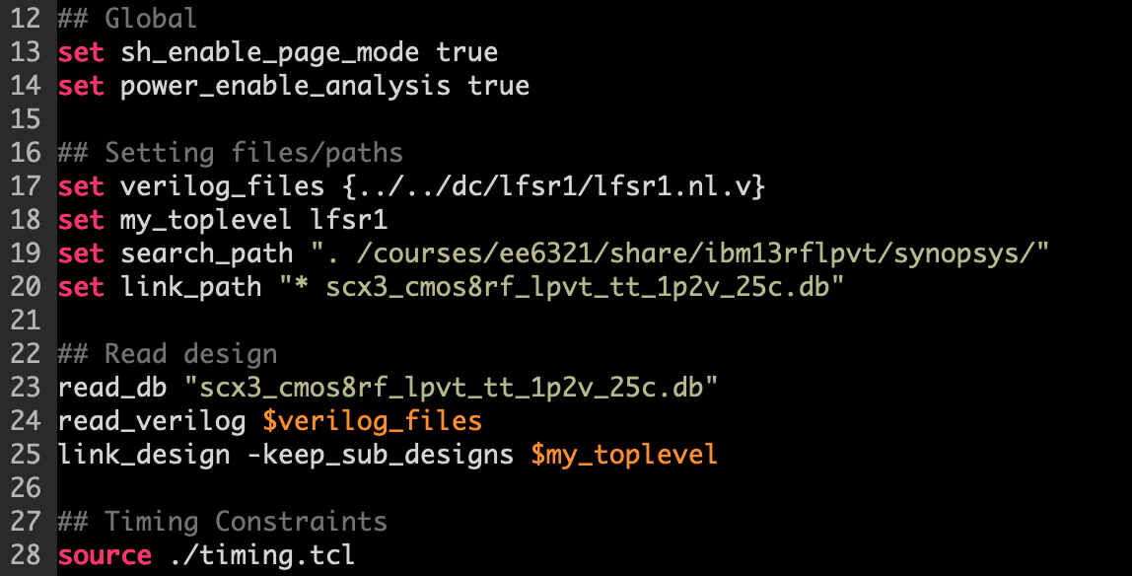
lfsr1.tcl (1)
Set Environment Variables
Set Library and Design
Timing Constraint Format is same as that in DC

Slide 12
.db File in Post-synthesis Verification
The .db file is compiled version of .lib file
Look at .lib file to get a sense of the kind of information present in .db file
/courses/ee6321/share/ibm13rflpvt/synopsys/scx3_cmos8rf_lpvt_tt_1p2v_25c.lib
Contains :
Units that will be used by the tool for time, voltage, etc.
The operating conditions
Models for timing and power of the standard cells
The unit for area is um² for the technology libraries we are using

Slide 13
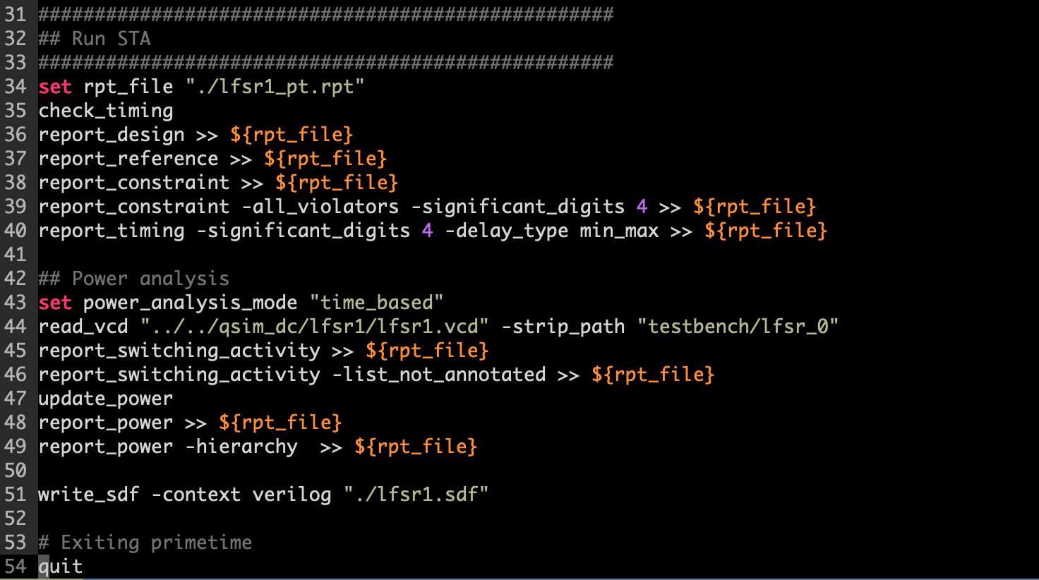
lfsr1.tcl (2)
Mention delay type
Read the vcd file
Update power estimates
Report power
Use man command in pt_shell to understand usage of commands
Or type “primetime” in command line to open up the tool’s gui, then look at help

Slide 14
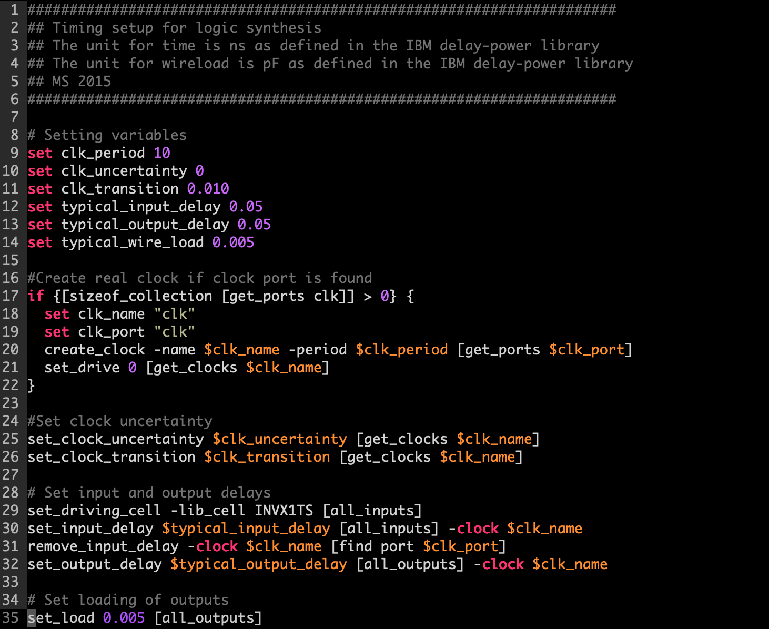
timing.tcl
You should make sure that the clock cycle here is the same as the verilog testbench where you generate the .vcd file!!

Slide 15
Report File: lfsr1_pt.rpt (1)
****************************************
Report : timing
-path_type full
-delay_type min_max
-max_paths 1
-sort_by slack
Design : lfsr1
Version: P-2019.03-SP2
Date : Thu Oct 15 21:40:06 2020
****************************************
Startpoint: lfsr_out_reg_0_
(rising edge-triggered flip-flop clocked by clk)
Endpoint: lfsr_out[0]
(output port clocked by clk)
Path Group: clk
Path Type: min
Point Incr Path
------------------------------------------------------------------------------
clock clk (rise edge) 0.0000 0.0000
clock network delay (ideal) 0.0000 0.0000
lfsr_out_reg_0_/CK (DFFHQX4TS) 0.0000 0.0000 r
lfsr_out_reg_0_/Q (DFFHQX4TS) 0.2738 0.2738 r
lfsr_out[0] (out) 0.0000 0.2738 r
data arrival time 0.2738
clock clk (rise edge) 0.0000 0.0000
clock network delay (ideal) 0.0000 0.0000
clock reconvergence pessimism 0.0000 0.0000
output external delay -0.0500 -0.0500
data required time -0.0500
------------------------------------------------------------------------------
data required time -0.0500
data arrival time -0.2738
------------------------------------------------------------------------------
slack (MET) 0.3238
Min path

Slide 16
Report File: lfsr1_pt.rpt (2)
Max path
Startpoint: lfsr_out_reg_5_
(rising edge-triggered flip-flop clocked by clk)
Endpoint: lfsr_out_reg_0_
(rising edge-triggered flip-flop clocked by clk)
Path Group: clk
Path Type: max
Point Incr Path
------------------------------------------------------------------------------
clock clk (rise edge) 0.0000 0.0000
clock network delay (ideal) 0.0000 0.0000
lfsr_out_reg_5_/CK (DFFQX1TS) 0.0000 0.0000 r
lfsr_out_reg_5_/Q (DFFQX1TS) 0.7417 0.7417 f
U50/Y (XOR2X1TS) 0.2572 0.9988 r
U51/Y (XOR2X1TS) 0.2823 1.2811 f
U52/Y (AO22X1TS) 0.4487 1.7298 f
lfsr_out_reg_0_/D (DFFHQX4TS) 0.0000 1.7298 f
data arrival time 1.7298
clock clk (rise edge) 10.0000 10.0000
clock network delay (ideal) 0.0000 10.0000
clock reconvergence pessimism 0.0000 10.0000
lfsr_out_reg_0_/CK (DFFHQX4TS) 10.0000 r
library setup time -0.2619 9.7381
data required time 9.7381
------------------------------------------------------------------------------
data required time 9.7381
data arrival time -1.7298
------------------------------------------------------------------------------
slack (MET) 8.0083

Slide 17
Report File: lfsr1_pt.rpt (3)
Power
****************************************
Report : Time Based Power
Design : lfsr1
Version: P-2019.03-SP2
Date : Thu Oct 15 21:40:06 2020
****************************************
Attributes
----------
i - Including register clock pin internal power
u - User defined power group
Internal Switching Leakage Total
Power Group Power Power Power Power ( %) Attrs
--------------------------------------------------------------------------------
clock_network 3.973e-05 0.0000 0.0000 3.973e-05 (63.16%) i
register 1.323e-05 3.830e-06 5.856e-10 1.706e-05 (27.12%)
combinational 5.048e-06 1.068e-06 2.489e-10 6.117e-06 ( 9.72%)
sequential 0.0000 0.0000 0.0000 0.0000 ( 0.00%)
memory 0.0000 0.0000 0.0000 0.0000 ( 0.00%)
io_pad 0.0000 0.0000 0.0000 0.0000 ( 0.00%)
black_box 0.0000 0.0000 0.0000 0.0000 ( 0.00%)
Net Switching Power = 4.898e-06 ( 7.79%)
Cell Internal Power = 5.801e-05 (92.21%)
Cell Leakage Power = 8.345e-10 ( 0.00%)
---------
Total Power = 6.290e-05 (100.00%)
X Transition Power = 0.0000
Glitching Power = 0.0000
Peak Power = 4.143e-03
Peak Time = 865.000
Internal power : Power consumed to switch parasitic caps (major portion) + short-circuit power (typically very small)
Switching power : Power used for switching gate cap

Slide 18
Summary of 4 lab sessions
*.m *.mdl
Lab#1
Matlab/Simulink
modeling and specification
testbench tb*.v
Lab#2
Behavioral Verilog
*.v
ModelSim
functional
verification
std. cell lib
*.db *.sldb
Lab#3
constraints
*.sdc
Design Compiler
Structural Verilog
*.nl.v
ModelSim
post-synthesis dynamic timing verification
Timing info.
*.sdf
Lab#4
post-synthesis static timing verification
PrimeTime
Encounter
Automatic Placement and Routing
post-synthesis power analysis

