Slide 1

1

Slide 2
Memory Compiler
Ashish Shukla
21st Oct, 2021
Acknowledgement: Mingoo Seok, previous TAs, Columbia

Slide 3
Memory Compiler
Use of Standard Library 130nm to 250nm SRAM generators to create instances with a variety of parameters and views
One can generate single and dual-port, high speed and high density SRAM.
Located at:
/courses/ee6321/share/mem_comp

Slide 4
SRAM Generator Features
Optimized for High Speed/Density or Low-Power or High Density
Aspect Ratio Control for Efficient Floor Planning
Memory Operation and Retention at Low Frequency
Low Active Power and Leakage-Only Standby Power
Timing and Power Models for Industry-Leading Design Tools
Configurable Word-Write Mask Option

Slide 5
Generating SRAM example (1)
Create “mem_comp” folder in your directory
Copy the contents from
/courses/ee6321/share/mem_comp to your local folder
Use For one-port memory “/courses/ee6321/share/mem_comp/rf1shd/bin/rf1shd” For two-port memory “/courses/ee6321/share/mem_comp/ra2shd_v20/bin/ra2shd_v20”

Slide 6
SRAM Standard Support
PostScript Datasheet
ASCII Datatable
Verilog Model ( .v)
VHDL Model
Synopsys Model ( .lib)
PrimeTime Model ( .data .mod)
TLF Model
VCLEF Footprint
GDSII Layout
LVS Netlist

Slide 7
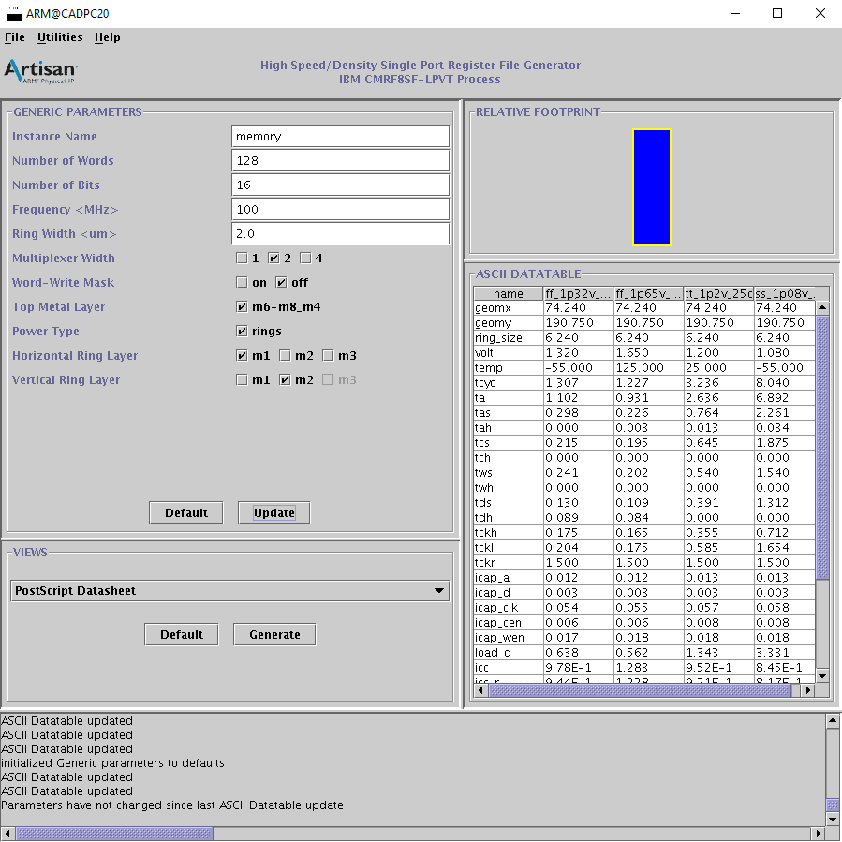
Generating SRAM example (2)
Memory Parameters
! There is a limited range for each parameters
Number of Words
- [16, 256]
Number of Bits - [4, 128]
Choose output file listed in slide 4
Notes:
Explain the parameters in detail

Slide 8
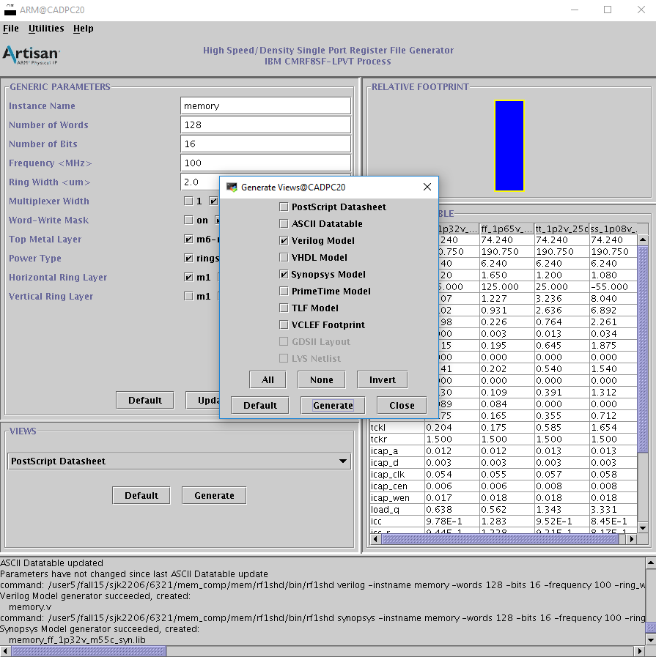
Generating SRAM example (3)
OR Under “Generate Menu” to generate files needed in one shot

Slide 9
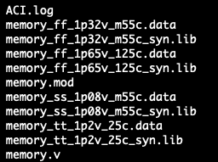
Outputs You Need
Instantiation name
Please use 1.2V 25℃ as your library file for assignment 4, you can try different libraries later if you want
.v can be used in Modelsim simulation
Notes:
rf1shd/bin/rf1shd

Slide 10
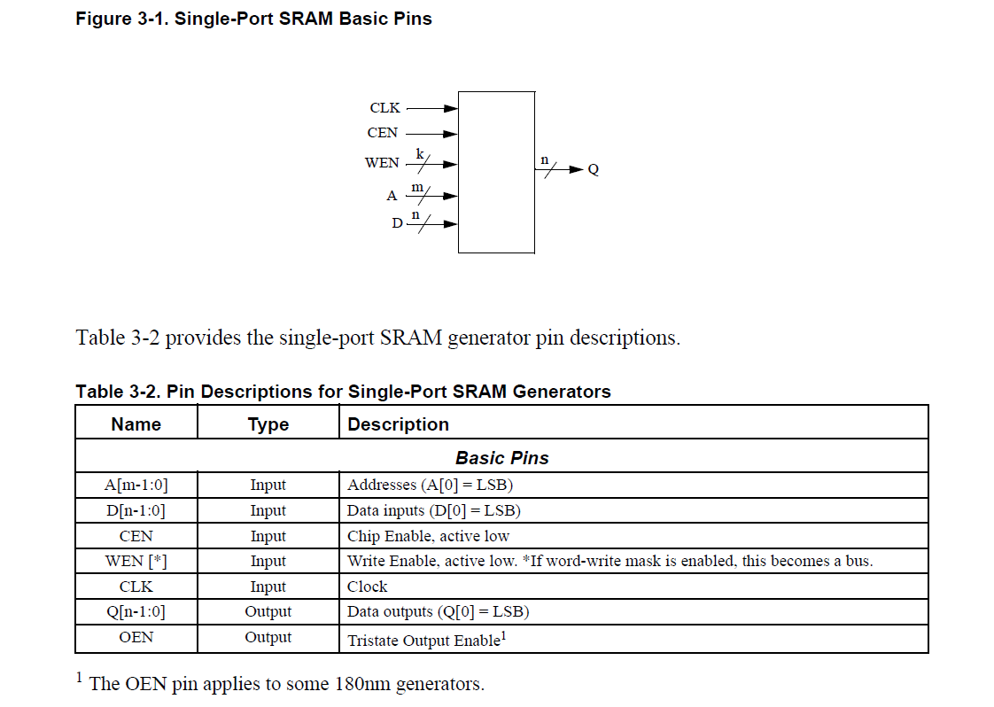
Sram Ports

Slide 11
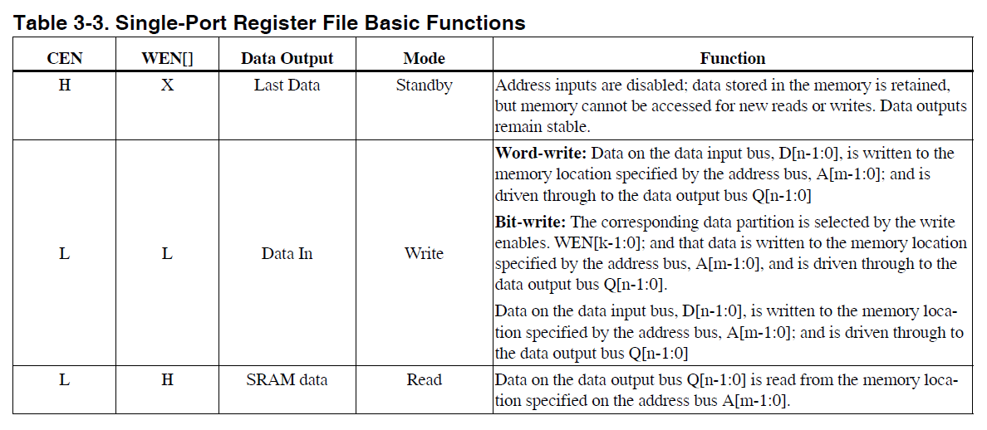
Detailed function description
All the details of the sram will be in ra2shd_v20.pdf (Artisan User Manual)
Design & memory-compiler.pdf is slides for memory compiler from ARES Lab

Slide 12
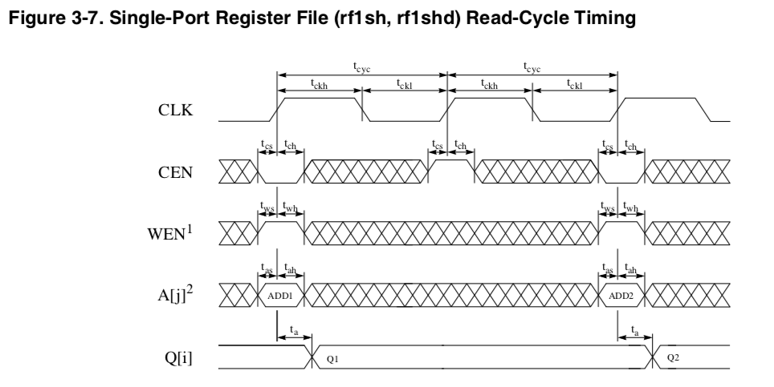
Sram Read Timing Diagram
Data (Q) will be available after the rising edge of the clock (1 clock cycle delay)

Slide 13
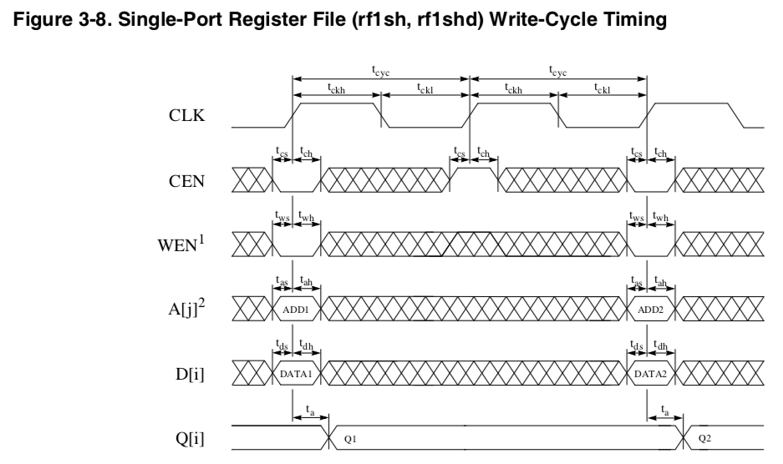
Sram Write Timing Diagram

Slide 14
Summary
testbench tb*.v
Behavioral Verilog
*.v
ModelSim
functional
verification
std. cell lib
*.db *.sldb
Memory Compiler (*.v, *.lib, & *.vclef)
constraints
*.sdc
Memory Compiler
Design Compiler
Structural Verilog
*.nl.v
ModelSim
post-synthesis dynamic timing verification
Timing info.
*.sdf
PrimeTime
static timing verification
power analysis
Encounter
Automatic Placement and Routing

Slide 15
Suggestions on Lab Assignment 4
Make sure you are familiar with previous labs
Take a look at the Memory Generator User Manual to learn the architecture & timing specification of SRAM.
First simulate the sram block you generated from memory compiler and then try to build the larger block. (RTL on-chip memory model guide.pdf as reference).
When running DC, you do not need to use read_verilog to include the [mem_cell_name].v generated by memory compiler and you do not need to use command to black-box your sram. You only need to include the correct db file. (.db file is generated by compiling .lib file through DC, codes are in /courses/ee6321/share/4823-fall2020/lib2db/).
You can use the same db file as above in your PT
Start early. This one will take some time.

