Slide 1
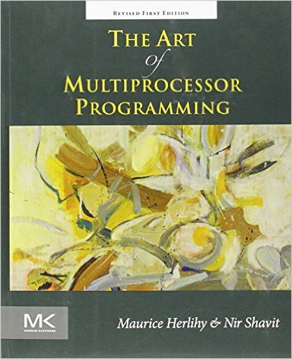
Monitors and Blocking Synchronization
Peng WU
wp@ios.ac.cn
Based on the slides by Avishai (Shai) Gretz for
Advanced Topics in Concurrent Programming, 236803
Instructor: Prof. Erez Petrank
Computer Science Department, Technion, Spring 2012

Slide 2
Table of Contents
Monitors
Conditions
Readers-Writers Lock
Reentrant Lock
Semaphore
Conclusions

Slide 3

Monitors
Combines data, methods, and synchronization
An instance of a class that provides mutual exclusion to its methods
Invented by
Per Brinch-Hansen in 1972
Concurrent Programming: The Architecture of Concurrent Programs. 1977
SuperPascal
C.A.R Hoare in 1974
1980 Turing Award for "fundamental contributions to the definition and design of programming languages"
Algol 60 Compiler, Quicksort(1960), Hoare Logic, CSP

Slide 4
Monitors
Motivation:
Suppose two threads, a producer and a consumer, share a FIFO queue and a lock to allow access to the queue
The code for the producer could look like this:
mutex.lock();
try {
queue.enq(x);
}
finally {
mutex.unlock();
}
Java, Python, but not C++
Microsoft extension
Resource Acquisition Is Initialization (RAII)

Slide 5
Monitors
Problems:
When the queue is full the enq method cannot execute
The producer may not have access to the internal state of the queue
Multiple producers/consumers have to keep track of the lock and the queue objects and maintain the same locking mechanism in order for the application to be correct

Slide 6
Monitors
Solution:
Providing the queue class with its own internal lock
acquired by each method when it is called
released when it returns
The enq/deq method will decide whether to block its caller

Slide 7
Monitors
A monitor is basically a class representing a shared resource comprised of:
Locks
Conditions
Methods
that acquire the locks upon being called and release the locks upon returning

Slide 8
Monitor Locks
When a thread fails to acquire a lock,
Spin / Busy-wait: checking continuously whether the lock is available
preferred when short delays are expected
waste of CPU time
only on multi-processors
Block: withdrawing from trying to acquire the lock
preferred when long delays are expected
expensive call to OS to try other threads
on both multi-processors and uniprocessors
Combination of spinning and blocking

Slide 9
Conditions
A Condition is a class associated with a lock
Motivation:
When a thread holding a lock of an object is waiting for something to happen – it is a very good idea to release the lock to let other threads access the object
After the waiting thread has released the lock, it needs a way to be notified when to reacquire the lock and try again.

Slide 10
Conditions - methods
void await(): called when a thread wants to wait for a certain property to hold
void signal(): called when a thread wants to wake up one thread waiting on this condition
void signalAll(): same as signal, but all waiting threads are awakened

Slide 11
Conditions
When signal/signalAll() is called, waiting threads on await() may return one at a time (with the lock reacquired)
This does not necessarily mean that the property holds at the time
Too many sleeping threads were awakened
The await() method may return spuriously
The awakened thread should retest the property and call await() again if it still does not hold

Slide 12
Conditions
Non-blocking condition variables
Signal and Continue
The signaling thread continues
Blocking condition variables
Signal and Wait
The signaling thread waits until the signaled thread relinquishes the lock
The original proposals by Hoare and Hansen

Slide 13
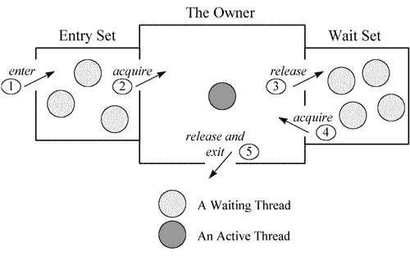
Monitor Locks

Slide 14
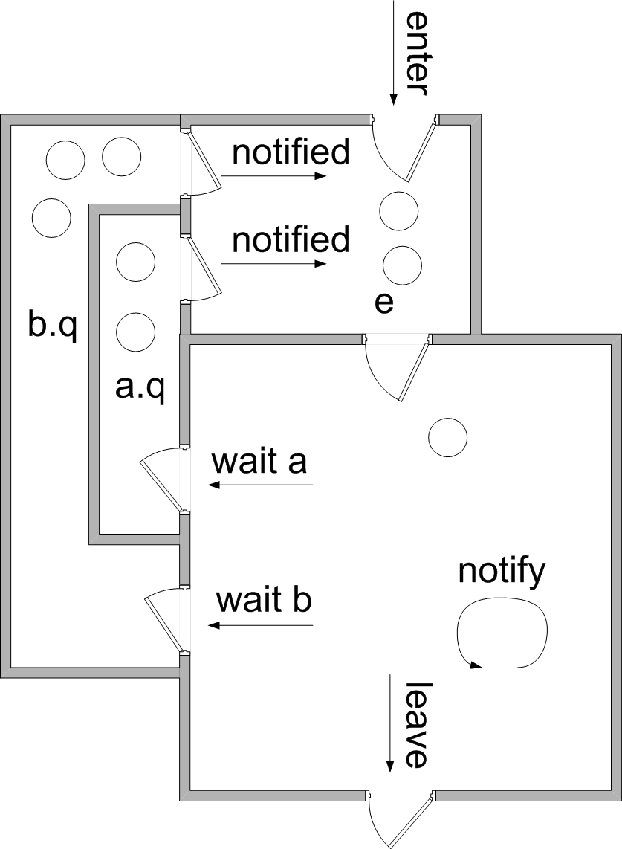
Non-blocking Condition Variables (Java Monitor Locks)
Notes:
https://en.wikipedia.org/wiki/Monitor_(synchronization)
e: entrance queue

Slide 15
Blocking Condition Variables
Notes:
https://en.wikipedia.org/wiki/Monitor_(synchronization)
e: entrance queue

Slide 16
Monitors in Java
Java provides built-in support for monitors in the form of synchronized blocks and methods
As well as built-in methods wait(), notify() and notifyAll()
Similar to await(), signal() and signalAll()
Associated with one (implicit) condition variable

Slide 17
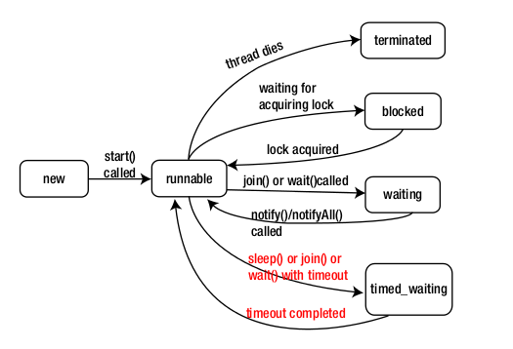
java.lang.Thread.State

Slide 18
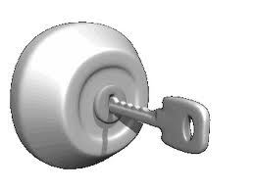
Example - LockedQueue
One Lock object
Two Condition objects:
notFull for enqueuing
notEmpty for dequeuing
Pros and Cons:
More efficient since less irrelevant threads are awakened
More complex to design

Slide 19
LockedQueue implementation
Class LockedQueue<T> {
final Lock lock = new ReentrantLock();
final Condition notFull = lock.newCondition();
final Condition notEmpty = lock.newCondition();
final T[] items;
int tail, head, count; …
}
Creating conditions notFull and notEmpty associated with the lock
public LockedQueue(int capacity) {
items = (T[]) new Object[capacity];
}

Slide 20
LockedQueue implementation
public void enq(T x) {
lock.lock();
try {
while (count == items.length)
notFull.await();
Enqueue x;
notEmpty.signal();
} finally {
lock.unlock();
}
}
public T deq() {
lock.lock();
try {
while (count == 0)
notEmpty.await();
Dequeue the first element;
notFull.signal();
Return the element dequeued;
} finally {
lock.unlock();
}
}
The queue is full – waiting on the notFull condition
The queue is empty – waiting on the notEmpty condition

Slide 21
Lost Wakeup
The Lost-Wakeup Problem
A thread may wait forever without realizing that the property for which it is waiting has become true
Example:
Instead of calling the notEmpty signal whenever enqueuing, notEmpty is signaled only when moving from the empty state (i.e., one element in queue)
Multiple producers and/or consumers
if (count == 1) {
notEmpty.signal();
}

Slide 22
Lost Wakeup
A Lost-Wakeup scenario:
A and B try to dequeue an empty queue and wait on the notEmpty condition
C enqueues and signals notEmpty, waking up A (“Signal and Continue”)
D enqueues before A dequeues – NOT signaling notEmpty
A dequeues but B suffers a lost-wakeup

Slide 23
Lost Wakeup
Rules of thumb to avoid lost-wakeup:
Understand the code
Signal ALL waiting threads
Wait with a timeout
Performance Penalty
both could wake up threads unnecessarily

Slide 24
Table of Contents
Monitors
Conditions
Readers-Writers Lock
Reentrant Lock
Semaphore
Conclusions

Slide 25


Readers-Writers Locks
Readers – return object data without modifying it
Writers – modify object data
Many shared objects exhibit many reader calls and few writer calls

Slide 26
Readers-Writers Locks
Two locks
Read lock, shared
no need to synchronize readers
Write lock, exclusive
Two safety properties
A thread can acquire the read lock only if there is no thread holding the write lock
In this way, multiple readers can acquire the read lock simultaneously
A thread can acquire the write lock only if there are no other threads holding the read or write lock

Slide 27
Simple Readers-Writers Lock
SimpleReadWriteLock Class
A Boolean variable (writer) indicating whether there is a thread holding the write lock
Only when writer == false can a thread acquire the read lock
A counter (readers) indicating how many threads are holding the read lock
Only when writer == false and readers ==0 can a thread acquire the write lock

Slide 28
Simple Readers-Writers Lock
The lock() and unlock() methods are accessed through objects of inner classes: ReadLock and WriteLock
One condition for both writes and reads

Slide 29
SimpleReadWriteLock implementation
public class SimpleReadWriteLock implements ReadWriteLock {
int readers;
boolean writer;
Lock lock;
Lock readLock, writeLock;
Condition condition;
public SimpleReadWriteLock() {
writer = false;
readers = 0;
lock = new ReentrantLock();
readLock = new ReadLock();
writeLock = new WriteLock();
condition = lock.newCondition();
}
One lock variable to synchronize lock() and unlock() methods of both WriteLock and ReadLock

Slide 30
ReadLock inner class
class ReadLock implements Lock {
public void lock() {
lock.lock();
try {
while (writer)
condition.await();
readers++;
} finally {
lock.unlock();
}
}
public void unlock() {
lock.lock();
try {
readers--;
if (readers == 0)
condition.signalAll();
} finally {
lock.unlock();
}
}
Wake up all the threads
Wait for the writer to release the write lock

Slide 31
WriteLock inner class
private class WriteLock implements Lock {
public void lock() {
lock.lock();
try {
while (readers > 0 || writer) {
condition.await();
}
writer = true;
} finally {
lock.unlock();
}
}
public void unlock() {
lock.lock();
try {
writer = false;
condition.signalAll();
} finally {
lock.unlock();
}
}
Wait for the readers to release their read locks or wait for the writer to release the write lock
Wake up all the threads: possibly more than one reader is waiting

Slide 32
SimpleReadWriteLock
The methods of the inner ReadLock and WriteLock classes synchronize on the same lock and condition of the SimpleReadWriteLock class
Pros:
Correct, Simple
Allows mutual exclusion
Cons:
Fairness does not hold
A writer could be waiting for a long time while readers keep acquiring the read lock

Slide 33
Fair Readers-Writers Lock
Ensuring that once a writer has requested the write lock, no more readers can acquire the read lock
Current readers will drain out and the writer will be able to acquire the write lock

Slide 34
Fair Readers-Writers Lock
A possible implementation: a FIFO Readers-Writers Lock
The counter field readers is replaced by two fields
readAcquires
number of readers who acquired the read lock
readReleases
number of readers who released the read lock

Slide 35
Fair Readers-Writers Lock
The field writer acts as a lock:
Writers set it to true when requesting the write lock even when there are active readers
When writer == true, readers can not increment the ReadAcquires field
Writers are informed that there are no more readers when a reader releasing the read lock identifies that readAcquires == readReleases
When a thread calls for WriteLock.lock() it has priority over subsequent ReadLock.lock() calls

Slide 36
FifoReadWriteLock
public class FifoReadWriteLock implements ReadWriteLock {
int readAcquires, readReleases;
boolean writer;
Lock lock;
Condition condition;
Lock readLock, writeLock;
public FifoReadWriteLock() {
readAcquires = readReleases = 0;
writer = false;
lock = new ReentrantLock();
condition = lock.newCondition();
readLock = new ReadLock();
writeLock = new WriteLock();
}
...
}
readAcquires and readReleases fields

Slide 37
ReadLock inner class
private class ReadLock implements Lock {
public void lock() {
lock.lock();
try {
while (writer)
condition.await();
readAcquires++;
} finally {
lock.unlock();
}
}
public void unlock() {
lock.lock();
try {
readReleases++;
if (readAcquires == readReleases)
condition.signalAll();
} finally {
lock.unlock();
}
}
}
No more readers holding the read lock

Slide 38
WriteLock inner class
private class WriteLock implements Lock {
public void lock() {
lock.lock();
try {
while (writer)
condition.await();
writer = true;
while (readAcquires != readReleases)
condition.await();
} finally {
lock.unlock();
}
}
public void unlock() {
writer = false;
condition.signalAll();
}
}
Waiting for current writer to release its lock
The main change – the writer marks it has acquired the write lock even before current readers have released their locks
Waiting for current readers to release their locks

Slide 39

Reentrant Lock
A lock is reentrant if the same thread can acquire it multiple times
Useful when a thread locks a lock and then calls for a nested method that locks it again
The lock must be released the same number of times; otherwise other threads will be unable to acquire the lock.
java.util.concurrent.locks.ReentrantLock
PTHREAD_MUTEX_RECURSIVE
std::recursive_mutex

Slide 40
Reentrant Lock
Example 1:
A writer thread calling for a write lock for the second time will deadlock with itself
Example 2 (using a fair readers-writers lock):
http://tutorials.jenkov.com/java-concurrency/read-write-locks.html
R1(A): Thread I acquires the read lock
W2(A): Thread II tries to acquire the write lock and is blocked
R1(A): Thread I tries to acquire the read lock again and is blocked because of thread II - deadlock

Slide 41
Our Own Reentrant Lock
Identifies the ThreadID of the thread who locks the lock
Changes when no other thread is holding the lock and a new thread acquires it
Counts the number of times the owner thread locked this lock
Incremented when the same thread calls lock()
decremented when the thread calls unlock()
When this counter is zero one waiting thread is awakened

Slide 42
SimpleReentrantLock implementation
public class SimpleReentrantLock implements Lock{
Lock lock;
Condition condition;
int owner, holdCount;
public SimpleReentrantLock() {
lock = new SimpleLock();
condition = lock.newCondition();
owner = 0;
holdCount = 0;
}
…
}
Number of times the owner thread has acquired the lock
The Thread ID of the current owner of the lock

Slide 43
SimpleReentrantLock implementation
If the same thread acquires lock – holdCount is incremented
public void lock() {
int me = ThreadID.get();
lock.lock();
try {
if (owner == me) {
holdCount++;
return;
}
while (holdCount != 0) {
condition.await();
}
owner = me;
holdCount = 1;
} finally {
lock.unlock()
}
}
In case holdCount == 0 owner is updated

Slide 44
SimpleReentrantLock implementation
public void unlock() {
lock.lock();
try {
if (holdCount == 0 || owner != ThreadID.get())
throw new IllegalMonitorStateException();
holdCount--;
if (holdCount == 0) {
condition.signal();
}
} finally {
lock.unlock();
}
}
Illegal unlock
The lock is free so one waiting thread is awakened

Slide 45

Semaphore
So far we’ve seen mutual exclusion locks where only one thread can access a critical section at the same time
Semaphore is a generalization of mutual exclusion locks
lock with a capacity – an upper bound on the number of threads that can hold the lock simultaneously

Slide 46
Semaphore
Uses a counter to count the number of threads currently holding the lock
acquire() – also known in the literature as P()
the counter incremented for acquiring the lock
release() – also known as V()
the counter decremented for releasing the lock

Slide 47
Semaphore - implementation
public class Semaphore {
final int capacity;
int state;
Lock lock;
Condition condition;
public Semaphore(int c) {
capacity = c;
state = 0;
lock = new ReentrantLock();
condition = lock.newCondition();
}
public void acquire() {
lock.lock();
try {
while (state == capacity)
condition.await();
state++;
} finally {
lock.unlock();
}
}
Counter indicating the number of threads in the critical section
Capacity of the semaphore
Semaphore is full – a thread needs to wait

Slide 48
Semaphore implementation
public void release() {
lock.lock();
try {
state--;
condition.signalAll();
} finally {
lock.unlock();
}
}
}
A thread released space in the semaphore – waiting threads are awakened

Slide 49
Conclusions
Monitors allow the control of locks and conditions from within the shared objects
mutual exclusion to its methods
synchronization among multiple threads on the shared resource
Synchronization code is implemented internally in a class and transparent to users
Conditions associated with locks allow threads to suspend and release the locks until certain properties hold
Readers-writers locks manage access to the shared objects when there are both reading and writing threads
Semaphores allow multiple threads to access critical sections simultaneously
Reentrant locks allow for threads to acquire the locks they already hold

Slide 50
Comparison of Concurrency Libraries
Features | Java | POSIX C | C++11
Threads | java.lang.thread class | pthread_t type | std::thread class
Mutual Exclusion | synchronized blocks | pthread_mutex_t type | std:mutex class
Thread Local Storage | ThreadLocal<T> class template | pthread_key_t type | thread_local variables
Atomic Operations | volatile variables | / | std::atomic<T> class template
Monitors/Waits for a predicate | wait() and notify() of java.lang.Object class, used inside synchronized blocks | pthread_cond_t type and associated API functions: pthread_cond_wait(), pthread_cond_signal() | std::condition_variable and std::condition_variable_any classes

Slide 51
Concurrent Data Structures
Data Structures
Linked lists, queues, stacks, hash tables, skiplists, priority queues, etc.
Add, Remove, Search
Concurrent Data Structures
can be accessed by multiple threads which may actually access the data simultaneously
Lock-based implementations
Coarse-grained or fine-grained
Lock-less implementations

Slide 52
Readings
Multithreaded data structures for parallel computing: Parts 1 & 2, Arpan Sen, 2011
http://www.ibm.com/developerworks/aix/library/au-multithreaded_structures1/index.html
http://www.ibm.com/developerworks/aix/library/au-multithreaded_structures2/index.html
SECOND SUMMER SCHOOL ON PRACTICE AND THEORY OF DISTRIBUTED COMPUTING
https://sptdc.ru/

Slide 53
Mutual Exclusion
Spin Locks | MIMD | Deadlock-free | Starvation-free | Fairness* | Space
Peterson/Filter | ✗ | ✓ | ✓ | ✗ | O(n)
Bakery | ✗ | ✓ | ✓ | FIFO | O(n)
TAS/TTAS | ✓ | ✓ | ✗ | ✗ | O(1)
Anderson Queue | ✓ | ✓ | ✓ | FIFO | O(n)
CLH, MCS Queue | ✓ | ✓ | ✓ | FIFO | O(n)

Slide 54
Deadlock-Free Lock
If some thread calls lock()‏
And never returns
Then other threads must complete lock() and unlock() calls infinitely often
System as a whole makes progress
Even if individuals starve
54
Notes:

54
At least one other thread is completing infinitely often, since there are only a finite number of threads.

Slide 55
Starvation-Free Lock
If some thread calls lock()‏
It will eventually return
Individual threads make progress
55
Notes:

55
We want every individual to be happy, not just the system as a whole.

