Slide 1
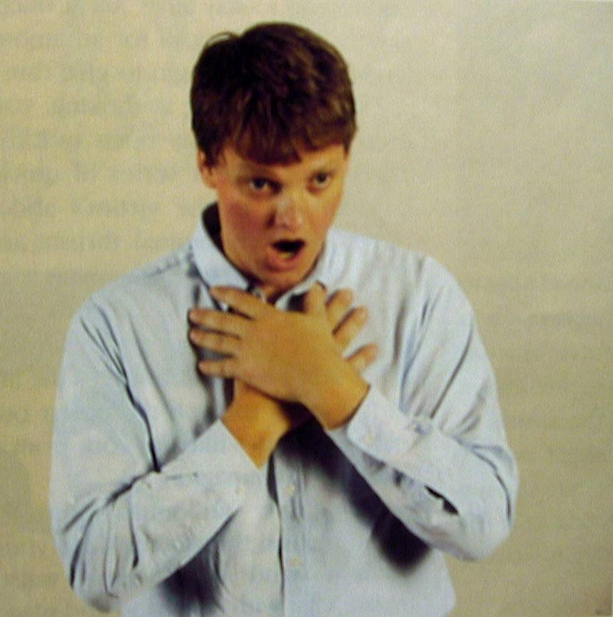
CHOKING

Slide 2
ACTIONS
FOR A CONSCIOUS ADULT
ASK THE CASUALTY TO COUGH, BUT DO NOT KEEP ASKING HER/HIM TO DO SO IF SHE/HE CANNOT COUGH UP THE FOREIGN OBJECT.

Slide 3
2. BEND THE CASUALTY WELL FORWARD AT THE WAIST AND GIVE UP TO 5 SHARP SLAPS BETWEEN THE SHOULDER BLADES WITH THE FLAT OF YOUR HAND.

Slide 4
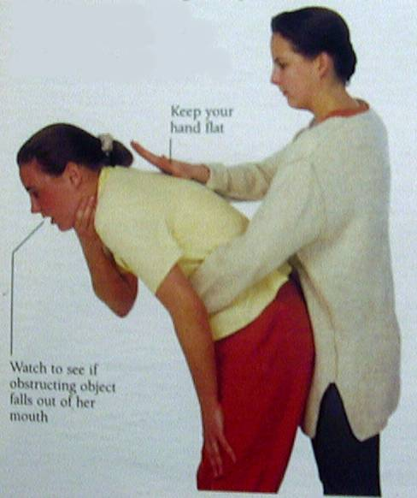

Slide 5
3. IF BACK SLAPS FAIL, TRY UP TO 5 ABDOMINAL THRUSTS (HAEMILICK MANOUVRE) PUT YOUR ARMS AROUND THE CASUALTY’S TRUNK. LINK YOUR HANDS BELOW THE RIBCAGE AND PULL SHARPLY INWARDS. THE OBSTRUCTING OBJECT MAY BE EXPELLED BY THE FORCE AGAINST THE CASUALTY’S DIAPHRAGM.

Slide 6
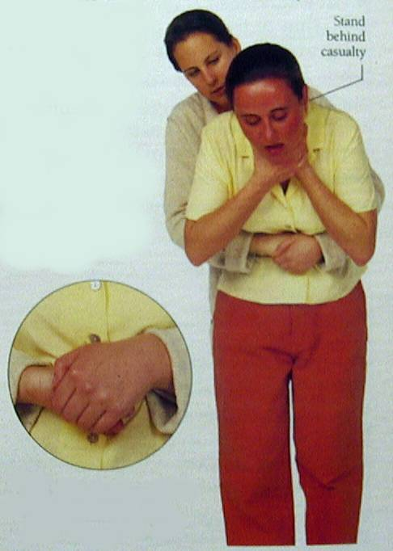

Slide 7
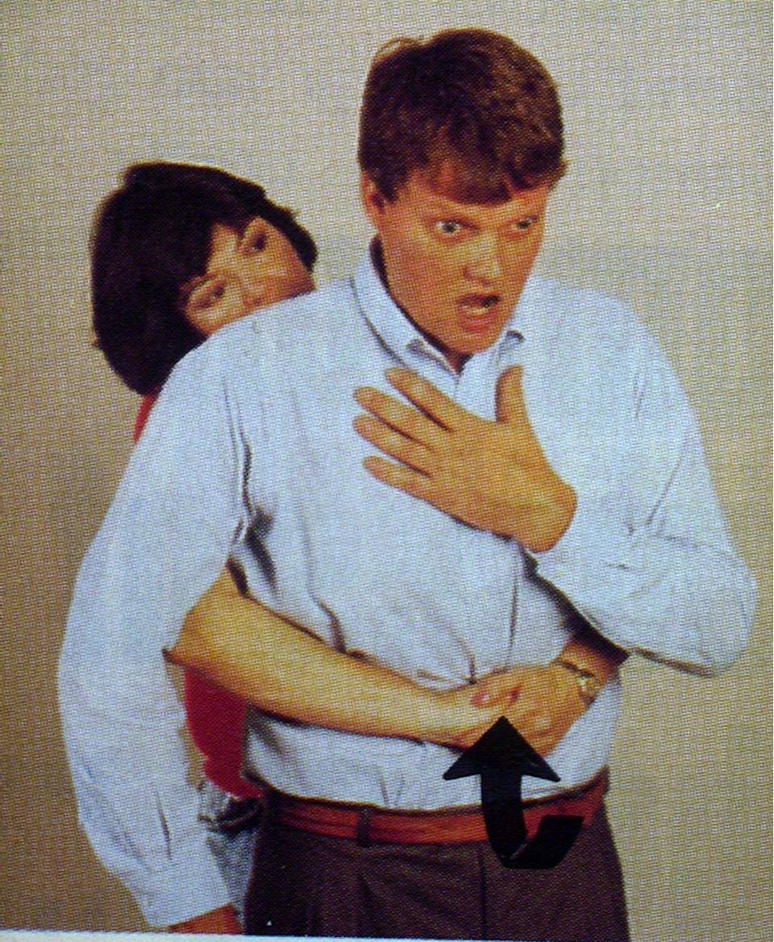
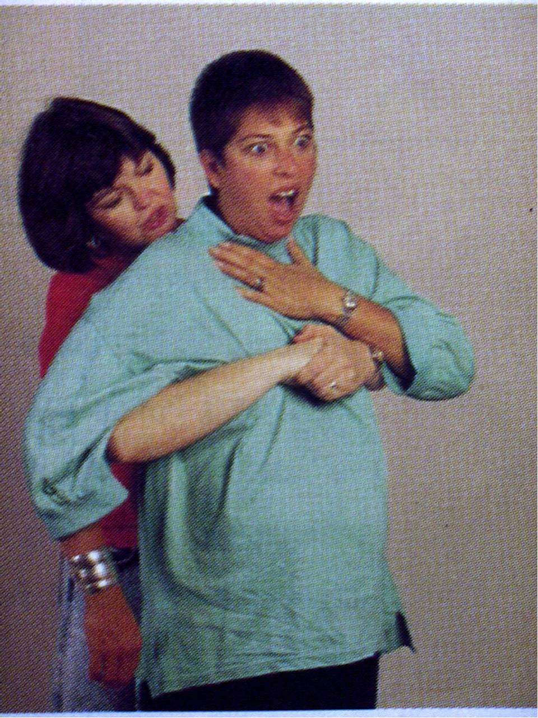
PREGNANT WOMAN

Slide 8
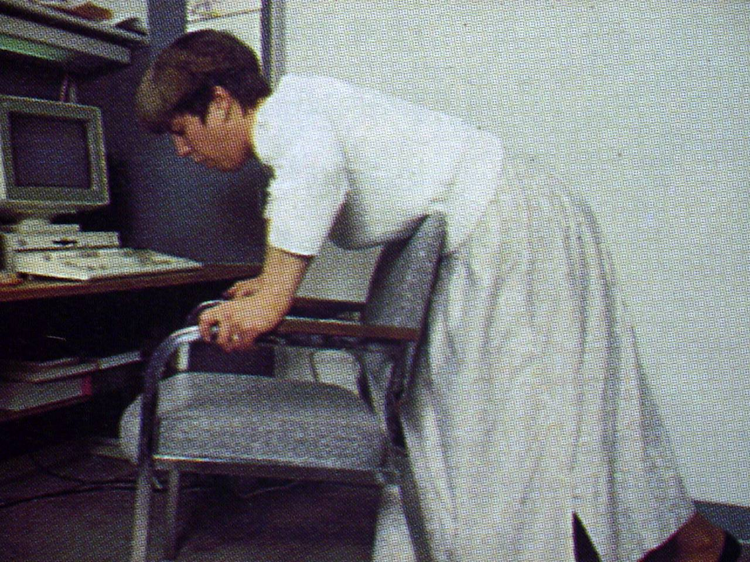

Slide 9
4. CONTINUE ALTERNATING BACKSLAPS AND ABDOMINAL THRUSTS UNTIL THE OBSTRUCTION CLEARS.

